Slide 1
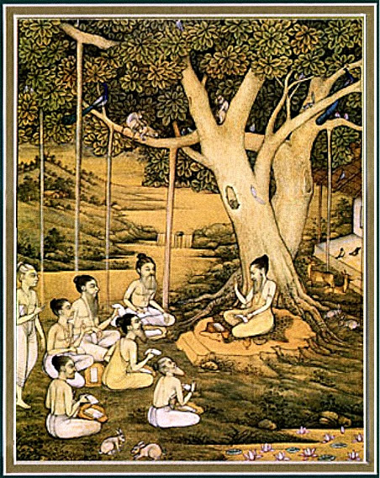
Srimad bhagavataM 2.2.1 – 14
meditating on
the lord WITHIN

Slide 2
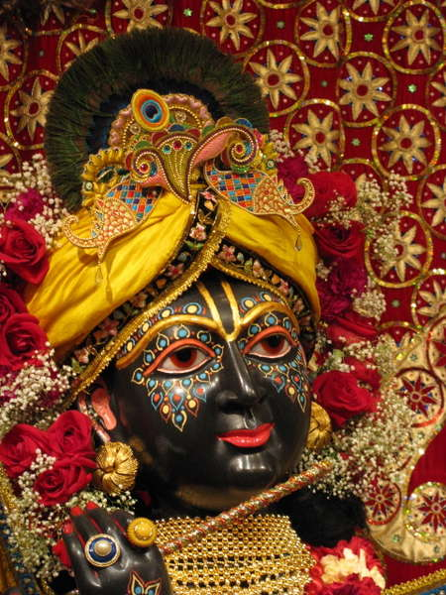
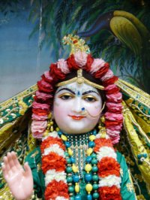
SB 1.2.4 narayanam namaskrtyam naram caiva narottamam devim sarasvatim vyasam tato jayam udirayet
Translation: Before reciting this Srimad Bhagavatam, which is the
very means of conquest, one should offer respectful obeisances
unto the Personality of Godhead, Narayana, unto Nara-Narayana
Rsi, the supermost human being, unto mother Sarasvati, the
goddess of learning, and unto Srila Vyasadeva, the author.

Slide 3
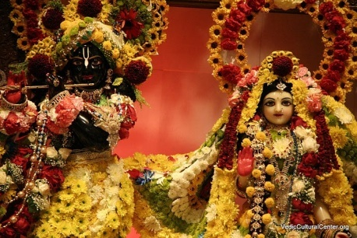
nasta-prayesu abhadresu nityaḿ bhagavata-sevaya bhagavaty uttama-sloke bhaktir bhavati naisthiki
SB 1.2.18
Translation: By regular attendance in classes on the
Bhagavatam and by rendering of service to the pure devotee,
all that is troublesome to the heart is almost completely
destroyed, and loving service unto the Personality of
Godhead, who is praised with transcendental songs, is
established as an irrevocable fact.

Slide 4
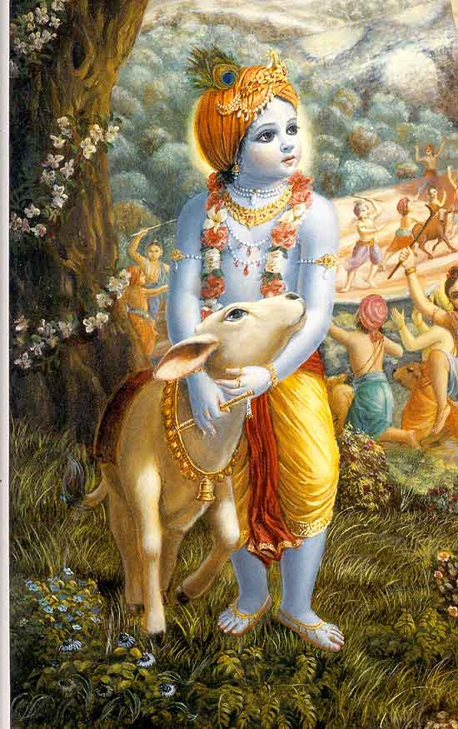
SB 2.2.1 – 14
Meditating on the Lord in the Heart

Slide 5
Section outline
1 Potency of meditating on the Virat-rupa
2 Do not aspire for heavenly pleasures
3 Do not chase after material enjoyment
4 - 5 Rely on nature’s basic gifts
6 - 7 Serve the Supersoul instead
8 - 12 Description of the Supersoul
13 Process of meditation on the Supersoul
14 Re-emphasizing meditation on the Lord

Slide 6
SB 2.2.1
çré-çuka uväca
evaà purä dhäraëayätma-yonir
nañöäà småtià pratyavarudhya tuñöät
tathä sasarjedam amogha-dåñöir
yathäpyayät präg vyavasäya-buddhiù
Çré Çukadeva Gosvämé said: Formerly, prior to the
manifestation of the cosmos, Lord Brahmä, by
meditating on the viräö-rüpa, regained his lost
consciousness by appeasing the Lord. Thus he was
able to rebuild the creation as it was before.

Slide 7
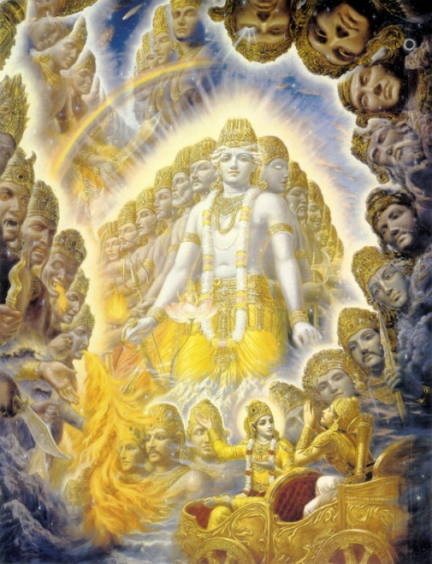
2.2.1 Potency of meditating on the Virat-rupa
All living entities are prone to forgetfulness
Result of meditating on the Virat-rupa
Revival of pure consciousness
Counteract the tendency to forget
Vyavasaya-buddhi follows (BG 2.41)
Leads to loving service of the Lord
“This forgetfulness of the living being—beginning from Brahmä down to the lowest insignificant ant—is a tendency which can be counteracted by meditation on the viräö-rüpa of the Lord.”
Notes:
Diety is identical with the Lord

Slide 8
SB 2.2.2
çäbdasya hi brahmaëa eña panthä
yan nämabhir dhyäyati dhér apärthaiù
paribhramaàs tatra na vindate 'rthän
mäyämaye väsanayä çayänaù
The way of presentation of the Vedic sounds is so
bewildering that it directs the intelligence of the
people to meaningless things like the heavenly
kingdoms. The conditioned souls hover in dreams of
such heavenly illusory pleasures, but actually they
do not relish any tangible happiness in such places.

Slide 9
2.2.2 Do not aspire for heavenly pleasures
Nature of the conditioned soul
Always planning for happiness
Unintelligent children on merry go-around
Worthlessness of all planets
Not immune to material pangs (BG 8.16)
Cannot attain eternal life of bliss
Real happiness is in the kingdom of God
Recommendation: Prepare to go back home
“Indirectly, Çréla Çukadeva Gosvämé affirms that Mahäräja Parékñit, in the last stage of life, should not desire to transfer himself to the so-called heavenly planets, but should prepare himself for going back home, back to Godhead. None of the material planets, nor the amenities available there for living conditions, is everlasting.”
Notes:
BG 8.16 - From the highest planet in the material world down to the lowest, all are places of misery wherein repeated birth and death take place. But one who attains to My abode, O son of Kuntī, never takes birth again.

Slide 10
SB 2.2.3
ataù kavir nämasu yävad arthaù
syäd apramatto vyavasäya-buddhiù
siddhe 'nyathärthe na yateta tatra
pariçramaà tatra samékñamäëaù
For this reason the enlightened person should
endeavor only for the minimum necessities of life
while in the world of names. He should be
intelligently fixed and never endeavor for unwanted
things, being competent to perceive practically that
all such endeavors are merely hard labor for nothing.

Slide 11
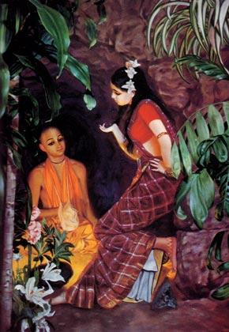
2.2.3 Do not chase after material enjoyment
Fruitive worker
Tries to make his position comfortable / secure
Aspires after big fortune (wealth, women etc)
Devotee
Considers fruitive activities as waste of time
Is not interested in such false things
Advice to the transcendentalist
Not be captivated by features of fruitive actors
Be fixed in mind despite difficulties of plain living
Accept bare necessities and depend on God’s gifts
Do not intimately mix with sense gratifiers
Do not waste even a second
Notes:
Names only – different formations of material elements and modes – no substance
SB 1.2.8 – dharmah svanuthistah – The occupational activities a man performs according to his own position are only so much useless labor if they do not provoke attraction for the message of the Personality of Godhead.

Slide 12
2.2.3 Do not chase after material enjoyment
“Human life is never meant for sense gratification, but for self-realization. Çrémad-Bhägavatam instructs us solely on this subject from the very beginning to the end. Human life is simply meant for self-realization. The civilization which aims at this utmost perfection never indulges in creating unwanted things, and such a perfect civilization prepares men only to accept the bare necessities of life or to follow the principle of the best use of a bad bargain. Our material bodies and our lives in that connection are bad bargains because the living entity is actually spirit, and spiritual advancement of the living entity is absolutely necessary. Human life is intended for the realization of this important factor, and one should act accordingly, accepting only the bare necessities of life and depending more on God's gift without diversion of human energy for any other purpose, such as being mad for material enjoyment.”
Notes:
Diety is identical with the Lord

Slide 13
SB 2.2.4
satyäà kñitau kià kaçipoù prayäsair
bähau svasiddhe hy upabarhaëaiù kim
saty aïjalau kià purudhänna-pätryä
dig-valkalädau sati kià dukülaiù
When there are ample earthly flats to lie on, what is
the necessity of cots and beds? When one can use his
own arms, what is the necessity of a pillow? When
one can use the palms of his hands, what is the
necessity of varieties of utensils? When there is ample
covering, or the skins of trees, what is the necessity of
clothing?

Slide 14
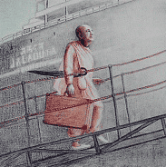
2.2.4 Rely on nature’s gifts
“…the sincere followers are advised therein to accept a voluntary life of renunciation in order to achieve the desired goal of life. If one is not accustomed to abiding by the life of renunciation and self-abnegation from the beginning, one should try to get into the habit at a later stage of life as recommended by Çréla Çukadeva Gosvämé, and that will help one to achieve the desired success.”
Notes:
yasyäham anugrhnani harisye tad-dhanam sanaih [SB 10.88.8] - If I especially favor someone, I gradually deprive him of his wealth. Then the relatives and friends of such a poverty-stricken man abandon him. In this way he suffers one distress after another.

Slide 15
SB 2.2.5
céräëi kià pathi na santi diçanti bhikñäà
naiväìghripäù para-bhåtaù sarito 'py açuñyan
ruddhä guhäù kim ajito 'vati nopasannän
kasmäd bhajanti kavayo dhana-durmadändhän
Are there no torn clothes lying on the common road?
Do the trees, which exist for maintaining others, no
longer give alms in charity? Do the rivers, being dried
up, no longer supply water to the thirsty? Are the
caves of the mountains now closed, or, above all, does
the Almighty Lord not protect the fully surrendered
souls? Why then do the learned sages go to flatter
those who are intoxicated by hard-earned wealth?

Slide 16
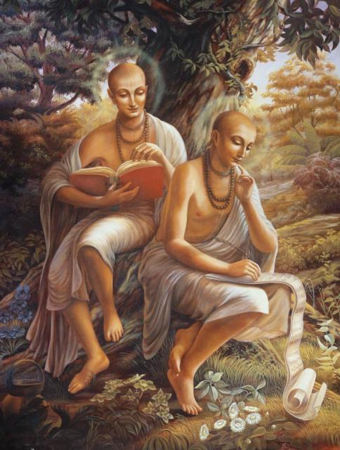
2.2.5 Regulations for renunciates
Dos
Accept alms for the benefit of the donor
Contribute literary work
Ex: Goswamis
Hold discourses
Have Firm faith in the Lord’s maintenance
Ex: Haridas thakura
Depend on the nature’s gifts
Become fully purified in existence (BG 16.5)
Live alone and be fearless
Don’ts
Never live like a parasite
If not contributing do not go begging
Do not adopt renounced order to solve economic problems
Notes:
Fully purified – daivi sampat – divine qualities
Never lives alone as Lord is always with him. Unless one is purified he will feel he is alone.
Fearless – he will feel presence of the Lord everywhere.

Slide 17
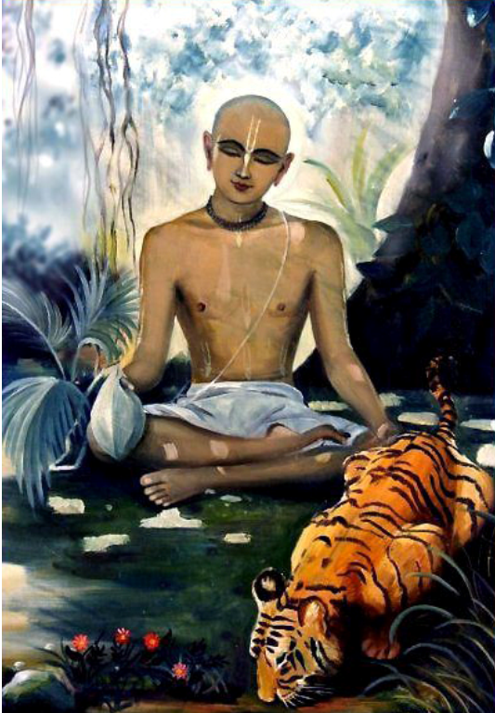
2.2.5 Regulations for renunciates
“When a man becomes a mendicant willfully or by circumstances, he must be of firm faith and conviction that the Supreme Lord is the maintainer of all living beings everywhere in the universe. Why, then, would He neglect the maintenance of a surrendered soul who is cent percent engaged in the service of the Lord? A common master looks to the necessities of his servant, so how much more would the all-powerful, all-opulent Supreme Lord look after the necessities of life for a fully surrendered soul.”
Notes:
Diety is identical with the Lord

Slide 18
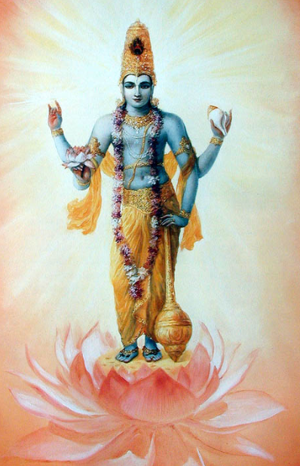
2.2.6 – 7
Serve the Supersoul instead
Notes:
1. Sp’s pastime to devotee painter – yogis take lifetimes to see the supersoul, I will describe how He is you can paint.

Slide 19
SB 2.2.6
evaà sva-citte svata eva siddha
ätmä priyo 'rtho bhagavän anantaù
taà nirvåto niyatärtho bhajeta
saàsära-hetüparamaç ca yatra
Thus being fixed, one must render service unto the
Supersoul situated in one's own heart by His
omnipotency. Because He is the Almighty Personality
of Godhead, eternal and unlimited, He is the ultimate
goal of life, and by worshiping Him one can end the
cause of the conditioned state of existence.

Slide 20
2.2.6 -7 Serve the Supersoul instead
Conditioned state of existence
Seeking pleasure in the illusory world
Analogy: Running after mirage water in the desert.
Analogy: Becoming detached from the mother
Everything is temporary
Endless cycle of samsara
Solution
Worship Lord Krsna within one’s heart
“We are all part and parcel of the Lord, the Lord is always affectionate to us, and He always tries to get us back home, back to Godhead. But we, the conditioned souls, do not care for Him and run instead after the illusory bodily connections. We must therefore extricate ourselves from all illusory connections of the world and seek reunion with the Lord, trying to render service unto Him.”

Slide 21
SB 2.2.7
kas täà tv anädåtya paränucintäm
åte paçün asatéà näma kuryät
paçyaï janaà patitaà vaitaraëyäà
sva-karmajän paritäpäï juñäëam
Who else but the gross materialists will neglect such
transcendental thought and take to the nonpermanent
names only, seeing the mass of people fallen in the
river of suffering as the consequence of accruing the
result of their own work?
Materialists worship demigods / Transcendentalists are not interested
Living entities are responsible for their own suffering
Lord is impartial, but gives protection to the surrendered soul (BG 9.29)
Notes:
BG 9.29 – samo 'haḿ sarva-bhūteṣu, na me dveṣyo 'sti na priyaḥ, ye bhajanti tu māḿ bhaktyā, mayi te teṣu cāpy aham
I envy no one, nor am I partial to anyone. I am equal to all. But whoever renders service unto Me in devotion is a friend, is in Me, and I am also a friend to him.

Slide 22
2.2.8 – 12
Description of the Supersoul
Notes:
1. Sp’s pastime to devotee painter – yogis take lifetimes to see the supersoul, I will describe how He is you can paint.

Slide 23
SB 2.2.8
kecit sva-dehäntar-hådayävakäçe
prädeça-mätraà puruñaà vasantam
catur-bhujaà kaïja-rathäìga-çaìkha-
gadä-dharaà dhäraëayä smaranti
Others conceive of the Personality of Godhead
residing within the body in the region of the heart and
measuring only eight inches, with four hands carrying
a lotus, a wheel of a chariot, a conchshell and a club
respectively.
Janardhana

Slide 24
SB 2.2.9
prasanna-vaktraà nalinäyatekñaëaà
kadamba-kiïjalka-piçaìga-väsasam
lasan-mahä-ratna-hiraëmayäìgadaà
sphuran-mahä-ratna-kiréöa-kuëòalam
His mouth expresses His happiness. His eyes spread
like the petals of a lotus, and His garments, yellowish
like the saffron of a kadamba flower, are bedecked
with valuable jewels. His ornaments are all made of
gold, set with jewels, and He wears a glowing head
dress and earrings.

Slide 25
SB 2.2.10
unnidra-håt-paìkaja-karëikälaye
yogeçvarästhäpita-päda-pallavam
çré-lakñaëaà kaustubha-ratna-kandharam
amläna-lakñmyä vana-mälayäcitam
His lotus feet are placed over the whorls of the
lotuslike hearts of great mystics. On His chest is the
Kaustubha jewel, engraved with a beautiful calf, and
there are other jewels on His shoulders. His complete
torso is garlanded with fresh flowers.
Spiritual

Slide 26
SB 2.2.11
vibhüñitaà mekhalayäìguléyakair
mahä-dhanair nüpura-kaìkaëädibhiù
snigdhämaläkuïcita-néla-kuntalair
virocamänänana-häsa-peçalam
He is well decorated with an ornamental wreath
about His waist and rings studded with valuable
jewels on His fingers. His leglets, His bangles, His
oiled hair, curling with a bluish tint, and His
Beautiful smiling face are all very pleasing.
Personality of Godhead is not an imagination but is the Supreme Person in fact and figure.

Slide 27
SB 2.2.12
adéna-lélä-hasitekñaëollasad-
bhrü-bhaìga-saàsücita-bhüry-anugraham
ékñeta cintämayam enam éçvaraà
yävan mano dhäraëayävatiñöhate
The Lord's magnanimous pastimes and the glowing
glancing of His smiling face are all indications of His
extensive benedictions. One must therefore concentrate on
this transcendental form of the Lord, as long as the mind
can be fixed on Him by meditation.
Devotee’s advantage over an impersonalist (BG 12.5)
This process of meditation is bhakti-yoga
Importance of being freed from sex desire
Notes:
Impersonalist are doubtful about personal feature. Their impersonal meditation is a source of suffering. SB gives authentic statement about meditation on factual form of the Lord.
Bhakti-Yoga : includes jnana-yoga, will result in anartha nivritti, results in Jnana and vairagya
Without being freed from sex desire – should not renounce, should not recite beyond 2 cantos, should not proceed beyond lotus feet in meditation.

Slide 28
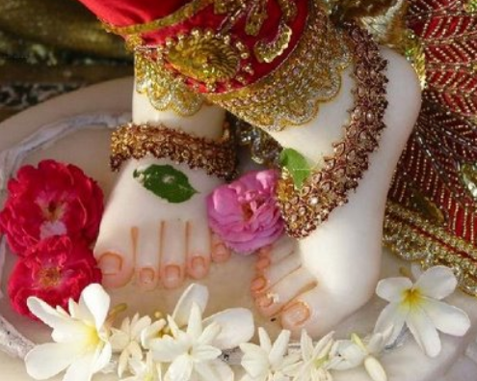
2.2.12 Description of the Supersoul
“So purification means getting free gradually from sex desire, and this is attained by meditation on the person of the Lord as described herein, beginning from the feet. One should not try to go upwards artificially without seeing for himself how much he has been released from the sex desire. The smiling face of the Lord is the Tenth Canto of Çrémad-Bhägavatam, and there are many upstarts who at once try to begin with the Tenth Canto and especially with the five chapters which delineate the räsa-lélä of the Lord. This is certainly improper.”
Notes:
Diety is identical with the Lord

Slide 29
SB 2.2.13
ekaikaço 'ìgäni dhiyänubhävayet
pädädi yävad dhasitaà gadäbhåtaù
jitaà jitaà sthänam apohya dhärayet
paraà paraà çuddhyati dhér yathä yathä
The process of meditation should begin from the lotus feet of
the Lord and progress to His smiling face. The meditation
should be concentrated upon the lotus feet, then the calves,
then the thighs, and in this way higher and higher. The more
the mind becomes fixed upon the different parts of the limbs,
one after another, the more the intelligence becomes
purified.
Arcana process is not meant for ones too engrossed in sense gratification.
Notes:
Process – meditate on the personality not impersonal/void; start with lotus feet and go up
Effects – one becomes purified, detached from sense gratification
Who is qualified – not the ones engrossed in sense gratification (impersonalists / voidists) but for devotees only.

Slide 30
SB 2.2.14
yävan na jäyeta parävare 'smin
viçveçvare drañöari bhakti-yogaù
tävat sthavéyaù puruñasya rüpaà
kriyävasäne prayataù smareta
Unless the gross materialist develops a sense of loving
service unto the Supreme Lord, the seer of both the
transcendental and material worlds, he should
remember or meditate upon the universal form of the
Lord at the end of his prescribed duties.

Slide 31
2.2.14 Re-emphasizing meditation on the Lord
“For the less intelligent beginners, meditation on the impersonal feature, the viräö-rüpa, or universal form of the Lord, will gradually qualify one to rise to personal contact. One is advised herewith to meditate upon the viräö-rüpa specified in the previous chapters in order to understand how the different planets, seas, mountains, rivers, birds, beasts, human beings, demigods and all that we can conceive are but different parts and limbs of the Lord's viräö form. This sort of thinking is also a type of meditation on the Absolute Truth, and as soon as such meditation begins, one develops one's godly qualities, and the whole world appears to be a happy and peaceful residence for all the people of the world. Without such meditation on God, either personal or impersonal, all good qualities of the human being become covered with misconceptions regarding his constitutional position, and without such advanced knowledge, the whole world becomes a hell for the human being.”
Notes:
Diety is identical with the Lord

Slide 32
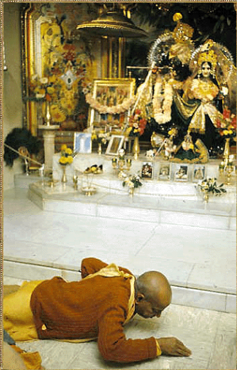
Practical Application
Minimize unnecessary necessities
Is it really required for my service?
Get rid of things unused for >= 6 months
Use everything in Krsna’s service
Increase our attachment to Krsna
Attentive / Submissive hearing of SB
Try to be sincere
Efficacy of the Arcana process
Take darshan everyday (morning / evening)
Deity is non-different from the original Lord
Privilege of Deity worship
Especially important for Grhasthas
Notes:
Srnvatam sva kathah Krsna – Lord from within cleanses the heart
TKG lecture - chastising devotees why they don’t attend diety worship
Who would not like to massage feet of SPOG

Slide 33
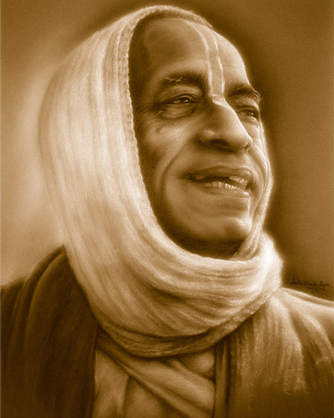
Thank you very much.
All glories to Srila Prabhupada!

