Slide 1
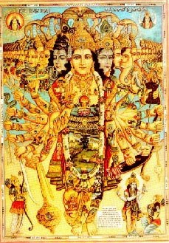
Bhakti Vaibhav Studies
Texts 22-39:
The Lord’s Universal Form:
Applying the Mind for
Purification

Slide 2
Chapter Theme
Texts 1-15 :The Sage immediately answers the king’s question
Texts 16-21: Preparing for a Better Next Life – Leaving Home in Renunication
Texts 22-39 : The Lord’s Universal Form: Applying the Mind for Purification

Slide 3
Section Theme
Sukadeva Goswami describes a purifying process based on pantheism through which materialistic persons can see the Lord while viewing the material world
Pantheism- doctrine that identifies God with each object in the Universe
From 2.1.20
Check the mind from materialism by training it to see everything as Vishnu (Immature Pantheism)
Gradually one understands everything in its spiritual relationship with Vishnu(Mature Pantheism)
Use matter to serve Lord Vishnu and not for personal enjoyment
Service attitude to perfect the theory of pantheism

Slide 4
2.1.22
rājovāca
yathā sandhāryate brahman dhāraṇā yatra sammatā yādṛśī vā hared āśu puruṣasya mano-malam
The fortunate King Parīkṣit, inquiring further, said: O brāhmaṇa, please describe in full detail how and where the mind has to be applied and how the conception can be fixed so that the dirty things in a person’s mind can be removed.

Slide 5
Important Points
Why is Maharaja Pariksit asking this question?
For the benefit of men who are unable to accept the Lord in His personal eternal form
(He already has a personal relationship with the Lord)
Dirty things in the mind:
Concocted desires for pleasure
Accumulated during the long prison life in the material world
Bind us to the cycle of material birth and death
How to remove these desires?
Only by associating with the Supreme Lord and His potencies

Slide 6
2.1.23
śrī-śuka uvāca
jitāsano jita-śvāso jita-saṅgo jitendriyaḥ sthūle bhagavato rūpe manaḥ sandhārayed dhiyā
Translation:
Śukadeva Gosvāmī answered: One should control the sitting posture, regulate the breathing process by the yogic prāṇāyāma and thus control the mind and senses and with intelligence apply the mind to the gross potencies of the Lord [called the virāṭ-rūpa].

Slide 7
Materially molded mind does not allow the materialist to go beyond the bodily concept of the self. Yoga is prescribed here to mold the character of the materialist
Removes lust, anger greed, avarice
Should not be diverted by desire by mystic powers

Slide 8
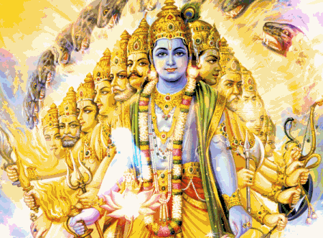
2.1.24
viśeṣas tasya deho ’yaṁ sthaviṣṭhaś ca sthavīyasām yatredaṁ vyajyate viśvaṁ bhūtaṁ bhavyaṁ bhavac ca sat
Translation:
This gigantic manifestation of the phenomenal material world as a whole is the personal body of the Absolute Truth, wherein the universal resultant past, present and future of material time is experienced.

Slide 9
2.1.25
aṇḍa-kośe śarīre ’smin saptāvaraṇa-saṁyute vairājaḥ puruṣo yo ’sau bhagavān dhāraṇāśrayaḥ
Translation:
The gigantic universal form of the Personality of Godhead, within the body of the universal shell, which is covered by sevenfold material elements, is the subject for the virāṭ conception.
While meditating upon the Universal form- one should not be misled by those posing as Lord Krsna but are not able to act like HIM or exhibit the virat rupa.

Slide 10
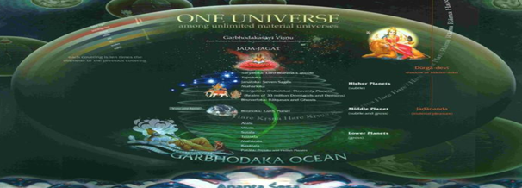
2.1.26
pātālam etasya hi pāda-mūlaṁ paṭhanti pārṣṇi-prapade rasātalam mahātalaṁ viśva-sṛjo ’tha gulphau talātalaṁ vai puruṣasya jaṅghe
Translation:
Persons who have realized it have studied that the planets known as Pātāla constitute the bottoms of the feet of the universal Lord, and the heels and the toes are the Rasātala planets. The ankles are the Mahātala planets, and His shanks constitute the Talātala planets.

Slide 11
2.1.27
dve jānunī sutalaṁ viśva-mūrter ūru-dvayaṁ vitalaṁ cātalaṁ ca mahītalaṁ taj-jaghanaṁ mahīpate nabhastalaṁ nābhi-saro gṛṇanti
Translation:
The knees of the universal form are the planetary system of the name Sutala, and the two thighs are the Vitala and Atala planetary systems. The hips are Mahītala, and outer space is the depression of His navel.

Slide 12
2.1.28
uraḥ-sthalaṁ jyotir-anīkam asya grīvā mahar vadanaṁ vai jano ’sya tapo varāṭīṁ vidur ādi-puṁsaḥ satyaṁ tu śīrṣāṇi sahasra-śīrṣṇaḥ
Translation:
The chest of the Original Personality of the gigantic form is the luminary planetary system, His neck is the Mahar planets, His mouth is the Janas planets, and His forehead is the Tapas planetary system. The topmost planetary system, known as Satyaloka, is the head of He who has one thousand heads.

Slide 13
2.1.29
indrādayo bāhava āhur usrāḥ karṇau diśaḥ śrotram amuṣya śabdaḥ nāsatya-dasrau paramasya nāse ghrāṇo ’sya gandho mukham agnir iddhaḥ
Translation:
His arms are the demigods headed by Indra, the ten directional sides are His ears, and physical sound is His sense of hearing. His nostrils are the two Aśvinī-kumāras, and material fragrance is His sense of smell. His mouth is the blazing fire.
Universal Form has dominated jivas and demigods
Worship of Universal Form or Shyamsundara appeases demigods
Therefore worship of Universal Fomr leads one to the right path

Slide 14
2.1.30
dyaur akṣiṇī cakṣur abhūt pataṅgaḥ pakṣmāṇi viṣṇor ahanī ubhe ca tad-bhrū-vijṛmbhaḥ parameṣṭhi-dhiṣṇyam āpo ’sya tālū rasa eva jihvā
Translation:
The sphere of outer space constitutes His eyepits, and the eyeball is the sun as the power of seeing. His eyelids are both the day and night, and in the movements of His eyebrows, Brahmā and similar supreme personalities reside. His palate is the director of water, Varuṇa, and the juice or essence of everything is His tongue .
The Lord tastes, sees and smells before we taste and smell anything

Slide 15
2.1.31
chandāṁsy anantasya śiro gṛṇanti daṁṣṭrā yamaḥ sneha-kalā dvijāni hāso janonmāda-karī ca māyā duranta-sargo yad-apāṅga-mokṣaḥ
Translation:
They say that the Vedic hymns are the cerebral passage of the Lord, and His jaws of teeth are Yama, god of death, who punishes the sinners. The art of affection is His set of teeth, and the most alluring illusory material energy is His smile. This great ocean of material creation is but the casting of His glance over us.

Slide 16
2.1.32
vrīḍottarauṣṭho ’dhara eva lobho dharmaḥ stano ’dharma-patho ’sya pṛṣṭham kas tasya meḍhraṁ vṛṣaṇau ca mitrau kukṣiḥ samudrā girayo ’sthi-saṅghāḥ
Translation:
Modesty is the upper portion of His lips, hankering is His chin, religion is the breast of the Lord, and irreligion is His back. Brahmājī, who generates all living beings in the material world, is His genitals, and the Mitrā-varuṇas are His two testicles. The ocean is His waist, and the hills and mountains are the stacks of His bones.

Slide 17
2.1.33
vrīḍottarauṣṭho ’dhara eva lobho dharmaḥ stano ’dharma-patho ’sya pṛṣṭham kas tasya meḍhraṁ vṛṣaṇau ca mitrau kukṣiḥ samudrā girayo ’sthi-saṅghāḥ
Translation:
Modesty is the upper portion of His lips, hankering is His chin, religion is the breast of the Lord, and irreligion is His back. Brahmājī, who generates all living beings in the material world, is His genitals, and the Mitrā-varuṇas are His two testicles. The ocean is His waist, and the hills and mountains are the stacks of His bones.

Slide 18
2.1.34
īśasya keśān vidur ambuvāhān vāsas tu sandhyāṁ kuru-varya bhūmnaḥ avyaktam āhur hṛdayaṁ manaś ca sa candramāḥ sarva-vikāra-kośaḥ
Translation:
O best amongst the Kurus, the clouds which carry water are the hairs on His head, the terminations of days or nights are His dress, and the supreme cause of material creation is His intelligence. His mind is the moon, the reservoir of all changes.

Slide 19
2.1.35
vijñāna-śaktiṁ mahim āmananti sarvātmano ’ntaḥ-karaṇaṁ giritram aśvāśvatary-uṣṭra-gajā nakhāni sarve mṛgāḥ paśavaḥ śroṇi-deśe
Translation:
The principle of matter [mahat-tattva] is the consciousness of the omnipresent Lord, as asserted by the experts, and Rudradeva is His ego. The horse, mule, camel and elephant are His nails, and wild animals and all quadrupeds are situated in the belt zone of the Lord.

Slide 20
2.1.36
How then can He be impersonal? His musical taste, artistic sense and standard intelligence, which is never fallible, are different signs of His Supreme Personality.
vayāṁsi tad-vyākaraṇaṁ vicitraṁ manur manīṣā manujo nivāsaḥ gandharva-vidyādhara-cāraṇāpsaraḥ svara-smṛtīr asurānīka-vīryaḥ
Translation:
Varieties of birds are indications of His masterful artistic sense. Manu, the father of mankind, is the emblem of His standard intelligence, and humanity is His residence. The celestial species of human beings, like the Gandharvas, Vidyādharas, Cāraṇas and angels, all represent His musical rhythm, and the demoniac soldiers are representations of His wonderful prowess.
Human being is meant for God realization and association with God.

Slide 21
2.1.37
Stress on demigods being included in virat purusha
Sacrifice with feasible goods is recommended by cooperation of classes
brahmānanaṁ kṣatra-bhujo mahātmā viḍ ūrur aṅghri-śrita-kṛṣṇa-varṇaḥ nānābhidhābhījya-gaṇopapanno dravyātmakaḥ karma vitāna-yogaḥ
Translation:
The virāṭ-puruṣa’s face is the brāhmaṇas, His arms are the kṣatriyas, His thighs are the vaiśyas, and the śūdras are under the protection of His feet. All the worshipable demigods are also overtaken by Him, and it is the duty of everyone to perform sacrifices with feasible goods to appease the Lord.

Slide 22
2.1.38
iyān asāv īśvara-vigrahasya yaḥ sanniveśaḥ kathito mayā te sandhāryate ’smin vapuṣi sthaviṣṭhe manaḥ sva-buddhyā na yato ’sti kiñcit
Translation:
I have thus explained to you the gross material gigantic conception of the Personality of Godhead. One who seriously desires liberation concentrates his mind on this form of the Lord, because there is nothing more than this in the material world.

Slide 23
Why meditate on the Universal form – Texts 22-38
Materialist:
Flickering- Intelligence bewildered by sense enjoyment and opulence(īśvaro ’ham ahaṁ bhogī )
Absorbed in matter
Impersonalism sets in
Cannot conceive of the Sat- Cit- Ananda personal form of the Lord
Reject the scriptures (sastra- vidhim-utsrjya)
Desires fulfilled without performing sacrifices – give up sastra
Fe
Want to see with their own eyes at once(2.1.24) | They can see the gigantic body of the Lord as Virat
Pay homage to the Superior material strength- tiger, lightning, elephant(2.1.24) | They can offer respect to the virat-rupa

Slide 24
Why meditate on the Universal Form?
“The Lord, being omnipotent, can offer His association by His inconceivable potencies. Thus persons who are unable to pin their faith on the personal feature of the Absolute are given a chance to associate with His virāṭ-rūpa, or the cosmic impersonal feature of the Lord. The cosmic impersonal feature of the Lord is a feature of His unlimited potencies. Since the potent and potencies are identical, even the conception of His impersonal cosmic feature helps the conditioned soul to associate with the Lord indirectly and thus gradually rise to the stage of personal contact.” –Purport 2.1.22

Slide 25
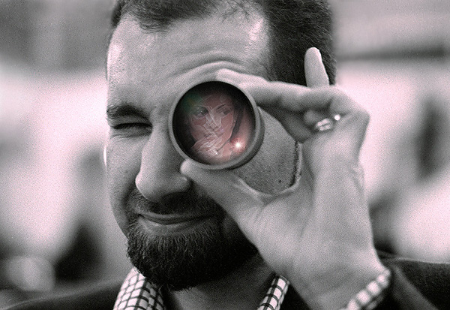
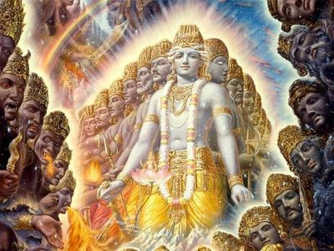
Adjust the lens by which they view matter because they cannot perceive spirit
Thus by a different conception one may realize the potency of the Lord
Potencies understood as manifestations of transcendence or of The Potent
Gradually the stage of full realization becomes possible
One automatically advances to the next step
From Purports 2.1.22,23,24,25

Slide 26
Minds of the materialistic men are flickering- constantly moving from one aspect to another 2.1.38

Slide 27
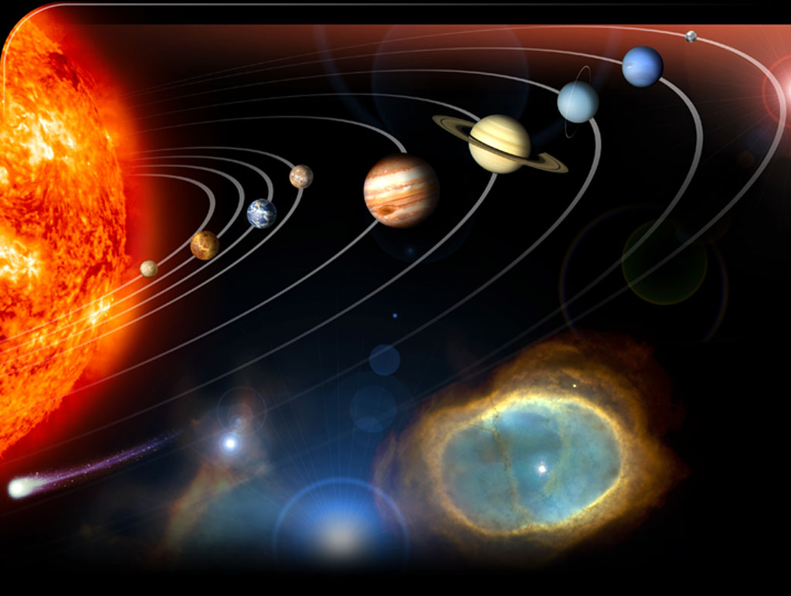
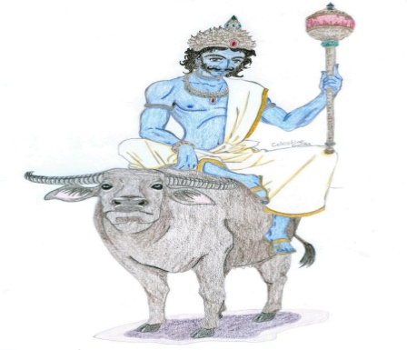
“Each and every item of the material manifestation entails a part of the body of the gigantic form, and thus the flickering mind can be fixed in the Lord only and nothing else.” -2.1.38 Purport
Stacks of His bones
His palate -director of water
Hairs of His body
Parts of His body
His artistic sense
Eyelids are both day and night
Jaws of His teeth
His mind

Slide 28
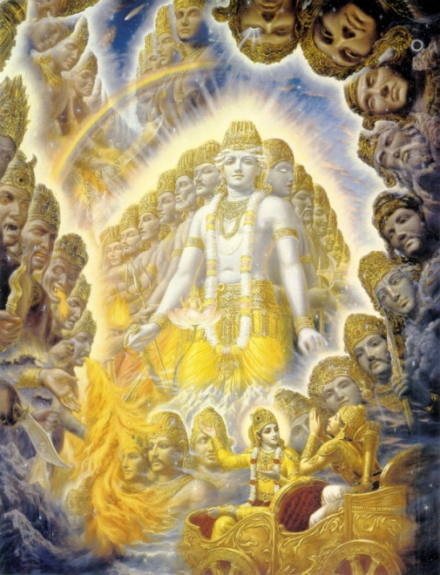
Clear Mind

Slide 29
“The neophyte student will gradually realize the hymns of Īśopaniṣad which state that the Supreme Lord is everywhere, and thus he will learn the art of not committing any offense to the body of the Lord”-2.1.38
Stacks of His bones
His palate -director of water
Hairs of His body
Parts of His body
His artistic sense
Eyelids are both day and night
Jaws of His teeth
His mind

Slide 30
“This sense of God-mindedness will diminish one’s pride in challenging the existence of God. Thus one can learn to show respect to everything, for all things are parts and parcels of the supreme body.”-2.1.38 purport

Slide 31
Attitude of service (2.1.26 purport)
“Visualization of the world in a spirit of lording over it is not God realization. To realize the Supreme Truth by conceiving of the Universal Form of the Lord, he must cultivate the service attitude.
Unless service attitude is revived , the conception of virata rupa will have very little effect on the seer” -2.1.26 Purport

Slide 32
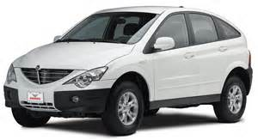
Attitude of service (2.1.37 purport)
Perform sacrifices by cooperation of classes/varnas
learn to offer sacrifices not only with clarified butter, but also with other manufactured goods in the propagation of the Lord’s glory, and that will bring about perfection in human society

Slide 33
Attitude of service: From Immature to Mature Pantheism
From 2.1.20
Pantheism extends the conception of the Absolute Truth to the Field of material energy
Dovetail things of matter through service
The pure devotee of the Lord knows the art of converting everything into its spiritual existence by this service attitude, and only in that devotional way can the theory of pantheism be perfected.

Slide 34
2.1.39
sa sarva-dhī-vṛtty-anubhūta-sarva ātmā yathā svapna-janekṣitaikaḥ taṁ satyam ānanda-nidhiṁ bhajeta nānyatra sajjed yata ātma-pātaḥ
Translation:
One should concentrate his mind upon the Supreme Personality of Godhead, who alone distributes Himself in so many manifestations just as ordinary persons create thousands of manifestations in dreams. One must concentrate the mind on Him, the only all-blissful Absolute Truth. Otherwise one will be misled and will cause his own degradation.

Slide 35
Important points
Srila Prabhupada
The conclusion is that one should unhesitatingly become a worshiper of Lord Kṛṣṇa, or, for that matter, His plenary expansion Nārāyaṇa, and none else. .. He is always in His transcendental position, but essentially He is everything, and nothing is apart from Him. As a part of Him, one should therefore concentrate on Him only, without deviation; otherwise one is sure to be overcome by the potencies of the material creation, one after another.

Slide 36
Important points
nānyatra sajjed
One should not be attached to anyone or anything else but the Supreme Lord because that attachment(yatah) causes one to fall(atma-patah) into the world of repeated birth and death
Jiva Goswami:
After describing the process of fixing the mind on the virat rupa- Sukadeva Goswami again brings us to the point of devotion to the Lord (sah)
Concentration on virat rupa results in concentration on the Lord
But a devotee should not become attached to focusing on the virat rupa, he should devote himself to the service of Lord Narayana

Slide 37
Practical Application
1.1.1 and 1.1.2
We can take up the process to the extent our sense enjoyment is stifled
See everything as Krishna’s energy and engage in service
It all depends on how we see things- HG Harivilas Prabhu
To see properly mind has to be cleaned up
Follow Srila Prabhupada’s process:
Chant ,Hear – anartha nivrtti
See everything as Krishna’s energy and engage in service
Follow instructions
This becomes our meditation

Slide 38
Summary
Dirty things of the mind can be cleared by meditating upon the Supreme Lord and His potencies
Check the mind from materialism by training it to see everything as Vishnu
Gradually one understands everything in its spiritual relationship with Vishnu
Service attitude to perfect the theory of pantheism
Devotee should not become attached to meditating upon the virat rupa
Nanyatra sajjed – do not become attached to anything else but the Lord
Attachment causes us to fall
Follow Srila Prabhupada

Slide 39
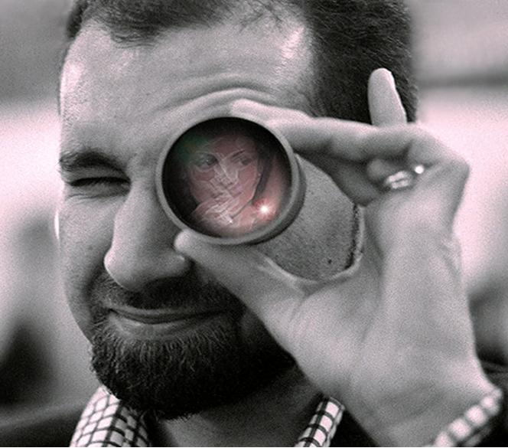
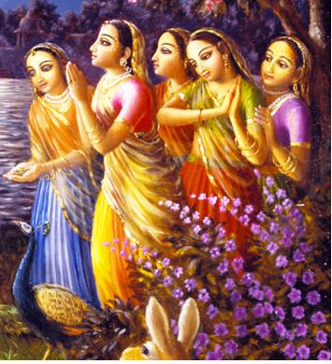

Slide 40
