Slide 1
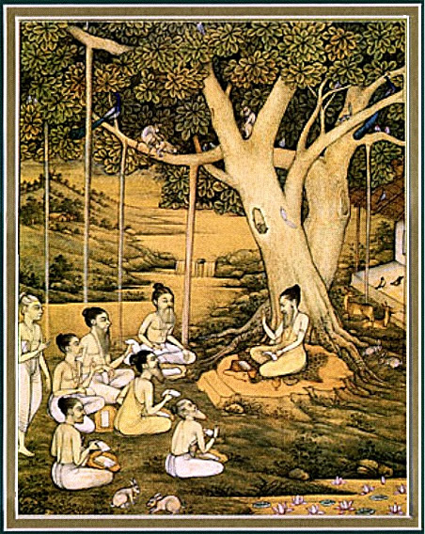
Srimad bhagavataM 2.1.16 – 21
Preparing for
BETTER next life

Slide 2
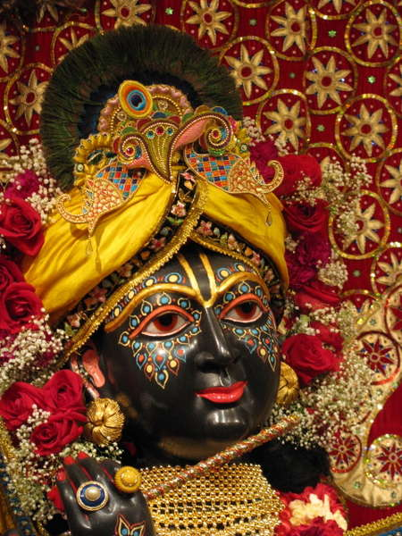
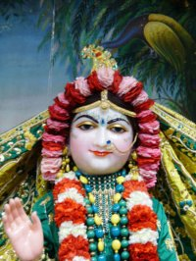
SB 1.2.4 narayanam namaskrtyam naram caiva narottamam devim sarasvatim vyasam tato jayam udirayet
Translation: Before reciting this Srimad Bhagavatam, which is the
very means of conquest, one should offer respectful obeisances
unto the Personality of Godhead, Narayana, unto Nara-Narayana
Rsi, the supermost human being, unto mother Sarasvati, the
goddess of learning, and unto Srila Vyasadeva, the author.

Slide 3
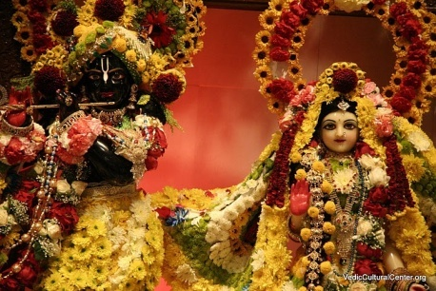
nasta-prayesu abhadresu nityaḿ bhagavata-sevaya bhagavaty uttama-sloke bhaktir bhavati naisthiki
SB 1.2.18
Translation: By regular attendance in classes on the
Bhagavatam and by rendering of service to the pure devotee,
all that is troublesome to the heart is almost completely
destroyed, and loving service unto the Personality of
Godhead, who is praised with transcendental songs, is
established as an irrevocable fact.

Slide 4
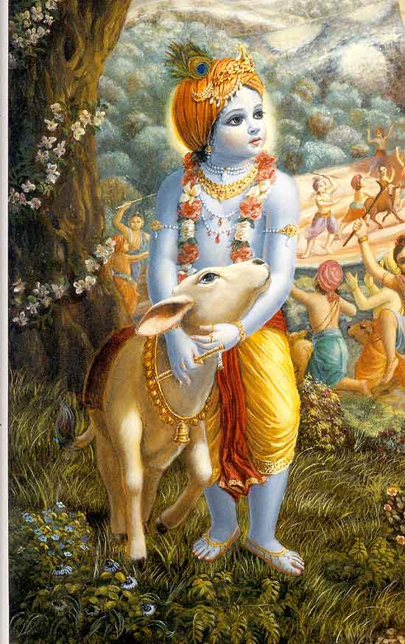
SB 2.1.16 – 21
Preparing for better next life: leaving home in renunciation.

Slide 5
Section outline
16 Leave home in renunciation
Process of mind control
18 Fix one’s mind in Lord’s service
Ultimate goal of meditation
Raising above the lower modes
21 Pantheism to Devotional Service

Slide 6
SB 2.1.16
gåhät pravrajito dhéraù
puëya-tértha-jaläplutaù
çucau vivikta äséno
vidhivat kalpitäsane
One should leave home and practice
self-control. In a sacred place he
should bathe regularly and sit down
in a lonely place duly sanctified.

Slide 7
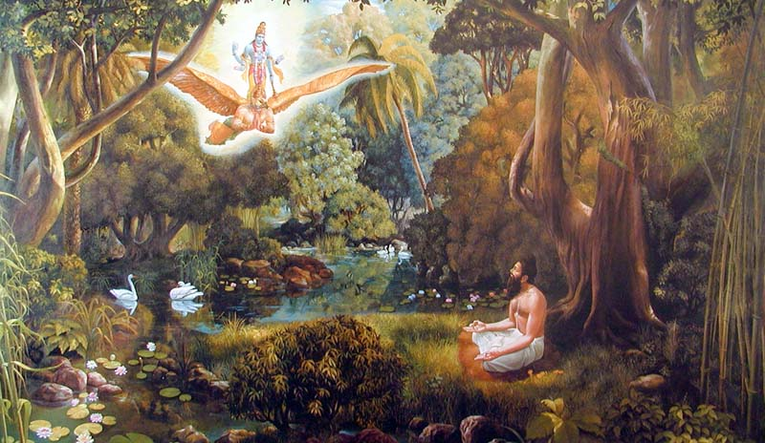
2.1.16 Leave home in Renunciation
Get out of one’s so called home
Sanatana dharma – retirement as early as age 50
Take shelter of Holy places
Guard against self-complacency – practice celibacy
Modern civilization
Expect comfortable life after retirement
Consequence - Death forces another body (lower species)
Notes:
Self-complacency – don’t start a new family in Holy Places.

Slide 8
2.1.16 Leave home in Renunciation
Practical Application: Be prepared at any moment
Sincere absorption – ‘last mantra I ever chant’
Practice ‘detached caring’
Draw strength from sadhana in good times
“In order to be saved from the danger of spoiling the human form of life and being attached to unreal things, one must take warning of death at the age of fifty, if not earlier. The principle is that one should take it for granted that the death warning is already there, even prior to the attainment of fifty years of age, and thus at any stage of life one should prepare himself for a better next life.”
Notes:
Death may not give us notice
Madhava prabhu – same melody
devotee - car in tracks – at the last moment thought - what will happen to my wife and children

Slide 9
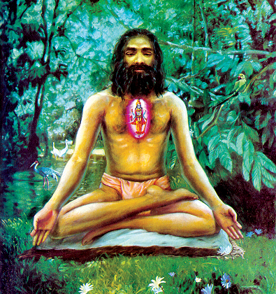
SB 2.1.17
abhyasen manasä çuddhaà
trivåd-brahmäkñaraà param
mano yacchej jita-çväso
brahma-béjam avismaran
After sitting in the above manner,
make the mind remember the three
transcendental letters [a-u-m], and
by regulating the breathing
process, control the mind so as not
to forget the transcendental seed.

Slide 10
2.1.17 Process of mind control
Omkara – what is it?
Seed of transcendental realization
3 transcendental letters a-u-m
Seed of transcendental sound
[BG 9.17] Direct representation of Absolute Truth
Note of address ‘O my Lord’
Process of mind control
Chant Omkara within mind + breathing process
Transcendental but mechanical process
Notes:
History
- Brahmana mystic
- Incarnaton of Lord Siva
- Kumari kunti pleases Durvasa
- Could travel in Space – 1 year – ambrish maharaja
Visit the pandavas
- Duryodhana’s plot
- Draupadi’s calling for Krsna

Slide 11
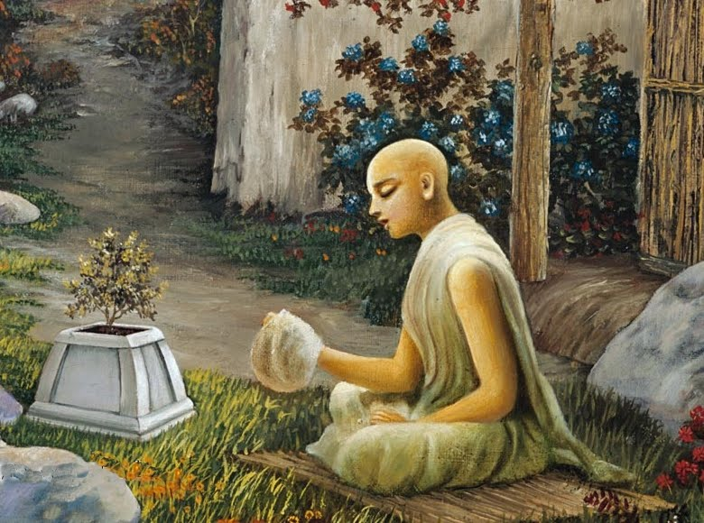
2.1.17 Process of mind control
Who is it for?
Persons unable to realize transcendental name on account of imperfect senses
One who is unable to chant directly the Holy Name of the Lord
What process do devotees follow?
Fix their minds on the Supreme
Chant the Holy Name
Notes:
Thru diff processes of hearing, chanting etc.

Slide 12
2.1.17 Process of mind control
Practical Application: Fix the mind on Krsna while chanting
“Just try to hear yourself chant sincerely” – Srila Prabhupada
Constant practice and detachment [BG 6.35]
One mantra at a time
Be present
“As we have several times expressed, since the transcendental name, form, attributes, pastimes, etc., of the Personality of Godhead are impossible to understand with the present material senses, it is necessary that through the mind, the center of sensual activities, such transcendental realization be set into motion. The devotees directly fix their minds on the Person of the Absolute Truth. But one who is unable to accommodate such personal features of the Absolute is disciplined in impersonality to train the mind to make further progress.”
Notes:
Withdraw mind from where it wanders and bring to the HolyName

Slide 13
SB 2.1.18
niyacched viñayebhyo 'kñän
manasä buddhi-särathiù
manaù karmabhir äkñiptaà
çubhärthe dhärayed dhiyä
Gradually, as the mind becomes progressively
spiritualized, withdraw it from sense activities, and by
intelligence the senses will be controlled. The mind too
absorbed in material activities can be engaged in the
service of the Personality of Godhead and become fixed in
full transcendental consciousness.

Slide 14
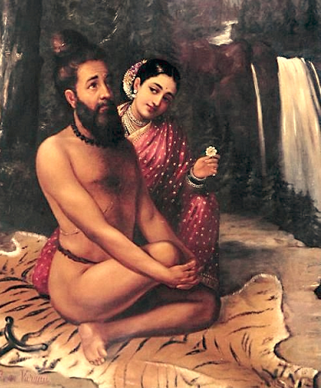
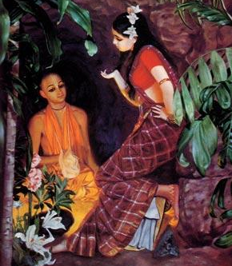
2.1.18 Fix one’s mind in Lord’s service
Pitfalls of mechanical process
Fails to fully control the mind
Ex: Visvamitra muni and Menaka
Mind remembers past sensual activities
Assured process
Fix the mind in Lord’s service [BG 6.47]
Ex: Haridasa thakura
Under proper guidance
Surest path of progress
Notes:
History
- Brahmana mystic
- Incarnaton of Lord Siva
- Kumari kunti pleases Durvasa
- Could travel in Space – 1 year – ambrish maharaja
Visit the pandavas
- Duryodhana’s plot
- Draupadi’s calling for Krsna

Slide 15
2.1.18 Fix one’s mind in Lord’s service
Practical Application: Every moment engaged in Lord’s service
Lord please engage me in your service
Consciously avoid non-KC engagements
“The mind, although ceasing to think of sensual activities at present, remembers past sensual activities from the subconscious status and thus disturbs one from cent percent engagement in self-realization. Therefore, Çukadeva Gosvämé recommends the next step of assured policy, namely to fix one's mind in the service of the Personality of Godhead.”
Notes:
Dreams / encounters – regret past sinful life and reflect how fortunate to serve. Pray to allow me to serve.
Sivarama swami mahraja’s article about watching T.V
Radhakrishna prabhu – parents T.V – try to minimize.
3. Different devotees have different capacities. All we care is if every moment engaged in service?

Slide 16
SB 2.1.19
tatraikävayavaà dhyäyed
avyucchinnena cetasä
mano nirviñayaà yuktvä
tataù kiïcana na smaret
padaà tat paramaà viñëor
mano yatra prasédati

Slide 17
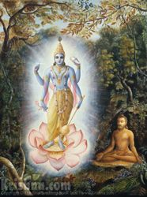
SB 2.1.19
Thereafter, you should meditate upon
the limbs of Viñëu, one after another,
without being deviated from the
conception of the complete body. Thus
the mind becomes free from all sense
objects. There should be no other thing
to be thought upon. Because the
Supreme Personality of Godhead,
Viñëu, is the Ultimate Truth, the mind
becomes completely reconciled in Him
only.

Slide 18
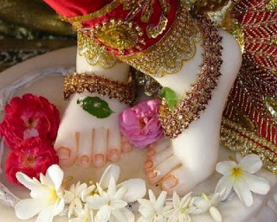
2.1.19 Ultimate goal of meditation
Significance of this verse
Meditating on Krsna is the Last word
on the subject of meditation
Supreme Lord is not impersonal
His body is different from ours
Temple worship is not idol worship
More practical meditation
Meditation on the limbs of the Lord in the temple
Omkara and forms of Vishnu in temple are non-different
Easier than meditation on impersonal Omkara [BG 12.5]
Notes:
Diety is identical with the Lord

Slide 19
2.1.19 Ultimate goal of meditation
Practical Application: Meditating on the Lord in the temple
Remember deity's lotus at least twice a day
Life centered around serving temple deity
Local temple deities are special
“Therefore, a neophyte's concentration or meditation upon the limbs of Viñëu in the temple, as contemplated in the revealed scriptures, is an easy opportunity for meditation for persons who are unable to sit down tightly at one place and then concentrate upon praëava oàkära or the limbs of the body of Viñëu, as recommended herein by Çukadeva Gosvämé, the great authority. The common man can benefit more by meditating on the form of Viñëu in the temple than on the oàkära, the spiritual combination of a-u-m as explained before.”
Notes:
After rising and before sleeping
5 miles, should make temple dieties main focus
All parents are not the same. Our parents nurtured us. Our deities are special to us.
Ex: Jaya Subhadra mathaji.

Slide 20
SB 2.1.20
rajas-tamobhyäm äkñiptaà
vimüòhaà mana ätmanaù
yacched dhäraëayä dhéro
hanti yä tat-kåtaà malam
One's mind is always agitated by the passionate mode of
material nature and bewildered by the ignorant mode of
nature. But one can rectify such conceptions by the
relation of Viñëu and thus become pacified by cleansing
the dirty things created by them.

Slide 21
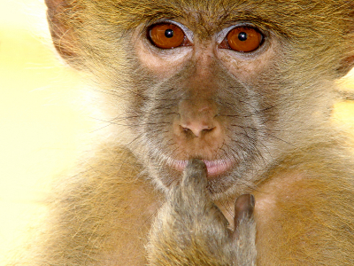
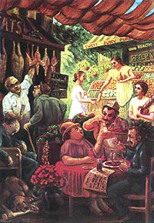
2.1.20 Raising above the lower modes
Persons influenced by passion / ignorance
Not bonafide candidates for God realization
Excessive attachment to women and wealth
Generally impersonalists / monists
Impersonalists / Monists
Think themselves liberated souls
Impure in heart
After many births surrender to SPOG [BG 7.19]
Notes:
Impure- due to lack of knowledge of personal feature of the Lord.

Slide 22
2.1.20 Raising above the lower modes
Solution
Constant remembrance of Vishnu in the impersonal form
Realize relation of Lord in everything via pantheism
Immature to mature pantheism
“Pantheism in its higher status does not permit the student to form an impersonal conception of the Absolute Truth, but it extends the conception of the Absolute Truth into the field of the so-called material energy. Everything created by the material energy can be dovetailed with the Absolute by an attitude of service, which is the essential part of living energy. The pure devotee of the Lord knows the art of converting everything into its spiritual existence by this service attitude, and only in that devotional way can the theory of pantheism be perfected.”
Notes:
Diety is identical with the Lord

Slide 23
SB 2.1.21
yasyäà sandhäryamäëäyäà
yogino bhakti-lakñaëaù
äçu sampadyate yoga
äçrayaà bhadram ékñataù
O King, by this system of remembrance and by being fixed
in the habit of seeing the all-good personal conception of
the Lord, one can very soon attain devotional service to the
Lord, under His direct shelter.

Slide 24
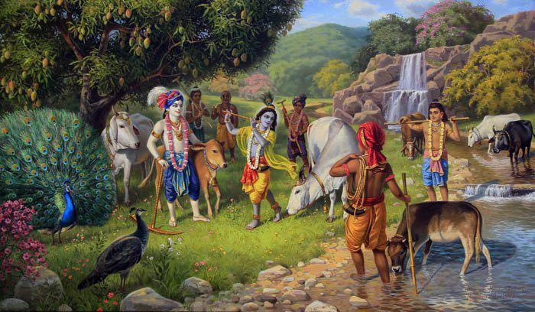
2.1.21 Pantheism to Devotional Service
“The devotional atmosphere created by pantheistic vision develops into devotional service in later days, and that is the only benefit for the impersonalist. It is confirmed in the Bhagavad-gétä (12.5) that the impersonal way of self-realization is more troublesome because it reaches the goal in an indirect way, although the impersonalist also becomes obsessed with the personal feature of the Lord after a long time.”
Notes:
Diety is identical with the Lord

Slide 25
Take Home
Be prepared at any moment
Fix the mind on Krsna while chanting
Every moment engaged in Lord’s service
Meditation on the Lord in the temple

Slide 26
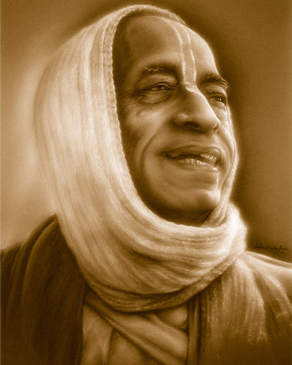
Thank you very much.
All glories to Srila Prabhupada!

