Slide 1
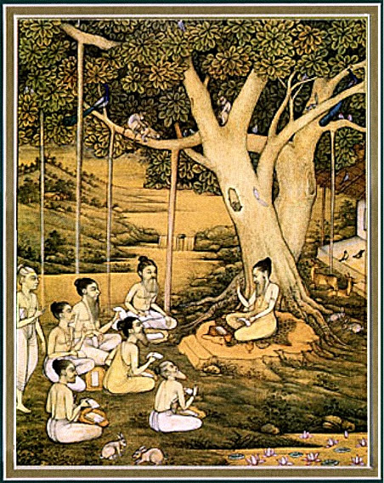
Srimad bhagavataM 1.9 Summary
The Art of dying

Slide 2
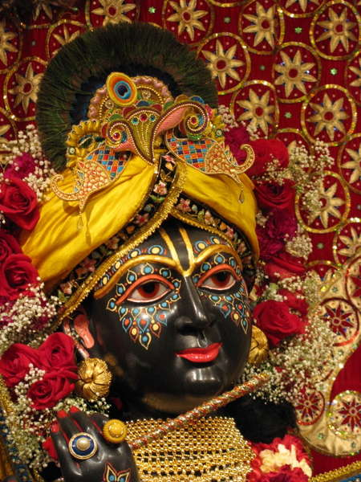
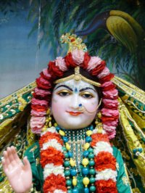
SB 1.2.4 narayanam namaskrtyam naram caiva narottamam devim sarasvatim vyasam tato jayam udirayet
Before reciting this Srimad Bhagavatam, which is the
very means of conquest, one should offer respectful
obeisances unto the Personality of Godhead, Narayana,
unto Nara - Narayana Rsi, the supermost human being,
unto mother Sarasvati, the goddess of learning, and unto
Srila Vyasadeva, the author.

Slide 3
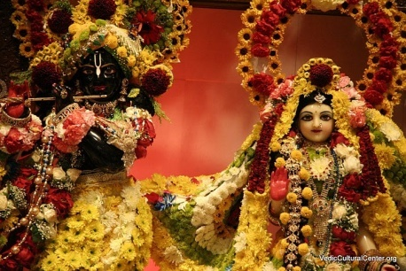
nasta-prayesy abhadresu nityaḿ bhagavata-sevaya bhagavaty uttama-sloke bhaktir bhavati naisthiki
SB 1.2.18
By regular attendance in classes on the Bhagavatam
and by rendering of service to the pure devotee, all
that is troublesome to the heart is almost completely
destroyed, and loving service unto the Personality of
Godhead, who is praised with transcendental songs, is
established as an irrevocable fact.

Slide 4
OUTLINE
1.9.1 – 10 Lord Krsna, the Pandavas and sages
approach Bhismadeva
1.9.11 – 17 Bhismadeva pacifies Yudhisthira maharaja
1.9.18 – 24 Glorification of Krsna as the SPOG
1.9.25 – 28 Instructions on how to rule
1.9.29 – 31 Preparing to leave
1.9.32 - 42 Final prayers
1.9.43 - 49 Departure and Separation

Slide 5
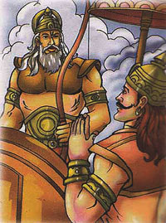
1.9.1- 10 : Lord Krsna, Pandavas & Sages approach Bhismadeva
Yudhisthira maharaja’s bewilderment
Pandavas and Lord Krsna accompany Yudhisthira maharaja
Great souls, rsis, Brahmanas and kings followed
Sages – Narada, Vyasa, Parusurama, Sukhadeva goswami and Kasyapa etc.
Bhismadeva received them appropriately
Notes:
1. Kuvera
Lord also bowed down as humanly custom
Sages came to give and receive
To Receive : Be part of this Glorious Occasion
To Give : Bring auspiciousness to that situation
3. Time place and circumstance
Though physically unfit, received with sweet words and hearty expressions.
Bhismadeva worshipped the Lord.

Slide 6
1.9.1- 10 : Lord Krsna, Pandavas & Sages approach Bhismadeva
“Expert religionists know perfectly well how to adjust religious principles in terms of time and place. All the great äcäryas or religious preachers or reformers of the world executed their mission by adjustment of religious principles in terms of time and place. There are different climates and situations in different parts of the world, and if one has to discharge his duties to preach the message of the Lord, he must be expert in adjusting things in terms of the time and place. He [Bhéñmadeva] was certainly unable at that time to welcome and receive them physically because he was neither at his home nor in a normal healthy condition. But he was quite fit by the activities of his sound mind, and therefore he could utter sweet words with hearty expressions, and all of them were well received. One can perform one's duty by physical work, by mind and by words. And he knew well how to utilize them in the proper place...”
Notes:
1. Kuvera
Lord also bowed down as humanly custom
Sages came to give and receive
To Receive : Be part of this Glorious Occasion
To Give : Bring auspiciousness to that situation
3. Time place and circumstance
Though physically unfit, received with sweet words and hearty expressions.
Bhismadeva worshipped the Lord.

Slide 7
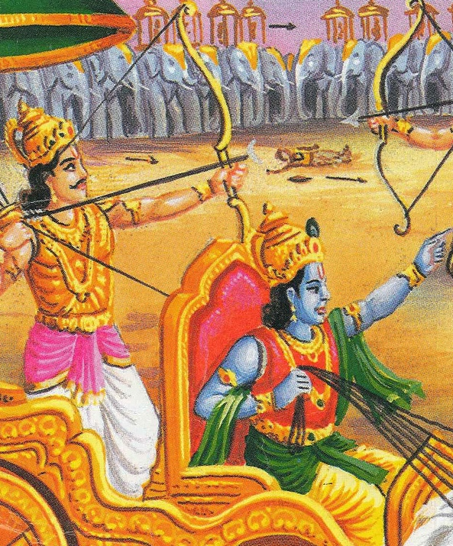
1.9.11- 17 : Bhismadeva pacifies Yudhisthira maharaja
Love, affection and empathy
Protected by Brahmanas, God and religion
Inevitable time
Inconceivable plan of the Lord.
Notes:
Pandavas and kunti suffered greatly – do not deserve to be alive
3 things to cross check
- Motive is to please Krsna
- Acting according to Brahmanas and Vaishnavas
- Acting acccording to theistic/ codes of religion
Wind carries the clouds – time controls everyone in the planet.
Time is irreversible – despite strong pandavas it happened.
No one can know the plan – great philosophers are bewildered.
You are appointed head, do your duty of taking care of the subjects.

Slide 8
1.9.11- 17 : Bhismadeva pacifies Yudhisthira maharaja
“Bhéñma wanted to impress upon Mahäräja Yudhiñöhira that since time immemorial no one, including such demigods as Çiva and Brahmä, could ascertain the real plan of the Lord. So what can we understand about it? It is useless also to inquire about it. Even the exhaustive philosophical inquiries of sages cannot ascertain the plan of the Lord. The best policy is simply to abide by the orders of the Lord without argument. The sufferings of the Päëòavas were never due to their past deeds. The Lord had to execute the plan of establishing the kingdom of virtue, and therefore His own devotees suffered temporarily in order to establish the conquest of virtue. …Even a great fighter like Bhéñma could not win the Battle of Kurukñetra because the Lord wanted to show that vice cannot conquer virtue, regardless of who tries to execute it.”
Notes:
1. Kuvera
Lord also bowed down as humanly custom
Sages came to give and receive
To Receive : Be part of this Glorious Occasion
To Give : Bring auspiciousness to that situation
3. Time place and circumstance
Though physically unfit, received with sweet words and hearty expressions.
Bhismadeva worshipped the Lord.

Slide 9
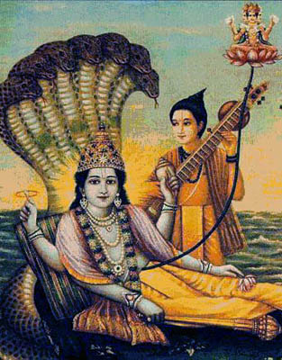
1.9.18 - 24 : Glorification of Krsna as the SPOG
This Çré Kåñëa is no other than the inconceivable, original Personality of Godhead. He is the first Näräyaëa, the supreme enjoyer. But He is moving amongst the descendants of King Våñëi just like one of us and He is bewildering us with His self-created energy.
O King, Lord Çiva, Närada the sage amongst the demigods, and Kapila, the incarnation of Godhead, all know very confidentially about His glories through direct contact.

Slide 10
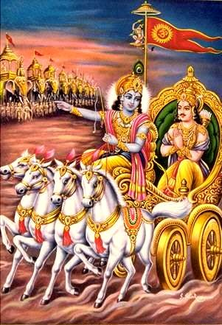
1.9.18 - 24 : Glorification of Krsna as the SPOG
O King, that personality whom, out of ignorance only, you thought to be your maternal cousin, your very dear friend, well-wisher, counselor, messenger, benefactor, etc., is that very Personality of Godhead, Çré Kåñëa.
Being the Absolute Personality of Godhead, He is present in everyone's heart. He is equally kind to everyone, and He is free from the false ego of differentiation. Therefore whatever He does is free from material inebriety. He is equibalanced.

Slide 11
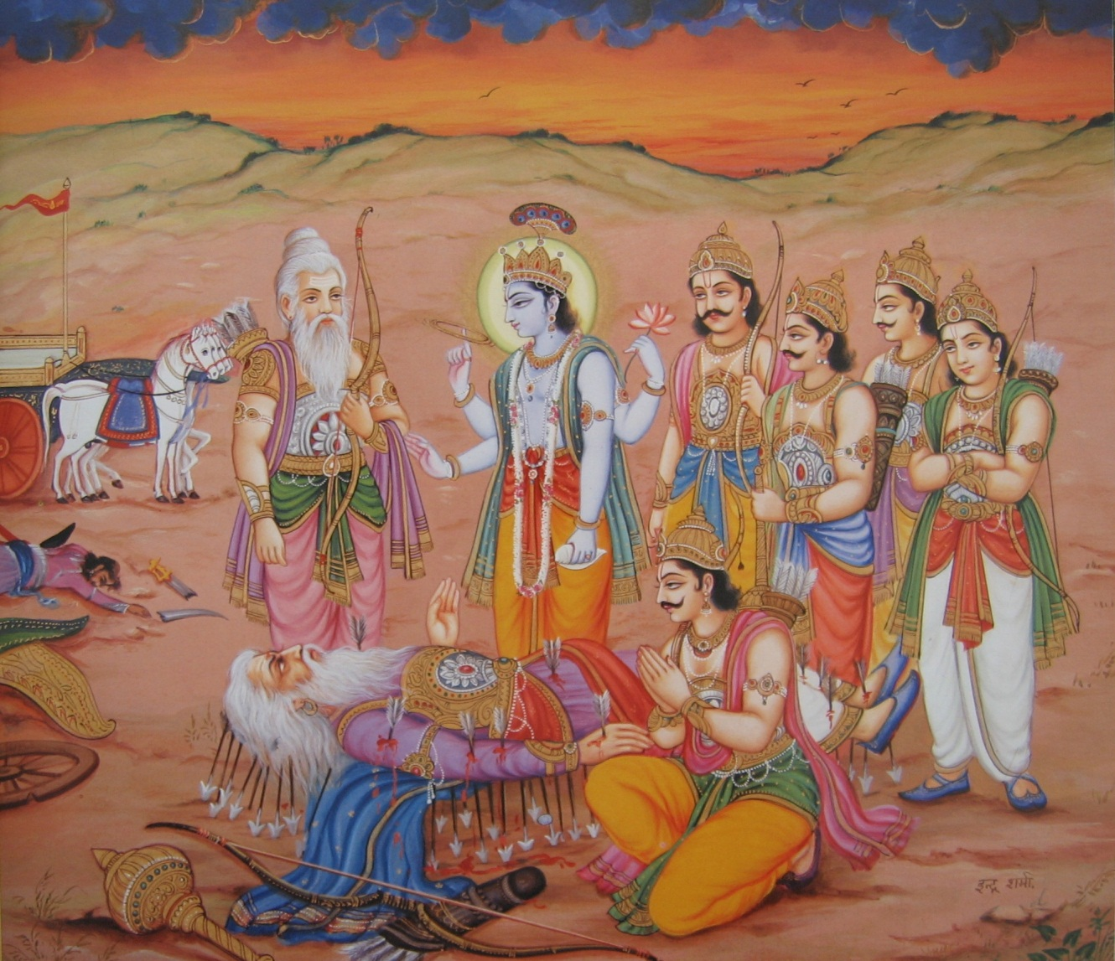
1.9.18 - 24 : Glorification of Krsna as the SPOG
Yet, despite His being equally kind to everyone, He has graciously come before me while I am ending my life, for I am His unflinching servitor.
The Personality of Godhead, who appears in the mind of the devotee by attentive devotion and meditation and by chanting of the holy name, releases the devotee from the bondage of fruitive activities at the time of his quitting the material body.

Slide 12
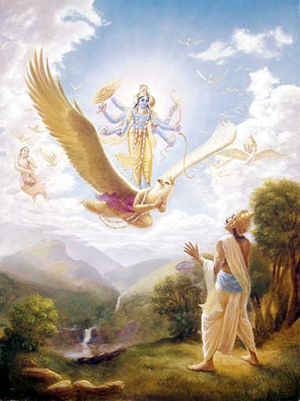
1.9.18 - 24 : Glorification of Krsna as the SPOG
May my Lord, who is four-handed and whose beautifully decorated lotus face, with eyes as red as the rising sun, is smiling, kindly await me at that moment when I quit this material body.

Slide 13
1.9.25 - 28 : Instructions on how to rule
Castes and Orders
Acts of charity
Duties of a king
Activities of salvation
Duties of women and devotees
Orders and Statuses
“The conception of four castes and four orders of life, as planned by the Lord Himself (Bg. 4.13), is to accelerate transcendental qualities of the individual person so that he may gradually realize his spiritual identity and thus act accordingly to get free from material bondage, or conditional life…The varëäçrama-dharma is prescribed for the civilized human being just to train him to successfully terminate human life.”
Notes:
Krsna wanted to show devotees are superior to great sages
- Pure devotee is sound in body and mind always
- Yudhisthira’s preference and submission to superiors.
First talks about qualifications to be civilized.
Brahmanas – sense control, study of scriptures
Ksatriyas – give charity, never pretend to be non-violent
Vaisyas – Cow protection
Sudras – Render service to higher castes
Interaction by attachment and
Counteraction by detachment
Brahmacarya – training ground for other ashramas
Grhastha – give charity
Vana & Sannyasa – live on charity only
3. Charity – give 50%, King – Lead subjects towards salvation
4. Women – shyness, devotees – diety centered life and 5 limbs of d.s
5. Cited history

Slide 14
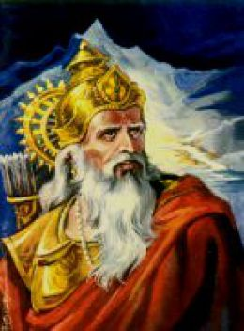
1.9.29 - 31 : Preparing to leave
Sun enters into Northern hemisphere
Withdraws his mind and fixes it on the SPOG
Freed from material inauspiciousness, bodily pain
External activities are stopped and offers transcendental prayers
Notes:
1. Kuvera
Lord also bowed down as humanly custom
Sages came to give and receive
To Receive : Be part of this Glorious Occasion
To Give : Bring auspiciousness to that situation
3. Time place and circumstance
Though physically unfit, received with sweet words and hearty expressions.
Bhismadeva worshipped the Lord.

Slide 15
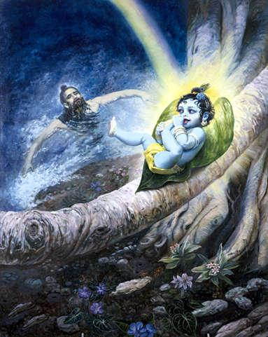
1.9.32 - 42 : Final prayers
Let me now invest my thinking, feeling and willing, which were so long engaged in different subjects and occupational duties, in the all-powerful Lord Çré Kåñëa. He is always self-satisfied, but sometimes, being the leader of the devotees, He enjoys transcendental pleasure by descending on the material world, although from Him only the material world is created.

Slide 16
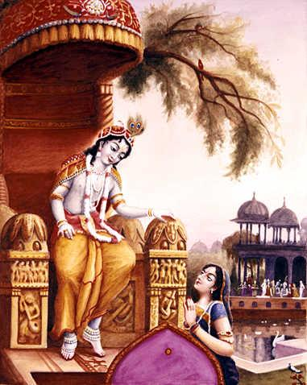
1.9.32 - 42 : Final prayers
Çré Kåñëa is the intimate friend of Arjuna. He has appeared on this earth in His transcendental body, which resembles the bluish color of the tamäla tree. His body attracts everyone in the three planetary systems [upper, middle and lower]. May His glittering yellow dress and His lotus face, covered with paintings of sandalwood pulp, be the object of my attraction, and may I not desire fruitive results.

Slide 17
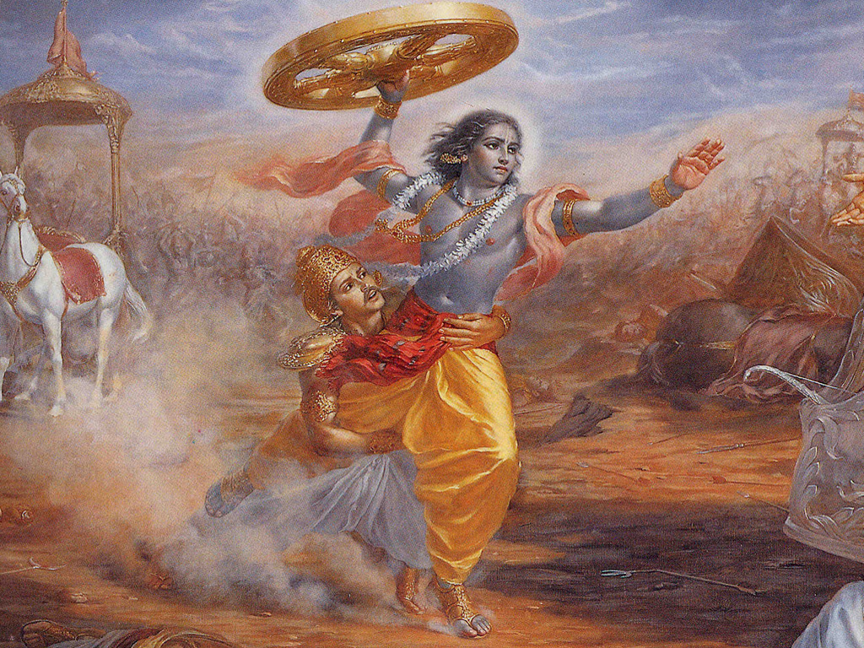
1.9.32 - 42 : Final prayers
On the battlefield [where Çré Kåñëa attended Arjuna out of friendship], the flowing hair of Lord Kåñëa turned ashen due to the dust raised by the hoofs of the horses. And because of His labor, beads of sweat wetted His face. All these decorations, intensified by the wounds dealt by my sharp arrows, were enjoyed by Him. Let my mind thus go unto Çré Kåñëa.

Slide 18
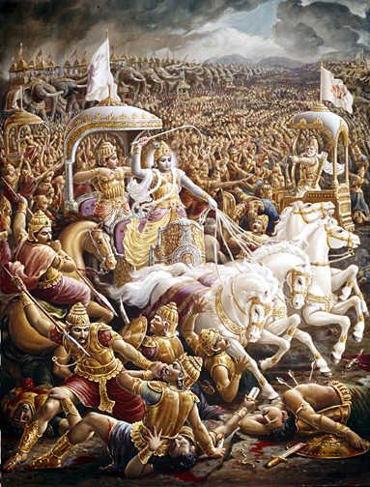
1.9.32 - 42 : Final prayers
In obedience to the command of His friend, Lord Çré Kåñëa entered the arena of the Battlefield of Kurukñetra between the soldiers of Arjuna and Duryodhana, and while there He shortened the life spans of the opposite party by His merciful glance. This was done simply by His looking at the enemy. Let my mind be fixed upon that Kåñëa.

Slide 19
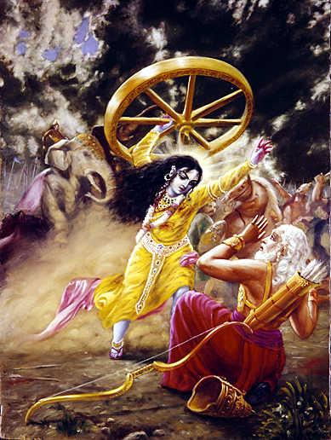
1.9.32 - 42 : Final prayers
When Arjuna was seemingly polluted by ignorance upon observing the soldiers and commanders before him on the battlefield, the Lord eradicated his ignorance by delivering transcendental knowledge. May His lotus feet always remain the object of my attraction.
Fulfilling my desire and sacrificing His own promise, He got down from the chariot, took up its wheel, and ran towards me hurriedly, just as a lion goes to kill an elephant. He even dropped His outer garment on the way.

Slide 20
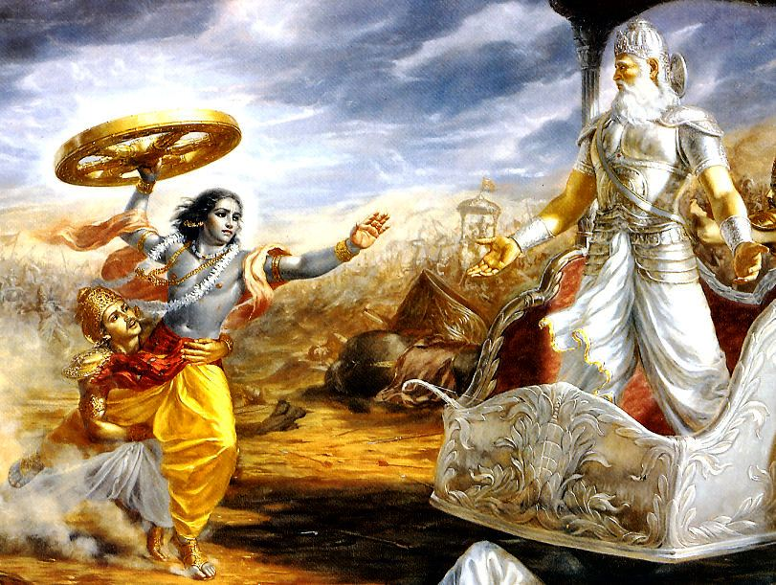
1.9.32 - 42 : Final prayers
May He, Lord Çré Kåñëa, the Personality of Godhead, who awards salvation, be my ultimate destination. On the battlefield He charged me, as if angry because of the wounds dealt by my sharp arrows. His shield was scattered, and His body was smeared with blood due to the wounds.

Slide 21
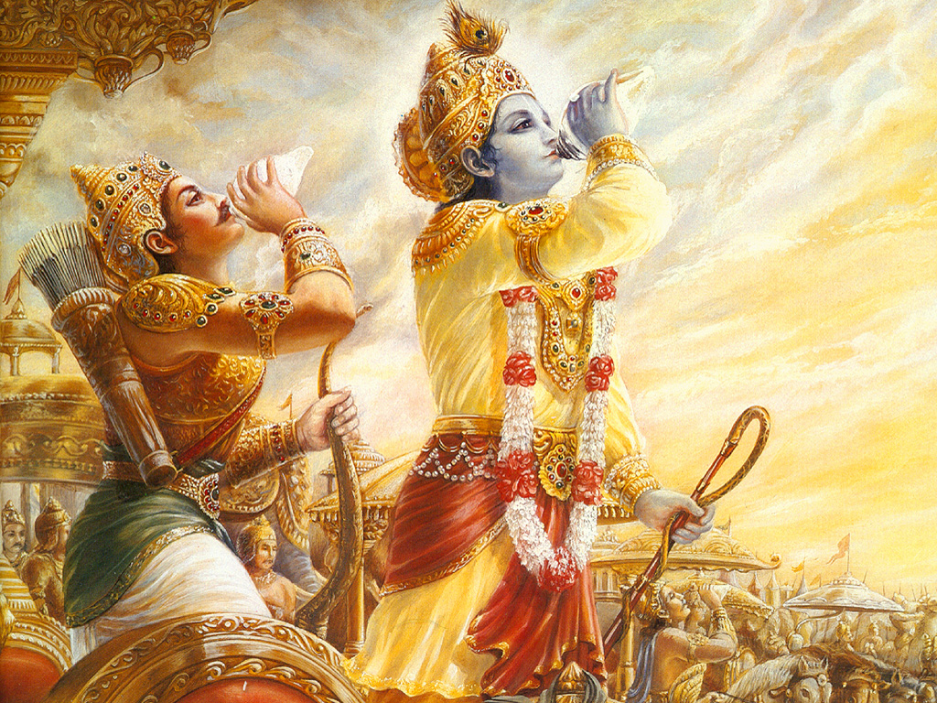
1.9.32 - 42 : Final prayers
At the moment of death, let my ultimate attraction be to Çré Kåñëa, the Personality of Godhead. I concentrate my mind upon the chariot driver of Arjuna who stood with a whip in His right hand and a bridle rope in His left, who was very careful to give protection to Arjuna's chariot by all means. Those who saw Him on the Battlefield of Kurukñetra attained their original forms after death.

Slide 22
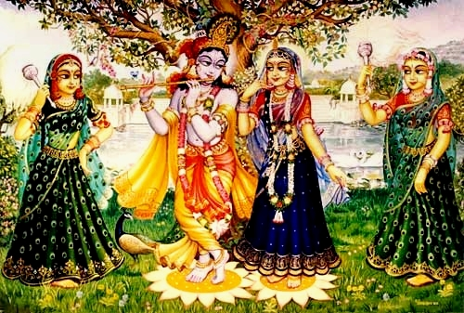
1.9.32 - 42 : Final prayers
Let my mind be fixed upon Lord Çré Kåñëa, whose motions and smiles of love attracted the damsels of Vrajadhäma [the gopés]. The damsels imitated the characteristic movements of the Lord [after His disappearance from the räsa dance].

Slide 23
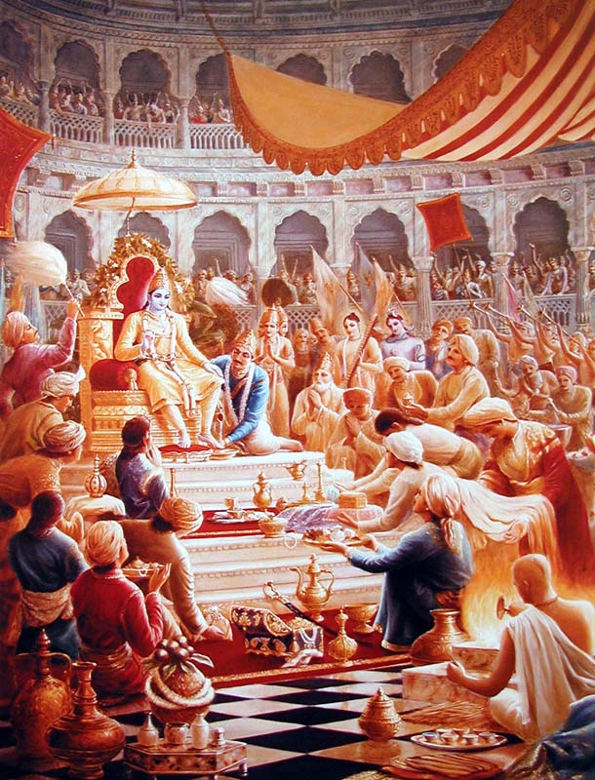
1.9.32 - 42 : Final prayers
At the Räjasüya-yajïa [sacrifice] performed by Mahäräja Yudhiñöhira, there was the greatest assembly of all the elite men of the world, the royal and learned orders, and in that great assembly Lord Çré Kåñëa was worshiped by one and all as the most exalted Personality of Godhead. This happened during my presence, and I remembered the incident in order to keep my mind upon the Lord.

Slide 24
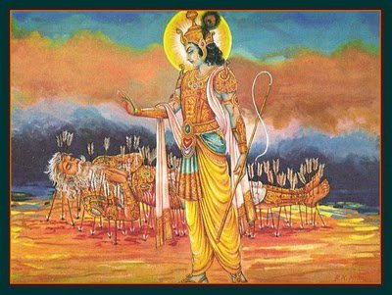
1.9.32 - 42 : Final prayers
Now I can meditate with full concentration upon that one Lord, Çré Kåñëa, now present before me because now I have transcended the misconceptions of duality in regard to His presence in everyone's heart, even in the hearts of the mental speculators. He is in everyone's heart. The sun may be perceived differently, but the sun is one.

Slide 25
1.9.43 - 49 : Departure & Separation
Merged with his mind, speech, sight and actions
Everyone silent like birds at the end of the day
Royal procession
Yudhisthira maharaja feels separation
Everyone glorify Krsna and return
Yudhisthira maharaja consoles uncle and aunt.
Yudhisthira maharaja rules the kingdom
Notes:
Self – Thinking of the Lord
Mind – Remembering the Lord
Tongue – Chanting the glories
Sight – saw the Lord personally
Everyone can attain by the process of D.S
Sky fell flowers
Not as a sentiment, due to separation from a great soul.
Returned with Lord in their hearts.
First talks about qualifications to be civilized.
Codes approved by Uncle and confirmed by the Lord.

Slide 26
1.9.43 - 49 : Departure & Seperation
“The stage attained by Bhéñmadeva while quitting his material body is called nirvikalpa-samädhi because he merged his self into thinking of the Lord and his mind into remembering His different activities. He chanted the glories of the Lord, and by his sight he began to see the Lord personally present before him, and thus all his activities became concentrated upon the Lord without deviation. This is the highest stage of perfection, and it is possible for everyone to attain this stage by practice of devotional service. The devotional service of the Lord consists of nine principles of service activities, and they are (1) hearing, (2) chanting, (3) remembering, (4) serving the lotus feet, (5) worshiping, (6) praying, (7) executing the orders, (8) fraternizing, and (9) fully surrendering. Any one of them or all of them are equally competent to award the desired result, but they require to be practiced persistently under the guidance of an expert devotee of the Lord.”
Notes:
1. Kuvera
Lord also bowed down as humanly custom
Sages came to give and receive
To Receive : Be part of this Glorious Occasion
To Give : Bring auspiciousness to that situation
3. Time place and circumstance
Though physically unfit, received with sweet words and hearty expressions.
Bhismadeva worshipped the Lord.

Slide 27
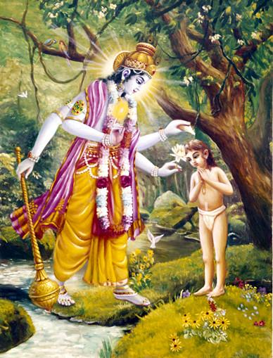
Our part – Back to basics
Sadhana-bhakti
Hearing and Chanting
Sincerely and attentively
Razor’s edge
Goal re(de)fined
Die before dying
Just this one life to Krsna!
Notes:
Under the guidance of S.M
Practice makes perfect - Same things we do, but with purity and devotion
SP : what will we do in S.W – chanting
ISKCON in S.W
Hearing
- SB/BG instructions of the Lord.
- Mukunda prabhu – shelter of BG
- If we feel understood it, means we dint.
- Siri babu prabhu, eager to hear.
Chanting
- Only exclusive time with Krsna
- Whole day so many activities/services – this time with Krsna
- Holy Name is a person – relationship – need to be careful and attentive.
4. D.S is like Razors edge
- Fall worse than materialists
- Very careful about offenses
- Devotee in India
- S.P – two complaints
- S.P – Maya wont attack me.
Goal redefined
- Windows reimagined
- reassess whom we r doing all these for, what is the goal
- complacent/routine esp at work, Guru maharaja post – come back to senses
Die before dying
- Madhava prabhu singing
- TKG home – I love you
- Death final exam
One life to Krsna!
- S.P – Vishnujana maharaja – give one life to Krsna
- What will you do if Krsna is there?
- SP disciples – 40 yrs, 50 yrs faithful to movement great achievement..

Slide 28
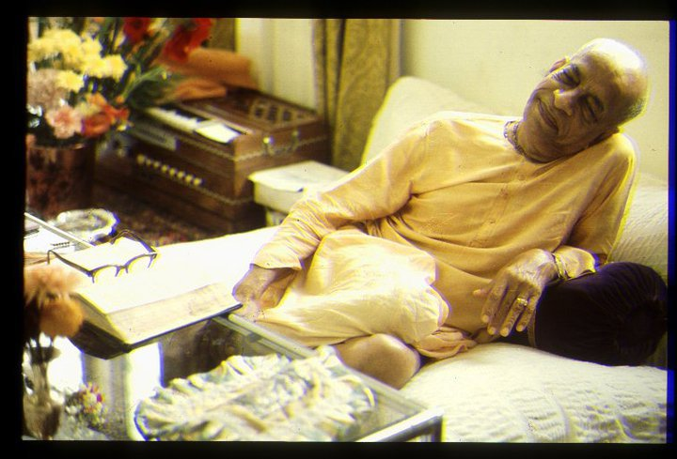
Thank you very much!
All glories to Srila Prabhupada!

