Slide 1
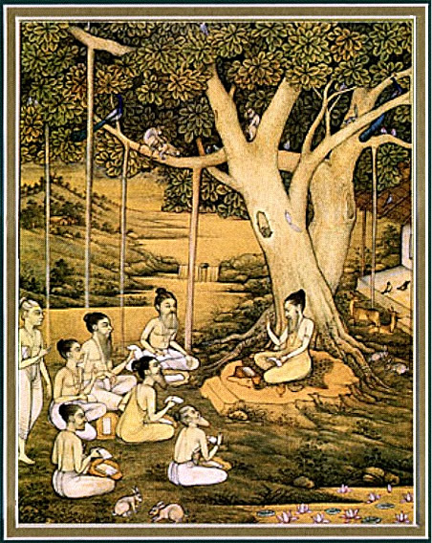
Srimad bhagavatam 1.9.34-42

Slide 2
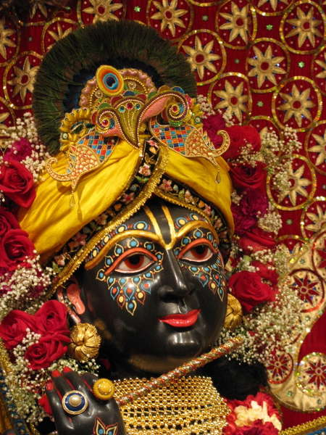
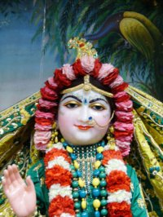
SB 1.2.4 narayanam namaskrtyam naram caiva narottamam devim sarasvatim vyasam tato jayam udirayet
Before reciting this Srimad-Bhagavatam, which is the very means of conquest, one should offer respectful obeisances unto the Personality of Godhead, Narayana, unto Nara-Narayana Rsi, the supermost human being, unto mother Sarasvati, the goddess of learning, and unto Srila Vyasadeva, the author.

Slide 3
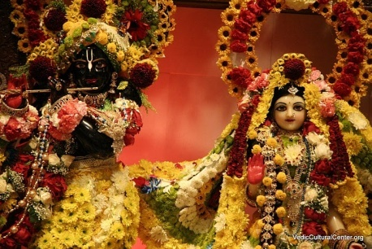
SB 1.2.18 nasta-prayesy abhadresu nityaḿ bhagavata-sevaya bhagavaty uttama-sloke bhaktir bhavati naisthiki
By regular attendance in classes on the Bhagavatam and by rendering of service to the pure devotee, all that is troublesome to the heart is almost completely destroyed, and loving service unto the Personality of Godhead, who is praised with transcendental songs, is established as an irrevocable fact.

Slide 4
RECAP….
1.9.1-11 Lord Krsna, the Pandavas and many sages approach the dying Bhismadeva
1.9.12-17 Bhismadeva pacifies Maharaj Yudhisthira
1.9.18-24 Bhéñmadeva glorifies Krsna as the SPG
1.9.25-28 Bhéñmadeva’s instructs Yudhisthira Maharaja
1.9.29-33 Bhéñmadeva now fixes his mind on Krsna while preparing to leave his body
1.9.34-42 Bhéñmadeva is offering his final prayers unto the Lord

Slide 6
Section Themes
1.9.34-38–The reciprocation between the Lord & His devotees
1.9.39-42– Perfection at death

Slide 7
1.9.34
yudhi turaga-rajo-vidhümra-viñvak-
kaca-lulita-çramaväry-alaìkåtäsye
mama niçita-çarair vibhidyamäna-
tvaci vilasat-kavace 'stu kåñëa ätmä
On the battlefield [where Çré Kåñëa attended Arjuna out of friendship], the flowing hair of Lord Kåñëa turned ashen due to the dust raised by the hoofs of the horses. And because of His labor, beads of sweat wetted His face. All these decorations, intensified by the wounds dealt by my sharp arrows, were enjoyed by Him. Let my mind thus go unto Çré Kåñëa.

Slide 8
1.9.34
Main points:
Krsna sees the devotion of His devotees :
Sharp arrows=soft roses
The Lord’s body is absolute/transcedental
→ Vibhidyamana - pierced
→Spirit is never pierced, cut, burnt, dried,etc (BG 2.23)

Slide 9
Main Points Cont’d…
Transcendental exchange between Lord Krsna & Bhismadeva
→ Bewilders the nondevotee atheist
→ Relished by the devotees
→ Increases faith of devotees
→ Highlights the all merciful nature of the Lord
→ Shows Krsna likes variety

Slide 10
Srila Prabhupada Purport 1.9.34
“Sré Viçvanätha Cakravarté Öhäkura, a great äcärya and devotee in the humor of conjugal love with the Lord, remarks very saliently in this regard. He says that the wounds created on the body of the Lord by the sharpened arrows of Bhéñmadeva were as pleasing to the Lord as the biting of a fiancee who bites the body of the Lord directed by a strong sense of sex desire. Such biting by the opposite sex is never taken as a sign of enmity, even if there is a wound on the body. Therefore, the fighting as an exchange of transcendental pleasure between the Lord and His pure devotee, Çré Bhéñmadeva, was not at all mundane. Besides that, since the Lord's body and the Lord are identical, there was no possibility of wounds in the absolute body. The apparent wounds caused by the sharpened arrows are misleading to the common man, but one who has a little absolute knowledge can understand the transcendental exchange in the chivalrous relation. The Lord was perfectly happy with the wounds caused by the sharpened arrows of Bhéñmadeva. The word vibhidyamäna is significant because the Lord's skin is not different from the Lord. Because our skin is different from our soul, in our case the word vibhidyamäna, or being bruised and cut, would have been quite suitable.”

Slide 11
1.9.35
sapadi sakhi-vaco niçamya madhye
nija-parayor balayo rathaà niveçya
sthitavati para-sainikäyur akñëä
håtavati pärtha-sakhe ratir mamästu
In obedience to the command of His friend, Lord Çré Kåñëa entered the arena of the Battlefield of Kurukñetra between the soldiers of Arjuna and Duryodhana, and while there He shortened the life spans of the opposite party by His merciful glance. This was done simply by His looking at the enemy. Let my mind be fixed upon that Kåñëa.

Slide 12
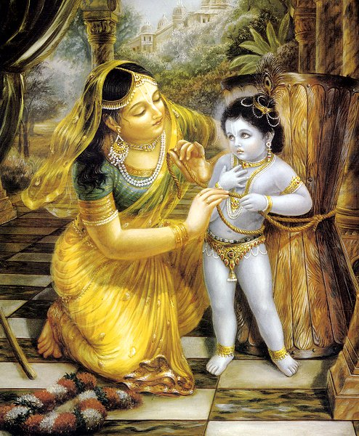
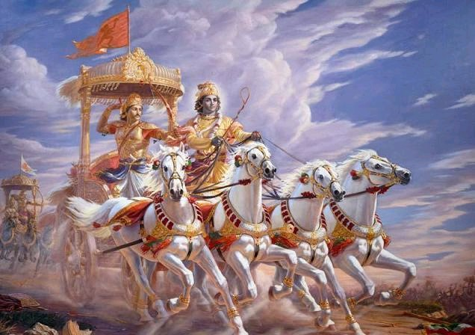
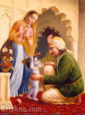
Main points
1. Krsna’s quality of Bhakta Vatsala
e.g. Arjuna- as chariot driver
Nanda Maharaja- Bringing his shoes
Damodar Lila- Mother Yasoda binding Him w/ rope

Slide 13
Main points Cont’d….
2. The Lord’s Merciful Glance
Is His transcendental Lila
e.g. a) Glancing at the Queens of Dwarka
b)Glancing at the Gopis
c) Accepting offerings thru His glance
Krsna diminshed the duration of life of the opposite party by His merciful glance
-All the fighters attained salvation- w/o the necessary qualifications
BG 9.29 samo 'haà sarva-bhüteñu
na me dveñyo 'sti na priyaù
ye bhajanti tu mäà bhaktyä
mayi te teñu cäpy aham
I envy no one, nor am I partial to anyone. I am equal to all. But whoever renders service unto Me I in devotion is a friend, is in Me, and I am also a friend to him.

Slide 14
Main points Cont’d….
3. Understanding the all good nature of the Lord
→ Krsna is our most well wishing friend
(BG 5.29 suhådaà sarva-bhütänäà)
→ His mercy is open to all(e.g. Sun)
→ What is our qualification to receive that mercy?
Based on how much eager and sincere we are to receive that mercy
→ Mercy can come in any form
Notes:
Externally it looks like Krsna is acting in favor of Arjuana, but actually it was for the benefit of Arjuna’s enemies.
Mercy : Sun is never partial ; utilize sun rays- stones become valuable, blind man can’t utilize the sun even being in the sun to see
Eagerness/sincerity- devotees do not do a business- xchange for service- therfore full mercy is open for him
Mercy in any form: Not only when we receive what we want, but mercy can come in ways that we consider unpleasant, uncomfortable-
Purpose – is to draw the devotee closer to Him
In other words, to strengthen his devotees' mood of dependence on Him and longing for Him, the Lord arranges for His devotees to go through some suffering, and when He appears in order to deliver them, their gratitude and transcendental pleasure are boundless.

Slide 15
Srila Prabhupada’s Purport 1.9.35
“ Therefore, the Lord is all good, and whatever He does is for everyone's good. Apparently it was for the victory of Arjuna, His intimate friend, but factually it was for the good of Arjuna's enemies. Such are the transcendental activities of the Lord, and whoever understands this also gets salvation after quitting this material body. The Lord does no wrong in any circumstance because He is absolute, all good at all times”.

Slide 16
1.9.36
vyavahita-påtanä-mukhaà nirékñya
sva-jana-vadhäd vimukhasya doña-buddhyä
kumatim aharad ätma-vidyayä yaç
caraëa-ratiù paramasya tasya me 'stu
When Arjuna was seemingly polluted by ignorance upon observing the soldiers and commanders before him on the battlefield, the Lord eradicated his ignorance by delivering transcendental knowledge. May His lotus feet always remain the object of my attraction.

Slide 17
Main Points
Arjuna’s Ignorance:
Eternal associate of the Lord
Intelligence polluted for a purpose
Bhismadeva’s perspective- witnessing the exchange
Fighting in Vedic times Vs Modern Times
Kings & Monarchs Vs Presidents & Ministers
Citizens immune from the effects of war

Slide 18
1.9.37
sva-nigamam apahäya mat-pratijïäm
åtam adhikartum avapluto rathasthaù
dhåta-ratha-caraëo 'bhyayäc caladgur
haririva hantum ibhaà gatottaréyaù
Fulfilling my desire and sacrificing His own promise, He got down from the chariot, took up its wheel, and ran towards me hurriedly, just as a lion goes to kill an elephant. He even dropped His outer garment on the way.

Slide 19
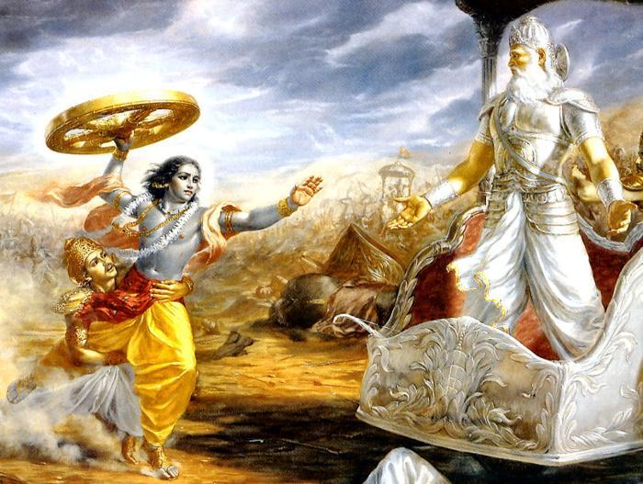

Slide 20
Main Points
Krsna is bound by His devotee’s love
→The Lord never forgets the loving service rendered by His devotees
→And He wants to reciprocate with their love
→BG 9.31 kaunteya pratijänéhi /na me bhaktaù praëaçyati
→Only devotees can understand His personal feature

Slide 21
1.9.38
çita-viçikha-hato viçérëa-daàçaù
kñataja-paripluta ätatäyino me
prasabham abhisasära mad-vadhärthaà
sa bhavatu me bhagavän gatir mukundaù
May He, Lord Çré Kåñëa, the Personality of Godhead, who awards salvation, be my ultimate destination. On the battlefield He charged me, as if angry because of the wounds dealt by my sharp arrows. His shield was scattered, and His body was smeared with blood due to the wounds.

Slide 22
Main Points
Bhismadeva’s Meditation
**Constantly fixed on seeing the transcendental feature of the Lord as a fighter
Devotee ever ready to serve as an instrument in the hands of the Lord(even as His enemy)
Both the Lord and the devotee become glorified in their respective positions
**BG 9.29 purport- diamond set in a golden ring

Slide 23
Srila Prabhupada’s Purport 1.9.38
“The astounding feature of such dealings is that a devotee can please the Lord by playing the part of an enemy. The Lord, being absolute, can accept service from His pure devotee even in the garb of an enemy. The Supreme Lord cannot have any enemy, nor can a so-called enemy harm Him because He is ajita, or unconquerable. But still He takes pleasure when His pure devotee beats Him like an enemy or rebukes Him from a superior position, although no one can be superior to the Lord. These are some of the transcendental reciprocatory dealings of the devotee with the Lord. And those who have no information of pure devotional service cannot penetrate into the mystery of such dealings”.

Slide 24
1.9.39
vijaya-ratha-kuöumba ätta-totre
dhåta-haya-raçmini tac-chriyekñaëéye
bhagavati ratir astu me mumürñor
yam iha nirékñya hatä gatäù sva-rüpam
At the moment of death, let my ultimate attraction be to Çré Kåñëa, the Personality of Godhead. I concentrate my mind upon the chariot driver of Arjuna who stood with a whip in His right hand and a bridle rope in His left, who was very careful to give protection to Arjuna's chariot by all means. Those who saw Him on the Battlefield of Kurukñetra attained their original forms after death.

Slide 25
Bhakti Yoga Vs Mystic Yoga
Bhakti Yoga | Mystic Yoga
Meditates on the personal feature of the Lord | Meditates on the Supersoul
Easily attains Samadhi by remembering personal feature, pastimes and chanting | Very difficult to attain Samadhi- Have to go thru the process of yama, niyama, dharana,etc
Concentration of the devotee is natural and Spontaneous | Concentration is mechanical
Mind, senses, intelligence fully purified by engagement in Devotional service | Mind and senses have to be controlled- No engagement
Through service- relationship re-established. Reciprocation and exchange of love | No service, so no relationship and no reciprocation and exchange of love
Devotee relishes | Boring and Lonely

Slide 26
Bhismadeva’s chivalrous rasa
Never forgot the Partha-sarathi feature of the Lord
Relished it even more than Arjuna
Krsna, the all merciful master
Awarded all present on the battlefield their original svarupa
Bhismadeva prayed for the same facility to be awarded to him as others- attainment of spiritual form
Shows although an eternal associate of the Lord, he did not take his position for granted

Slide 27
How to not take the blessings/opportunities we get/have in our lives for granted?
Realizing our insignificant position
Praying for mercy
By cultivating gratitude

Slide 28
1.9.40
alita-gati-viläsa-valguhäsa-
praëaya-nirékñaëa-kalpitorumänäù
kåta-manu-kåta-vatya unmadändhäù
prakåtim agan kila yasya gopa-vadhvaù
Let my mind be fixed upon Lord Çré Kåñëa, whose motions and smiles of love attracted the damsels of Vrajadhäma [the gopés]. The damsels imitated the characteristic movements of the Lord [after His disappearance from the räsa dance].

Slide 29
Main points
Bhismadeva is seeking the blessings of the Gopis
Appreciates the intense love of the Gopis for Krsna
Relation of Arjuna and the Gopis with Krsna
The Gopis attained qualitative oneness w/Krsna
Srila Prabhupada’s purport:
“The relation of the Lord with Arjuna is undoubtedly praiseworthy for devotees like Bhéñmadeva, but the relation of the gopés with the Lord is still more praiseworthy because of their still more purified loving service. By the grace of the Lord, Arjuna was fortunate enough to have the fraternal service of the Lord as chariot driver, but the Lord did not award Arjuna with equal strength. The gopés, however, practically became one with the Lord by attainment of equal footing with the Lord. Bhéñma's aspiration to remember the gopés is a prayer to have their mercy also at the last stage of his life”.

Slide 30
Kåñëa’s Hiding from the Gopés- From Krsna book
“After searching for Kåñëa here and there, the gopés became fatigued, and then they began to talk like madwomen. They could satisfy themselves only by imitating the different pastimes of Kåñëa. One gopé imitated a hand-driven cart, and another gopé lay down beneath the cart and threw up her legs, touching the wheels of the cart, as Kåñëa did to kill the demon Çakaöäsura. One gopé imitated child Kåñëa and lay down on the ground, and one gopé became the demon Tåëävarta and carried the small child Kåñëa by force into the sky. In this way all the gopés were madly feeling the absence of Kåñëa”.

Slide 31
1.9.41
muni-gaëa-nåpa-varya-saìkule 'ntaù-
sadasi yudhiñöhira-räjasüya eñäm
arhaëam upapeda ékñaëéyo
mama dåçi-gocara eña ävir ätmä
At the Räjasüya-yajïa [sacrifice] performed by Mahäräja Yudhiñöhira, there was the greatest assembly of all the elite men of the world, the royal and learned orders, and in that great assembly Lord Çré Kåñëa was worshiped by one and all as the most exalted Personality of Godhead. This happened during my presence, and I remembered the incident in order to keep my mind upon the Lord.

Slide 32
Main Points
Tradition before Rajasuya- yajna
-Challenge horse sent all over the world
- Accept the challenge- have to fight
-Or accept the supremacy of Maharaja Yudhisthira
Krsna- The cynosure of all the assembled
- All wanted to see and pay their respects to Krsna
Bhismadeva derived great pleasure in seeing the whole world honor Krsna

Slide 33
1.9.42
tam imam aham ajaà çaréra-bhäjäà
hådi hådi dhiñöhitam ätma-kalpitänäm
pratidåçam iva naikadhärkam ekaà
samadhi-gato 'smi vidhüta-bheda-mohaù
Now I can meditate with full concentration upon that one Lord, Çré Kåñëa, now present before me because now I have transcended the misconceptions of duality in regard to His presence in everyone's heart, even in the hearts of the mental speculators. He is in everyone's heart. The sun may be perceived differently, but the sun is one.

Slide 34
Main Points
What are the misconceptions of duality being addressed in this verse?
Misconception 1: To see Brahmajyoti and Paramatma as different from Krsna
Correct Understanding: Absolute Truth is one. There is no difference between Him and His personal glow, brahmajyoti or His plenary portions as Paramatma
Example of the sun
Misconception 2: Krsna of Vrindavan(Syamasundara) is different from Krsna at the battlefield of Kuruksetra(Partha-sarathi)
Correct Understanding: Krsna is both Paratha-sarathi and Syamasundara.

Slide 35
Srila Prabhupada’s Purport 1.9.42
“This misconception of duality is completely removed from the mind of Bhéñmadeva, and he is now satisfied that it is Lord Çré Kåñëa only who is all in all in everything. This enlightenment is attained by the great mahätmäs or devotees, as it is stated in Bhagavad-gétä (7.19) that Väsudeva is all in all in everything and that there is no existence of anything without Väsudeva. Väsudeva, or Lord Çré Kåñëa, is the original Supreme Person, as now confirmed by a mahäjana, and therefore both the neophytes and the pure devotees must try to follow in his footsteps. That is the way of the devotional line”.

Slide 36
Take Home Points from this verses(1.9.34-42)
Importance of meditation on the personal feature of the Lord
The Lord is Bhavagrahi-the Lord who accepts the devotional attitude of His devotee. Important to have the right consciousness while doing service
Accepting the Lord’s will in our lives
Prepare ourselves to become an useful instrument in the hands of devotees, Spiritual Master and Krsna
Importance of prayers/meditation in our life
Mood of our prayers
Preparing our life to pass the final test- death
Notes:
.

Slide 37
Part of an Interview w/H.H Bhakti Tirtha Swami
Divyambara dd: Praying for devotees, who are ill or in difficulty…
Bhakti-tirtha Swami: You should never be karma-kandic.. Our position is trying to be beyond. And that’s what causes a problem. That especially devotees from Christian backgrounds are so much in the habit of the whole idea of prayer is asking for something. I saw it in my own life—I was so much in the background of consciously praying every day out loud but more for something. When I became a devotee, I was just considering, I’m chanting Hare Krsna now and that’s the maha-prayer, so that’s it.
But then what is going on in the rest of the day with the mind. How much is good to have more control of the mind by focusing it on different prayers. So then when a devotee is ill, or in some difficulty, or in some particular situation, we have to pray that Krsna helps that devotee in that specific way if it’s going to help that devotee’s spiritual life. Or to help that devotee in such a way to help his spiritual life. Also to prayer that whatever is going to help that devotee in being a better devotee.

Slide 38
Divyambara dd: Also your daily prayer is that whatever I need to experience to be a better servant, let it happen or come to me.
Bhakti-tirtha Swami: Yeah. On the back I think of my Beggar I and II, I have it in my bathrooms in all my places framed so that I would repeat it or try to reflect on it as a daily meditation. Sometimes I just pray in my own words, of course and beg a prayer in the ten different kinds of Vaisnava prayers and I just [?] in my own words.
Divyambara dd: Please share some of your realization and experience of the Lord’s reciprocation to your prayer. Sometimes you would say, “Be careful what you pray for.”
Bhakti-tirtha Swami: In my own life I’ve prayed mostly to be forced. The general theme underlining my prayers and my way of trying to serve, I pray to be forced to experience whatever is necessary to be at the right place at the right time as much as possible, to be limited with what free will of mine may cause a problem. Even though it’s hard… It’s easy to say it but it’s hard to accept fully just being pushed into situations or put into situations. But my basic mood of prayer is, I know what I want, You know what I need, therefore bring on me what I need. And then I try to keep this internal dialog with this internal mantra.

Slide 39
References
Unveiling His Lotus feet – HG Bhurijana prabhu
www.romapadaswami.com
http://www.dandavats.com/?p=166

Slide 40
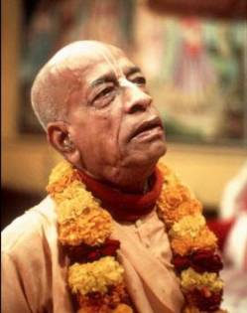
Srila Prabhupada ki jay!!!

