Slide 1
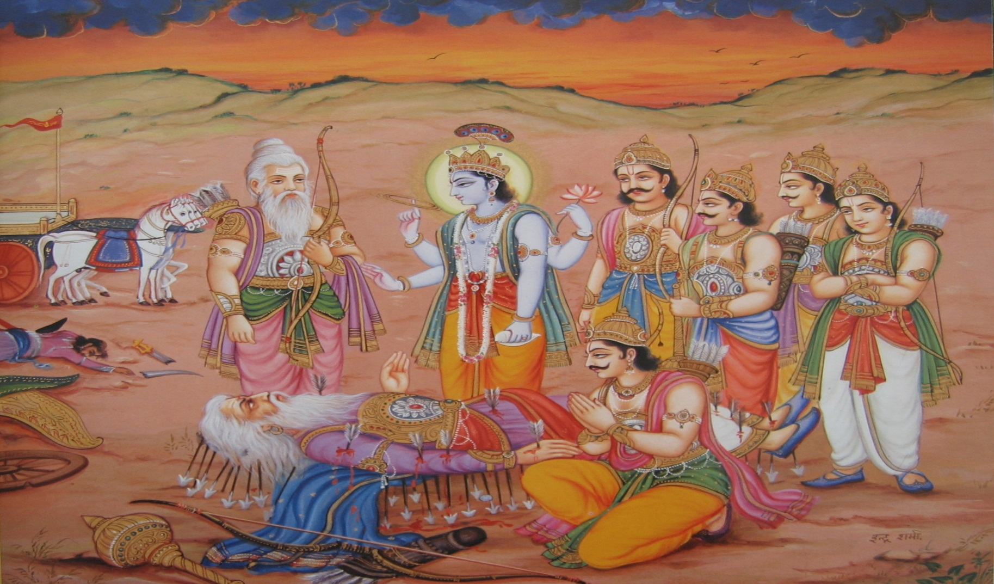
Śrīmad Bhāgavatam
1.9.11–22
Bhīṣmadeva offers guidance to Yudhisthira Maharaja

Slide 2
SB 1.2.4
nārāyaṇaḿ namaskṛtya
naraḿ caiva narottamam
devīḿ sarasvatīḿ vyāsaḿ
tato jayam udīrayet
Before reciting this Srimad Bhagavatam, which is the
very means of conquest, one should offer respectful obeisances unto the Personality of Godhead, Narayana, unto Nara-Narayana Rsi, the supermost human being, unto mother Sarasvati, the goddess of learning, and unto Srila Vyasadeva, the author.

Slide 3
SB 1.2.18
naṣṭa-prāyeṣv abhadreṣu
nityaḿ bhāgavata-sevayā
bhagavaty uttama-śloke
bhaktir bhavati naiṣṭhikī
By regular attendance in classes on the Bhagavatam and by rendering of service to the pure devotee, all that is troublesome to the heart is almost completely destroyed, and loving service unto the Personality of Godhead, who is praised with transcendental songs, is established as an irrevocable fact.

Slide 4
Outline
1.9.11 Devotee’s compassion
12-13 Best Protection: God, Brahmanas & Religion
14-17 Devotee ‘s vision of misfortune
18-22 Krsna’s dealings with His devotees

Slide 5
SB 1.9.11
pāṇḍu-putrān upāsīnān
praśraya-prema-sańgatān
abhyācaṣṭānurāgāśrair
andhībhūtena cakṣuṣā
The sons of Mahārāja Pāṇḍu were sitting silently nearby, overtaken with affection for their dying grandfather. Seeing this, Bhīṣmadeva congratulated them with feeling. There were tears of ecstasy in his eyes, for he was overwhelmed by love and affection.

Slide 6
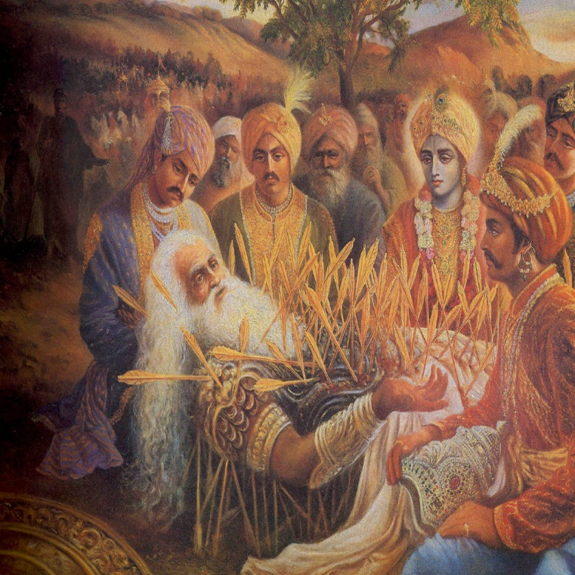
SB 1.9.12
aho kaṣṭam aho 'nyāyyaḿ
yad yūyaḿ dharma-nandanāḥ
jīvituḿ nārhatha kliṣṭaḿ
vipra-dharmācyutāśrayāḥ
Bhīṣmadeva said: Oh, what terrible
sufferings and what terrible injustices you
good souls suffer for being the sons of
religion personified. You did not deserve
to remain alive under those tribulations,
yet you were protected by the
brāhmaṇas, God and religion.

Slide 7
Battle of Kurukṣetra – To counteract injustice
Practical application
Trying circumstances or feeling despondent
Purpose/motivation to please Krsna
Instructions of brāhmaṇas and Vaiṣṇavas
Codes of religion/Codes of Theistic conduct
Qualities of a Vaiṣṇavas – Receptive, Compassion
Controlling/Serving departments
“As long as a person is fully in cooperation with the wishes
of the Lord, guided by the bona fide brāhmaṇas and
Vaiṣṇavas and strictly following religious principles, one
has no cause for despondency, however trying the
circumstances of life”

Slide 8
SB 1.9.13
saḿsthite 'tirathe pāṇḍau
pṛthā bāla-prajā vadhūḥ
yuṣmat-kṛte bahūn kleśān
prāptā tokavatī muhuḥ
As far as my daughter-in-law Kuntī is concerned, upon the great General Pāṇḍu's death, she became a widow with many children, and therefore she suffered greatly. And when you were grown up she suffered a great deal also because of your actions.

Slide 9
Doubly lamented
“This means that she was destined to suffer by providence,
and this one has to tolerate without being disturbed.”
One of the first instructions in BG (2.14)
mātrā-sparśās tu kaunteya
śītoṣṇa-sukha-duḥkha-dāḥ
āgamāpāyino 'nityās
tāḿs titikṣasva bhārata
Practical application
Any provoking situations?
Change/fix it. No complaints
Mode of ignorance
Circumstances beyond control

Slide 10
SB 1.9.14
sarvaḿ kāla-kṛtaḿ manye
bhavatāḿ ca yad-apriyam
sapālo yad-vaśe loko
vāyor iva ghanāvaliḥ
In my opinion, this is all due to inevitable time, under whose control everyone in every planet is carried, just as the clouds are carried by the wind.

Slide 11
Supreme kāla - forceful representative of the Lord within
the material world (BG 11.32- kalo 'smi)
Clouds carried by the wind
Practical application
In proper order - Protected
Difficulty
– Guiding principles
Adjust– don’t lament
Vaikunta Consciousness – by always connected to Krsna.
“Even the most pious has to suffer the condition of material nature.
But a pious man is faithful to the Lord, for he is guided by the
bona fide brāhmaṇa and Vaiṣṇava following the
religious principles”
“Everyone has to bear the actions and reactions of time as
long as one is within the conditions of the
material world.”

Slide 12
SB 1.9.15
yatra dharma-suto rājā
gadā-pāṇir vṛkodaraḥ
kṛṣṇo 'strī gāṇḍivaḿ cāpaḿ
suhṛt kṛṣṇas tato vipat
O how wonderful is the influence of inevitable time. It is irreversible — otherwise, how can there be reverses in the presence of King Yudhiṣṭhira, the son of the demigod controlling religion; Bhīma, the great fighter with a club; the great bowman Arjuna with his mighty weapon Gāṇḍīva; and above all, the Lord, the direct well-wisher of the Pāṇḍavas?

Slide 13
Reversals
Karma (sinful)
Time (sinless)
“Kāla is identical with the Lord Himself, and therefore the influence
of kāla indicates the inexplicable wish of the Lord Himself.
There is nothing to be lamented when a matter is beyond
the control of any human being.”

Slide 14
SB 1.9.16
na hy asya karhicid rājan
pumān veda vidhitsitam
yad vijijñāsayā yuktā
muhyanti kavayo 'pi hi
O King, no one can know the plan of the Lord [Śrī Kṛṣṇa]. Even though great philosophers inquire exhaustively, they are bewildered.

Slide 15
Plan of the Lord
“So what can we understand about it? It is useless also to
inquire about it. Even the exhaustive philosophical inquiries
of sages cannot ascertain the plan of the Lord. The best policy
is simply to abide by the orders of the Lord without argument.”
Vice cannot conquer Virtue
“Even a great fighter like Bhīṣma could not win the Battle of
Kurukṣetra because the Lord wanted to show that vice cannot
conquer virtue, regardless of who tries to execute it. Bhīṣmadeva
was a great devotee of the Lord, but he chose to fight against
the Pāṇḍavas by the will of the Lord because the Lord wanted
to show that a fighter like Bhīṣma cannot win
on the wrong side.”
What is the actual plan of the Lord?
Establish the kingdom of virtue

Slide 16
SB 1.9.17
tasmād idaḿ daiva-tantraḿ
vyavasya bharatarṣabha
tasyānuvihito 'nāthā
nātha pāhi prajāḥ prabho
O best among the descendants of Bharata [Yudhiṣṭhira], I maintain, therefore, that all this is within the plan of the Lord. Accepting the inconceivable plan of the Lord, you must follow it. You are now the appointed administrative head, and, my lord, you should now take care of those subjects who are now rendered helpless.

Slide 17
Devotee’s vision of misfortune
Housewife teaching daughter-in-law - BG
Ungrudgingly accept tribulations as a benediction
Bhīṣmadeva’s instruction to Mahārāja Yudhiṣṭhira
“A pure devotee of the Lord accepts tribulations as
favors from the Lord. Since the Lord is absolute, there is no
mundane difference between the two.”

Slide 18
SB 1.9.18
eṣa vai bhagavān sākṣād
ādyo nārāyaṇaḥ pumān
mohayan māyayā lokaḿ
gūḍhaś carati vṛṣṇiṣu
This Śrī Kṛṣṇa is no other than the inconceivable, original Personality of Godhead. He is the first Nārāyaṇa, the supreme enjoyer. But He is moving amongst the descendants of King Vṛṣṇi just like one of us and He is bewildering us with His self-created energy.

Slide 19
Deductive process - disciplic succession not dogmatic, BG 4.2
Ex - identity of the father
Modern scientists as authorities - Moon landing
Lord Śrī Kṛṣṇa - Original Personality of Godhead
Authority - Bhīṣmadeva, Brahmāji, Ācārya Śańkara
Action of internal and external energies on living entities
expands into unlimited numbers of Nārāyaṇas
incarnates in the material world amongst the men, animals or demigods
“The bewilderment regarding Śrī Kṛṣṇa is due to the action of His
twofold internal and external energies upon the third one,
called marginal energy.”
“Great authorities like Bhīṣma, however, escape His
bewilderment by the mercy of the Lord.”

Slide 20
SB 1.9.19
asyānubhāvaḿ bhagavān
veda guhyatamaḿ śivaḥ
devarṣir nāradaḥ sākṣād
bhagavān kapilo nṛpa
O King, Lord Śiva, Nārada the sage amongst the demigods, and Kapila, the incarnation of Godhead, all know very confidentially about His glories through direct contact.

Slide 21
Glories of the Lord in different transcendental loving services
Placing devotee in difficulty?
“Placing the devotee into material troubles necessitates delivering him from the illusory material relations. The material relations are based on reciprocation of material enjoyment, which depends mainly on material resources. Therefore, when material resources are withdrawn by the Lord, the devotee is cent percent attracted toward the transcendental loving service of the Lord.”

Slide 22
SB 1.9.20
yaḿ manyase mātuleyaḿ
priyaḿ mitraḿ suhṛttamam
akaroḥ sacivaḿ dūtaḿ
sauhṛdād atha sārathim
O King, that personality whom, out of ignorance only, you thought to be your maternal cousin, your very dear friend, well-wisher, counselor, messenger, benefactor, etc., is that very Personality of Godhead, Śrī Kṛṣṇa.
“Out of His causeless mercy and favor upon His unalloyed devotees,
He performs all kinds of service, but that does not mean that He has
changed His position as the Absolute Person.”

Slide 23
SB 1.9.21
sarvātmanaḥ sama-dṛśo
hy advayasyānahańkṛteḥ
tat-kṛtaḿ mati-vaiṣamyaḿ
niravadyasya na kvacit
Being the Absolute Personality of Godhead, He is present in everyone's heart. He is equally kind to everyone, and He is free from the false ego of differentiation. Therefore whatever He does is free from material inebriety. He is equibalanced.

Slide 24
Absolute - Everything and everyone is the manifestation
of Krsna’s energy. Ex- Sun
Chariot driver of living entities
Power of devotional service
Krsna becomes grateful & wants to give Himself
“Since He has nothing to do with the material conception of life because He is absolute spiritual identity”
Qualification to attract Krsna?
Mercy of pure devotees – Only hope!

Slide 25
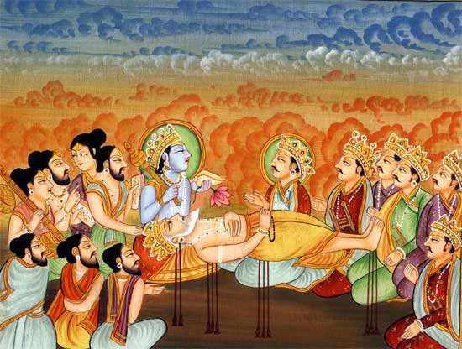
SB 1.9.22
tathāpy ekānta-bhakteṣu
paśya bhūpānukampitam
yan me 'sūḿs tyajataḥ sākṣāt
kṛṣṇo darśanam āgataḥ
Yet, despite His being equally kind to everyone, He has graciously come before me while I am ending my life, for I am His unflinching servitor.

Slide 26
Relationship between devotee and the Lord
“Having unflinching faith in the Supreme Lord as one's protector, friend and master is the natural condition of eternal life.”
most Happy - absolute dependence
cause of falldown - misidentifying
Root cause of all troubles -
False egotism
Appearance of Lord Kṛṣṇa at the deathbed of Bhīṣmajī?
Unflinching devotee / intimate relation of the soul
How to approach Krsna?
“The best way to establish our relation in transcendental sweetness is to approach Him through His recognized devotees. One should not try to establish the relation directly; there must be a via medium which is transparent and competent to lead us to the right path.”

Slide 27
Summary
Stress management – 3 guiding principles
Difficulties/Reversals
Absolute dependence on the Lord – Most happy
Cause of fall down – independent desire

Slide 28
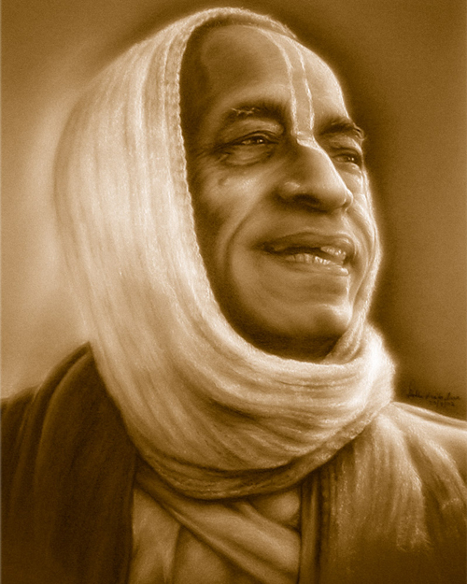
References
HH Romapada Swami Maharaj’s SB Lectures
Unveiling His Lotus feet – HG Bhurijana prabhu

