Slide 1
Srimad Bhagavatam (Chapter 8) (1.8.44-1.8.52)

Slide 2
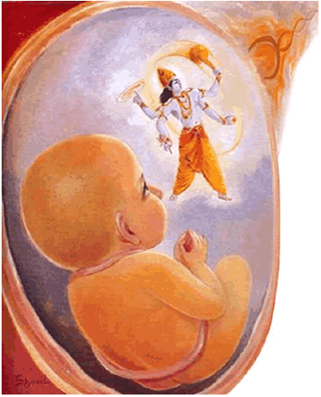

Slide 4
Contents: 1.8.44: Suta Goswami on the Power of Prayers 1.8.45-1.8.47: Suta Goswami on Illusion of affection 1.8.48-1.8.52: King Yudhistir’s lamentation.

Slide 5
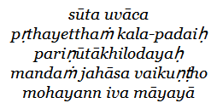
1.8.44
Suta Gosvāmī said: The Lord, thus hearing the prayers of Kuntīdevī, composed in choice words for His glorification, mildly smiled. That smile was as enchanting as His mystic power.

Slide 6
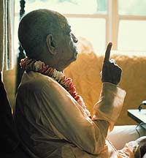
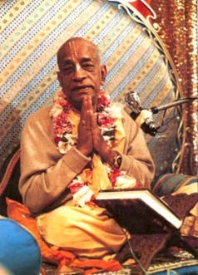
Purport:
All His devotees worship Him in that way, by chosen words, and therefore the Lord is known as Uttamaśloka. No amount of chosen words is sufficient to enumerate the Lord's glory, and yet He is satisfied by such prayers as the father is satisfied even by the broken linguistic attempts of the growing child

Slide 7
Prayers
arjuna uvāca kṛṣṇa kṛṣṇa mahā-bāho bhaktānām abhayańkara tvam eko dahyamānānām apavargo 'si saḿsṛteḥ Arjuna said: O my Lord Śrī Kṛṣṇa, You are the almighty Personality of Godhead.
There is no limit to Your different energies. Therefore only You are competent to
instill fearlessness in the hearts of Your devotees.
Everyone in the flames of material miseries can find the path of liberation in You only.
Uttarovāca pāhi pāhi mahā-yogin deva-deva jagat-pate nānyaḿ tvad abhayaḿ paśye yatra mṛtyuḥ parasparam Uttarā said: O Lord of lords, Lord of the universe! You are the greatest of mystics.
Please protect me, for there is no one else who can save me from the clutches of
death in this world of duality.

Slide 8
Prayers
Bhakti Tirtha Swami
Hare Krishna Temples are Vaikunta
Consulate Example
Everyone is involved in hearing and chanting about Krishna
Only a bhakta can give bhakti (Analogy: only an consulate can give visa)
Some one from the spiritual world should come and open the place.
How should be pray? 3 stages of Prayers (Source: Expressing prayers through Humility – Shyamananda prabhu)
Samprartanatmika: Attachment for the Lord is not manifest
Dhainya bhodhika: Humility and extreme worthlessness
Lalasamayi: Extreme Greed for Personal service.

Slide 9
1.8.45

Slide 10
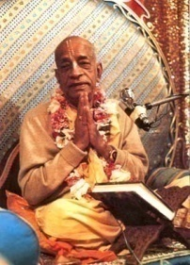
PURPORT: “No one could make Lord Kṛṣṇa stay at Hastināpura when He decided to start for Dvārakā, but the simple request of King Yudhiṣṭhira that the Lord remain there for a few days more was immediately effective. This signifies that the power of King Yudhiṣṭhira was loving affection, which the Lord could not deny. The almighty God is thus conquered only by loving service and nothing else. He is fully independent in all His dealings, but He voluntarily accepts obligations by the loving affection of His pure devotees.”
Krishna is Ajita. (No one can conquer, order, supersede Him) 3 months old – Demons like Putana were conquered by Krishna
Kamsa – planned very nicely to conquery Krishna: Dhanur Yajna, Elephant, Chanur, Mustika, etc
“Ajita Jito apy asi” – Conquered by his loving devotees

Slide 11
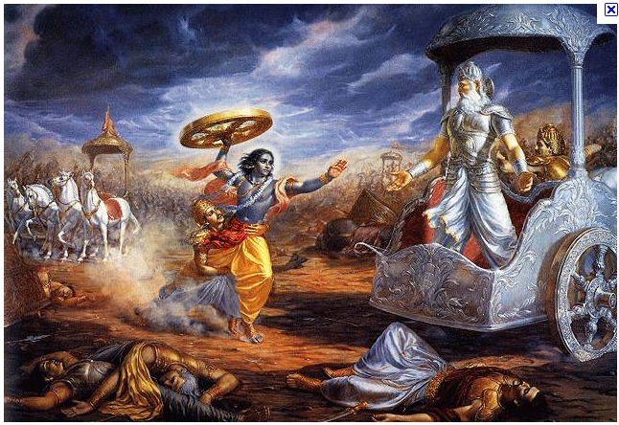
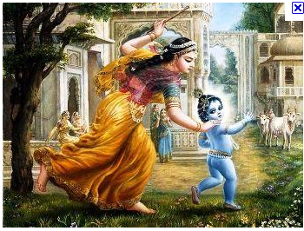
Krsna Can be conquered by his loving devotee
Bhisma: “So Bhisma conquered over Krsna. Instead of conquering over Arjuna, he conquered over Krsna.”
Yudhisthira: “Maharaja Yudhisthira, he conquered over Krsna’s decision. If we become devotee of Krsna, then ajita jito ‘py asi. This is the statement of Lord Brahma, that Krsna can be conquered.”
Yasoda Ma: “Yasoda-ma conquered over Krsna. How Krsna was afraid of His mother.”
Pure Bhakti is very rare! Then Krishna agrees to be conquered.
Raghunatha Das Goswami: - Tiger, Veil.
“So any devotee can attain that stage, controlling Krsna by love and affection. There is no question… A devotee never likes to control over… They want to serve Krsna. This is also service. When a devotee conquers over Krsna or controls over Krsna, that is also service.”

Slide 12
1.8.46
Translation: "King Yudhiṣṭhira, who was much aggrieved, could not be convinced, despite instructions by great sages headed by Vyāsa and the Lord Kṛṣṇa Himself, the performer of superhuman feats, and despite all historical evidence."

Slide 13
Purport
As Supersoul of King Yudhiṣṭhira, He did not allow the King to be convinced by the words of Vyāsa and others, including Himself, because He desired that the King hear instructions from the dying Bhīṣmadeva, who was another great devotee of the Lord.
The Lord wanted that at the last stage of his material existence the great warrior Bhīṣmadeva see Him personally and see his beloved grandchildren, King Yudhiṣṭhira, etc., now situated on the throne, and thus pass away very peacefully.
Bhīṣmadeva was not at all satisfied to fight against the Pāṇḍavas, who were his beloved fatherless grandchildren. But the kṣatriyas are also very stern people, and therefore he was obliged to take the side of Duryodhana because he was maintained at the expense of Duryodhana. Besides this, the Lord also desired that King Yudhiṣṭhira be pacified by the words of Bhīṣmadeva so that the world could see that Bhīṣmadeva excelled all in knowledge, including the Lord Himself.

Slide 14
Krishna glorifies his devotee:
Lord Ram:
“Why did Lord Ram have to send Hanuman to cross 3000 yojanas to find Sita?”.
Arjuna –
Viswarupa Darshan.
Lord Chaitanya –
“Why didn’t Lord Chaitanya preach all over the world?”
Because he wanted to give credit to his devotee – Srila Prabhupada.
Brahma:
Atri, Daksha, etc

Slide 15
1.8.47
Translation: "King Yudhiṣṭhira, son of Dharma, overwhelmed by the death of his friends, was aggrieved just like a common, materialistic man. O sages, thus deluded by affection, he began to speak."

Slide 16
Srila Prabhupada’s Purport
King Yudhiṣṭhira, though he was not expected to become aggrieved like a common man, became deluded by worldly affection by the will of the Lord (just as Arjuna was apparently deluded).
The common man thinks of violence and nonviolence in terms of the body, but that is a kind of delusion. Everyone is duty-bound according to one's occupational duties. A kṣatriya is bound to fight for the right cause, regardless of the opposite party. In such discharge of duty, one should not be disturbed by annihilation of the material body, which is only an external dress of the living soul.
All this was perfectly known to Mahārāja Yudhiṣṭhira, but by the will of the Lord he became just like a common man because there was another great idea behind this delusion: the King would be instructed by Bhīṣma as Arjuna was instructed by the Lord Himself.

Slide 17
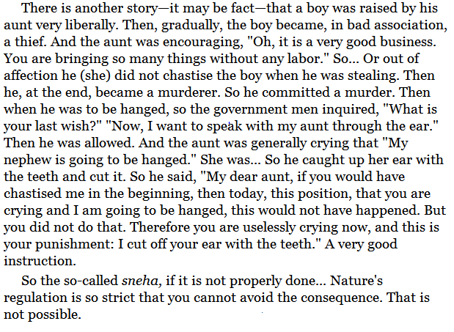
Example 1 of Misdirected Affection: of Srila Prabhupada!

Slide 18
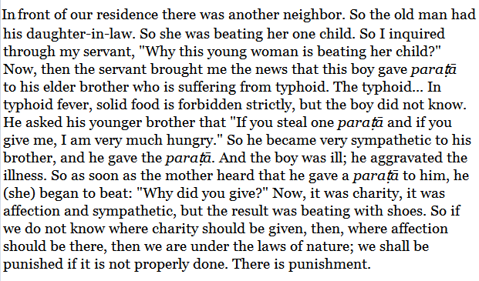
Example 2: Srila Prabhupada

Slide 19
Queen Kunti, Prahlad Maharaj:
Queen Kunti: “Kindly help me sever this affection of my family, the Pandavas and Vrsnis” [1.8.41]
Queen Kunti: “let my attraction be constantly drawn unto You without being diverted to anyone else.” [1.8.42]
Prahlāda Mahārāja: SP: “Prahlāda Mahārāja was standing, and his father was being killed. So from material point of view, Prahlāda Mahārāja could have asked Nṛsiṁhadeva, "My Lord, do not kill my father." He could have asked, and immediately his request would have been granted. But he did not do that. He was standing and seeing. But he knows that "This killing of the body of my father is not killing. I shall save him. I shall save him." That he did. When he was offered benediction, he did not take anything. He said, "My Lord, what shall I do, all this material benediction? I have seen in the case of my father. He was so strong that even the demigods were frightened for his presence. His position was so strong, and You finished it within a minute. So what is the benefit of taking? No, no. Please do not request me." But although he did not ask anything for his personal self, but he asked the Lord, prayed, that "One thing I request." "What is that?" "My father was a great demon, and he was against You. He has committed so many sinful life. So I know he'll have to suffer for these things. I request You to excuse him." This is Vaiṣṇava son. "Oh, yes, immediately." Immediately.

Slide 20
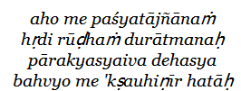
1.8.48
Translation: "King Yudhiṣṭhira said: O my Lord, I am the most sinful man. Just see my heart, which is full of ignorance. This body, which is ultimately meant for others, has killed many, many phalanxes of men."

Slide 21
This body is Krishna’s property

Slide 22
1.8.49
Translation: "I have killed many boys, brāhmaṇas, well-wishers, friends, parents, preceptors and brothers. Though I live millions of years, I will not be relieved from the hell that awaits me for all these sins."
1.8.50
Translation: "There is no sin for a king who kills for the right cause, who is engaged in maintaining his citizens. But this injunction is not applicable to me."

Slide 23
Vibhishan – Brother
Prahlad Maharaj – Father
Bali Maharaj – Guru
Gopis – Family, Husband, etc.

Slide 24
1.8.51:

Slide 25
Purport
The way of work (karma) is like that. It creates one action and another reaction simultaneously and thus increases the chain of material activities, binding the performer in material bondage.
In the Bhagavad-gītā. the remedy is suggested that such actions and reactions of the path of work can be checked only when work is done on behalf of the Supreme Lord.
The Battle of Kurukṣetra was actually fought by the will of the Supreme Lord Śrī Kṛṣṇa, as it is evident from His version, and only by His will was Yudhiṣṭhira placed on the throne of Hastināpura. Therefore, factually no sin whatsoever touched the Pāṇḍavas, who were only the order carriers of the Lord. For others, who declare war out of personal interest, the whole responsibility lies on them.

Slide 26
1.8.52:

Slide 27
Purport
Aśvamedha yajñas or gomedha yajñas, sacrifices in which a horse or a bull is sacrificed, were not, of course, for the purpose of killing the animals. Lord Caitanya said that such animals sacrificed on the altar of yajña were rejuvenated and a new life was given to them.It was just to prove the efficacy of the hymns of the Vedas. By recitation of the hymns of the Vedas in the proper way, certainly the performer gets relief from the reactions of sins, but in case of such sacrifices improperly done under inexpert management, surely one has to become responsible for animal sacrifice.
In this age of quarrel and hypocrisy there is no possibility of performing the yajñas perfectly for want of expert brāhmaṇas who are able to conduct such yajñas.
Mahārāja Yudhiṣṭhira therefore gives a hint to performing sacrifices in the age of Kali. In the Kali-yuga the only sacrifice recommended is the performance of hari-nāma-yajña inaugurated by Lord Śrī Caitanya Mahāprabhu. But one should not indulge in animal killing and counteract it by performing the hari-nāma yajña. The whole purpose, therefore, is served when everything is done for the will of the Lord. This is possible only for the devotees.

Slide 28
References
HH Romapada Maharaj’s lectures on 8th chapter
http://prabhupadavani.org
audio.Iskcondesiretree.info:
Lectures on Maharaj Yudhistir’s lamentation.
Unveiling His Lotus feet – HG Bhurijana prabhu

