Slide 1
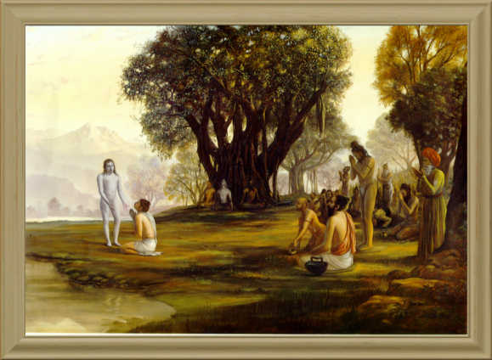
Srimad Bhagavatam
1.8.37 – 1.8.43
Kuntīdevī Concludes by Expresessing Her Fear – and Her Actual Desire.

Slide 2
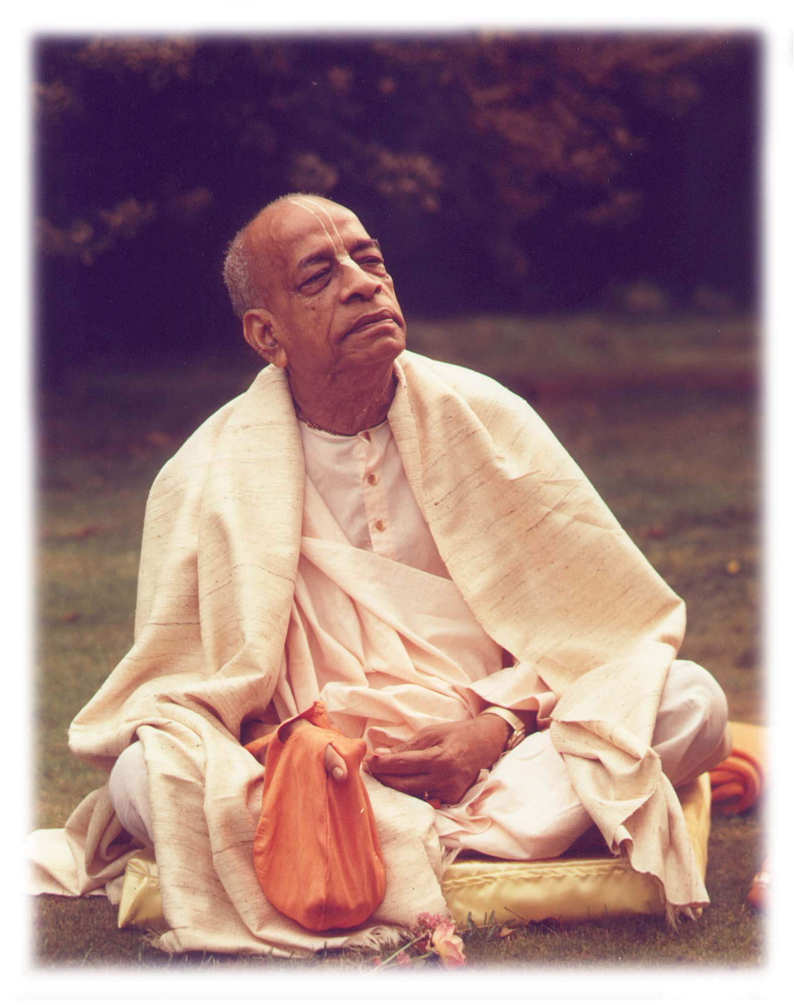
Based on the teachings of His Divine Grace A.C. Bhaktivedanta Swami Prabhupada
Founder Acharya
International Society for Krishna Consciousness

Slide 3
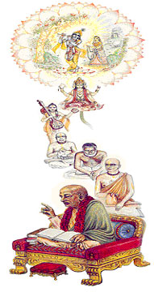
Seeking the Blessings of Guru, Gauranga & All the Assembled Vaishnavas

Slide 4
Kuntīdevī Concludes by Expresessing Her Fear – and Her Actual Desire
1.8.37- 40 – Fear
1.8.41- 42 – Desire
1.8.43 – Conclusion

Slide 5
Śrīmad Bhāgavatam 1.8.37
apy adya nas tvaḿ sva-kṛtehita prabho
jihāsasi svit suhṛdo 'nujīvinaḥ
yeṣāḿ na cānyad bhavataḥ padāmbujāt
parāyaṇaḿ rājasu yojitāḿhasām
TRANSLATION
O my Lord, You have executed all duties Yourself. Are you leaving us today, though we are completely dependent on Your mercy and have no one else to protect us, now when all kings are at enmity with us?

Slide 6
SB 1.8.37 Full Surrender Important Points from Purport
Spiritual fortune Vs Material misfortune.
Perfect civilization is to work with valor but at the same time depend completely on the Lord. The Pāṇḍavas were the ideal executors of this standard of civilization. Undoubtedly they were completely dependent on the good will of Lord Śrī Kṛṣṇa, but they were not idle parasites of the Lord. They were all highly qualified both by personal character and by physical activities. Still they always looked for the mercy of the Lord.
Anātha Vs Sanātha.
BG 7.19 – Sign of a mahātmā.
For Pāṇḍavas, separation from the Lord was just like the separation of a fish from water. Śrīmatī Kuntīdevī, therefore, felt such separation like a thunderbolt, and the whole prayer of the Queen is to try to persuade the Lord to stay with them. After the Battle of Kurukṣetra, although the inimical kings were killed, their sons and grandsons were still there to deal with the Pāṇḍavas. It is not only the Pāṇḍavas who were put into the condition of enmity, but all of us are always in such a condition, and the best way of living is to become completely dependent on the will of the Lord and thereby overcome all difficulties of material existence.

Slide 7
SB 1.8.37 Full Surrender Six Symptoms of Surrender
HBV - 11.417
ānukūlyasya sańkalpaḥ prātikūlyasya varjanam
rakṣiṣyatīti viśvāso goptṛtve varaṇaḿ tathā
ātma-nikṣepa-kārpaṇye ṣaḍ-vidhā śaraṇāgatiḥ
(1) accepting things favorable for devotional service,
(2) rejecting things unfavorable for devotional service,
(3) believing firmly in the Lord's protection,
(4) feeling exclusively dependent on the mercy of the Lord for one's maintenance,
(5) having no interest separate from that of the Lord, and
(6) always feeling meek and humble before the Lord

Slide 8
Śrīmad Bhāgavatam 1.8.38
ke vayaḿ nāma-rūpābhyāḿ
yadubhiḥ saha pāṇḍavāḥ
bhavato 'darśanaḿ yarhi
hṛṣīkāṇām iveśituḥ
TRANSLATION
As the name and fame of a particular body is finished with the disappearance of the living spirit, similarly if You do not look upon us, all our fame and activities, along with the Pāṇḍavas and Yadus, will end at once.

Slide 9
SB 1.8.38 Our Actual Value Important Points from Purport
Kuntīdevī is quite aware that the existence of the Pāṇḍavas is due to Śrī Kṛṣṇa only.
The Pāṇḍavas are undoubtedly well established in name and fame and are guided by the great King Yudhiṣṭhira, who is morality personified, and the Yadus are undoubtedly great allies, but without the guidance of Lord Kṛṣṇa all of them are nonentities, as much as the senses of the body are useless without the guidance of consciousness.
No one should be proud of his prestige, power and fame without being guided by the favor of the Supreme Lord.
The living beings are always dependent, and the ultimate dependable object is the Lord Himself.
We may, therefore, invent by our advancement of material knowledge all sorts of counteracting material resources, but without being guided by the Lord all such inventions end in fiasco, however strong and stout the reactionary elements may be.

Slide 10
Śrīmad Bhāgavatam 1.8.39
neyaḿ śobhiṣyate tatra
yathedānīḿ gadādhara
tvat-padair ańkitā bhāti
sva-lakṣaṇa-vilakṣitaiḥ
TRANSLATION
O Gadādhara [Kṛṣṇa], our kingdom is now being marked by the impressions of Your feet, and therefore it appears beautiful. But when You leave, it will no longer be so.

Slide 11
SB 1.8.39 Beauty in Kṛṣṇa’s Presence Important Points from Purport
There are certain particular marks on the feet of the Lord which distinguish the Lord from others.
The marks of a flag, thunderbolt, and instrument to drive an elephant, umbrella, lotus, disc, etc., are on the bottom of the Lord's feet.
These marks are impressed upon the soft dust of the land where the Lord traverses.
The land of Hastināpura was thus marked while Lord Śrī Kṛṣṇa was there with the Pāṇḍavas, and the kingdom of the Pāṇḍavas thus flourished by such auspicious signs.
Kuntīdevī pointed out these distinguished features and was afraid of ill luck in the absence of the Lord.

Slide 12
Śrīmad Bhāgavatam 1.8.40
ime jana-padāḥ svṛddhāḥ
supakvauṣadhi-vīrudhaḥ
vanādri-nady-udanvanto
hy edhante tava vīkṣitaiḥ
TRANSLATION
All these cities and villages are flourishing in all respects because the herbs and grains are in abundance, the trees are full of fruits, the rivers are flowing, the hills are full of minerals and the oceans full of wealth. And this is all due to Your glancing over them.

Slide 13
SB 1.8.40 Natural Prosperity Important Points from Purport
Human prosperity flourishes by natural gifts and not by gigantic industrial enterprises.
The natural gifts such as grains and vegetables, fruits, rivers, the hills of jewels and minerals, and the seas full of pearls are supplied by the order of the Supreme, and as He desires, material nature produces them in abundance or restricts them at times.
The natural law is that the human being may take advantage of these godly gifts by nature and satisfactorily flourish on them without being captivated by the exploitative motive of lording it over material nature.
The flow of river waters fertilizes the fields, and there is more than what we need. Minerals are produced in the hills, and the jewels in the ocean. If the human civilization has sufficient grains, minerals, jewels, water, milk, etc., then why should it hanker after terrible industrial enterprises at the cost of the labor of some unfortunate men?
But all these natural gifts are dependent on the mercy of the Lord. What we need, therefore, is to be obedient to the laws of the Lord and achieve the perfection of human life by devotional service. The indications by Kuntīdevī are just to the point. She desires that God's mercy be bestowed upon them so that natural prosperity be maintained by His grace.

Slide 14
Śrīmad Bhāgavatam 1.8.41
atha viśveśa viśvātman
viśva-mūrte svakeṣu me
sneha-pāśam imaḿ chindhi
dṛḍhaḿ pāṇḍuṣu vṛṣṇiṣụ
TRANSLATION
O Lord of the universe, soul of the universe, O personality of the form of the universe, please, therefore, sever my tie of affection for my kinsmen, the Pāṇḍavas and the Vṛṣṇis.

Slide 15
SB 1.8.41 Cutting of Ties of Affection Important Points from Purport
A pure devotee of the Lord is ashamed to ask anything in self-interest from the Lord. But the householders are sometimes obliged to ask favors from the Lord, being bound by the tie of family affection.
Both the families required the Lord's help because both were dependent devotees of the Lord. Śrīmatī Kuntīdevī wished Śrī Kṛṣṇa to remain with her sons the Pāṇḍavas, but by His doing so her paternal house would be bereft of the benefit. All these partialities troubled the mind of Kuntī, and therefore she desired to cut off the affectionate tie.
A pure devotee cuts off the limited ties of affection for his family and widens his activities of devotional service for all forgotten souls.
Eg. Six Gosvāmīs, who followed the path of Lord Caitanya.
To cut off all family affection means to broaden the field of activities. Without doing this, no one can be qualified as a brāhmaṇa, a king, a public leader or a devotee of the Lord.
Such personalities as a brāhmaṇa, a devotee, a king or a public leader must be very broadminded in discharging their respective duties.
The Lord is addressed as the Lord of the universe, or the Lord of the universal mind, indicating His all-powerful ability to cut the hard knot of family affection.

Slide 16
Śrīmad Bhāgavatam 1.8.42
tvayi me 'nanya-viṣayā
matir madhu-pate 'sakṛt
ratim udvahatād addhā
gańgevaugham udanvatị
TRANSLATION
O Lord of Madhu, as the Ganges forever flows to the sea without hindrance, let my attraction be constantly drawn unto You without being diverted to anyone else.

Slide 17
SB 1.8.42 Unalloyed Devotion Important Points from Purport
A living being, whoever he may be, must have this feeling of affection for others because this is a symptom of life. The symptoms of life, such as desire, anger, hankerings, feelings of attraction, etc., cannot be annihilated.
In devotional service the desire is changed only for the service of the Lord in place of desire for sense gratification. Eg. Arjuna changing after hearing BG.
It is declared in all the scriptures that Arjuna attained spiritual perfection by devotional service to the Lord in friendship. The fighting was there, the friendship was there, Arjuna was there, and Kṛṣṇa was there, but Arjuna became a different person by devotional service.
The prayers of Kuntī also indicate the same categorical changes in activities. Śrīmatī Kuntī wanted to serve the Lord without diversion, and that was her prayer. This unalloyed devotion is the ultimate goal of life.
Our attention is usually diverted to the service of something which is nongodly or not in the program of the Lord. When the program is changed into the service of the Lord, that is to say when the senses are purified in relation with the service of the Lord, it is called pure unalloyed devotional service. Śrīmatī Kuntīdevī wanted that perfection and prayed for it from the Lord.

Slide 18
SB 1.8.42 Unalloyed Devotion Important Points from Purport Continued…
Her affection for the Pāṇḍavas and the Vṛṣṇis is not out of the range of devotional service because the service of the Lord and the service of the devotees are identical. Sometimes service to the devotee is more valuable than service to the Lord. But here the affection of Kuntīdevī for the Pāṇḍavas and the Vṛṣṇis was due to family relation. This tie of affection in terms of material relation is the relation of māyā because the relations of the body or the mind are due to the influence of the external energy.
Relations of the soul, established in relation with the Supreme Soul, are factual relations. When Kuntīdevī wanted to cut off the family relation, she meant to cut off the relation of the skin. The skin relation is the cause of material bondage, but the relation of the soul is the cause of freedom. This relation of the soul to the soul can be established by the via medium of the relation with the Supersoul.
Seeing in the darkness is not seeing. But seeing by the light of the sun means to see the sun and everything else which was unseen in the darkness. That is the way of devotional service.
“In this world things rarely go they we want them to go. In fact if everything goes they we want, then we must be doing something wrong. That’s the way the devotee things. The Materialist thinks we must be doing right. Because, if everything goes they we want, then there is no need of having God in our life.”

Slide 19
Śrīmad Bhāgavatam 1.8.43
śrī-kṛṣṇa kṛṣṇa-sakha vṛṣṇy-ṛṣabhāvani-dhrug-
rājanya-vaḿśa-dahanānapavarga-vīrya
govinda go-dvija-surārti-harāvatāra
yogeśvarākhila-guro bhagavan namas tẹ
TRANSLATION
O Kṛṣṇa, O friend of Arjuna, O chief amongst the descendants of Vṛṣṇi, You are the destroyer of those political parties which are disturbing elements on this earth. Your prowess never deteriorates. You are the proprietor of the transcendental abode, and You descend to relieve the distresses of the cows, the brāhmaṇas and the devotees. You possess all mystic powers, and You are the preceptor of the entire universe. You are the almighty God, and I offer You my respectful obeisances.

Slide 20
SB 1.8.43 Enchantment by Kṛṣṇa’s Glories Important Points from Purport
A summary of the Supreme Lord Śrī Kṛṣṇa is made herein by Śrīmatī Kuntīdevī.
The almighty Lord has His eternal transcendental abode where He is engaged in keeping surabhi cows.
He is served by hundreds and thousands of goddesses of fortune.
He descends on the material world to reclaim His devotees and to annihilate the disturbing elements in groups of political parties and kings who are supposed to be in charge of administration work.
He creates, maintains and annihilates by His unlimited energies, and still He is always full with prowess and does not deteriorate in potency.
The cows, the brāhmaṇas and the devotees of the Lord are all objects of His special attention because they are very important factors for the general welfare of living beings.

Slide 21
SB 1.8.37-43 Quotes
“When you make commitment to carry on some service, you may not know what’s down the road. What are the good fortunes and obstacles you have encounter. A surrendered soul doesn’t consider those things. Whatever is down the road, it is part of the service, you just accept it. It is service to accept the good fortunes and the obstacles.” – SB 1.8.40 by HH Romapada Swami.
“By faith in the instruction of the Spiritual Master, all facilities will come. We need purity in the heart.” – SB 1.8.40 by HH Romapada Swami.
“Kunti is not a family breaker. Srimad Bhagavatam is not. Srila Prabhupada was not. People think like that. A Sadhu breaks family. A Sadhu brings spirtual attachment.” – SB 1.8.41 by HH Romapada Swami
“In this world things rarely go they we want them to go. In fact if everything goes they we want, then we must be doing something wrong. That’s the way the devotee things. The Materialist thinks we must be doing right. Because, if everything goes they we want, then there is no need of having God in our life. Otherwise everything will be superficial.” – SB 1.8.42 by HH Radhanath Swami

Slide 22
References
Teachings of Queen Kunti.
SB 177-188 http://www.prabhupadavani.org/main/Bhagavatam/177.html
Rompadaswami.com //http://www.romapadaswami.com/node/3882
ISKCON Desire Tree http://audio.iskcondesiretree.info/index.php?q=f&f=%2F02_-_ISKCON_Swamis%2FISKCON_Swamis_-_R_to_Y%2FHis_Holiness_Radhanath_Swami%2FLectures%2F00_-_Year_wise%2FDevotional_Nectar_-_1992

