Slide 1
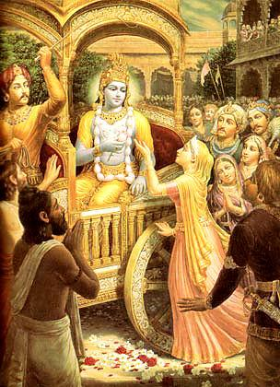
Srimad Bhagavatam 1.8.28 - 1.8.36
Prayers by Queen Kunti
Translations and purports
by
His Divine Grace A.C. Bhaktivedanta Swami Prabhupada
Founder-Acarya of the International Society for Krsna consciousness

Slide 2
S.B. 1.2.4
nārāyaṇaḿ namaskṛtya
naraḿ caiva narottamam
devīḿ sarasvatīḿ vyāsaḿ
tato jayam udīrayet
Before reciting this Śrīmad-Bhāgavatam, which is the very means of conquest, one should offer respectful obeisances unto the Personality of Godhead, Nārāyaṇa, unto Nara-nārāyaṇa Ṛṣi, the supermost human being, unto mother Sarasvatī, the goddess of learning, and unto Śrīla Vyāsadeva, the author.

Slide 3
S.B. 1.2.18
naṣṭa-prāyeṣv abhadreṣu
nityaḿ bhāgavata-sevayā
bhagavaty uttama-śloke
bhaktir bhavati naiṣṭhikī
By regular attendance in classes on the Bhāgavatam and by rendering of service to the pure devotee, all that is troublesome to the heart is almost completely destroyed, and loving service unto the Personality of Godhead, who is praised with transcendental songs, is established as an irrevocable fact.

Slide 4
S.B. 1.8.28-1.8.36: Outline
1.8.28-29: Krsna’s equality
1.8.30-31: Krsna’s bewildering activities
1.8.32-36: Reasons for Krsna’s appearance

Slide 5
S.B. 1.8.28
manye tvāḿ kālam īśānam
anādi-nidhanaḿ vibhum
samaḿ carantaḿ sarvatra
bhūtānāḿ yan mithaḥ kaliḥ
My Lord, I consider Your Lordship to be eternal time, the supreme controller, without beginning and end, the all-pervasive one. In distributing Your mercy, You are equal to everyone. The dissensions between living beings are due to social intercourse.

Slide 6
Highlights
Kala and Paramatma
Proper use vs misuse of freedom
Predestined vs creating our destiny

Slide 7
S.B. 1.8.29
na veda kaścid bhagavaḿś cikīrṣitaḿ
tavehamānasya nṛṇāḿ viḍambanam
na yasya kaścid dayito 'sti karhicid
dveṣyaś ca yasmin viṣamā matir nṛṇām
O Lord, no one can understand Your transcendental pastimes, which appear to be human and are so misleading. You have no specific object of favor, nor do You have any object of envy. People only imagine that You are partial.

Slide 8
Highlights
Krsna’s equality vs partiality
Partiality is relative to the recipient
E.g. Sun’s rays on stone vs blind man

Slide 9
S.B. 1.8.30
janma karma ca viśvātmann
ajasyākartur ātmanaḥ
tiryań-nṝṣiṣu yādaḥsu
tad atyanta-viḍambanam
Of course it is bewildering, O soul of the universe, that You work, though You are inactive, and that You take birth, though You are the vital force and the unborn. You Yourself descend amongst animals, men, sages and aquatics. Verily, this is bewildering.

Slide 10
Highlights
How can Krsna be present everywhere and still be localized ?
How to reconcile apparent contradictions ?

Slide 11
S.B. 1.8.31
gopy ādade tvayi kṛtāgasi dāma tāvad
yā te daśāśru-kalilāñjana-sambhramākṣam
vaktraḿ ninīya bhaya-bhāvanayā sthitasya
sā māḿ vimohayati bhīr api yad bibheti
My dear Kṛṣṇa, Yaśodā took up a rope to bind You when You committed an offense, and Your perturbed eyes overflooded with tears, which washed the mascara from Your eyes. And You were afraid, though fear personified is afraid of You. This sight is bewildering to me.

Slide 12
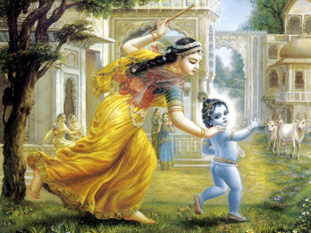
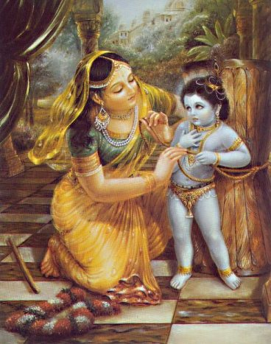
Highlights
Krsna’s stealing
Krsna being chastised
Krsna’s fear is real, not feigned
Challenge to mayavadis
Vaikuntha vs Goloka
Bhakta-vatsala

Slide 13
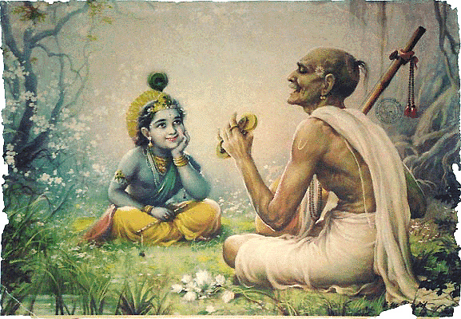
“Throwing off my hand, O Krishna, You’ve run away. What’s so wonderful about that? I’ll only consider You as strong as a man if You can escape from my heart!” - Srila Bilvamangala Thakura

Slide 14
S.B. 1.8.32
kecid āhur ajaḿ jātaḿ
puṇya-ślokasya kīrtaye
yadoḥ priyasyānvavāye
malayasyeva candanam
Some say that the Unborn is born for the glorification of pious kings, and others say that He is born to please King Yadu, one of Your dearest devotees. You appear in his family as sandalwood appears in the Malaya hills.

Slide 15
Highlights
Krsna’s only purpose: to glorify His devotees
Being connected with Krsna
Becoming dear to Krsna
Krsna’s independence

Slide 16
S.B. 1.8.33
apare vasudevasya
devakyāḿ yācito 'bhyagāt
ajas tvam asya kṣemāya
vadhāya ca sura-dviṣām
Others say that since both Vasudeva and Devakī prayed for You, You have taken Your birth as their son. Undoubtedly You are unborn, yet You take Your birth for their welfare and to kill those who are envious of the demigods.

Slide 17
Highlights
Sutapa and Prsni
Sacrificing for pleasure of the Lord

Slide 18
S.B. 1.8.34
bhārāvatāraṇāyānye
bhuvo nāva ivodadhau
sīdantyā bhūri-bhāreṇa
jāto hy ātma-bhuvārthitaḥ
Others say that the world, being overburdened like a boat at sea, is much aggrieved, and that Brahmā, who is Your son, prayed for You, and so You have appeared to diminish the trouble.

Slide 19
Highlights
Brahma as atma-bhu
Escalation of problems

Slide 20
S.B. 1.8.35
bhave 'smin kliśyamānānām
avidyā-kāma-karmabhiḥ
śravaṇa-smaraṇārhāṇi
kariṣyann iti kecana
And yet others say that You appeared to rejuvenate the devotional service of hearing, remembering, worshiping and so on in order that the conditioned souls suffering from material pangs might take advantage and gain liberation.

Slide 21
Highlights
Devotional service is constitutional position
Avidya-kama-karmabhih
Sri Caitanya Mahaprabhu

Slide 22
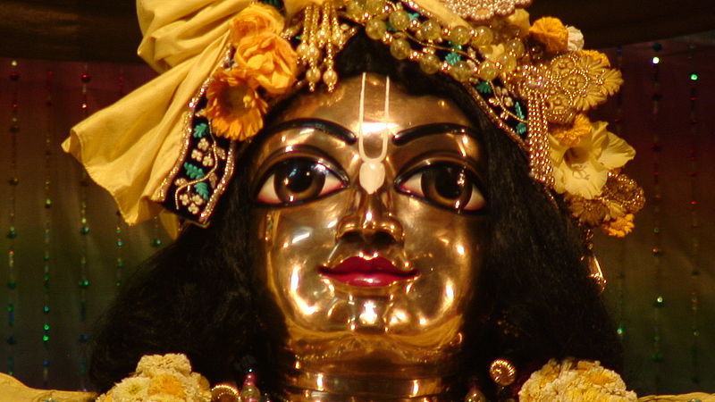
vairāgya-vidyā-nija-bhakti-yoga-śikṣārtham ekaḥ puruṣaḥ purāṇaḥ śrī-kṛṣṇa-caitanya-śarīra-dhārī kṛpāmbudhir yas tam ahaḿ prapadye

Slide 23
"Let me take shelter of the Supreme Personality of Godhead, Śrī Kṛṣṇa, who has descended in the form of Lord Caitanya Mahāprabhu to teach us real knowledge, His devotional service and detachment from whatever does not foster Kṛṣṇa consciousness. He has descended because He is an ocean of transcendental mercy. Let me surrender unto His lotus feet. (CC Madhya 6.254)

Slide 24
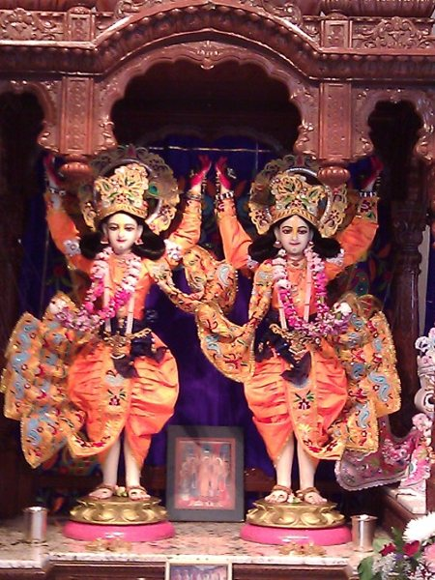
anarpita-carim cirat karunayavatirnah kalau samarpayitum unnatojjvala-rasam sva-bhakti-sriyam harih purata-sundara-dyuti-kadamba-sandipitah sada hridaya-kandare sphuratu vah saci-nandanah

Slide 25
"May the Supreme Lord who is known as the son of Srimati Saci-devi be transcendentally situated in the innermost core of your heart. Resplendent with the radiance of molten gold, He has descended in the Age of Kali by His causeless mercy to bestow what no incarnation has ever offered before: the most elevated mellow of devotional service, the mellow of conjugal love.“ (CC Adi 3.4)

Slide 26
S.B. 1.8.36
śṛṇvanti gāyanti gṛṇanty abhīkṣṇaśaḥ
smaranti nandanti tavehitaḿ janāḥ
ta eva paśyanty acireṇa tāvakaḿ
bhava-pravāhoparamaḿ padāmbujam
O Kṛṣṇa, those who continuously hear, chant and repeat Your transcendental activities, or take pleasure in others' doing so, certainly see Your lotus feet, which alone can stop the repetition of birth and death.

Slide 27
Highlights
Hearing must be from bona fide sources
Absolute nature of Krsna’s pastimes
Glories of Srimad Bhagavatam

Slide 28
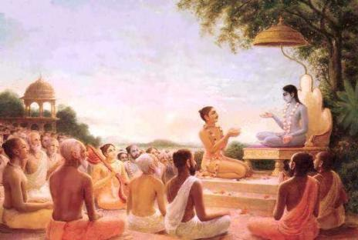
O nectar from the ocean of all scriptures, singular fruit of all the Vedas, rich mine of the precious gems of all conclusive truths, You are the only giver of sight to all the worlds.
O life air of all the Supreme Lord’s devotees, O master, Srimad Bhagavatam! You are the sun risen in the darkness of Kali. You are the exact image of Sri Krsna.
I bow down to You, who are supremely blissful to read. Your every syllable pours down a flood of prema. You can always be served by everyone. You are Sri Krsna Himself.

Slide 29
My only friend, my constant companion, my spiritual master, my great wealth! My savior, my good fortune, my source of ecstasy, I bow down to You.
O bestower of saintliness to the unsaintly, O exalter of the most fallen, please never leave me. Always appear in my heart and my voice with pure love.
(Sri Krsna-lila-stava 412-416)

Slide 30
Summary
Krsna is equal to all although He appears to be partial to His devotees
Krsna’s qualities and activities are inconceivable and thus bewilder the mind of the nondevotees due to apparent contradictions
Pure devotional service in the footsteps of the residents of Vrindavana is the highest perfection
Importance of chanting and hearing as taught by Lord Sri Caitanya Mahaprabhu

Slide 31
References
www.prabhupadavani.org
Srila Prabhupada’s lecture transcriptions
www.rompadaswami.com
Srila Romapada Maharaja’s lectures
www.iskcondesiretree.com
Her Grace Narayani Mathaji’s lectures
Unveiling His Lotus Feet
Sri Bhurijana Prabhu’s Detailed Overview

