Slide 1
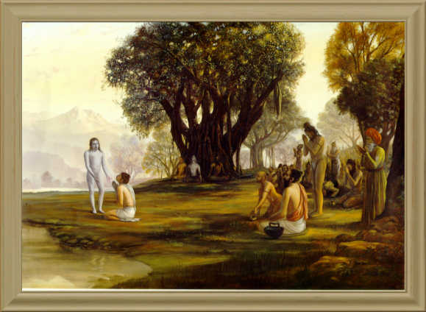
Srimad Bhagavatam
1.8.17 – 1.8.22

Slide 2
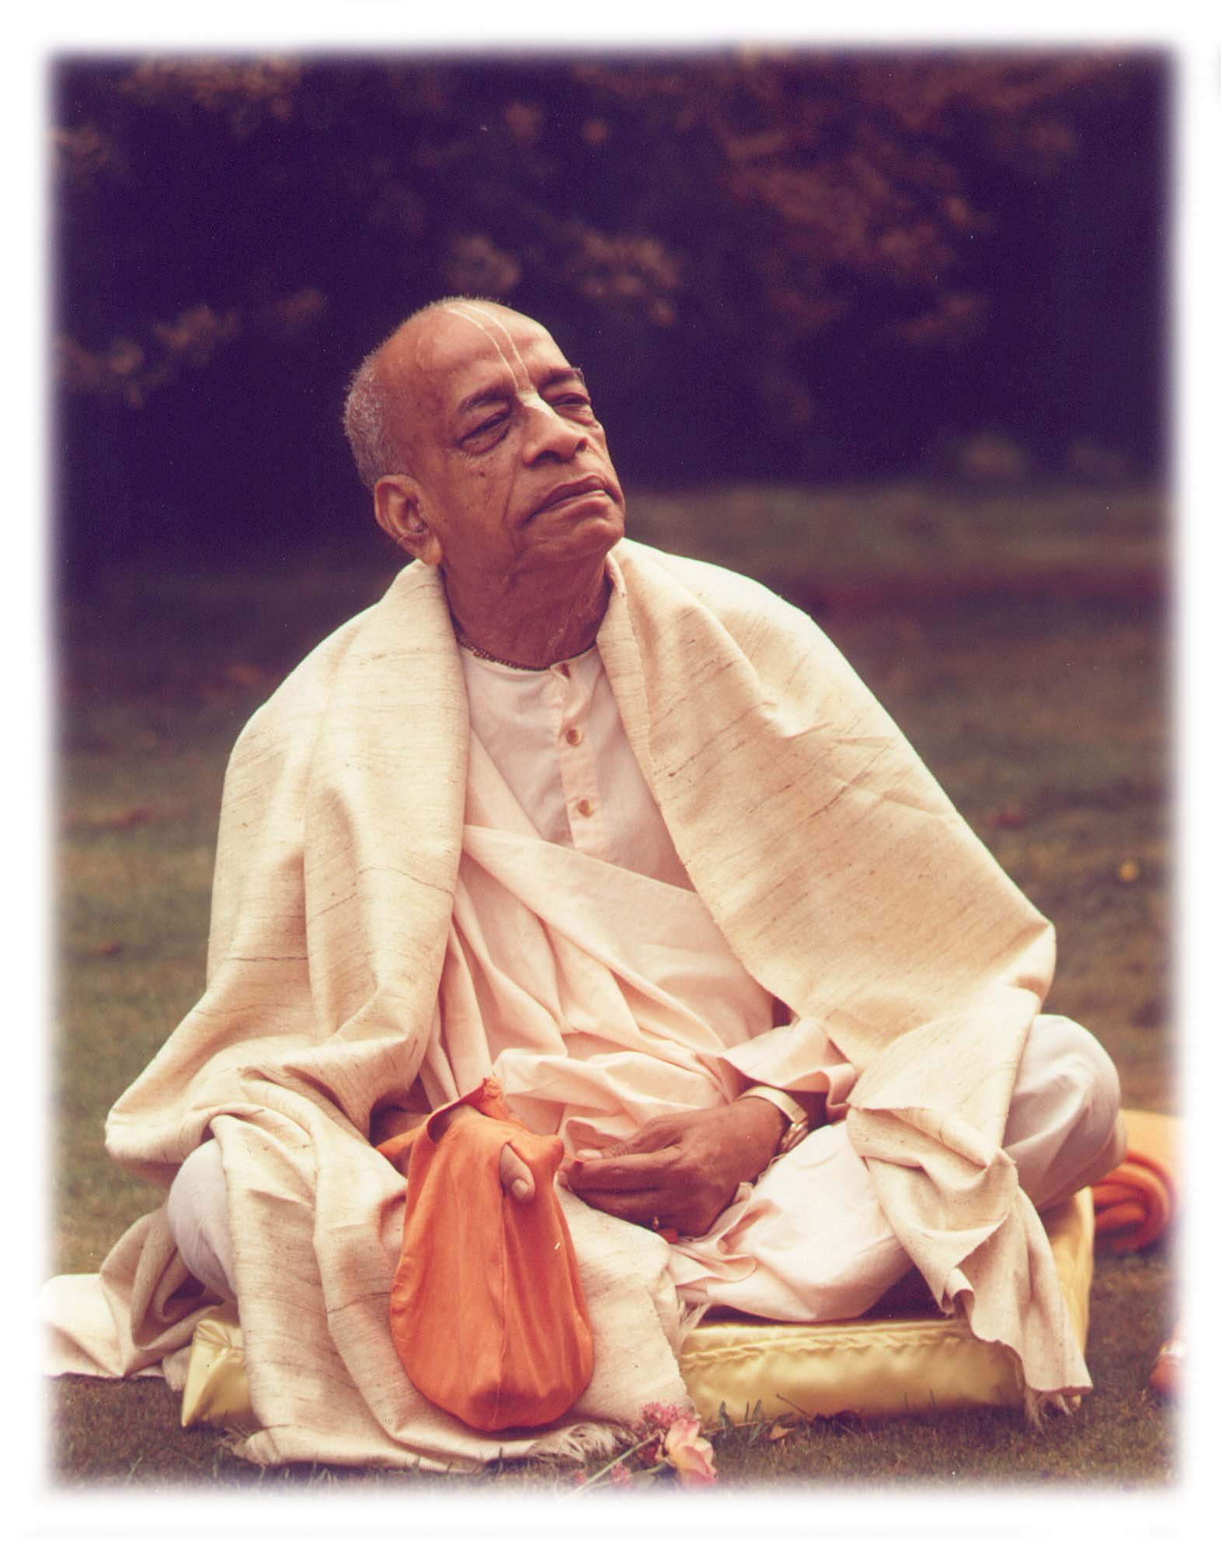
Based on the teachings of His Divine Grace A.C. Bhaktivedanta Swami Prabhupada
~ Founder Acharya ~
International Society For Krishna Consciousness

Slide 3
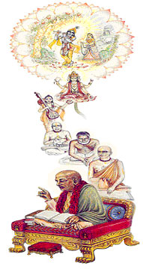
Seeking the Blessings of Guru, Gauranga & All the Assembled Vaishnavas

Slide 4
Śrīmad Bhāgavatam 1.2.4
nārāyaṇaḿ namaskṛtya
naraḿ caiva narottamam
devīḿ sarasvatīḿ vyāsaḿ
tato jayam udīrayet
TRANSLATION
Before reciting this Śrīmad-Bhāgavatam, which is the very means of conquest, one should offer respectful obeisances unto the Personality of Godhead, Nārāyaṇa, unto Nara-nārāyaṇa Ṛṣi, the supermost human being, unto mother Sarasvatī, the goddess of learning, and unto Śrīla Vyāsadeva, the author.

Slide 5
Śrīmad Bhāgavatam 1.2.18
naṣṭa-prāyeṣv abhadreṣu
nityaḿ bhāgavata-sevayā
bhagavaty uttama-śloke
bhaktir bhavati naiṣṭhikī
TRANSLATION
By regular attendance in classes on the Bhāgavatam and by rendering of service to the pure devotee, all that is troublesome to the heart is almost completely destroyed, and loving service unto the Personality of Godhead, who is praised with transcendental songs, is established as an irrevocable fact.

Slide 6
Section Themes
1.8.18 – 1.8.20
Kunthi expressing in a very concise and simple heartedly the Deep & profound understanding about Krsna’s Position
She’s indicating her amazement / bewilderment of all pervasiveness of Krsna & Localized feature of Krsn
1.8.21
Queen Kuntī specifically adores the incarnation or descent of Lord Kṛṣṇa
1.8.22
Queen Kunti glorifying the spiritual body of the lord Krsna

Slide 7
Śrīmad Bhāgavatam 1.8.17
brahma-tejo-vinirmuktair
ātmajaiḥ saha kṛṣṇayā
prayāṇābhimukhaḿ kṛṣṇam
idam āha pṛthā satī
TRANSLATION
Thus saved from the radiation of the brahmāstra, Kuntī, the chaste devotee of the Lord, and her five sons and Draupadī addressed Lord Kṛṣṇa as He started for home.

Slide 8
Śrīmad Bhāgavatam 1.8.18
kunty uvāca
namasye puruṣaḿ tvādyam
īśvaraḿ prakṛteḥ param
alakṣyaḿ sarva-bhūtānām
antar bahir avasthitam
TRANSLATION
Śrīmatī Kuntī said: O Kṛṣṇa, I offer my obeisances unto You because You are the original personality and are unaffected by the qualities of the material world. You are existing both within and without everything, yet You are invisible to all.

Slide 9
puruṣaḿ ādyam – The Orignal Supreme person
Govindam ‘Adi Purusam’ tam aham Bhajami
Kunti is saying here is Krns is Absolure Truth the Origin/Source of everything. And he has no other source.
Krsna - nityo nityānāḿ cetanaś cetanānām
Living entities - Though transcendental, they are neither original nor infallible
Example: Mother / father of the living entity in the Material world.
He is the Mother & Father of every one, but yet he doesn’t have Mother / Father.
The other feeling that Kunthi is that ‘He is respecting her like his mother’. Hard to process it.
Krsna get of the Chariot and touch Kunthi and seeks her blessing to have a safe journey back to Dwaraka.
īśvaraḿ prakṛteḥ param – Controller beyond the material cosmos
Mayadhyaksena prakrtih suyate sa-caracaram [BG-9.10]
This material nature, which is one of My energies, is working under My direction, O son of Kuntī, producing all moving and nonmoving beings. Under its rule this manifestation is created and annihilated again and again.

Slide 10
alakṣyaḿ sarva-bhūtānām – Invisible to all living beings
Sarvasya caham hrdi sannivistah… [BG-15.15]
Isvarah sarva-bhutanam hrd-dese… [BG-18.61]
The Supreme Lord is situated in everyone's heart, O Arjuna, and is directing the wanderings of all living entities, who are seated as on a machine, made of the material energy.
Prahlad Maharaj & Hiranyakasipu
Example : Two birds on a tree, Dog and a master, Children playing on the beach.
Example – Can you show me God? Reporter – Did you see God?
Example Aurobindo Ashram….
mahajano yena gatah... As Kunti's advising
antar bahir avasthitam - Existing both within and without
Queen Kuntī affirms that the Lord, although both within and without all living beings, is still invisible.
Kuntī was puzzled about whether Śrī Kṛṣṇa is all-pervasive or localized
Krns reserves the right of not being exposed

Slide 11
Atah sri-krsna-namadi na bhaved grahyam indriyaih [BRS. 1.2.234]. The indriya, these senses, cannot perceive, cannot see, cannot touch, cannot hear namadi. Unless we are purified, we cannot hear Krsna’s name or see Krsna.
How can we see Krsna?
Mayy asakta-manah partha yogam yunjan mad-asrayah…
Premanjana-cchurita-bhakti-vilocanena…
Practical experinces of Mahajas….We have to follow them
Their recommendation…. sva-kathah krsnah punya-sravana-kirtanah [SB 1.2.17].
Example – Prabhupada’s Only qualification is hearing

Slide 12
Śrīmad Bhāgavatam 1.8.19
māyā-javanikācchannam
ajñādhokṣajam avyayam
na lakṣyase mūḍha-dṛśā
naṭo nāṭyadharo yathā
TRANSLATION
Being beyond the range of limited sense perception, You are the eternally irreproachable factor covered by the curtain of deluding energy. You are invisible to the foolish observer, exactly as an actor dressed as a player is not recognized.
.

Slide 13
Difficulties in understanding Krsna:
māyā-javanikācchannam - Covered by the curtain of deluding energy
Scientist unable to understand Material nature itself
Ajna – No sufficient knowledge, because they are in Rojo and Thamo Guna
alakṣyaḿ sarva-bhūtānām - Invisible to Living Entities
adhokṣajam – Beyond the range of material conception / sense perception
Very important Philosophical Concept & Devotional Concept.
Philosophical concept: We have to use the senses to sever the one who is beyond the senses, that is a mystry.
2nd Chapter – 1st Question: Essence of all the vedic knowledge is - To servce Adoksaja. Sa vai pumsam Paro Dharmo…
Devotional Concept: Bhaj – root word of Bhakti – Bhaj mean Practicle engagement for the senses in the spirit of devotion. Why - to realize Adoksaja.
Not – Arm chair philosophy. Krsn is all pervasive and he is realized through Bhakthi.

Slide 14
Adhoksaja means where these kinds of speculation, beginning from a to ksa, will not act.
Avyayam – Ir-reproachable – Defect Less / Perfect / unlimited / imperishable / Inexhaustible
BG 7.13: Deluded by the three modes [goodness, passion and ignorance], the whole world does not know Me, who am above the modes and inexhaustible.
BG 7.24: Unintelligent men, who do not know Me perfectly, think that I, the Supreme Personality of Godhead, Kṛṣṇa, was impersonal before and have now assumed this personality. Due to their small knowledge, they do not know My higher nature, which is imperishable and supreme.
na lakṣyase mūḍha-dṛśā– Invisible to foolish observer.
Krsna’s Divinity:
Appear as different incarnations. Rama, Nrisimha
Krsna Super human Passtimes – SB Tenth Canto
Marvelous Capacities – As hero, householer, teacher , renouncer
Was accepted as SPG by great Authoritative Personalities
Krsna himself declared his divinity in many scriptures

Slide 15
Yet demoniac mentality who are always reluctant to accept the Lord as the Supreme Absolute Truth
Three Reasons for not able to see Krsna.
Not able to see Krsna due to poor fund of knowledge.
Partially due to Stuburrn nature or misdeeds in the past and present, even after giving proper training.
They depend on their imperfect senses to see and understand Krsna. Ex Material Scientist.
naṭo nāṭyadharo yathā – As an artist dressed as a player
Krsna is every where - goloka eva nivasaty akhilatma-bhutah [Bs. 5.37].
Example : Chaitanya Prabhu - Grand drama

Slide 16
.
What about persons who do not have Prema & who cannot see God and wish to make step towards god by worshiping ?
Temple worship (Archa Vigraha) is important for such kind of people. Obeservig the regulation
Purport is not only deity worship in temple, but churches, mosques, gurudwars, Cianagouges.
For less intelligent persons, bowing down before the authority of the Lord, as generally done in the temples, mosques or churches, is as beneficial as it is for the advanced devotees to meditate upon Him by active service.
Just by seeing the diety it’s not that we have now realized, but it’s an opportunity to do active service to the diety, then the divinity of the Archa vigraha will be disclosed.
Similarly serving Book bhagavatam and the person bhagavatam great service is done, it purifyies ones existence removes layers of covering and can see Krnsa in the pages of Bhagavatam as disclosed by person bhagavatam. Our method Is to perceive Krsna through the act of service.
Prancharatricka Viddi / Bhagavat Viddi – Service to Bhagavtam + diety worship + Chanting + different occupational duties that you carry out in that consciousness.
Principle : - Fixing the mind In devotion on the supreme lord who is beyond the scenses. That’s what Kunti is saying here.

Slide 17
Śrīmad Bhāgavatam 1.8.20
tathā paramahaḿsānāḿ
munīnām amalātmanām
bhakti-yoga-vidhānārthaḿ
kathaḿ paśyema hi striyaḥ
TRANSLATION
You Yourself descend to propagate the transcendental science of devotional service unto the hearts of the advanced transcendentalists and mental speculators, who are purified by being able to discriminate between matter and spirit. How, then, can we women know You perfectly?
.

Slide 18
Śrīmad Bhāgavatam 1.8.21
kṛṣṇāya vāsudevāya
devakī-nandanāya ca
nanda-gopa-kumārāya
govindāya namo namaḥ
TRANSLATION
Let me therefore offer my respectful obeisances unto the Lord, who has become the son of Vasudeva, the pleasure of Devakī, the boy of Nanda and the other cowherd men of Vṛndāvana, and the enlivener of the cows and the senses.
.

Slide 19
Here Kunti Devi is speaking in a very humble way, though she perfectly understand Krsna Position,
You yourself descend to propagate the transcendental science of devotional service unto the hearts of the advanced transcendentalists and mental speculators, who are purified by being able to discriminate between matter and spirit.
Direct indication is these are not the qualification for understanding Krsna
But she is now asking how would the woman know krsna.
Example of Humilty – Full fruit bearing tree Vs barren tree
The propensity to speculate is great in Men.
Actually that is a reward to the woman as they don’t have to waste their time.
Woman are blessed by the Lord because they believe at once in the superiority and almightiness of the Lord, and thus they offer obeisances without reservation.
Prabhupada – Lecuture - All over the world – Religious gathering, woman are there in greater number, because they have natural soft heartedness and eagerness to worship god. And men has the ego like male egoistic pride of not surrendering to anyone.
Bhakthi Siddanta Swami – Simplicity – number one quality of a devotee
Several connotation – Speak the truth whatever it is – Being straight forward
Keep yourself simple – only the necessary things.
Bhakthi Vinod Takur – How to check the progress in spiritual life –
Loosing attraction to the material things.

Slide 20
Lord is Unapproachable by any material assets
Descends out of unbounded and causeless mercy descends on the earth as He is. WHY?
To Show His special mercy upon His unalloyed devotees
And to diminish the upsurges of the demoniac persons.
Queen Kuntī specifically adores the decent of Krna all other incarnations
Because in this particular incarnation He is more approachable.
There is no parallel to His childhood pastimes as exhibited at Vrajabhūmi, which are the prototypes of His eternal affairs in the original Kṛṣṇaloka described as the cintāmaṇi-dhāma in the Brahma-saḿhitā.
Had He not become the son of Vasudeva and Devakī, Queen Kuntī could not claim Him to be her nephew and thus address Kṛṣṇa in parental affection.

Slide 21
But Nanda and Yaśodā are more fortunate because they could relish the Lord's childhood pastimes, which are more attractive than all other pastimes. Lord Śrī Kṛṣṇa descended Himself at Vrajabhūmi with all His transcendental entourage and paraphernalia.
Śrī Caitanya Mahāprabhu therefore confirmed that no one is as fortunate as the residents of Vrajabhūmi, and specifically the cowherd girls, who dedicated their everything for the satisfaction of the Lord. His pastimes with Nanda and Yaśodā and His pastimes with the cowherd men and especially with the cowherd boys and the cows have caused Him to be known as Govinda.
Human prosperity depends more on brahminical culture and cow protection.
Lord Kṛṣṇa is never satisfied where these are lacking

Slide 22
Śrīmad Bhāgavatam 1.8.22
namaḥ pańkaja-nābhāya
namaḥ pańkaja-māline
namaḥ pańkaja-netrāya
namas te pańkajāńghraye
TRANSLATION
My respectful obeisances are unto You, O Lord, whose abdomen is marked with a depression like a lotus flower, who are always decorated with garlands of lotus flowers, whose glance is as cool as the lotus and whose feet are engraved with lotuses.
.

Slide 23
What distinguishes Lord’s body from the bodies of all others
The specific symbolical marks on the spiritual body of the Personality of
They are all special features of the body of the Lord. The Lord may appear as one of us, but He is always distinct by His specific bodily features.
Importace of Temple worship.
Śrīmatī Kuntī claims herself unfit to see the Lord because of her being a woman.
This is claimed because women, śūdras (the laborer class) and the dvija-bandhus, or the wretched descendants of the higher three classes, are unfit by intelligence to understand transcendental subject matter concerning the spiritual name, fame, attributes, forms, etc., of the Supreme Absolute Truth.
Such persons, although they are unfit to enter into the spiritual affairs of the Lord, can see Him as the arcā-vigraha, who descends on the material world just to distribute favors to the fallen souls, including the above-mentioned women, śūdras and dvija-bandhus.

Slide 24
Why is the Lord known as the Pańkajanābhi.
Because such fallen souls cannot see anything beyond matter, the Lord condescends to enter into each and every one of the innumerable universes as the Garbhodakaśāyī Viṣṇu, who grows a lotus stem from the lotus like depression in the center of His transcendental abdomen, and thus Brahmā, the first living being in the universe, is born.
The Pańkajanābhi Lord accepts the arcā-vigraha (His transcendental form) in different elements, namely a form within the mind, a form made of wood, a form made of earth, a form made of metal, a form made of jewel, a form made of paint, a form drawn on sand, etc.
How should the arcā-vigraha be worshiped
All such forms of the Lord are always decorated with garlands of lotus flowers, and there should be a soothing atmosphere in the temple of worship to attract the burning attention of the nondevotees always engaged in material wranglings.
Therefore, the Lord is merciful even to the women, śūdras and dvija-bandhus, provided they agree to visit the temple of worship in different forms made for them.
Such temple visitors are not idolaters, as alleged by some men with a poor fund of knowledge.

Slide 25
One should begin to see the Lord from His lotus feet, gradually rising to the thighs, waist, chest and face.
One should not try to look at the face of the Lord without being accustomed to seeing the lotus feet of the Lord.
Śrīmatī Kuntī, because of her being the aunt of the Lord, did not begin to see the Lord from the lotus feet because the Lord might feel ashamed, and thus Kuntīdevī, just to save a painful situation for the Lord, began to see the Lord just above His lotus feet, i.e., from the waist of the Lord, gradually rising to the face, and then down to the lotus feet. In the round, everything there is in order.
All the great ācāryas established such temples of worship in all places just to favor the less intelligent, and one should not pose himself as transcending the stage of temple worship while one is actually in the category of the śūdras and the women or less.

Slide 26
References
http://www.prabhupadavani.org
http://www.romapadaswami.com

Slide 27
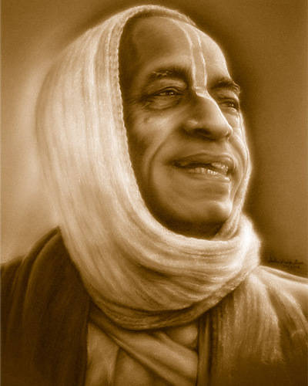
All glories to Srila Prabhupada!

