Slide 1
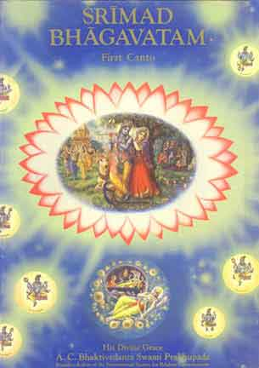
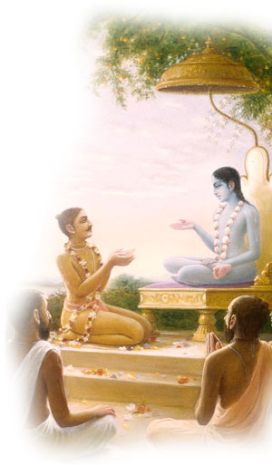
Srimad Bhagavtam 1.7.1-1.7.17
Invocation prayers
Recap of last week
SB 1.7.8-1.7.17
Session Summary
Smile
References

Slide 2
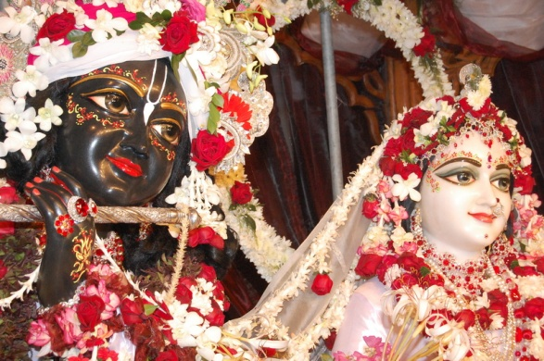
SB 1.2.4
narayanam namaskrtyam naram caiva narottamam devim sarasvatim vyasam tato jayam udirayet
Before reciting this Srimad-Bhagavatam, which is the very means of conquest, one should offer respectful obeisances unto the Personality of Godhead, Narayana, unto Nara-Narayana Rsi, the supermost human being, unto mother Sarasvati, the goddess of learning, and unto Srila Vyasadeva, the author.

Slide 3
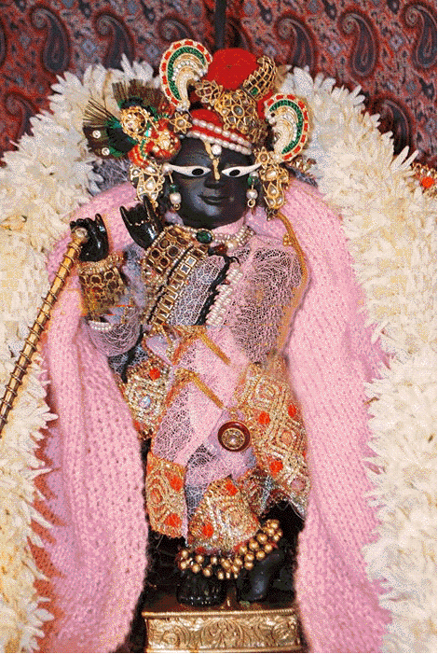
SB 1.2.18
nasta-prayesy abhadresu nityaḿ bhagavata-sevaya bhagavaty uttama-sloke bhaktir bhavati naisthiki
By regular attendance in classes on the Bhagavatam and by rendering of service to the pure devotee, all that is troublesome to the heart is almost completely destroyed, and loving service unto the Personality of Godhead, who is praised with transcendental songs, is established as an irrevocable fact.

Slide 4
Recap
Chapter 1 – The son of Drona punished
Maharaja Pariksit is miraculously saved in the womb of his mother. This was caused by Drauni (Asvatthama), Acarya Drona's son, who killed the five sons of Draupadi while they were asleep, for which he was punished by Arjuna.
For spiritual advancement of knowledge a suitable place and atmosphere are definitely required.
Perfect vision of the Absolute Truth is possible only by the linking process of devotional service. Srila Vyasdev achieved it by linking his mind in engaging in bhakti yoga w/o a tinge of materialism.
The living being is by constitution transcendental to material encagement, but he is now imprisoned by the external energy, and therefore he thinks himself one of the material products. And due to this unholy contact, the pure spiritual entity suffers material miseries under the modes of material nature.

Slide 5
Recap
The ways of illusory energy are very stiff to overcome, one who surrenders unto the lotus feet of the Lord is set free by the order of the Supreme. This surrendering process is the remedial measure for getting relief from the bewildering ways of the illusory energy and is completed by the influence of association.
Srimad-Bhagavatam is the summum bonum remedy for suffering humanity in the clutches of maya. Srila Vyasadeva therefore first of all diagnosed the actual disease of the conditioned souls, i.e., their being illusioned by the external energy. He also saw the perfect Supreme Being, from whom illusory energy is far removed,.
The process of devotional service is a great transcendental science and begins with the process of hearing and chanting the name, fame, glory, etc., of the Supreme Personality of Godhead. Revival of the dormant affection or love of Godhead does not depend on the mechanical system of hearing and chanting, but it solely and wholly depends on the causeless mercy of the Lord. When the Lord is fully satisfied with the sincere efforts of the devotee, He may endow him with His loving transcendental service.

Slide 6
[SB 1.7.8] sa samhitam bhagavatim krtvanukramya catma-jam sukam adhyapayam asa nivrtti-niratam munih
The great sage Vyasadeva, after compiling the Srimad-Bhagavatam and revising it, taught it to his own son, Sri Sukadeva Gosvami, who was already engaged in self-realization.

Slide 7
Key points
Srimad-Bhagavatam is the natural commentation on the Brahma-sutras (Vedanta Sutras) compiled by the same author.
Although it is especially meant for the paramahamsas, or those who are totally engaged in self realization, it works into the depths of the hearts of those who may be worldly men.
It was compiled before the disappearance of King Pariksit and after the departure of Lord Krsna.
Puranas → Mahabharata → Srimad Bhagavatam (5000 years ago)
Narada Muni → Srila Veda Vyas dev→ Srila Sukadev Goswami → Srila Suta Goswami
Srimad-Bhagavatam is the science for following the path of nivrtti-marga. This is the natural inclination for all conditioned souls. The theme of Srimad-Bhagavatam is the cure of the materialistic disease of the human being, or stopping completely the pangs of material existence.

Slide 8
Srila Prabhupada Uvaca
Don't be victimized by the Mayavadi so-called Vaisnava. It is very dangerous. Therefore it is said, sa samhitam bhagavatim krtvanukramya catma-jam (that vedic literature in relationship with the Personality of Godhead by correction and repetition). It is very confidential subject matter. He taught it, instructed to Sukadeva Gosvami. Atma-jam. Like father, like son. There is no difference between son and disciple.
So what was the qualification of Sukadeva Gosvami which induced Vyasadeva to teach him this samhitam? Sukam adhyapayam asa nivrtti-niratam: he has no more attraction for material world. That is the qualification. Nirvrtti. There are two kinds of life: nirvrtti and pravrtti. Pravrtti means materialistic, karmis who have got tendency to enjoy this material world. So the whole Vedic literature is there how to make him stop this pravrtti-marg. Vyasadeva preferred to teach Srimad-Bhagavatam to his son Sukadeva Gosvami because he was Nirvrtti-niratam.
Sukadeva Gosvami was not a grammarian, but he learned everything from his father by hearing. Therefore it is called sruyamanayam. If you hear from the right person, properly, then you become perfect. There is no need of literary education. Therefore Vedas are called sruti.
Srimad-Bhagavatam Vrndavana, September 7, 1976

Slide 9
Punch line
So Sukadeva Gosvami is the next acarya, but one has to learn from the original acarya. Evam parampara-praptam imam rajarsayo viduh [Bg. 4.2]. So unless we come to the parampara system, acarya after acarya, there is no right education. Therefore Caitanya Mahaprabhu's private secretary, personal secretary, Svarupa Damodara, he advised, bhagavat para giya bhagavat sthane. If you want to learn Srimad-Bhagavatam, you go to a person whose life is Bhagavatam. Grantha bhagavata and person bhagavata -- both of them bhagavatas.

Slide 10
[SB 1.7.9] saunaka uvaca sa vai nivrtti-niratah sarvatropeksako munih kasya va brhatim etam atmaramah samabhyasat
Sri Saunaka asked Suta Gosvami: Sri Sukadeva Gosvami was already on the path of self-realization, and thus he was pleased with his own self. So why did he take the trouble to undergo the study of such a vast literature?

Slide 11
Key points
For the people in general the highest perfection of life is to cease from material activities and be fixed on the path of self-realization.
Out of thousands and millions of such karmis, one may become an atmarama by self-realization. Atma means self, and arama means to take pleasure.
the standard of pleasure enjoyed by the karmis is different from that of the atmaramas. The atmaramas are completely indifferent to material enjoyment in every respect.
Srila Sukadeva Gosvami had already attained that stage, and still he was attracted to undergo the trouble of studying the great Bhagavatam literature. This means that Srimad-Bhagavatam is a postgraduate study even for the atmaramas, who have surpassed all the studies of Vedic knowledge

Slide 12
[SB 1.7.10] suta uvaca atmaramas ca munayo nirgrantha apy urukrame kurvanty ahaitukim bhaktim ittham-bhuta-guno harih
All different varieties of atmaramas [those who take pleasure in atma, or spirit self], especially those established on the path of selfrealization, though freed from all kinds of material bondage, desire to render unalloyed devotional service unto the Personality of Godhead. This means that the Lord possesses transcendental qualities and therefore can attract everyone, including liberated souls.

Slide 13
Key points
The atmaramas render devotional service unto the Lord not for personal interest but for the pleasure of the Lord.
Sukadeva Gosvami was attracted by the transcendental pastimes of the Lord. Sukadeva Gosvami was already situated in the liberated stage, yet he was attracted by the pastimes of the Lord. This proves that the quality of the Lords’s pastimes has nothing to do with material affinity.
By remembering the Lord in acute distress one can be free from all varieties of miseries and anxieties. Gradually the Lord vanquishes all obstacles on the path of devotional service of a pure devotee, and the result of nine devotional activities, such as hearing and chanting, becomes manifested.
Unalloyed devotional service of the Lord progresses in different stages. Practice of devotional service in the material field is of eighty-one different qualities, and above such activities is the transcendental practice of devotional service, which is one and is called sadhana-bhakti.

Slide 14
Key points
When unalloyed practice of sadhana-bhakti is matured into transcendental love for the Lord, the transcendental loving service of the Lord begins gradually developing into nine progressive stages of loving service under the headings of attachment, love, affection, feelings, affinity, adherence, following, ecstasy, and intense feelings of separation.
Santa Rasa - The attachment of an inactive devotee develops up to the stage of transcendental love of God.
Dasya Rasa - Attachment of an active servitor develops up to the stage of. Adherence (devotion)
Sakhya Rasa - For a friendly devotee develops up to the stage of following.
Vatalsya Rasa - The paternal devotees also develops up to the stage of following.
Madhurya Rasa - Devotees in conjugal love develop ecstasy up to the stage of intense feelings of separation.

Slide 15
Srila Prabhpada Uvaca
So Krsna is purna in every respect, and if we take to Krsna consciousness, shelter of the lotus feet of Krsna -- sa vai manah krsna-padaravindayoh -- if we fix up our mind always at the lotus feet of Krsna, then everything will follow very perfectly. That is promised by Krsna. Tesam satata-yuktanam bhajatam priti-purvakam [Bg. 10.10]. If one is engaged always in love and affection... Not as official love. Ecstatic love, spontaneous, that is wanted. That example is here in Vrndavana. At least, as we get information of Vrndavana from the sastras, from Srimad-Bhagavatam, how spontaneously the inhabitants of Vrndavana -- the gopis and the cowherds boys and the birds, beasts, the calves, the animals, the trees, everyone, even the flies, the bees, the insect, even the dust, the grass -- everyone is..., they are all cinmaya, spiritual. They are not material. But they are attracted to Krsna in different varieties.
Vrndavana, September 9, 1976

Slide 16
[SB 1.7.11] harer gunaksipta-matir bhagavan badarayanih adhyagan mahad akhyanam nityam visnu-jana-priyah
Srila Sukadeva Gosvami, son of Srila Vyasadeva, was not only transcendentally powerful. He was also very dear to the devotees of the Lord. Thus he underwent the study of this great narration [Srimad- Bhagavatam].

Slide 17
Key points
According to Brahma-vaivarta Purana, Srila Sukadeva Gosvami was a liberated soul even within the womb of his mother and did not stay home. Srila Vyasadeva impressed upon him the synopsis of the Bhagavatam so that the child could be made attached to the transcendental activities of the Lord.
The idea is that generally the liberated souls are attached to the feature of impersonal Brahman with a monistic view of becoming one with the supreme whole. But by the association of pure devotees like Vyasadeva, even the liberated soul becomes attracted to the transcendental qualities of the Lord. By the mercy of Sri Narada, Srila Vyasadeva was able to narrate the great epic of Srimad-Bhagavatam, and by the mercy of Vyasadeva, Srila Sukadeva Gosvami was able to grasp the import. The transcendental qualities of the Lord are so attractive that Srila Sukadeva Gosvami became detached from being completely absorbed in impersonal Brahman and took up the personal activity of the Lord.

Slide 18
Key points
He was thrown from the impersonal conception of the Absolute and he realized the transcendental bliss with the personal feature than the impersonal.
And from that time, not only did he himself become very dear to the visnu-janas, or the devotees of the Lord, but also the visnu-janas became very dear to him.
The devotees of the Lord, who do not wish to kill the individuality of the living entities and desire to become personal servitors of the Lord. They do not like the impersonalists. Similarly the impersonalists, who desire to become one with the Supreme, are unable to evaluate the devotees of the Lord.
It appears that Srila Sukadeva Gosvami also had no liking for the devotees because he was an impersonalist. But since he himself became a saturated devotee, he desired always the transcendental association of the visnujanas, and the visnu-janas also liked his association, since he became a personal Bhagavata.

Slide 19
[SB 1.7.12] pariksito 'tha rajarser janma-karma-vilapanam samstham ca pandu-putranam vaksye krsna-kathodayam
Suta Gosvami thus addressed the rsis headed by Saunaka: Now I shall begin the transcendental narration of the Lord Sri Krsna and topics of the birth, activities and deliverance of King Pariksit, the sage amongst kings, as well as topics of the renunciation of the worldly order by the sons of Pandu.

Slide 20
Key points
Lord Krsna is so kind to the fallen souls that He personally incarnates Himself amongst the different kinds of living entities and takes part with them in daily activities.
Without Krsna, all the supplementary literatures like the Puranas and Mahabharata are simply stories or historical facts. But with Krsna they become transcendental, and when we hear of them we at once become transcendentally related with the Lord.
Krsna and His pure devotees like the Pandavas are on the same plane. Krsna is not without His devotees of all the rasas, and the pure devotees like the Pandavas are not without Krsna.

Slide 21
Punch line
The devotees and the Lord are interlinked, and they cannot be separated. Therefore talks about them are all krsna-katha, or topics of the Lord.

Slide 22
Srila Prabhpada Uvaca
So Srimad-Bhagavatam is amalam puranam. Amalam. Mala means dirty things and amalam means without any dirty things. What is that dirty things? The dirty things means the material modes of nature -- sattva-guna, rajo-guna, tamo-guna. Because it is material it is called mala, dirty. And Srimad-Bhagavatam: amalam, without any material contamination, because simply narration of Bhagavan and Bhagavan's devotees. Bhagavata, bhakta. Therefore it is named Bhagavatam: dealings between the Supreme Personality of Godhead and His devotees. Srimad-Bhagavatam.

Slide 23
Srila Prabhpada Uvaca
You cannot make any spiritual progress by simultaneously acting impiously and at the same time... It may... Not it may -- it is sure it will go. But it will go very slow. Just like if you have got dry wood, then the fire ignites very easily. And if you bring wet fuel, it takes time. Of course, as soon as there is fire, the wetness of the fuel will dry. But it will require extra energy. And if you put dry fuel, then it ignites very easily. So in order to keep us dry without being wetted by the impious activities, then spiritual progress will be very quick. We should remember that. Actually, if we want to be advanced in Krsna consciousness, it is our duty to keep ourself dry from material wetness.

Slide 24
[SB 1.7.13-14] yada mrdhe kaurava-srnjayanam viresv atho vira-gatim gatesu vrkodaraviddha-gadabhimarsabhagnoru- dande dhrtarastra-putre bhartuh priyam draunir iti sma pasyan krsna-sutanam svapatam siramsi upaharad vipriyam eva tasya jugupsitam karma vigarhayanti
When the respective warriors of both camps, namely the Kauravas and the Pandavas, were killed on the Battlefield of Kuruksetra and the dead warriors obtained their deserved destinations, and when the son of Dhrtarastra fell down lamenting, his spine broken, being beaten by the club of Bhimasena, the son of Dronacarya [Asvatthama] beheaded the five sleeping sons of Draupadi and delivered them as a prize to his master, foolishly thinking that he would be pleased. Duryodhana, however, disapproved of the heinous act, and he was not pleased in the least.

Slide 25
Key points
Both the Bhagavad-gita and Srimad-Bhagavatam are transcendental topics of Lord Krsna.
The Gita is krsna-katha, or topics of Krsna, because it is spoken by the Lord
The Bhagavatam is also krsna-katha because it is spoken about the Lord.
Lord Sri Caitanya Mahaprabhu wanted everyone to be informed of both krsna-kathas by His order.
Lord Caitanya desired that all who are born in India seriously understand such krsna-kathas and then after full realization preach the transcendental message to everyone in all parts of the world.

Slide 26
Srila Prabhpada Uvaca
So to become Vaisnava is not so easy thing. One has to become brahmana, then when he surpasses the stages of becoming brahmana then he becomes a Vaisnava. Suddha-sattva. Sattvam visuddham vasudeva-sabditam. Then Krsna is born. When one comes to the Vaisnava stage, then he can understand what is Krsna. Just like Krsna was born of Vasudeva. Similarly, when one comes to the stage of Vasudeva... Vasudeva means perfect Vaisnava.
So the Pandavas were pure devotees; therefore Krsna took his side and they became victorious in the fight. And Krsna is always ready to give protection to His devotees. Kaunteya pratijanihi na me bhaktah pranasyati. His sudarsana-cakra always protects His devotees. That is the position of devotee.

Slide 27
[SB 1.7.15] mata sisunam nidhanam sutanam nisamya ghoram paritapyamana tadarudad vaspa-kalakulaksi tam santvayann aha kiritamali
Draupadi, the mother of the five children of the Pandavas, after hearing of the massacre of her sons, began to cry in distress with eyes full of tears. Trying to pacify her in her great loss, Arjuna spoke to her thus:

Slide 28
[SB 1.7.16] tada sucas te pramrjami bhadre yad brahma-bandhoh sira atatayinah gandiva-muktair visikhair upahare tvakramya yat snasyasi dagdha-putra
O gentle lady, when I present you with the head of that brahmana, after beheading him with arrows from my Gandiva bow, I shall then wipe the tears from your eyes and pacify you. Then, after burning your sons‘ bodies, you can take your bath standing on his head.

Slide 29
Key points
An enemy who sets fire to the house, administers poison, attacks all of a sudden with deadly weapons, plunders wealth or usurps agricultural fields, or entices one's wife is called an aggressor. Such an aggressor, though he be a brahmana or a so-called son of a brahmana, has to be punished in all circumstances.
Arjuna knew well that Asvatthama was the son of a brahmana, but because the so-called brahmana acted like a butcher, he was taken as such, and there was no question of sin in killing such a brahmana's son who proved to be a villain.

Slide 30
Srila Prabhpada Uvaca
Kiritamali is Arjuna. So they were directly connected with Krsna. Draupadi's another name is Krsna. And still they had to suffer the material pangs. Not that because one is Krsna conscious there will be no material suffering. Actually, those who are Krsna conscious, they have no material suffering. Although it appears that they are suffering, they are not suffering. They can accept any so-called suffering and accept it as mercy of Krsna. They never take it as suffering. A devotee, when he's in suffering, so-called suffering, he accepts it as the mercy of Krsna. And he rather thanks Krsna, that "I had to suffer many more times, but You have minimized it, giving me little suffering. So it is Your mercy." And if anyone lives on that attitude, everything taken as Krsna's mercy, then he is guaranteed to go back home, back to Godhead. Mukti-pade sa daya-bhak. Daya-bhak means his going back to home, back to Godhead, is exactly like the inheritance of property by the son. Mukti-pade sa daya-bhak. So we should learn from the Pandavas that Krsna was always present with them, still they had to suffer so much material tribulations. So they were never unhappy, neither they requested Krsna that "My dear friend Krsna, You were always with us. Still we had to suffer." Never expressed that. That is pure devotion. Never try to take any benefit from Krsna. Simply try to give benefit to Krsna. Do not take any benefit from Krsna. This is pure devotion

Slide 31
[SB 1.7.17] iti priyam valgu-vicitra-jalpaih sa santvayitvacyuta-mitra-sutah anvadravad damsita ugra-dhanva kapi-dhvajo guru-putram rathena
Arjuna, who is guided by the infallible Lord as friend and driver, thus satisfied the dear lady by such statements. Then he dressed in armor and armed himself with furious weapons, and getting into his chariot, he set out to follow Asvatthama, the son of his martial teacher.

Slide 32
Session Summary
Srimad-Bhagavatam is the science for following the path of nivrtti-marga.(Path of self realization)
If you hear from the right person, properly, then you become perfect. There is no need of literary education.
Srimad-Bhagavatam is a postgraduate study even for the atmaramas, who have surpassed all the studies of Vedic knowledge
Sukadeva Gosvami was attracted by the transcendental pastimes of the Lord. Sukadeva Gosvami was already situated in the liberated stage, yet he was attracted by the pastimes of the Lord. This proves that the quality of the Lords’s pastimes has nothing to do with material affinity.
By remembering the Lord in acute distress one can be free from all varieties of miseries and anxieties. Gradually the Lord vanquishes all obstacles on the path of devotional service of a pure devotee, and the result of nine devotional activities, such as hearing and chanting, becomes manifested.

Slide 33
Session Summary
The transcendental qualities of the Lord are so attractive that Srila Sukadeva Gosvami became detached from being completely absorbed in impersonal Brahman and took up the personal activity of the Lord.
Since Srila Sukadeva Goswami himself became a saturated devotee, he desired always the transcendental association of the visnujanas, and the visnu-janas also liked his association, since he became a personal Bhagavata.
Without Krsna, all the supplementary literatures like the Puranas and Mahabharata are simply stories or historical facts. But with Krsna they become transcendental, and when we hear of them we at once become transcendentally related with the Lord.
Krsna and His pure devotees like the Pandavas are on the same plane. Krsna is not without His devotees of all the rasas, and the pure devotees like the Pandavas are not without Krsna.

Slide 34
Smile

Slide 35
References
Srimad Bhagavatam – His divine grace A.C.Bhaktivedanta Swami
www.Prabhupadavani.org (all lecture dates recorded in the quotes)

Slide 36
Srimad Bhagavtam Ki Jai Srila Prabhupada ki Jai

