Slide 1
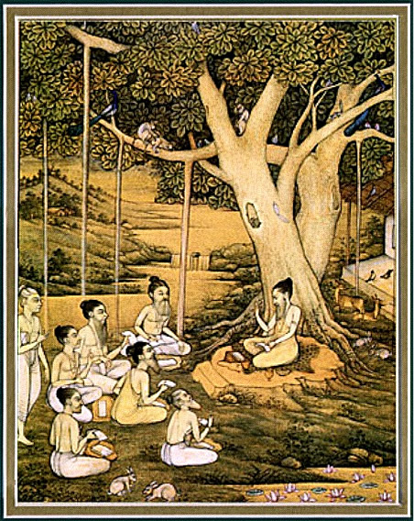
Srimad bhagavataM 1.5.32 – 40

Slide 2
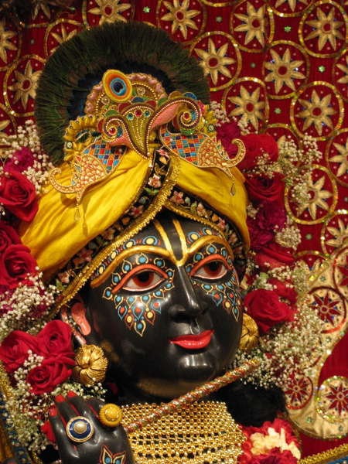
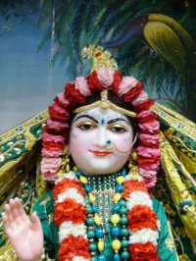
SB 1.2.4 narayanam namaskrtyam naram caiva narottamam devim sarasvatim vyasam tato jayam udirayet
Translation: Before reciting this Srimad Bhagavatam, which is the
very means of conquest, one should offer respectful obeisances
unto the Personality of Godhead, Narayana, unto Nara-Narayana
Rsi, the supermost human being, unto mother Sarasvati, the
goddess of learning, and unto Srila Vyasadeva, the author.

Slide 3
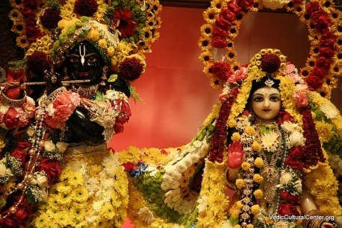
nasta-prayesy abhadresu nityaḿ bhagavata-sevaya bhagavaty uttama-sloke bhaktir bhavati naisthiki
SB 1.2.18
Translation: By regular attendance in classes on the
Bhagavatam and by rendering of service to the pure devotee,
all that is troublesome to the heart is almost completely
destroyed, and loving service unto the Personality of
Godhead, who is praised with transcendental songs, is
established as an irrevocable fact.

Slide 4
SB 1.5.32 – 40
Path of perfection for conditioned souls
Hearing & Chanting
Notes:
-> 5’th chapter begins with Srila Vyasadeva asking Narada to explain why he is feeling dissatisfied. Then Narada explains you did not describe the glories of the Lord. People have to be qualified, by describing glories you can do so. His own personal example how despite having insignificant parentage, he development attachment to hear and attained confidential knowledge given by SupremeLord himself.
Now Narada is going to say application from his life.
->This section is most philosophical section of 1’st canto.
-> Narada muni gave initial direction, then explained how that principle is worked in His life, how he is going to
give practical application to Srila Vyasadeva. Srila Prabhupada is going to map to us.
-> Narada muni proved that Sri Vyasa’s approach for fruitive activity will not work, now he will give key
to the solution that works
-> While in this world, imperfect senses, tendency to Lord it over – how to gradually elevate them?
-> Basis on which iskcon is formed.

Slide 5
SB 1.5.32
etat saàsücitaà brahmaàs
täpa-traya-cikitsitam
yad éçvare bhagavati
karma brahmaëi bhävitam
Translation: O Brähmaëa Vyäsadeva, it is decided by
the learned that the best remedial measure for removing
all troubles and miseries is to dedicate one's activities to
the service of the Supreme Lord Personality of Godhead
[Çré Kåñëa].
Notes:
-> Verse says your activities should be dovetailed in the matter of satisfying the Supreme Lord.
-> Karma yoga in Bg – yad karosi .. BG 9.27 –
-> SB also describes so it can elevate common people.

Slide 6
1.5.32 Purport
Material existence is full of miseries
Most practical solution – hear submissively Lord’s activities
Lord is the ultimate sanctioning officer (patient, river crossing)
Therefore must dedicate our activities unto Him
Examples :
- Learned scholar, scientist, philosopher, poet – employ learning
- Administrator, statesman, warrior, politician etc – est lord’s supremacy
- Fight for the Lord’s cause – Arjuna
- Businessman, industrialist, agriculturalist – spend money
Engage Laksmi in the service of Lord Narayana
Samsucitam – realized by the expert and erudite scholars.
Notes:
1. We hear so many times – dukhalayam asasvatham, but maintain hope in this world. That’s why when
Something unexpected happens we cannot handle. Only when we realize this we will whole heartedly take shelter. We should pray for this realization. SB 10.14.58 – padam padam yad vipadam na tesam
2. From His personal experience Sri Narada is speaking. Therefore He asks Vyasa to describe glories of the Lord.
3. People try so much to rid of miseries, but lord’s sanction should be there.
4. Samsucitam not Narada’s childish realization, but spoken by expert and erudite scholars.

Slide 7
1.5.32 Purport
“The best thing is, after all, to get relief from all material activities and engage oneself completely in hearing the transcendental pastimes of the Lord. But in case of the absence of such an opportunity, one should try to engage in the service of the Lord everything for which one has specific attraction, and that is the way of peace and prosperity.”
Hearing and Chanting
- Dovetailing is not the goal
- Uplifts our activities
- For any significant service
- All else to support this
Notes:
-> Goal is not dovetailing our activities. Goal is loving service to the Lord.
-> So while dovetailing our activities, hearing and chanting should go on, so those activities will be elevated.
-> When one develops love for Krsna one naturally works 100% for Krsna, while one is in Karma-yoga platform, consciousness may not be there.
-> Someone asked their S.M I am ready tell me what I should do – Maharaja said go to website and download and listen to all lectures.
-> Romapada maharaja also gave two devotees wanted to do something for Prabhupada they went on spree of
Hearing and chanting, now empowered.
-> Hearing and chanting is like our bread and butter.
-> mother Malati’s example.

Slide 8
SB 1.5.33
ämayo yaç ca bhütänäà
jäyate yena suvrata
tad eva hy ämayaà dravyaà
na punäti cikitsitam
Translation: O good soul, does not a thing, applied
therapeutically, cure a disease which was caused by that
very same thing?
Notes:
-> This verse says how karma can be engaged.
-> Narada muni gives analogy how this works.

Slide 9
1.5.33 Purport
Disease - sense gratification
Cikisitam – essence of KC movement
Expert physician – bowel disorder (milk, yogurt)
Miseries cannot be mitigated by material activities.
Matter acts as a spiritual force when engaged in the service of the spirit.
Analogy: iron – fire, earth
Result: Treats our material disease
Elevate ourselves to the spiritual plane
Realize everything is Brahman
Notes:
Too much indulgence in sense gratification causes disease – 10 rasa gulla, or overeating – causes mucus and disease.
- Ghee – beg, borrow, steal – sinful activities which lead to suffering.
- American president falls prey – common people also follow.
Cikisitam
-> Satisfy Krsna’s senses, work for Krsna.
-> Mayavadis do not know this
-> Activities should not be stopped they should be
reformed. BG Krsna says impelled by modes you will anyway fight.
-> is purification
-> activity is same account has to be changed.
-> changing process is Bhakti
-> essence of KC movement - Process is authorized and laid out by Sri Narada Muni himself.
-> Cannot give up activities – Fine balance – should not lord it over material nature (karmi) or reject material things (impersonalists, mayavadi)
-> Arjuna in 5’th chapter – knowledge is better than fruitive work and now asking me to fight
3. under the direction of physician – Guru → Srila Gurudeva instruction about work
Analogies: knife – killing or operation; microphone, dancing in the ball room and dancing in the temple
- We have personal experience by following the process we got purified. 25 yrs we dint get a bit of it.
Personal incident – attached to certain result – fear/lamentation, when surrendered – no anxiety.
- read uttara and how Lord’s will was there and no one could destroy – gave me so much faith.
- Knowledge is aside, realization is aside.
Living in the world, dealing with matter, dealing with our tendency to enjoy gradually purifies one.
At best with karma-yoga can come to brahman realization, to go beyond we need more bhakti..

Slide 10
1.5.33 Purport
“The threefold miseries of material existence cannot be mitigated simply by material activities. Such activities have to be spiritualized, just as by fire iron is made red-hot, and thereby the action of fire begins. Similarly, the material conception of a thing is at once changed as soon as it is put into the service of the Lord. That is the secret of spiritual success. We should not try to lord it over the material nature, nor should we reject material things. The best way to make the best use of a bad bargain is to use everything in relation with the supreme spiritual being.”
Notes:
-> need not give up activities, consciousness and center of the activities have to be changed – who is the beneficiary?

Slide 11
Srila Prabhupada’s lecture
“Our activities in this material world with these material elements, when we violate the laws, we become entangled. But the same material activities, when it is turned into Krsna prasadam, dovetailed with Krsna for hearing and chanting Hare Krsna maha-mantra, what we are doing? We are also doing the same thing. Here is the temple. What is this temple? The same ingredients, the same cement, same brick, same stone, same worker, same plan as the skyscraper. But what is the difference? Because it is cikitsitam, it is for Krsna. You spoil your energy by the same purchase of cement, bricks, and other things for sense gratification -- a theater hall, a dancing hall. The same energy spent for dancing for Krsna, the same hall, you become liberated. By one dancing hall you go to hell, and by another dancing hall you become liberated. This is the secret.”

Slide 12
SB 1.5.34
evaà nåëäà kriyä-yogäù
sarve saàsåti-hetavaù
ta evätma-vinäçäya
kalpante kalpitäù pare
Translation: Thus when all a man's activities are
dedicated to the service of the Lord, those very activities
which caused his perpetual bondage become the
destroyer of the tree of work.
Notes:
-> Result of such activities – bondage from tree of work – 15’th chapter – asvattha tree

Slide 13
1.5.34 Purport
Fruitive work – transmigration.
Work for Lord’s mission – Karma-yoga - liberation.
“The conclusion is that when the result of all fruitive and other work is dovetailed with the service of the Lord, it will cease to generate further karma and will gradually develop into transcendental devotional service, which will not only cut off completely the root of the banyan tree of work but will also carry the performer to the lotus feet of the Lord.”
Notes:
Ex: While working at motorola called my office and discussed the solution, and now also having dreams – but it is purifying as it is cikisitam.

Slide 14
1.5.34 Purport – Summary of Sri Narada’s life
-> Seek the association of pure devotees
-> Render loving service without reservation
-> By mercy, be injected with transcendental qualities
-> Strong attachment to hearing Lord’s pastimes.
-> Realize self, Supreme soul and the eternal relation
-> Perfect knowledge of the Personality of Godhead
-> Exhibit good qualities even in this body
“By such puruñottama-yoga, as it is stated in the Bhagavad-gétä, one is made perfect even during the present corporeal existence, and one exhibits all the good qualities of the Lord to the highest percentage. Such is the gradual development by association of pure devotees.”
Notes:
Maharaja’s are so attractive due to their purity, spiritual qualities and service attitude.
All thru need association of pure devotees..

Slide 15
SB 1.5.35
yad atra kriyate karma
bhagavat-paritoñaëam
jïänaà yat tad adhénaà hi
bhakti-yoga-samanvitam
Translation: Whatever work is done here in this life for
the satisfaction of the mission of the Lord is called
bhakti-yoga, or transcendental loving service to the Lord,
and what is called knowledge becomes a concomitant
factor.
Notes:
SB 1.2.13 – atah pumbhir dvija ….samsiddhir haritosanam
SB 1.2.7 – vasudeve bhagavati …jnanam ca yad ahaitukam
From karma-yoga will lead to bhakti-yoga. They are same but different, we will see in a minute how it is so.

Slide 16
1.5.35 Purport
Fruitive work results in no transcendental knowledge
Bhakti-yoga is above Jnana and Karma – BRS 1.1.11
Jnana and Karma are dependent on bhakti-yoga – SB 1.5.12
Need to know God to please Him
‘Pleasing Krsna’ factor
- Karma yoga -> Bhakti yoga
- Essence of everything
- Saves us from complacency
- Protects against being mechanical
- Dynamic relationship
- Aim of KC movement
Notes:
Non-fruitive work needs to be there – give in charity is so important.
Only bhakti can give bhakti – HG Radhakrsna prabhu to curb my false ego – we don’t want to show off we are better than others, we want to make devotees.
1.5.12 – naiskarmyam api acyuta bhava varjitam..
-> No material impediment can hinder bhakti
3. Owls philosophy
Karma yoga -> bhakti yoga – object of our worship increases.
We will be doing same activities rest of our lives – our Krsna centeredness should increase (maharaja’s etc also do the same thing)
Initially dovetailing – me and Krsna are partners – bhakti yoga means He is master, I am servant
Jaya subhadra mathaji – Karma yoga – what we like we do, bhakti – what Krsna likes we do.
H.G Gauranga prabhu mentioned – we should go deeper
Pleasing Krsna is like watering the root - everything is satisfied.

Slide 17
1.5.35 Purport
“The Lord does not want His sons, the living beings, to suffer the threefold miseries of life. He desires that all of them come to Him and live with Him, but going back to Godhead means that one must purify himself from material infections. When work is performed, therefore, to satisfy the Lord, the performer becomes gradually purified from the material affection. This purification means attainment of spiritual knowledge.”
Notes:
We have to do our part – purify/qualify ourselves.
Knowledge is already there – needs to be uncovered.
Personal incident – prabhu and discussions, how he was not reading but had correct understanding..
and better realization.

Slide 18
Srila Prabhupada’s lecture
“So this is the process, bhagavat-tosanam or hari-tosanam. Also this way. And to receive the knowledge from Bhagavan, that is also parampara system. The parampara system must be maintained, and if it is done nicely, then as it is stated here, yad atra kriyate, whatever you do, that is for your perfection. If you keep this parampara system and if you try to satisfy the Supreme Personality of Godhead, then whatever you do, that is perfection. It doesn't matter. The test is whether Krsna is satisfied, whether your spiritual master is satisfied. Then you are perfect..”
Notes:
We have to do our part – purify/qualify ourselves.
Knowledge is already there – needs to be uncovered. Personal incident – prabhu and discussions.

Slide 19
SB 1.5.36
kurväëä yatra karmäëi
bhagavac-chikñayäsakåt
gåëanti guëa-nämäni
kåñëasyänusmaranti ca
Translation: While performing duties according to the
order of Çré Kåñëa, the Supreme Personality of Godhead,
one constantly remembers Him, His names and His
qualities.
Notes:
Siksaya – by the will of – or order of

Slide 20
1.5.36 Purport
Expert devotee while doing duties constantly remembers the Lord’s name, fame, qualities etc.
Order of the Lord – Lord is the supreme proprietor (BG 5.29)
Pure devotee constantly glorifies the Lord
Application
Not less than 50% should be utilized for preaching
Under the guidance of a pure devotee
How can we qualify?
- No need to change our position
- Give up speculation to become one with the Lord.
- Submissively receive order from a Pure devotee
Notes:
Too many activities no time to hear and chant – over endeavour – spirtual life is about balance.
Need to establish Him as Supreme proprietor in Vedic sacrifices, day-to-day dealings.
Knowing this one wants to serve – duty of servant is to glorify the master, spread his glories.
Everyone is required – if everyone says Hare Krsna, who will build temple – we need everyone – four varnas and four ashramas.
Everything will be successful – one constantly remembers Lord’s name fame qualities, pastimes etc.

Slide 21
SB 1.5.37
oà namo bhagavate tubhyaà
väsudeväya dhémahi
pradyumnäyäniruddhäya
namaù saìkarñaëäya ca
Translation: Let us all chant the glories of Väsudeva
along with His plenary expansions Pradyumna,
Aniruddha and Saìkarñaëa.

Slide 22
1.5.37 Purport
“The purport is that any transaction, either in the field of fruitive work or in empiric philosophy, which is not ultimately aimed at transcendental realization of the Supreme Lord, is considered to be useless.”
“The most confidential part of the instruction is that one should always chant and remember the glories of the Lord Çré Kåñëa, the Supreme Personality of Godhead, along with His different plenary portions expanded as Väsudeva, Saìkarñaëa, Pradyumna and Aniruddha.”
Notes:
Shrama eva hi kevalam theme
Essence of all duties - smartavyah satato vishnu vismartavyah na jätucit – Always remember Krsna and never forget Him.

Slide 23
SB 1.5.38
iti mürty-abhidhänena
mantra-mürtim amürtikam
yajate yajïa-puruñaà
sa samyag darçanaù pumän
Translation: Thus he is the actual seer who worships,
in the form of transcendental sound representation,
the Supreme Personality of Godhead, Viñëu, who has
no material form.
Notes:
Murti – form and difficulty
Amurtikam – no material form or without any difficulty.
-> One who approaches the Lord with His transcendental sound is the real seer.

Slide 24
1.5.38 Purport
“Our present senses are all made of material elements, and therefore they are imperfect in realizing the transcendental form of Lord Viñëu. He is therefore worshiped by sound representation via the transcendental method of chanting. Anything which is beyond the scope of experience by our imperfect senses can be realized fully by the sound representation. A person transmitting sound from a far distant place can be factually experienced. If this is materially possible, why not spiritually? This experience is not a vague impersonal experience. It is actually an experience of the transcendental Personality of Godhead, who possesses the pure form of eternity, bliss and knowledge.”
Notes:
Diagram of universal creation – Holy Name is coming from Goloka to here – not ordinary sound.
Otherwise how we can chant same thing for so many times and so many years and never get tired.

Slide 25
1.5.38 Purport
“The transcendental form of eternal bliss and knowledge can be experienced by our original spiritual senses, which can be revived by chanting of the holy mantras, or transcendental sound representations. Such sound should be received from the transparent agency of the bona fide spiritual master, and the chanting may be practiced by the direction of the spiritual master. That will gradually lead us nearer to the Lord.”
Notes:
After purified, transcendental form can be experienced by spiritual senses.
Received thru SM.
Gayatri mantra is there on the internet but no affect until received from SM.
should give SM chance to accept us – rithvik philosophy.
Someone asked Guru maharaja I will worship Krsna directly why SM is coming in between.
Maharaja explained – SM brings God in focus – like binoculars.

Slide 26
SB 1.5.39
imaà sva-nigamaà brahmann
avetya mad-anuñöhitam
adän me jïänam aiçvaryaà
svasmin bhävaà ca keçavaù
Translation: O brähmaëa, thus by the Supreme Lord
Kåñëa I was endowed first with the transcendental
knowledge of the Lord as inculcated in the confidential
parts of the Vedas, then with the spiritual opulences, and
then with His intimate loving service.
Notes:
Result of chanting Lord’s glories as experienced by Sri Narada Muni.
We can also experience this – Srila Prabhupada gives we can qualify.
Goal is His intimate loving service

Slide 27
1.5.39 Purport
How to qualify ourselves
-> Avoid 10 offenses
-> Unflinching faith in the Lord and the Spiritual master
-> Receive the mantra thru disciplic succession.
-> Perfect the chanting process.
Chanting
-> No substitute
-> Now is the time
-> Is Begging
-> Foundation of all activities
-> Saves us from falling down
Notes:
Inattention is the root offense which leads to all others. If we somehow fix that everything else will follow.
2. Yasya deve para bhaktir yatha deve tatha guru – SU 6.23
- not by erudite scholarship but by serving s.m. Relationship is eternal during – sambandha, abhideya and
prayojana. Even in S.W. we are assisting our Guru Maharaja – not like mayavadi.
3. We hear so much chanting is foundation of all activities – somehow we should prioritize and spend that sacred time with the HolyName.
-> Else, some one said in Japa retreat, whole year of inattention is that now when I have time, I cannot chant.
-> Recently we both were sick, it was so difficult to manage everything, imagine when we are dying.
-> 86 yr old mathaji told, while you can – beg, cry all that counts.
4. Receive thru disciplic – somehow we all were fortunate. It just occurred, when we teach Bgita it is bonafide as we now part of disciplic succession – what an amazing fortune.

Slide 28
SB 1.5.40
tvam apy adabhra-çruta viçrutaà vibhoù
samäpyate yena vidäà bubhutsitam
präkhyähi duùkhair muhur arditätmanäà
saìkleça-nirväëam uçanti nänyathä
Translation: Please, therefore, describe the Almighty
Lord's activities which you have learned by your vast
knowledge of the Vedas, for that will satisfy the
hankerings of great learned men and at the same time
mitigate the miseries of the masses of common people
who are always suffering from material pangs. Indeed,
there is no other way to get out of such miseries.
Notes:
Final conclusion – describe Almighty Lord’s activities and SB is serving that instruction of His S.M. Therefore
contains just Lord’s glories.
SB is for perfected souls and conditioned souls.
No other way …

Slide 29
1.5.40 Purport
“Çré Närada Muni from practical experience definitely asserts that the prime solution of all problems of material work is to broadcast very widely the transcendental glories of the Supreme Lord.”
“Çré Näradajé advised Vyäsadeva to describe the glories of the Lord just to do good to all eight classes of men, both good and bad. Çrémad-Bhägavatam is therefore not meant for any particular class of men or sect. It is for the sincere soul who actually wants his own welfare and peace of mind.”
Notes:
4 good people – chatur vidha – 7.16 – intuitively take shelter of the Lord – so they will get benefit
Other 4 – na mam dusktritino (7.15) – all suffering material miseries, so they will get benefitted also.
Fruit of Narada’s instructions is SB – how to uplift the conditioned souls gradually to loving service by hearing and chanting Supreme Lord’s activities.

Slide 30
Summary
Material disease is cured by dovetailing activities in the service of the Lord.
Karma yoga leads to Bhakti Yoga
While performing duties, one remembers constantly Lord’s name, fame, activities
Attains knowledge, opulences and intimate loving service.
Therefore Srila Vyasadeva, please describe the Almighty Lord’s activities - SB.
There is no other way to get out of material miseries.

Slide 31
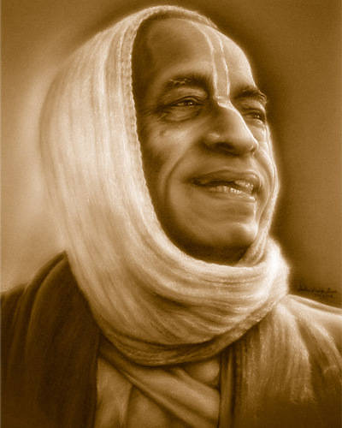
References
HH Romapada maharaja’s lectures on this section.
HG Bhurijana prabhu’s – Unveiling His Lotus Feet.
HG Bhurijana prabhu’s overview class on IskconDesireTree.
Srila Prabhupada’s purports.
All of you!
All glories to Srila Prabhupada!

