Slide 1
Srimad Bhagavatam (Narada Muni’s Previous Life) (1.5.23-1.5.31)

Slide 2
Contents: 1.5.23 – 1.5.24 Entering of Sages 1.5.25-- 1.5.26 Offering service 1.5.27-1.5.29 Receiving Mercy & Taste 1.5.30-1.5.31 Sages leaving Narada Muni

Slide 3
Narada Muni

Slide 4
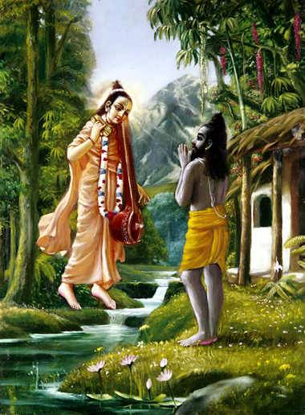

Slide 5
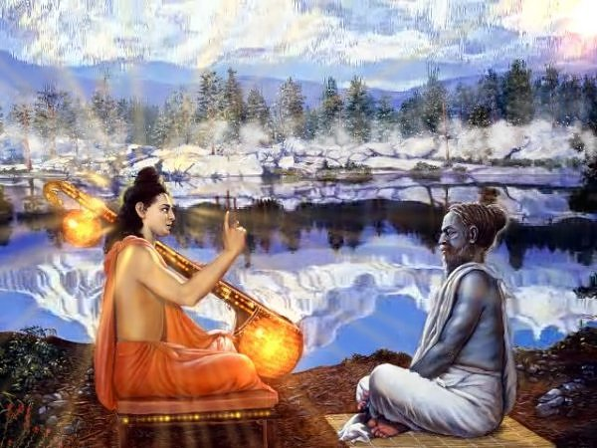

Slide 6
1.5.23 ahaḿ purātīta-bhave 'bhavaḿ mune dāsyās tu kasyāścana veda-vādinām nirūpito bālaka eva yogināḿ śuśrūṣaṇe prāvṛṣi nirvivikṣatām
O muni, in the last millennium I was born as the son of a certain maidservant engaged in the service of brāhmaṇas who were following the principles of Vedānta. When they were living together during the four months of the rainy season, I was engaged in their personal service.

Slide 7
Son of a poor maid servant

Slide 8
Sages entering the house

Slide 9
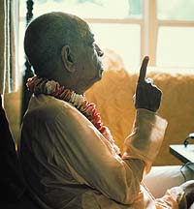
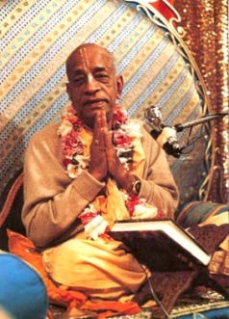
Prabhupada’s Purport (Power of Devotional Service):
He was the son of the most insignificant parentage. He was not properly educated. Still, because his complete energy was engaged in the service of the Lord, he became an immortal sage. Such is the powerful action of devotional service.

Slide 10
Importance of Seeking Blessings
Blessings:
Ambarish Maharaj: took blessings of the great sages before drinking water, before he broke the fast. It was that blessing that protected him.
Sublime Principle: Before we do any endeavor we seek the blessings – With that come protection and success.
Srila Prabhupada – Radha Damodar, Mayapur – Blessing of Spiritual Master before boarded the ship from Calcutta.
Bhakta ashirwade Krishe te Bhakti hai,
Bhakta asirvada prabhu shire dhari lai.
Mahaprabhu says: “Swarup damodar give your blessings to Rupa and Sanatana”.
Nothing more valuable than the blessings of the Vaishnavas.

Slide 11
1.5.24 te mayy apetākhila-cāpale 'rbhake dānte 'dhṛta-krīḍanake 'nuvartini cakruḥ kṛpāḿ yadyapi tulya-darśanāḥ śuśrūṣamāṇe munayo 'lpa-bhāṣiṇi
Although they were impartial by nature, those followers of the Vedānta blessed me with their causeless mercy. As far as I was concerned, I was self-controlled and had no attachment for sports, even though I was a boy. In addition, I was not naughty, and I did not speak more than required.

Slide 12
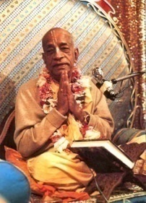
jihvara lalase yei iti-uti dhaya sisnodara-parayana krishna nahi paya
"One who is subservient to the tongue and who thus goes here and there, devoted to the genitals and the belly, cannot attain Krishna.”
gramya-katha na sunibe, gramya-varta na kahibe bhala na khaibe ara bhala na paribe
"Do not talk like people in general or hear what they say. You should not eat very palatable food, nor should you dress very nicely.”

Slide 13
In this way, the saintly devotees continued their stay in the house for four months during the rainy season.

Slide 14
1.5.25 ucchiṣṭa-lepān anumodito dvijaiḥ sakṛt sma bhuñje tad-apāsta-kilbiṣaḥ evaḿ pravṛttasya viśuddha-cetasas tad-dharma evātma-ruciḥ prajāyate
Once only, by their permission, I took the remnants of their food, and by so doing all my sins were at once eradicated. Thus being engaged, I became purified in heart, and at that time the very nature of the transcendentalist became attractive to me.

Slide 17
Three forms of Blessings
bhakta-pada-dhuli ara bhakta-pada-jala bhakta-bhukta-avasesha-tina maha-bala
"The dust of the feet of a devotee, the water that has washed the feet of a devotee, and the remnants of food left by a devotee are three very powerful substances."
Mahaprabhu caught Advaita Acharya and put his feet on his head.
ei tina-seva haite krishna-prema haya punah punah sarva-sastre phukariya kaya

Slide 18
Examples: Three forms of Blessings
Shivananda Sen:
Every year all the vaisnavas from Bengal to Jagannatha Puri. He would pay all the taxes.
One year, Nityananda prabhu cursed him saying: “I curse that the 3 sons of the Shivananda Sen die”.
“Today my Lord, you have accepted me as your servant”. “Dust of your lotus feet that is not granted to even Brahma, you have given that to me”. Nityananda prabhu embraced him
Bhakta pada jal –
Venkatta Bhatta, Gopal Bhatta Goswami – Mahaprabhu,
Krishna washed the lotus feet of Sudhama.
Bhakta bhukta avasesha –
Kalidas, - only uttered “Krishna, Krishna” – uncle of Raghunath das goswami.
In the context of Kalidas is this verse quoted in CC.

Slide 19
1.5.26 tatrānvahaḿ kṛṣṇa-kathāḥ pragāyatām anugraheṇāśṛṇavaḿ manoharāḥ tāḥ śraddhayā me 'nupadaḿ viśṛṇvataḥ priyaśravasy ańga mamābhavad ruciḥ
O Vyāsadeva, in that association and by the mercy of those great Vedāntists, I could hear them describe the attractive activities of Lord Kṛṣṇa And thus listening attentively, my taste for hearing of the Personality of Godhead increased at every step..

Slide 20
Srila Prabhupada’s Purport
Men are naturally apt to hear histories and narrations of various personalities performing mundane activities, without knowing that by such association one simply wastes valuable time and also becomes addicted to the three qualities of mundane nature. Instead of wasting time, one can get spiritual success by turning his attention to the transcendental pastimes of the Lord. By hearing the narration of the pastimes of the Lord, one contacts directly the Personality of Godhead, and, as explained before, by hearing about the Personality of Godhead, from within, all accumulated sins of the mundane creature are cleared. Thus being cleared of all sins, the hearer gradually becomes liberated from mundane association and becomes attracted to the features of the Lord. One can attain to the highest perfection of life simply by attentive hearing of the transcendental pastimes of the Lord from the right sources, as Śrī Nārada heard them from the pure devotees (bhakti-vedāntas) in his previous life. This process of hearing in the association of the devotees is especially recommended in this age of quarrel (Kali).

Slide 21
Mercy of Vaishnavas!
And in Saranagati, Srila Bhaktivinode Thakur writes: “O Vaishnava, you are an ocean of mercy. Please shower your compassion upon me. Give me the shade of your lotus feet and purify my polluted heart. I am following you, begging-Sri Krishna is yours-you have the power-give him to me!”
Narottama dasa Thakura sings a similar song: “I am so sinful; how can I possibly serve the Lord? I have no love for my guru. I have no love for the devotees and I am constantly deluded. I am so absorbed in material life that I have forgotten who I am. The witch Maya is waiting to hang a noose around my neck. I have no power to resist her on my own. I am helpless without your mercy. I know that you never see the faults of anyone, so I'm begging you-please save me." (Prarthana )
In the Padma Purana, Shiva says to his wife Parvati: “O Goddess, higher than the worship of all the gods and goddesses is the worship of the Supreme Lord Vishnu. But higher still is the worship of everyone and everything that is dear to Him, including Ganga devi, Tulasi devi, the book Bhagavata and the devotee Bhagavata.”

Slide 22
1.5.27 tasmiḿs tadā labdha-rucer mahā-mate priyaśravasy askhalitā matir mama yayāham etat sad-asat sva-māyayā paśye mayi brahmaṇi kalpitaḿ pare
O great sage, as soon as I got a taste for the Personality of Godhead, my attention to hear of the Lord was unflinching. And as my taste developed, I could realize that it was only in my ignorance that I had accepted gross and subtle coverings, for both the Lord and I are transcendental.

Slide 23
Awakening Love for Krishna!
Caitanya-caritamrita (Madhya 22.128-129) as follows:
“sadhu-sanga, nama-kirtana, bhagavata-sravana mathura-vasa, sri-murtira sraddhaya sevana sakala-sadhana-sreshtha ei panca anga krishna-prema janmaya ei pancera alpa sanga”
"One should associate with devotees, chant the holy name of the Lord, hear Srimad-Bhagavatam, reside at Mathura, and worship the Deity with faith and veneration. These five limbs of devotional service are the best of all. Even a slight performance of these five awakens love for Krishna."

Slide 24
1.5.28 itthaḿ śarat-prāvṛṣikāv ṛtū harer viśṛṇvato me 'nusavaḿ yaśo 'malam sańkīrtyamānaḿ munibhir mahātmabhir bhaktiḥ pravṛttātma-rajas-tamopahā
Thus during two seasons — the rainy season and autumn — I had the opportunity to hear these great-souled sages constantly chant the unadulterated glories of the Lord Hari. As the flow of my devotional service began, the coverings of the modes of passion and ignorance vanished.

Slide 25
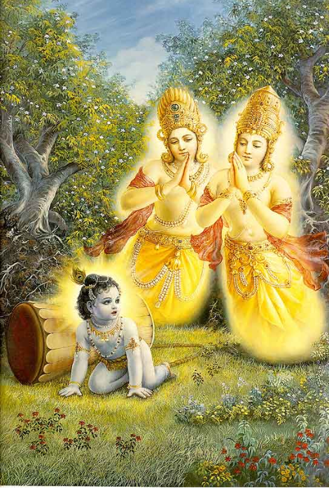
Month of Karthik! – Narada Muni’s Compassion
Parikshit Maharaj is asking Sukadeva Goswami – How is it that Narada Muni become angry to sons of Kuvera: “ena devasheh tamah” (SB 10.10.1)
Nalakuvera & Manigriva –
1. anuchar of Shiva,
2. sons of maha-bhagavat Kuvera ,
3. residing in Kailash,
4. taking bath in Ganges (10.10.2).
Sukadeva Goswami – “Tayoh anugraha-arthaya” (10.10.7)– intensity of offense is proportional to the intensity of the position of the offender. Anugraha
1. Courtyard of Nanda Maharaj
2. You will remember what mistakes you committed (fire of repentence)
3. Vasudeva sanidhya – Close association of Vasudev
4. Revive back your dormant bhakti for the supreme personality of Godhead.
kuveratmajau baddha-murtyaiva yadvat tvaya mocitau bhakti-bhajau krtau ca

Slide 26
Churning of the Milk Ocean
Sthana,
Kala,
Karma,
Hetu (mandara hill)
Artha (ingredients)
Mati (intention)
Demons had not taken the shelter of the Lotus feet of Krishna and Sainty persons.

Slide 27
1.5.29 & 1.5.30 Translations
(SB 1.5.29) I was very much attached to those sages. I was gentle in behavior, and all my sins were eradicated in their service. In my heart I had strong faith in them. I had subjugated the senses, and I was strictly following them with body and mind.
(SB 1.5.30) As they were leaving, those bhakti-vedāntas, who are very kind to poor-hearted souls, instructed me in that most confidential subject which is instructed by the Personality of Godhead Himself.

Slide 28
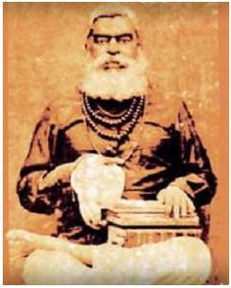
Bhaktivinod Thakur’s Purport on attachment to Saintly devotees:
"Like a mirror, a person takes on the qualities of those with whom he comes in contact. One who is intelligent should therefore seek the company of those who have the same ideals in order to develop their good qualities in himself.”
Kapila Deva said, "O mother! Saintly persons who are tolerant, merciful and friendly to all creatures, who do not make enemies and are peaceful, ornament the society of the pious. They take shelter of me and engage in constantly hearing and chanting about me. The various kinds of material miseries thus do not affect them, because they are always filled with thoughts of my pastimes and activities. O virtuous lady! Sadhus such as these are free from all attachment. You should pray for the association of such holy men, for that will counteract the pernicious effects of contact with unholy persons."(SB 3.25.21, 23-4)
"O my lord, allow me to have that great good fortune, either in this life or somewhere else, even if it be in the body of a lowly creature, whereby I can live amongst your intimate devotees and serve your lotus feet." (SB 10.14.30)

Slide 29
1.5.31 yenaivāhaḿ bhagavato vāsudevasya vedhasaḥ māyānubhāvam avidaḿ yena gacchanti tat-padam
Chatur Sloka Bhagavatam:
The mere chanting of the following slokas will have their own abundant and blissful Trancendental sound vibrations to influence the mind and intelligence of the person who chants them for they have been taught by the LORD KRISHNA to the first living being in the creation, LORD BRAHMA in order to progress in our goal to understand and reach Krishna. Further, reading or chanting of the four stanzas tantamount to reading all the 18,000 stanzas in Srimad Bhagavatam. Brahma in turn taught to Maharshi Narada who preached the same to his disciple Sri Krishna Dwaipayana Vyasa Deva and in this way they are handed our down the line.
By that confidential knowledge, I could understand clearly the influence of the energy of Lord Śrī Kṛṣṇa, the creator, maintainer and annihilator of everything. By knowing that, one can return to Him and personally meet Him.
In the commentary on this text, Srila Jiva Goswami stats: “By confidential knowledge, Narada was referring to the catuh-sloka Bhagavatam. This knowledge is far above impersonal knowledge. Narada wished Vysasadev to emphasize these same sacred truths in his own writings”

Slide 30
SB 2.9.33: Brahmā, it is I, the Personality of Godhead, who was existing before the creation, when there was nothing but Myself. Nor was there the material nature, the cause of this creation. That which you see now is also I, the Personality of Godhead, and after annihilation what remains will also be I, the Personality of Godhead. SB 2.9.34: O Brahmā, whatever appears to be of any value, if it is without relation to Me, has no reality. Know it as My illusory energy, that reflection which appears to be in darkness. SB 2.9.35: O Brahmā, please know that the universal elements enter into the cosmos and at the same time do not enter into the cosmos; similarly, I Myself also exist within everything created, and at the same time I am outside of everything. SB 2.9.36: A person who is searching after the Supreme Absolute Truth, the Personality of Godhead, most certainly search for it up to this, in all circumstances, in all space and time, and both directly and indirectly.
aham evāsam evāgre
nānyad yat sad-asat param
paścād ahaḿ yad etac ca
yo 'vaśiṣyeta so 'smy aham (SB 2.9.33)
ṛte 'rthaḿ yat pratīyeta
na pratīyeta cātmani
tad vidyād ātmano māyāḿ
yathābhāso yathā tamaḥ (SB 2.9.34)
yathā mahānti bhūtāni
bhūteṣūccāvaceṣv anu
praviṣṭāny apraviṣṭāni
tathā teṣu na teṣv aham (SB 2.9.35)
etāvad eva jijñāsyaḿ
tattva-jijñāsunātmanaḥ
anvaya-vyatirekābhyāḿ
yat syāt sarvatra sarvadā (SB 2.9.36)

Slide 31
References
HH Radhanath Maharaj’s lectures on Narada Muni
HH Romapada Maharaj’s lectures on 5th chapter
HH Indradyumna Swami’s talks on Srila Prabhupada’s memories.
http://prabhupadavani.org
audio.Iskcondesiretree.info:
Lectures on Narada Muni
Bhurijana prabhu’s Srimad Bhagavatam Overview lecture on 1.5.23-1.5.31
Unveiling His Lotus feet – HG Bhurijana prabhu
Veda Narayana prabhu and family
All of your blessings.

