Slide 1
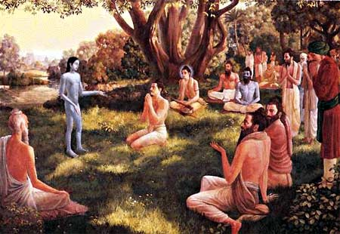
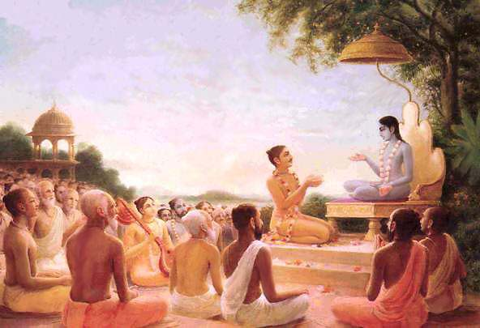
Srimad Bhagavatam
Canto 1 Chapter 19 – Humility is empowering

Slide 2
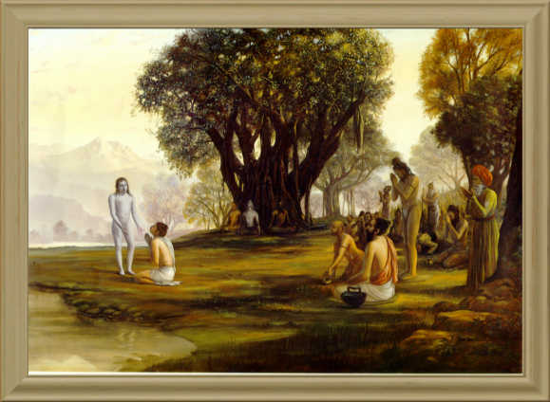
Srimad Bhagavatam
1.19.31 – 1.19.40
Humility is empowering to receive the mercy
By Gauranga Candra Das

Slide 3
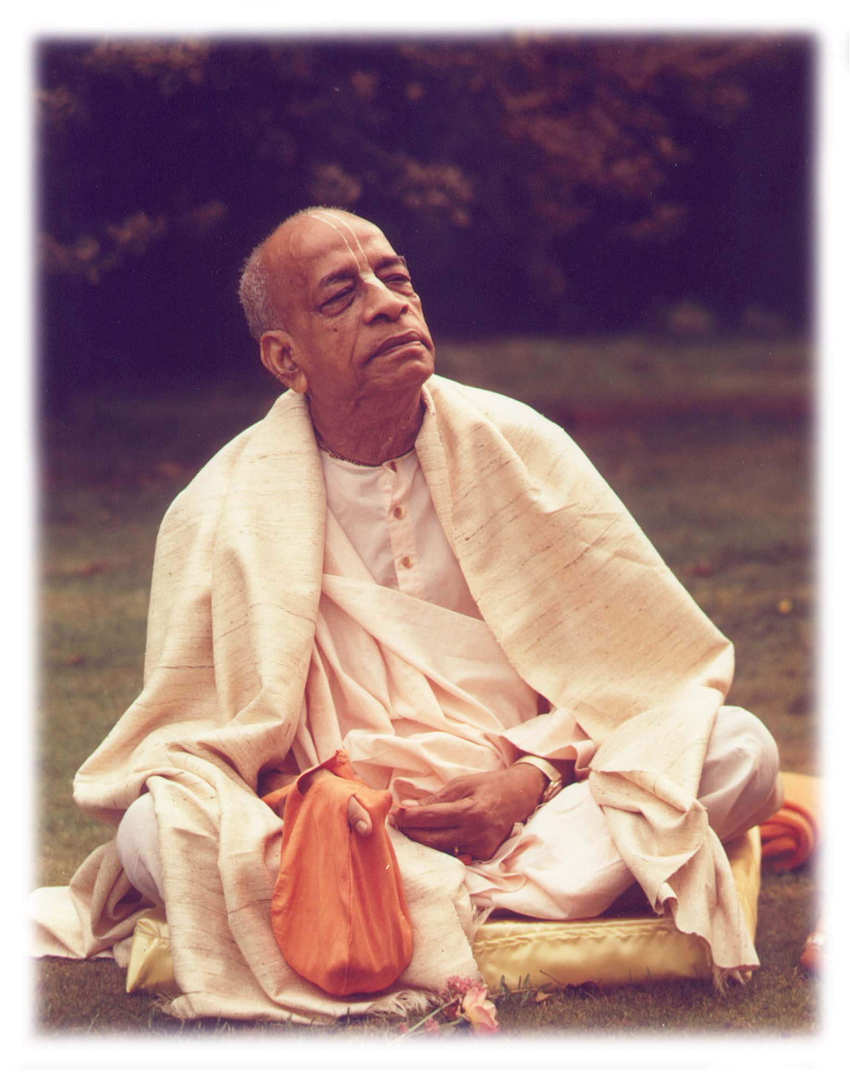
Based on the teachings of His Divine Grace A.C. Bhaktivedanta Swami Prabhupada
~ Founder Acharya ~
International Society For Krishna Consciousness

Slide 4
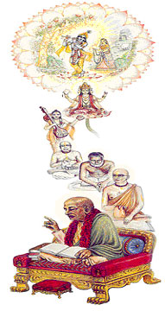
Seeking the Blessings of Guru, Gauranga & All the Assembled Vaishnavas

Slide 5
Śrīmad Bhāgavatam 1.2.4
nārāyaṇaḿ namaskṛtya
naraḿ caiva narottamam
devīḿ sarasvatīḿ vyāsaḿ
tato jayam udīrayet
TRANSLATION
Before reciting this Śrīmad-Bhāgavatam, which is the very means of conquest, one should offer respectful obeisances unto the Personality of Godhead, Nārāyaṇa, unto Nara-nārāyaṇa Ṛṣi, the supermost human being, unto mother Sarasvatī, the goddess of learning, and unto Śrīla Vyāsadeva, the author.

Slide 6
Śrīmad Bhāgavatam 1.2.18
naṣṭa-prāyeṣv abhadreṣu
nityaḿ bhāgavata-sevayā
bhagavaty uttama-śloke
bhaktir bhavati naiṣṭhikī
TRANSLATION
By regular attendance in classes on the Bhāgavatam and by rendering of service to the pure devotee, all that is troublesome to the heart is almost completely destroyed, and loving service unto the Personality of Godhead, who is praised with transcendental songs, is established as an irrevocable fact.

Slide 7
Section Theme – Humility is empowering
1.19.31-34
Mahārāja Parīkṣit greets Śrī Śukadeva Gosvāmī as per Vaishnava Etiquette and glories of Sadhu Sanga.
1.19.35 – 1.19.36
Śrī Śukadeva Gosvāmī’s arrival is Krsna’s mercy on Mahārāja Parīkṣit .
1.19.37-40
The King thus spoke and questioned the sage, using sweet language. Then the great and powerful personality, the son of Vyāsadeva, who knew the principles of religion, began his reply.

Slide 8
Śrīmad Bhāgavatam 1.19.31
praśāntam āsīnam akuṇṭha-medhasaḿ
muniḿ nṛpo bhāgavato 'bhyupetya
praṇamya mūrdhnāvahitaḥ kṛtāñjalir
natvā girā sūnṛtayānvapṛcchat
TRANSLATION
The sage Śrī Śukadeva Gosvāmī sat perfectly pacified, intelligent and ready to answer any question without hesitation. The great devotee, Mahārāja Parīkṣit, approached him, offered his respects by bowing before him, and politely inquired with sweet words and folded hands.

Slide 9
The gesture now adopted by Mahārāja Parīkṣit of questioning a master is quite befitting in terms of scriptural injunctions. The scriptural injunction is that one should humbly approach a spiritual master to understand the transcendental science. Mahārāja Parīkṣit was now prepared for meeting his death, and within the very short time of seven days he was to know the process of entering the kingdom of God. In such important cases, one is required to approach a spiritual master. There is no necessity of approaching a spiritual master unless one is in need of solving the problems of life. One who does not know how to put questions before the spiritual master has no business seeing him. And the qualification of the spiritual master is perfectly manifested in the person of Śukadeva Gosvāmī. Both the spiritual master and the disciple, namely Śrī Śukadeva Gosvāmī and Mahārāja Parīkṣit, attained perfection through the medium of Śrīmad-Bhāgavatam.

Slide 10
Śukadeva Gosvāmī learned Śrīmad-Bhāgavatam from his father, Vyāsadeva, but he had no chance to recite it. Before MahārājaParīkṣit he recited Śrīmad-Bhāgavatam and answered the questions of Mahārāja Parīkṣit unhesitatingly, and thus both the master and the disciple got salvation.
HH Romapada Swami: Bhagavatam is teaching us how qualified people receive saints and benefit from association

Slide 11
Śrīmad Bhāgavatam 1.19.32
parīkṣid uvāca
aho adya vayaḿ brahman
sat-sevyāḥ kṣatra-bandhavaḥ
kṛpayātithi-rūpeṇa
bhavadbhis tīrthakāḥ kṛtāḥ
TRANSLATION
The fortunate King Parīkṣit said: O brāhmaṇa, by your mercy only, you have sanctified us, making us like unto places of pilgrimage, all by your presence here as my guest. By your mercy, we, who are but unworthy royalty, become eligible to serve the devotee.

Slide 12
Saintly devotees like Śukadeva Gosvāmī generally do not approach worldly enjoyers, especially those in royal orders. Mahārāja Pratāparudra was a follower of Lord Caitanya, but when he wanted to see the Lord, the Lord refused to see him because he was a king.
For a devotee who desires to go back to Godhead, two things are strictly prohibited: worldly enjoyers and women. Therefore, devotees of the standard of Śukadeva Gosvāmī are never interested in seeing kings.
Mahārāja Parīkṣit was, of course, a different case. He was a great devotee, although a king, and therefore Śukadeva Gosvāmī came to see him in his last stage of life. Mahārāja Parīkṣit, out of his devotional humility, felt himself an unworthy descendant of his great kṣatriya forefathers, although he was as great as his predecessors.

Slide 13
The unworthy sons of the royal orders are called kṣatra-bandhavas, as the unworthy sons of the brāhmaṇas are called dvija-bandhus or brahma-bandhus. Mahārāja Parīkṣit was greatly encouraged by the presence of Śukadeva Gosvāmī. He felt himself sanctified by the presence of the great saint whose presence turns any place into a place of pilgrimage.

Slide 14
Śrīmad Bhāgavatam 1.19.33
yeṣāḿ saḿsmaraṇāt puḿsāḿ
sadyaḥ śuddhyanti vai gṛhāḥ
kiḿ punar darśana-sparśa-
pāda-śaucāsanādibhiḥ
TRANSLATION
Simply by our remembering you, our houses become instantly sanctified. And what to speak of seeing you, touching you, washing your holy feet and offering you a seat in our home?

Slide 15
The importance of holy places of pilgrimage is due to the presence of great sages and saints.
It is said that sinful persons go to the holy places and leave their sins there to accumulate. But the presence of the great saints disinfects the accumulated sins, and thus the holy places continue to remain sanctified by the grace of the devotees and saints present there.
If such saints appear in the homes of worldly people, certainly the accumulated sins of such worldly enjoyers become neutralized. Therefore, the holy saints actually have no self-interest with the householders. The only aim of such saints is to sanctify the houses of the householders, and the householders therefore should feel grateful when such saints and sages appear at their doors.
A householder who dishonors such holy orders is a great offender. A householder who does not bow down before a saint at once must undergo fasting for the day in order to neutralize.

Slide 16
Śrīmad Bhāgavatam 1.19.34
sānnidhyāt te mahā-yogin
pātakāni mahānty api
sadyo naśyanti vai puḿsāḿ
viṣṇor iva suretarāḥ
TRANSLATION
Just as the atheist cannot remain in the presence of the Personality of Godhead, so also the invulnerable sins of a man are immediately vanquished in your presence, O saint! O great mystic!.

Slide 17
There are two classes of human beings, namely the atheist and the devotee of the Lord. The devotee of the Lord, because of manifesting godly qualities, is called a demigod, whereas the atheist is called a demon.
The demon cannot stand the presence of Viṣṇu, the Personality of Godhead. The demons are always busy in trying to vanquish the Personality of Godhead, but factually as soon as the Personality of Godhead appears, by either His transcendental name, form, attributes, pastimes, paraphernalia or variegatedness, the demon is at once vanquished.
It is said that a ghost cannot remain as soon as the holy name of the Lord is chanted. The great saints and devotees of the Lord are in the list of His paraphernalia, and thus as soon as a saintly devotee is present, the ghostly sins are at once vanquished. That is the verdict of all Vedic literatures. One is recommended, therefore, to associate only with saintly devotees so that worldly demons and ghosts cannot exert their sinister influence.

Slide 18
HG Govind Prabhu: People go to holy places to clear there sins and end up creating new ones. E.g. Taking bath in cold rivers/lakes in cold season on crowded time and passing Uri…
SB 10.84.13: One who identifies his self as the inert body composed of mucus, bile and air, who assumes his wife and family are permanently his own, who thinks an earthen image or the land of his birth is worshipable, or who sees a place of pilgrimage as merely the water there, but who never identifies himself with, feels kinship with, worships or even visits those who are wise in spiritual truth — such a person is no better than a cow or an ass.
HG hari vilas Prabhu’s parikrama tile program.

Slide 19
Śrīmad Bhāgavatam 1.19.35
api me bhagavān prītaḥ
kṛṣṇaḥ pāṇḍu-suta-priyaḥ
paitṛ-ṣvaseya-prīty-arthaḿ
tad-gotrasyātta-bāndhavaḥ
TRANSLATION
Lord Kṛṣṇa, the Personality of Godhead, who is very dear to the sons of King Pāṇḍu, has accepted me as one of those relatives just to please His great cousins and brothers.

Slide 20
A pure and exclusive devotee of the Lord serves his family interest more dexterously than others, who are attached to illusory family affairs. Generally people are attached to family matters, and the whole economic impetus of human society is moving under the influence of family affection.
Such deluded persons have no information that one can render better service to the family by becoming a devotee of the Lord. The Lord gives special protection to the family members and descendants of a devotee, even though such members are themselves nondevotees!
Mahārāja Prahlāda was a great devotee of the Lord, but his father, Hiraṇyakaśipu, was a great atheist and declared enemy of the Lord. But despite all this, Hiraṇyakaśipu was awarded salvation due to his being the father of Mahārāja Prahlāda.

Slide 21
The Lord is so kind that he gives all protection to the family members of His devotee, and thus the devotee has no need to bother about his family members, even if one leaves such family members aside to discharge devotional service.
Mahārāja Yudhiṣṭhira and his brothers were the sons of Kuntī, the paternal aunt of Lord Kṛṣṇa, and Mahārāja Parīkṣit admits the patronage of Lord Kṛṣṇa because of his being the only grandson of the great Pāṇḍavas.

Slide 22
Śrīmad Bhāgavatam 1.19.36
anyathā te 'vyakta-gater
darśanaḿ naḥ kathaḿ nṛṇām
nitarāḿ mriyamāṇānāḿ
saḿsiddhasya vanīyasaḥ
TRANSLATION
Otherwise [without being inspired by Lord Kṛṣṇa] how is it that you have voluntarily appeared here, though you are moving incognito to the common man and are not visible to us who are on the verge of death?

Slide 23
The great sage Śukadeva Gosvāmī was certainly inspired by Lord Kṛṣṇa to appear voluntarily before Mahārāja Parīkṣit, the great devotee of the Lord, just to give him the teachings of Śrīmad-Bhāgavatam.
One can achieve the nucleus of the devotional service of the Lord by the mercy of the spiritual master and the Personality of Godhead.
The spiritual master is the manifested representative of the Lord to help one achieve ultimate success. One who is not authorized by the Lord cannot become a spiritual master.
Śrīla Śukadeva Gosvāmī is an authorized spiritual master, and thus he was inspired by the Lord to appear before Mahārāja Parīkṣit and instruct him in the teachings of Śrīmad-Bhāgavatam.

Slide 24
One can achieve the ultimate success of going back to Godhead if he is favored by the Lord's sending His true representative.
As soon as a true representative of the Lord is met by a devotee of the Lord, the devotee is assured a guarantee for going back to Godhead just after leaving the present body.
This, however, depends on the sincerity of the devotee himself. The Lord is seated in the heart of all living beings, and thus he knows very well the movements of all individual persons.
As soon as the Lord finds that a particular soul is very eager to go back to Godhead, the Lord at once sends His bona fide representative.
The sincere devotee is thus assured by the Lord of going back to Godhead. The conclusion is that to get the assistance and help of a bona fide spiritual master means to receive the direct help of the Lord Himself.

Slide 25
Śrīmad Bhāgavatam 1.19.37
ataḥ pṛcchāmi saḿsiddhiḿ
yogināḿ paramaḿ gurum
puruṣasyeha yat kāryaḿ
mriyamāṇasya sarvathā
TRANSLATION
You are the spiritual master of great saints and devotees. I am therefore begging you to show the way of perfection for all persons, and especially for one who is about to die.

Slide 26
Unless one is perfectly anxious to inquire about the way of perfection, there is no necessity of approaching a spiritual master. A spiritual master is not a kind of decoration for a householder. Generally a fashionable materialist engages a so-called spiritual master without any profit. The pseudo spiritual master flatters the so-called disciple, and thereby both the master and his ward go to hell without a doubt.
Mahārāja Parīkṣit is the right type of disciple because he puts forward questions vital to the interest of all men, particularly for the dying men. The question put forward by Mahārāja Parīkṣit is the basic principle of the complete thesis of Śrīmad-Bhāgavatam. Now let us see how intelligently the great master replies.
HH Romapada Swami Maharaj: 2 questions: What is the duty in general and what is the duty of a dying man. Everyone is dying (shortly or in 100 years). ?
SB 2.1-3 summarizes the answer. Q&A is standard method.

Slide 27
Śrīmad Bhāgavatam 1.19.38
yac chrotavyam atho japyaḿ
yat kartavyaḿ nṛbhiḥ prabho
smartavyaḿ bhajanīyaḿ vā
brūhi yad vā viparyayam
TRANSLATION
Please let me know what a man should hear, chant, remember and worship, and also what he should not do. Please explain all this to me.

Slide 28
Śrīmad Bhāgavatam 1.19.39
nūnaḿ bhagavato brahman
gṛheṣu gṛha-medhinām
na lakṣyate hy avasthānam
api go-dohanaḿ kvacit
TRANSLATION
O powerful brāhmaṇa, it is said that you hardly stay in the houses of men long enough to milk a cow.

Slide 29
Saints and sages in the renounced order of life go to the houses of the householders at the time they milk the cows, early in the morning, and ask some quantity of milk for subsistence. A pound of milk fresh from the milk bag of a cow is sufficient to feed an adult with all vitamin values, and therefore saints and sages live only on milk.
Even the poorest of the householders keep at least ten cows, each delivering twelve to twenty quarts of milk, and therefore no one hesitates to spare a few pounds of milk for the mendicants. It is the duty of householders to maintain the saints and sages, like the children.
HH Romapada Swami Maharaj: Question needs to be relevant (Not useless) What is the value of the question? Should have meaningful application. Not just to identify contradictions with IQ or academic. Knowledge is meant for practical application.
No one respects hypocrates because they do not apply the knowledge.

Slide 30
So a saint like Śukadeva Gosvāmī would hardly stay at the house of a householder for more than five minutes in the morning. In other words, such saints are very rarely seen in the houses of householders, and Mahārāja Parīkṣit therefore prayed to him to instruct him as soon as possible.
The householders also should be intelligent enough to get some transcendental information from visiting sages. The householder should not foolishly ask a saint to deliver what is available in the market. That should be the reciprocal relation between the saints and the householders.
HH Romapada Swami Maharaj: When one trusts you with a question, you should be worthy of that trust. Be honest . If you are not sure of the answer, say that. If needed, seek clarity from higher authorities. Typical questions Why there are so many religions? (3 modes), how to choose?, everyone says they are right. Do not ask worldly things in the short time available with saintly person. e.g. How can I get my daughter get married?

Slide 31
Śrīmad Bhāgavatam 1.19.40
sūta uvāca
evam ābhāṣitaḥ pṛṣṭaḥ
sa rājñā ślakṣṇayā girā
pratyabhāṣata dharma-jño
bhagavān bādarāyaṇiḥ
TRANSLATION
Śrī Sūta Gosvāmī said: The King thus spoke and questioned the sage, using sweet language. Then the great and powerful personality, the son of Vyāsadeva, who knew the principles of religion, began his reply.

Slide 32
HH Romapada Swami Maharaj:
Appreciates HG HariVilas Prabhu‘s strong platform for growing congregation. Strategy: Don’t be too narrow and drive people away.
It was months before Srila Prabhupada gave regulative principles. First he captured their hearts and minds. After the disciples asked if there is any standard, he is yes, I will give you tomorrow.
Formula to welcome visitors in temple (NIC)- Identify Needs Interests and Concerns and hang out with that.
When someone asks question ,means trusts you about spiritual life, be honest, validate if you are trust worthy. Do you have exact answer from a trustworthy source? If not, connect that person to HG HariVilas Prabhu.

Slide 33
HH Romapada Swami Maharaj:
Real story of a child identified with cancer and no medical solution. 2 or 3 weeks to die. One gets serious.
Every morning the chanting could be the last chanting. Preparing for death which can come any time.

Slide 34
References
Vedabase.net
romapadaswami.com

Slide 35
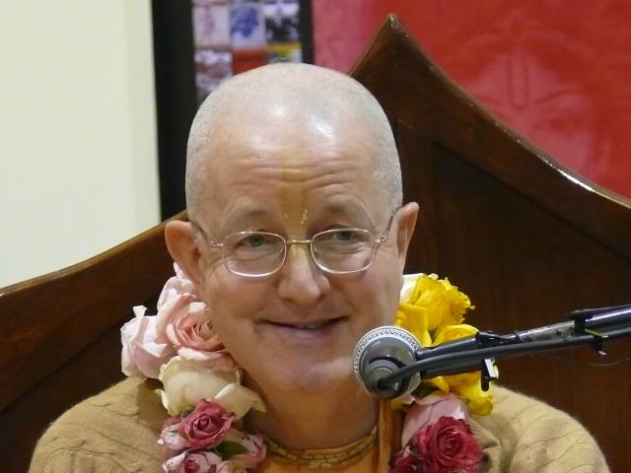
All glories to HH Romapada Maharaj

Slide 36
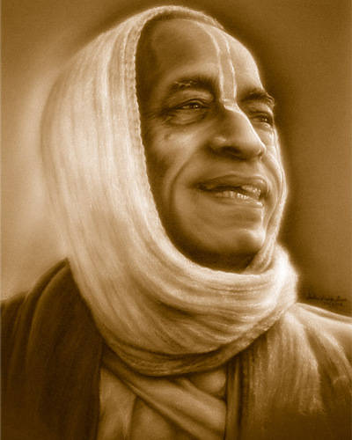
All glories to Srila Prabhupada!

