Slide 1
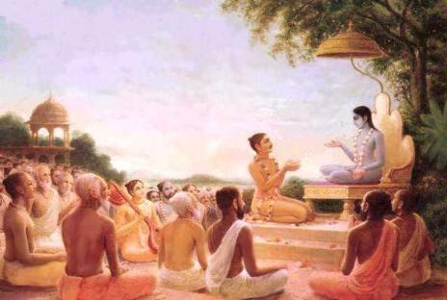
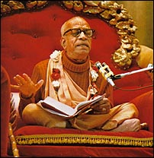
Srimad Bhagavatham 1.19.20-30

Slide 2
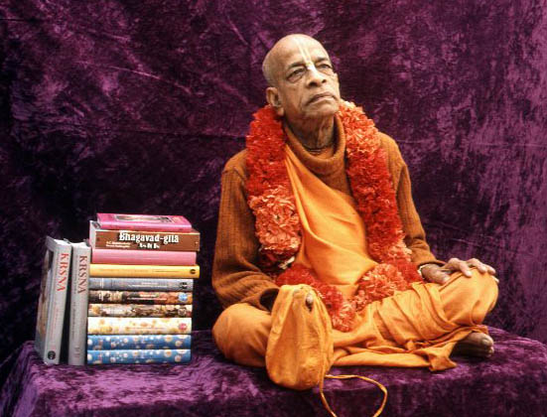

Slide 3
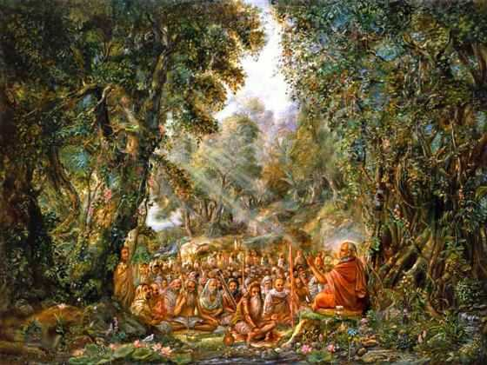
Suta Goswami narrating Srimad Bhagvatam.

Slide 4
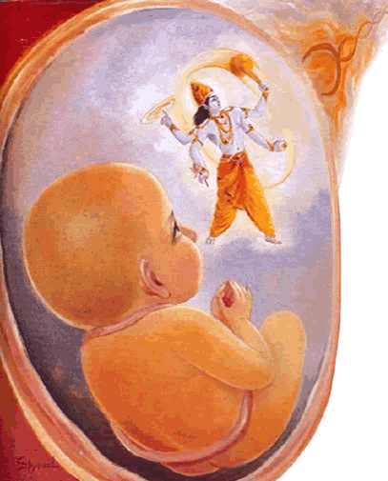
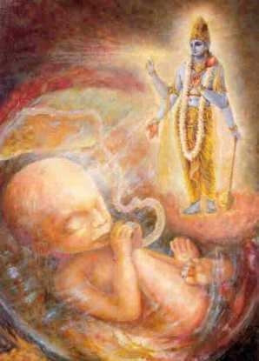
Lord Krishna

Slide 5
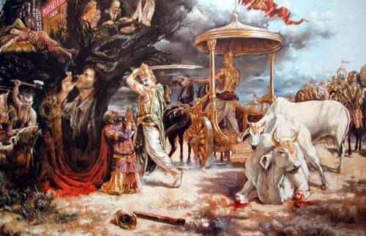
Maharaj Parikshit gives Kali residing places in Gold and where four regulative principles are broken

Slide 6
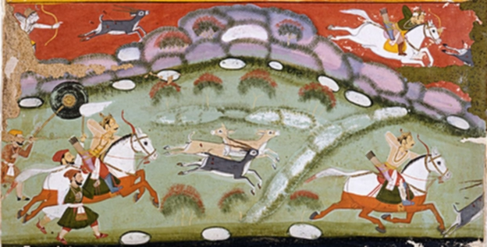
Maharaj Parikshit on a Hunting Trip

Slide 7
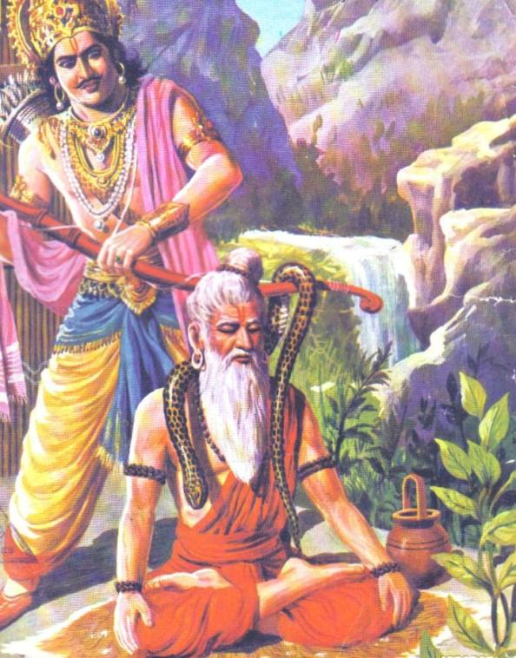

Slide 8
SB 1.19.20:
na vā idaḿ rājarṣi-varya citraḿ
bhavatsu kṛṣṇaḿ samanuvrateṣu
ye 'dhyāsanaḿ rāja-kirīṭa-juṣṭaḿ
sadyo jahur bhagavat-pārśva-kāmāḥ
[The sages said:] O chief of all the saintly kings of the Pāṇḍu dynasty who are strictly in the line of Lord Śrī Kṛṣṇa! It is not at all astonishing that you give up your throne, which is decorated with the helmets of many kings, to achieve eternal association with the Personality of Godhead.

Slide 9
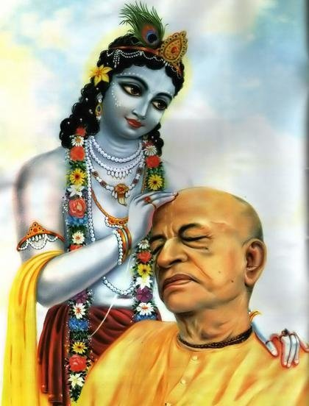
SB 1.19.20:
Foolish politicians who hold political administrative posts think that the temporary posts they occupy are the highest material gain of life, and therefore they stick to those posts even up to the last moment of life, without knowing that achievement of liberation as one of the associates of the Lord in His eternal abode is the highest gain of life. The human life is meant for achieving this end. The Lord has assured us in the Bhagavad-gītā many times that going back to Godhead, His eternal abode, is the highest achievement. Prahlāda Mahārāja, while praying to Lord Nṛsiḿha, said, "O my Lord, I am very much afraid of the materialistic way of life, and I am not the least afraid of Your present ghastly ferocious feature as Nṛsiḿhadeva.

Slide 10
SB 1.19.20:
This materialistic way of life is something like a grinding stone, and we are being crushed by it. We have fallen into this horrible whirlpool of the tossing waves of life, and thus, my Lord, I pray at Your lotus feet to call me back to Your eternal abode as one of Your servitors. This is the summit liberation of this materialistic way of life. I have very bitter experience of the materialistic way of life. In whichever species of life I have taken birth, compelled by the force of my own activities, I have very painfully experienced two things, namely separation from my beloved and meeting with what is not wanted. And to counteract them, the remedies which I undertook were more dangerous than the disease itself. So I drift from one point to another birth after birth, and I pray to You therefore to give me a shelter at Your lotus feet."

Slide 11
SB 1.19.20:
The Pāṇḍava kings, who are more than many saints of the world, knew the bitter results of the materialistic way of life. They were never captivated by the glare of the imperial throne they occupied, and they sought always the opportunity of being called by the Lord to associate with Him eternally. Mahārāja Parīkṣit was the worthy grandson of Mahārāja Yudhiṣṭhira. Mahārāja Yudhiṣṭhira gave up the imperial throne to his grandson, and similarly Mahārāja Parīkṣit, the grandson of Mahārāja Yudhiṣṭhira, gave up the imperial throne to his son Janamejaya. That is the way of all the kings in the dynasty because they are all strictly in the line of Lord Kṛṣṇa. Thus the devotees of the Lord are never enchanted by the glare of materialistic life, and they live impartially, unattached to the objects of the false, illusory materialistic way of life.

Slide 12
SB 1.19.21:
sarve vayaḿ tāvad ihāsmahe 'tha
kalevaraḿ yāvad asau vihāya
lokaḿ paraḿ virajaskaḿ viśokaḿ
yāsyaty ayaḿ bhāgavata-pradhānaḥ
We shall all wait here until the foremost devotee of the Lord, Mahārāja Parīkṣit, returns to the supreme planet, which is completely free from all mundane contamination and all kinds of lamentation.

Slide 13
Beyond the limitation of the material creation, which is compared to the cloud in the sky, there is the paravyoma, or the spiritual sky, full of planets called Vaikuṇṭhas. Such Vaikuṇṭha planets are also differently known as the Puruṣottamaloka, Acyutaloka, Trivikramaloka, Hṛṣīkeśaloka, Keśavaloka, Aniruddhaloka, Mādhavaloka, Pradyumnaloka, Sańkarṣaṇaloka, Śrīdharaloka, Vāsudevaloka, Ayodhyāloka, Dvārakāloka and many other millions of spiritual lokas wherein the Personality of Godhead predominates; all the living entities there are liberated souls with spiritual bodies as good as that of the Lord. There is no material contamination; everything there is spiritual, and therefore there is nothing objectively lamentable. They are full of transcendental bliss, and are without birth, death, old age and disease.

Slide 14
And amongst all the above-mentioned Vaikuṇṭhalokas, there is one supreme loka called Goloka Vṛndāvana, which is the abode of the Lord Śrī Kṛṣṇa and His specific associates. Mahārāja Parīkṣit was destined to achieve this particular loka, and the great ṛṣis assembled there could foresee this. All of them consulted among themselves about the great departure of the great King, and they wanted to see him up to the last moment because they would no more be able to see such a great devotee of the Lord. When a great devotee of the Lord passes away, there is nothing to be lamented because the devotee is destined to enter into the kingdom of God. But the sorry plight is that such great devotees leave our sight, and therefore there is every reason to be sorry. As the Lord is rarely to be seen by our present eyes, so also are the great devotees. The great ṛṣis, therefore, correctly decided to remain on the spot till the last moment.

Slide 15
SB 1.19.22:
āśrutya tad ṛṣi-gaṇa-vacaḥ parīkṣit
samaḿ madhu-cyud guru cāvyalīkam
ābhāṣatainān abhinandya yuktān
śuśrūṣamāṇaś caritāni viṣṇoḥ
All that was spoken by the great sages was very sweet to hear, full of meaning and appropriately presented as perfectly true. So after hearing them, Mahārāja Parīkṣit, desiring to hear of the activities of Lord Śrī Kṛṣṇa, the Personality of Godhead, congratulated the great sages.

Slide 16
SB 1.19.23:
samāgatāḥ sarvata eva sarve
vedā yathā mūrti-dharās tri-pṛṣṭhe
nehātha nāmutra ca kaścanārtha
ṛte parānugraham ātma-śīlam
The King said: O great sages, you have all very kindly assembled here, having come from all parts of the universe. You are all as good as supreme knowledge personified, who resides in the planet above the three worlds [Satyaloka]. Consequently you are naturally inclined to do good to others, and but for this you have no interest, either in this life or in the next.

Slide 17
SB 1.19.23:
Six kinds of opulences, namely wealth, strength, fame, beauty, knowledge and renunciation, are all originally the different attributes pertaining to the Absolute Personality of Godhead. The living beings, who are part-and-parcel entities of the Supreme Being, have all these attributes partially, up to the full strength of seventy-eight percent. In the material world these attributes (up to seventy-eight percent of the Lord's attributes) are covered by the material energy, as the sun is covered by a cloud. The covered strength of the sun is very dim, compared to the original glare, and similarly the original color of the living beings with such attributes becomes almost extinct. There are three planetary systems, namely the lower worlds, the intermediate worlds and the upper worlds.

Slide 18
SB 1.19.23:
The human beings on earth are situated at the beginning of the intermediate worlds, but living beings like Brahmā and his contemporaries live in the upper worlds, of which the topmost is Satyaloka. In Satyaloka the inhabitants are fully cognizant of Vedic wisdom, and thus the mystic cloud of material energy is cleared. Therefore they are known as the Vedas personified. Such persons, being fully aware of knowledge both mundane and transcendental, have no interest in either the mundane or transcendental worlds. They are practically desireless devotees. In the mundane world they have nothing to achieve, and in the transcendental world they are full in themselves. Then why do they come to the mundane world? They descend on different planets as messiahs by the order of the Lord to deliver the fallen souls. On the earth they come down and do good to the people of the world in different circumstances under different climatic influences. They have nothing to do in this world save and except reclaim the fallen souls rotting in material existence, deluded by material energy.

Slide 19
SB 1.19.24:
tataś ca vaḥ pṛcchyam imaḿ vipṛcche
viśrabhya viprā iti kṛtyatāyām
sarvātmanā mriyamāṇaiś ca kṛtyaḿ
śuddhaḿ ca tatrāmṛśatābhiyuktāḥ
O trustworthy brāhmaṇas, I now ask you about my immediate duty. Please, after proper deliberation, tell me of the unalloyed duty of everyone in all circumstances, and specifically of those who are just about to die.

Slide 20
SB 1.19.24:
In this verse the King has placed two questions before the learned sages. The first question is what is the duty of everyone in all circumstances, and the second question is what is the specific duty of one who is to die very shortly. Out of the two, the question relating to the dying man is most important because everyone is a dying man, either very shortly or after one hundred years. The duration of life is immaterial, but the duty of a dying man is very important. Mahārāja Parīkṣit placed these two questions before Śukadeva Gosvāmī also on his arrival, and practically the whole of the Śrīmad-Bhāgavatam, beginning from the Second Canto up to the last Twelfth Canto, deals with these two questions.

Slide 21
SB 1.19.24:
The conclusion arrived at thereof is that devotional service of the Lord Śrī Kṛṣṇa, as it is confirmed by the Lord Himself in the last phases of the Bhagavad-gītā, is the last word in relation to everyone's permanent duty in life. Mahārāja Parīkṣit was already aware of this fact, but he wanted the great sages assembled there to unanimously give their verdict on his conviction so that he might be able to go on with his confirmed duty without controversy. He has especially mentioned the word śuddha, or perfectly correct. For transcendental realization or self-realization, many processes are recommended by various classes of philosophers. Some of them are first-class methods, and some of them are second- or third-class methods. The first-class method demands that one give up all other methods and surrender unto the lotus feet of the Lord and thus be saved from all sins and their reactions.

Slide 22
SB 1.19.25:
tatrābhavad bhagavān vyāsa-putro
yadṛcchayā gām aṭamāno 'napekṣaḥ
alakṣya-lińgo nija-lābha-tuṣṭo
vṛtaś ca bālair avadhūta-veṣaḥ
At that moment there appeared the powerful son of Vyāsadeva, who traveled over the earth disinterested and satisfied with himself. He did not manifest any symptoms of belonging to any social order or status of life. He was surrounded with women and children, and he dressed as if others had neglected him.

Slide 23
SB 1.19.25:
The word bhagavān is sometimes used in relation with some of the great devotees of the Lord, like Śukadeva Gosvāmī. Such liberated souls are disinterested in the affairs of this material world because they are self-satisfied by the great achievements of devotional service. As explained before, Śukadeva Gosvāmī never accepted any formal spiritual master, nor did he undergo any formal reformatory performances. His father, Vyāsadeva, was his natural spiritual master because Śukadeva Gosvāmī heard Śrīmad-Bhāgavatam from him. After this, he became completely self-satisfied. Thus he was not dependent on any formal process. The formal processes are necessary for those who are expected to reach the stage of complete liberation, but Śrī Śukadeva Gosvāmī was already in that status by the grace of his father. As a young boy he was expected to be properly dressed, but he went about naked and was uninterested in social customs.

Slide 24
SB 1.19.25:
He was neglected by the general populace, and inquisitive boys and women surrounded him as if he were a madman. He thus appears on the scene while traveling on the earth of his own accord. It appears that upon the inquiry of Mahārāja Parīkṣit, the great sages were not unanimous in their decision as to what was to be done. For spiritual salvation there were many prescriptions according to the different modes of different persons. But the ultimate aim of life is to attain the highest perfectional stage of devotional service to the Lord. As doctors differ, so also sages differ in their different prescriptions. While such things were going on, the great and powerful son of Vyāsadeva appeared on the scene.

Slide 26
SB 1.19.26:
taḿ dvyaṣṭa-varṣaḿ su-kumāra-pāda-
karoru-bāhv-aḿsa-kapola-gātram
cārv-āyatākṣonnasa-tulya-karṇa-
subhrv-ānanaḿ kambu-sujāta-kaṇṭham
This son of Vyāsadeva was only sixteen years old. His legs, hands, thighs, arms, shoulders, forehead and the other parts of his body were all delicately formed. His eyes were beautifully wide, and his nose and ears were highly raised. He had a very attractive face, and his neck was well formed and beautiful like a conchshell.

Slide 27
SB 1.19.26:
A respectable personality is described beginning with the legs, and this honored system is observed here with Śukadeva Gosvāmī. He was only sixteen years of age. A person is honored for his achievements and not for advanced age. A person can be older by experience and not by age. Śrī Śukadeva Gosvāmī, who is described herein as the son of Vyāsadeva, was by his knowledge more experienced than all the sages present there, although he was only sixteen years old.

Slide 28
SB 1.19.27:
nigūḍha-jatruḿ pṛthu-tuńga-vakṣasam
āvarta-nābhiḿ vali-valgūdaraḿ ca
dig-ambaraḿ vaktra-vikīrṇa-keśaḿ
pralamba-bāhuḿ svamarottamābham
His collarbone was fleshy, his chest broad and thick, his navel deep and his abdomen beautifully striped. His arms were long, and curly hair was strewn over his beautiful face. He was naked, and the hue of his body reflected that of Lord Kṛṣṇa.

Slide 29
SB 1.19.27:
His bodily features indicate him to be different from common men. All the signs described in connection with the bodily features of Śukadeva Gosvāmī are uncommon symptoms, typical of great personalities, according to physiognomical calculations. His bodily hue resembled that of Lord Kṛṣṇa, who is the supreme among the gods, demigods and all living beings.

Slide 30
SB 1.19.28:
śyāmaḿ sadāpīvya-vayo-'ńga-lakṣmyā
strīṇāḿ mano-jñaḿ rucira-smitena
pratyutthitās te munayaḥ svāsanebhyas
tal-lakṣaṇa-jñā api gūḍha-varcasam
He was blackish and very beautiful due to his youth. Because of the glamor of his body and his attractive smiles, he was pleasing to women. Though he tried to cover his natural glories, the great sages present there were all expert in the art of physiognomy, and so they honored him by rising from their seats.

Slide 32
SB 1.19.29:
sa viṣṇu-rāto 'tithaya āgatāya
tasmai saparyāḿ śirasājahāra
tato nivṛttā hy abudhāḥ striyo 'rbhakā
mahāsane sopaviveśa pūjitaḥ
Mahārāja Parīkṣit, who is also known as Viṣṇurāta [one who is always protected by Viṣṇu], bowed his head to receive the chief guest, Śukadeva Gosvāmī. At that time all the ignorant women and boys ceased following Śrīla Śukadeva. Receiving respect from all, Śukadeva Gosvāmī took his exalted seat.

Slide 33
SB 1.19.29:
On Śukadeva Gosvāmī's arrival at the meeting, everyone, except Śrīla Vyāsadeva, Nārada and a few others, stood up, and Mahārāja Parīkṣit, who was glad to receive a great devotee of the Lord, bowed down before him with all the limbs of his body. Śukadeva Gosvāmī also exchanged the greetings and reception by embrace, shaking of hands, nodding and bowing down, especially before his father and Nārada Muni. Thus he was offered the presidential seat at the meeting. When he was so received by the king and sages, the street boys and less intelligent women who followed him were struck with wonder and fear. So they retired from their frivolous activities, and everything was full of gravity and calm.

Slide 34
SB 1.19.30:
sa saḿvṛtas tatra mahān mahīyasāḿ
brahmarṣi-rājarṣi-devarṣi-sańghaiḥ
vyarocatālaḿ bhagavān yathendur
graharkṣa-tārā-nikaraiḥ parītaḥ
Śukadeva Gosvāmī was then surrounded by saintly sages and demigods just as the moon is surrounded by stars, planets and other heavenly bodies. His presence was gorgeous, and he was respected by all.

Slide 35
SB 1.19.29:
In the great assembly of saintly personalities, there was Vyāsadeva the brahmarṣi, Nārada the devarṣi, Paraśurāma the great ruler of the kṣatriya kings, etc. Some of them were powerful incarnations of the Lord. Śukadeva Gosvāmī was not known as brahmarṣi, rājarṣi or devarṣi, nor was he an incarnation like Nārada, Vyāsa or Paraśurāma. And yet he excelled them in respects paid. This means that the devotee of the Lord is more honored in the world than the Lord Himself. One should therefore never minimize the importance of a devotee like Śukadeva Gosvāmī.

Slide 36
Practical Application (by HH Tamal Krishna Goswami maharaj)
Advancement we see today has improved life
On the other hand life has deteriorated – anxiety with material progress
Advancement <=> Dehumanized
More immune, more cold
Material thing is for my satisfaction – individualism
Fewer people are willing to sacrifice for others
More stimulation – ignores goal of life
Prabhupada’s solution – Varnashrama
People in a city are more isolated today although closer today
Simple culture – simpler lifestyle and less problems
Troupes of people putting Ramayana and Mahabharata

Slide 37
Practical Application (by HH Tamal Krishna Goswami maharaj)
Prabhupada’s solution – Varnashrama
Entertainment to get out of cycle of birth and death, thinking about Lord Rama and Krishna
People have been doing this for thousands of years
Up until 200 years worlwide ago divorce was very very few
World was a mysterious place up until 200 years ago worldwide
Miracle are when an intelligent is concerned about the world
Outside as Bhagavan (overall picture) and inside as paramatma (specific care)

Slide 38
Practical Application (by HH Tamal Krishna Goswami maharaj)
You cannot know difference between mad man and wise man until the person speaks
People tend to be rude to someone who is not aligned with current norms
Sukdev Goswami was seen as mad by some and wise by some
Sukhdev goswami is a realized soul and embodies the parampara
Ignorant persons cannot understand this – if you cannot see, touch or taste it does exist
Here is evidence from transcendental perspective – two people hearing a lecture will respond in different ways – lack of possession of qualifications
Devotional life when sinful reactions are complete
If you are still receiving reactions to past sinful activities you cannot understand what sinful life
Problem is people have become overwhelmingly sinful so difficulty in understanding
So they come up with godless religions – may seem as religion
Traditional societies stood together for a long time – 1000s and mllions of years – they had the right glue
Modern religions do not hold very long

Slide 39
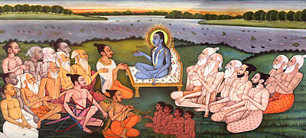

Slide 41
References
HH Bhakti Vikasa Swami Lectures - Various
HH Tamal Krishna Goswami Lectures
1997.02.07 Dallas, US SB 1.19.21 58:33 13.4M Believe in "Vedic Myths" or Modern Nightmare
1997.02.15 Dallas, US SB 1.19.29 44:53 10.3M It's Hard Not To Advance in Spiritual Life
HDG Srila Prabhupada Lectures
Bhurijana Prabhu books
HH Harivilas Prabhu wisdom

