Slide 1
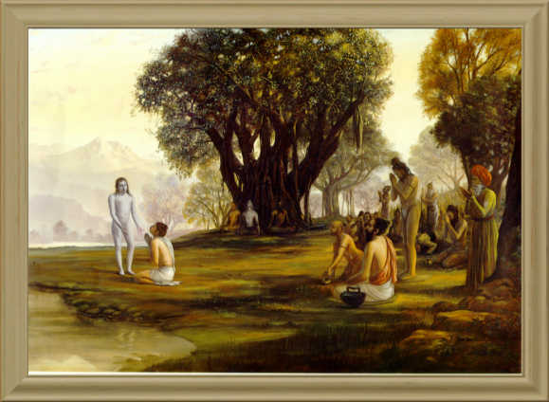
Srimad Bhagavatam
1st Canto 19th Chapter - The Appearance of Śukadeva Gosvāmī
1.19.01 – 1.19.08
By Nritya Gauranga Das

Slide 2
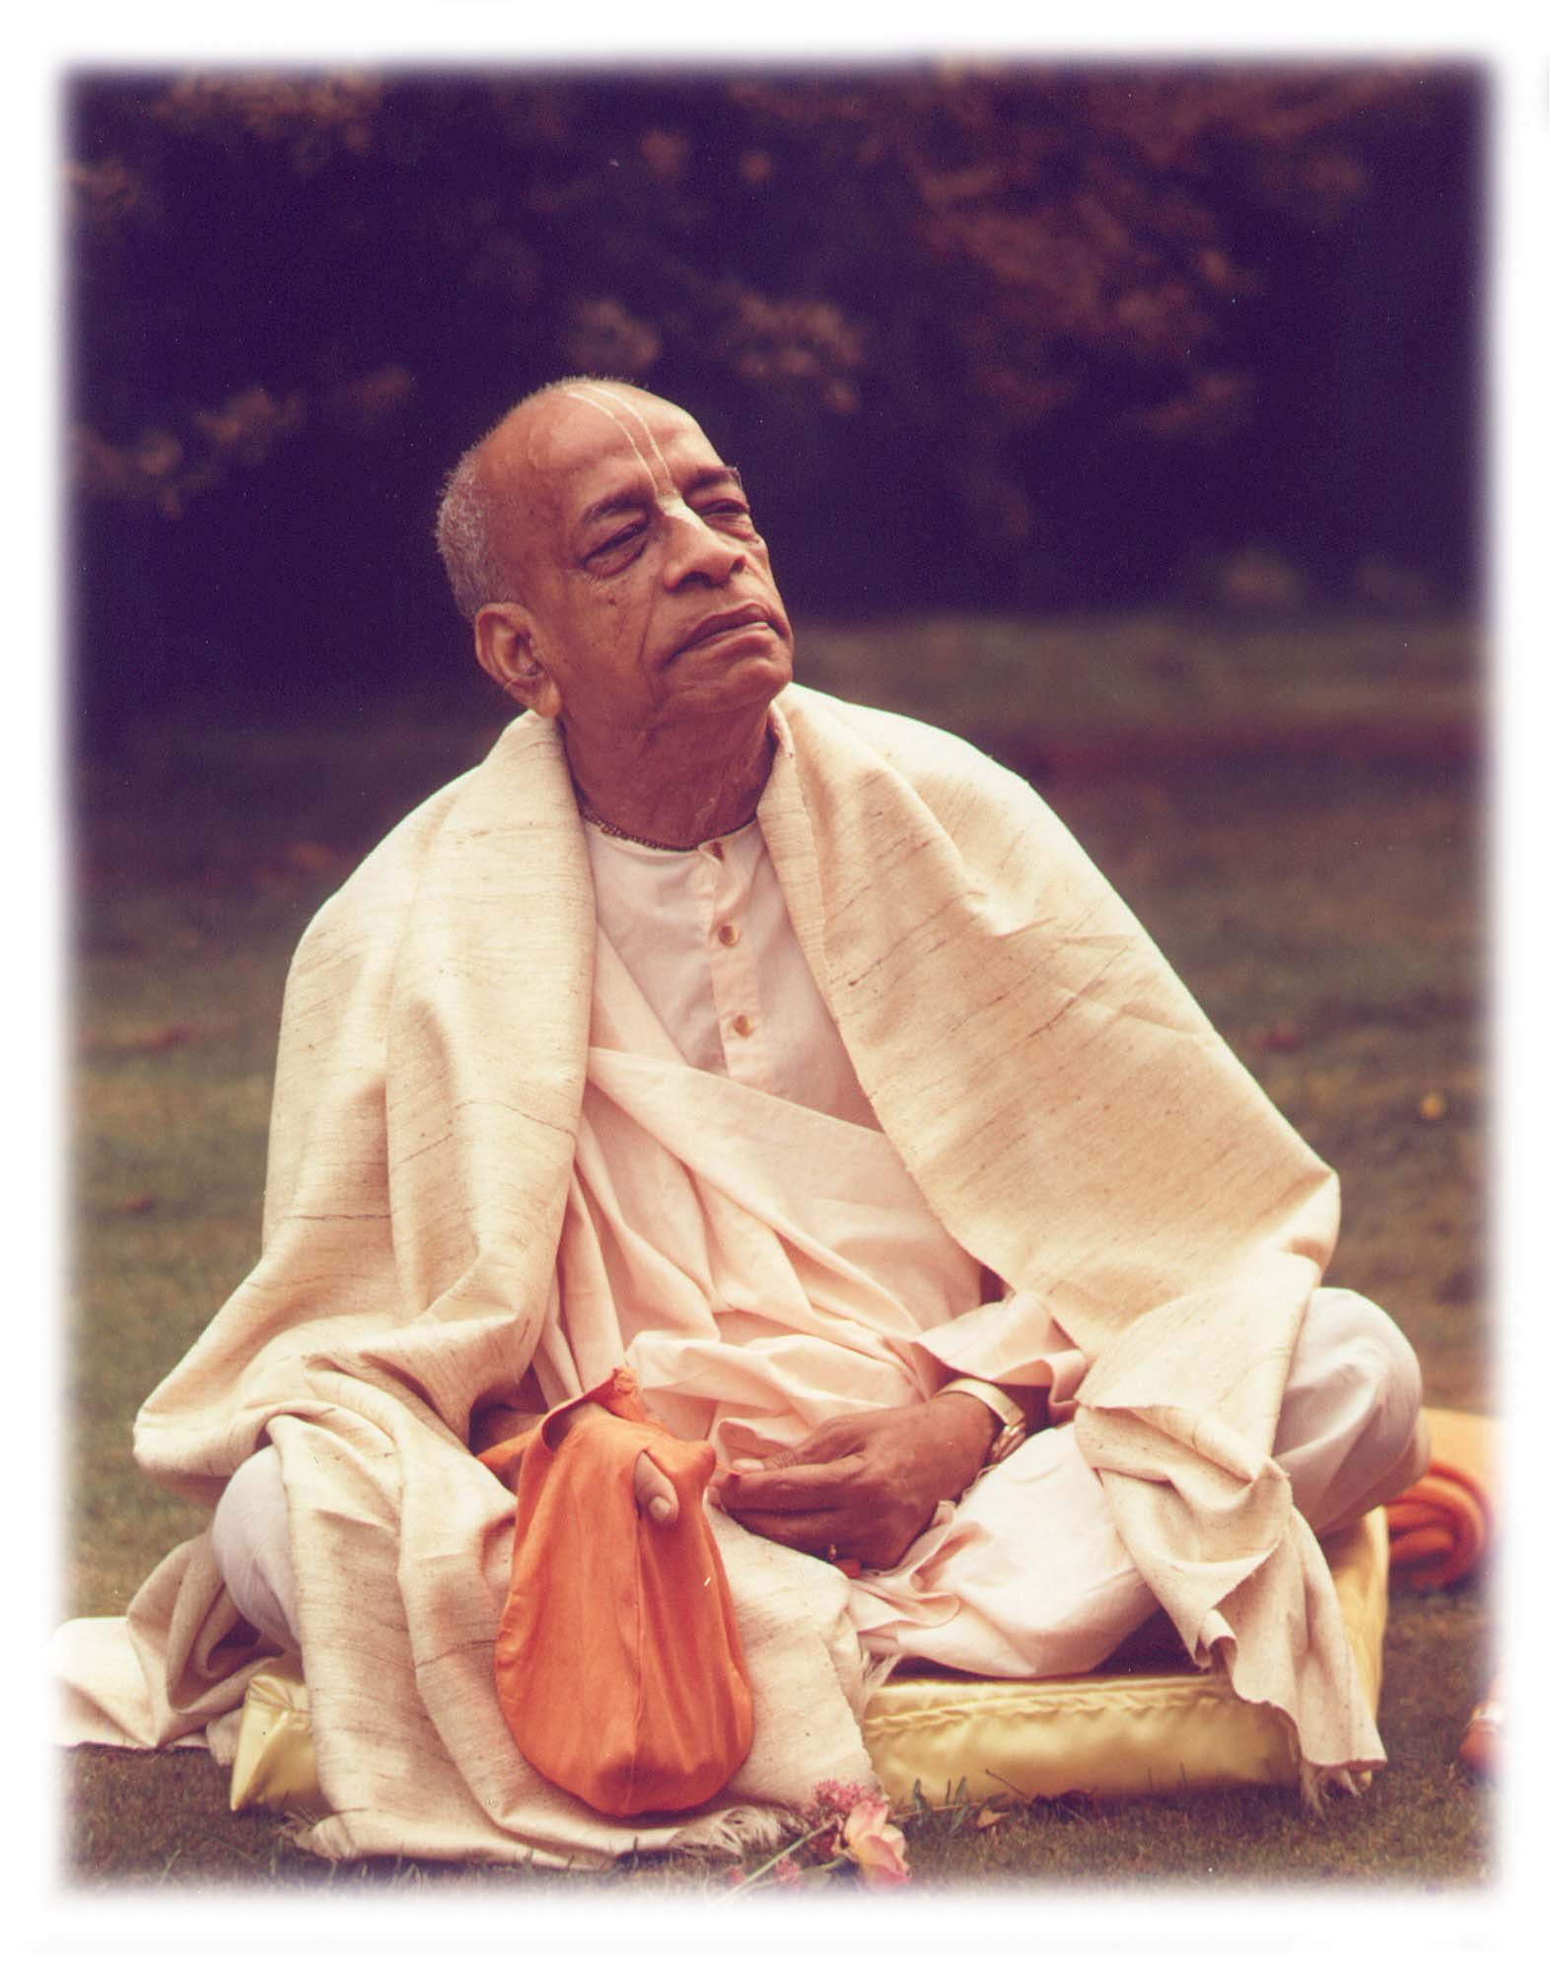
Based on the teachings of His Divine Grace A.C. Bhaktivedanta Swami Prabhupada
~ Founder Acharya ~
International Society For Krishna Consciousness

Slide 3
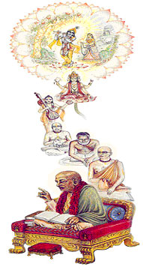
Seeking the Blessings of Guru, Gauranga & All the Assembled Vaishnavas

Slide 4
Śrīmad Bhāgavatam 1.2.4
nārāyaṇaḿ namaskṛtya
naraḿ caiva narottamam
devīḿ sarasvatīḿ vyāsaḿ
tato jayam udīrayet
TRANSLATION
Before reciting this Śrīmad-Bhāgavatam, which is the very means of conquest, one should offer respectful obeisances unto the Personality of Godhead, Nārāyaṇa, unto Nara-nārāyaṇa Ṛṣi, the supermost human being, unto mother Sarasvatī, the goddess of learning, and unto Śrīla Vyāsadeva, the author.

Slide 5
Śrīmad Bhāgavatam 1.2.18
naṣṭa-prāyeṣv abhadreṣu
nityaḿ bhāgavata-sevayā
bhagavaty uttama-śloke
bhaktir bhavati naiṣṭhikī
TRANSLATION
By regular attendance in classes on the Bhāgavatam and by rendering of service to the pure devotee, all that is troublesome to the heart is almost completely destroyed, and loving service unto the Personality of Godhead, who is praised with transcendental songs, is established as an irrevocable fact.

Slide 6
Chapter 19 Sections & Section Thems
1.19.1 - 7
Mahārāja Parīkṣit: Preparation for Death.
1.19.8 - 19
A devotees association with sages.
1.19.20 – 24
Desires of Devotees.
1.19.25 - 40
Associating with a saint.

Slide 7
Section Theme – Repentance & Preparation of Death
1.19.1 - 3
Mahārāja Parīkṣit Repents – For his accidental improper behaviour towards Śamīka Rishi.
1.19.4
Mahārāja Parīkṣit - Receives news of his imminent death.
1.19.5 – 7
Mahārāja Parīkṣit – Prepares for his death.
1.19.8
Arrival of great sages to visit Mahārāja Parīkṣit

Slide 8
Śrīmad Bhāgavatam 1.19.1
sūta uvāca
mahī-patis tv atha tat-karma garhyaḿ
vicintayann ātma-kṛtaḿ sudurmanāḥ
aho mayā nīcam anārya-vat kṛtaḿ
nirāgasi brahmaṇi gūḍha-tejasi
TRANSLATION
Śrī Sūta Gosvāmī said: While returning home, the King [Mahārāja Parīkṣit] felt that the act he had committed against the faultless and powerful brāhmaṇa was heinous and uncivilized. Consequently he was distressed.

Slide 9
Mood of a Vaishnava-
Considers himself at fault.
What did Maharaj Parikshit Regret for?
For his accidental improper treatment of the powerful brāhmaṇa, who was faultless.
Ritual or Knowledge is not just enough – Ex: SPP’s God Brother
Avoid committing the sin again by fully surrendering at the lotus feet of Lord and always trying to be in the service of the lord Krsna.
Result of sincere repentance for accidental sins?
By the grace of the Lord all sins unwillingly committed by a devotee are burnt in the fire of repentance.
Practicle Application:
Devotees should sincerely repent for this accidental sins.
Ex: Lord Brahma

Slide 10
Śrīmad Bhāgavatam 1.19.2
dhruvaḿ tato me kṛta-deva-helanād
duratyayaḿ vyasanaḿ nāti-dīrghāt
tad astu kāmaḿ hy agha-niṣkṛtāya me
yathā na kuryāḿ punar evam addhā
TRANSLATION
[King Parīkṣit thought:] Due to my neglecting the injunctions of the Supreme Lord I must certainly expect some difficulty to overcome me in the near future. I now desire without reservation that the calamity come now, for in this way I may be freed of the sinful action and not commit such an offense again

Slide 11
Injunctions of the Supreme Lord?
Brāhmaṇas and cows must be given all protection
A man's personal misconduct affects all his family members.
Each of our consciousness affects our close circle mostly our family members, both positively & negatively.
Those who are in a most responsible position and those who are trying to be Vaishanvas, need to set the right standards.
yad yad ācarati śreṣṭhas tat tad evetaro janaḥ (BG -3.21)
Thoughts of a Responsible Devotee.
Unselfish - Let the Imminent calamity fall on me and not on my family members.
By suffering personally he would be restrained from future sins.
At the same time the sin which he had committed would be counteracted so that his descendants would not suffer.
NOTE: The family members of a devotee also share the effects of a devotee's service unto the Lord. Ex: Prahlad Maharaj.

Slide 12
Śrīmad Bhāgavatam 1.19.3
adyaiva rājyaḿ balam ṛddha-kośaḿ
prakopita-brahma-kulānalo me
dahatv abhadrasya punar na me 'bhūt
pāpīyasī dhīr dvija-deva-gobhyaḥ
TRANSLATION
I am uncivilized and sinful due to my neglect of brahminical culture, God consciousness and cow protection. Therefore I wish that my kingdom, strength and riches burn up immediately by the fire of the brāhmaṇa's wrath so that in the future I may not be guided by such inauspicious attitudes.

Slide 13
Maharaj Parikshit wish that his kingdom, strength and riches burn up immediately by the fire of the brāhmaṇa's wrath?
Pride – Pride comes with the Strength & Wealth and may enable one to act in an inauspecious way.
Exmaple: Nalakuvara & Manigriva. King Vena.
Cow protection means feeding the brahminical culture, How?
Cow being one the seven mother and it’s existance is full of service.
Cow is not a object to make money.
Cows milk nourishes fine tissues and brings one to the mode of goodness.

Slide 14
Progressive human civilization is based on?
Brahminical culture for self-purification,
God consciousness for self-realization and
Cow protection for getting sufficient milk and the best food to continue a perfect civilization
All economic development of the state by trade, commerce, agriculture and industries must be fully utilized in relation to the above principles.
What does Age of Kali aims at?
Killing the higher principles of life.
Mahārāja Parīkṣit was induced to disregard the brahminical culture due to a slight provocation of hunger and thirst.

Slide 15
How to achieve peace and prosperity in the world?
Every state and every home must endeavor to advance the cause of brahminical culture for self-purification, God consciousness for self-realization and cow protection for getting sufficient milk and the best food to continue a perfect civilization
Practical Application!
Don’t become proud of your Strength & Wealth and act in an inauspecious way.
Know that SPG is the source of you Strength & Wealth.
Engage your wealth and strength in the advancement of brahminical culture, God consciousness and cow protection. This will bring peace and prosperity in the world.
Lead a principle centered Life:
Follow Injunctions / instructions of Spritual master and Lord Krsna.
Dadami Bhuddiyogam tam yena mam upayanthiti

Slide 16
Śrīmad Bhāgavatam 1.19.4
sa cintayann ittham athāśṛṇod yathā
muneḥ sutokto nirṛtis takṣakākhyaḥ
sa sādhu mene na cireṇa takṣakā
nalaḿ prasaktasya virakti-kāraṇam
TRANSLATION
While the King was thus repenting, he received news of his imminent death, which would be due to the bite of a snake-bird, occasioned by the curse spoken by the sage's son. The King accepted this as good news, for it would be the cause of his indifference toward worldly things.

Slide 17
How is real happiness Achieved.?
Spiritual existence or by cessation of the repetition of birth and death
Poverty-stricken are better candidates for attaining Perfection.
Material attachments are like anchors.
Śamīka Muni regrets the incident & conveys the news to the King as a matter of duty.
Both Śamīka Muni and the King were self-realized souls
Mahārāja Parīkṣit didn’t go the muni to beg his pardon
He doesn’t want to embarrass the muni further.
Instead he decided to prepare himself for his imminent death and find out the way to go back to Godhead

Slide 18
Purpose of Varnasrama / Sanantana dharma :
Prepares a man for going back to Godhead
House hoder →Vanaprasta → Sanyasa
Parīkṣit Mahārāja got seven-day notice, but the common man there is no definite notice.
Irresponsible life is adopted because of a sinful desire to condemn brahminical culture, God consciousness and cow protection, for which the state is responsible.
The states revenue should be employed for -
To advance in 3 items mentioned above.
Educate the populace to prepare for death.
India follow PM – Do not imitate materialistic states.

Slide 19
Śrīmad Bhāgavatam 1.19.5
atho vihāyemam amuḿ ca lokaḿ
vimarśitau heyatayā purastāt
kṛṣṇāńghri-sevām adhimanyamāna
upāviśat prāyam amartya-nadyām
TRANSLATION
Mahārāja Parīkṣit sat down firmly on the banks of the Ganges to concentrate his mind in Kṛṣṇa consciousness, rejecting all other practices of self-realization, because transcendental loving service to Kṛṣṇa is the greatest achievement, superseding all other methods.

Slide 20
What does a devotees desire?
Go back to the abode of the lord.
None of the material planets are suitable for his stay.
Purpose of going back to godhead?
Just to become one of the associates of the Lord in various Rasas the capacity of servitor, friend, parent or conjugal lover of the Lord, either in one of the innumerable Vaikuṇṭha planets or in Goloka Vṛndāvana.
Mahārāja Parīkṣit was aware of all this Information.
Due to his accumulated piety and birth in a high family of devotees, Vaiṣṇavas.
Modern scientists eager to reach the Moon - Mahārāja Parīkṣit does not care a fig any material planets.
Mahārāja Parīkṣit’s disposition?
He became more determined in the transcendental loving service of Lord Kṛṣṇa by complete fasting on the bank of the transcendental River Yamunā.

Slide 21
Practicle application!
Death could be at any moment.
Each one of us will be tested at that time. – Be prepared.

Slide 22
Śrīmad Bhāgavatam 1.19.6
yā vai lasac-chrī-tulasī-vimiśra-
kṛṣṇāńghri-reṇv-abhyadhikāmbu-netrī
punāti lokān ubhayatra seśān
kas tāḿ na seveta mariṣyamāṇaḥ
TRANSLATION
The river [Ganges, by which the King sat to fast] carries the most auspicious water, which is mixed with the dust of the lotus feet of the Lord and tulasī leaves. Therefore that water sanctifies the three worlds inside and outside and even sanctifies Lord Śiva and other demigods. Consequently everyone who is destined to die must take shelter of this river.

Slide 23
Mahārāja Parīkṣit, at once retired from family life and shifted himself to the sacred bank of the Yamunā River.
Śrīla Jīva Gosvāmī, says - King took shelter on the bank of the Yamunā. Śrīla Jīva - more accurate because of the geographical situation of Hastinapura.
Comparing the sanctity of Ganges & Yamunā
Yamuna - more directly connected with Lord Kṛṣṇa, as Lord contacted the River Yamunā more than the Ganges.
The Lord sanctified the River Yamunā from the beginning of His transcendental pastimes in the world. Ex: Vasudeva carrying Baby Krsna
Varāha Purāṇa - Śrīla Jīva Gosvāmī,
No difference between the Ganges and the Yamunā,
Ganges is sanctified 100 times - is called the Yamunā.
1000 names of Viṣṇu = one name of Rāma,
3 names of Lord Rāma = one name of Kṛṣṇa.

Slide 24
Śrīmad Bhāgavatam 1.19.7
iti vyavacchidya sa pāṇḍaveyaḥ
prāyopaveśaḿ prati viṣṇu-padyām
dadhau mukundāńghrim ananya-bhāvo
muni-vrato mukta-samasta-sańgaḥ
TRANSLATION
Thus the King, the worthy descendant of the Pāṇḍavas, decided once and for all and sat on the Ganges' bank to fast until death and give himself up to the lotus feet of Lord Kṛṣṇa, who alone is able to award liberation. So, freeing himself from all kinds of associations and attachments, he accepted the vows of a sage.

Slide 25
Way to liberation?
Free up oneself from all sorts of material association & Meditate upon the lotus feet of Lord Śrī Kṛṣṇa.
Result: Cease to commit any further sins & Free from the effects of all previous sins respectively.
Mukunda - The giver of liberation
Significance of sitting on the banks of Ganges or the Yamunā
Gives one a chance to remember the Lord continuously.
When will the lord help a devotee progress toward the path of liberation?
One should not willingly commit any sin in his life & should constantly remember the lotus feet of the Lord without deviation
NOTE: If there are accidental sins committed by the devotee, the Lord saves the surrendered soul from all sins, as confirmed. (SB. 11.5.42)
Notes:
21

Slide 26
Practical Application!
Devotees should not willingly commit any sin in his life & should constantly remember the lotus feet of the Lord without deviation.

Slide 27
Śrīmad Bhāgavatam 1.19.8
tatropajagmur bhuvanaḿ punānā
mahānubhāvā munayaḥ sa-śiṣyāḥ
prāyeṇa tīrthābhigamāpadeśaiḥ
svayaḿ hi tīrthāni punanti santaḥ
TRANSLATION
At that time all the great minds and thinkers, accompanied by their disciples, and sages who could verily sanctify a place of pilgrimage just by their presence, arrived there on the plea of making a pilgrim's journey.

Slide 28
Great-minded sages arrived there on the plea of pilgrimage.
Actually they came to meet Mahārāja Parīkṣit and not to take a bath of pilgrimage.
All of them were competent enough to sanctify the places of pilgrimage.
Common men visiting pilgrimage sites Vs Sages Visiting the sites
Why did the sages come to see Parikshit Maharaj?
They could foresee that Śrīmad-Bhāgavatam would be spoken by Śukadeva Gosvāmī.
All of them wanted to take advantage of the great occasion.
Śrīmad-Bhāgavatam is relished even by the liberated souls.

Slide 29
Practical Application!
When we visit the holy dham’s our goal should be to hear Krsna Katha from the Sadhus and not just to take bath and get rid of our sins.
When devotees get together – Do not gossip on the worldly affairs, instead read / discuss on Holy scriptures like Bhagavad Gita / Srimad Bhagavatam etc…

Slide 30
References
Lectures:
HH Tamala Krsna Goswami
HH Romapada Swami
HG Bhurija Prabhu

Slide 31
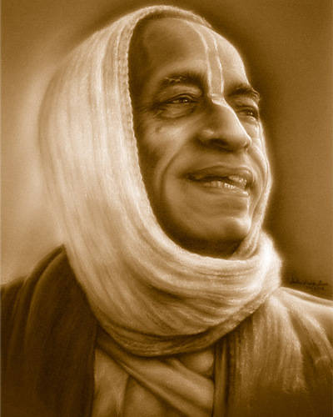
All glories to Srila Prabhupada!

