Slide 1
Srimad Bhagavatam
1.18.38 – 1.18.50
Śamīka Ṛṣi Regrets his Son’s Deed withLamentation and Prayers

Slide 2
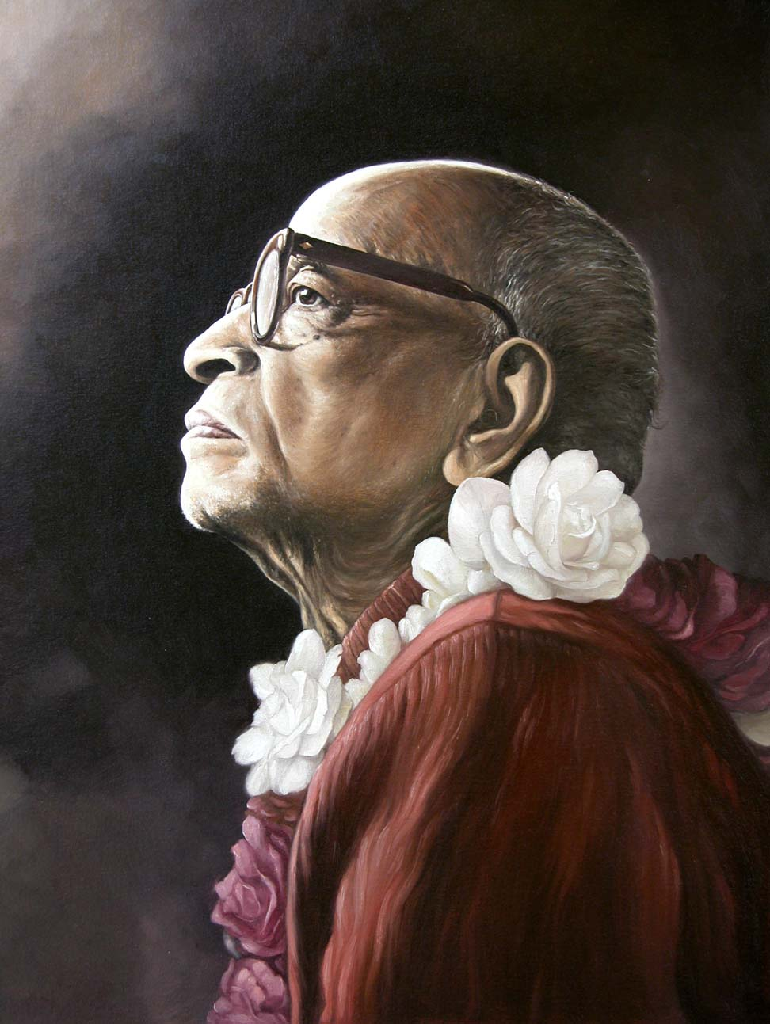
Based on the teachings of His Divine Grace A.C. Bhaktivedanta Swami Prabhupada
Founder Acharya
International Society for Krishna Consciousness

Slide 3
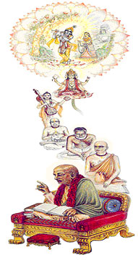
Seeking the Blessings of Guru, Gauranga & All the Assembled Vaishnavas

Slide 4
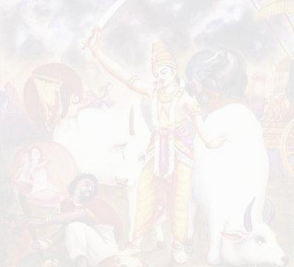
Chapter 18 : Maharaj Parikshit cursed by a Brahmana boy
Suta Goswami begins describing Maharaj Parikshit’s life which contains wonderful dealings with Krishna.
Suta Goswami tells how the King dealt with the appearance of Kali within His kingdom.
The sages glorify Suta Goswami and the importance of hearing about Krsna from great devotees.
They then request Him to describe the pastimes of the Lord, especially the topics upon which Maharaj Parikshit fixed His mind and thus attained Krsna's Lotus Feet.
Suta Goswami explains how purification happens by hearing about Krsna & then begins explaining Krsna's exalted qualities
1
2
3
4
5
6
7
8
9
10
11
12
13
14
15
16
17
18
19
20
21
22
23
Suta Goswami begins narrating how Maharaj Parikshit insulted the sage Shamika Rishi by placing a dead snake around the meditating sage's neck.
After Shamika Rishi is insulted, His son, Shringi, curses Maharaj Parikshit to die in seven days.
Shamika Rishi laments when He hears what His son has done.
Shamika Rishi prays to the Supreme Lord to forgive His son's foolishness.
24
25
26
27
28
29
30
31
38
39
40
41
42
43
44
45
46
32
33
34
35
36
37
47
48
49
50

Slide 5
Śamīka Ṛṣi Regrets his Son’s Deed with Lamentation and Prayers
1.18.38–40: Devotees must be Self-Conscious
1.18.41: Instinctive Behavior is not for Devotees
1.18.42–43: Duties of a Monarch
1.18.44–45: Effects of Democratic Leadership
1.18.46: Qualities of Mahārāja Parīkṣit
1.18.47: Taking Responsibilities for Our Actions
1.18.48–50: Behavior of Devotees

Slide 6
Śrīmad Bhāgavatam 1.18.38
ato 'bhyetyāśramaḿ bālo
gale sarpa-kalevaram
pitaraḿ vīkṣya duḥkhārto
mukta-kaṇṭho ruroda ha
Translation
Thereafter, when the boy returned to the hermitage, he saw a snake on his father's shoulder, and out of his grief he cried very loudly.

Slide 7
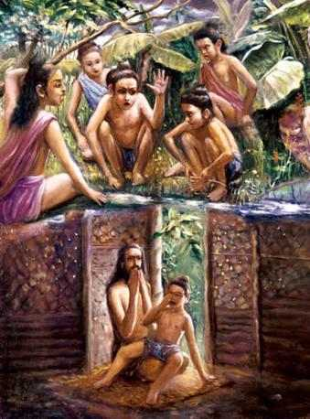
SB 1.18.38 Lamentation of Śṛńgi Important Points from Purport
Srngi was not happy due to his mistake because he wanted to be relieved of the burden on his heart by crying.
So after entering the hermitage and seeing his father in that condition, he cried loudly so that he might be relieved.
But it was too late. The father regretted the whole incident.
Notes:
The boy was not happy because he committed a great mistake, and he wanted to be relieved of the burden on his heart by crying. So after entering the hermitage and seeing his father in that condition, he cried loudly so that he might be relieved. But it was too late. The father regretted the whole incident.

Slide 8
Śrīmad Bhāgavatam 1.18.39
sa vā āńgiraso brahman
śrutvā suta-vilāpanam
unmīlya śanakair netre
dṛṣṭvā cāḿse mṛtoragam
Translation
O brāhmaṇas, the ṛṣi, who was born in the family of Ańgirā Muni, hearing his son crying, gradually opened his eyes and saw the dead snake around his neck.

Slide 9
Śrīmad Bhāgavatam 1.18.40
visṛjya taḿ ca papraccha
vatsa kasmād dhi rodiṣi
kena vā te 'pakṛtam
ity uktaḥ sa nyavedayat
Translation
He threw the dead snake aside and asked his son why he was crying, whether anyone had done him harm. On hearing this, the son explained to him what had happened.

Slide 10
SB 1.18.40 Devotees must be Self-Conscious Important Points from Purport
Śamīka Ṛṣi did not take the dead snake on his neck very seriously.
Nothing seriously wrong in Mahārāja Parīkṣit's act.
Foolish son took it very seriously, and being influenced by Kali he cursed the King and thus ended a chapter of happy history.
Notes:
The father did not take the dead snake on his neck very seriously. He simply threw it away.
Actually there was nothing seriously wrong in Mahārāja Parīkṣit's act, but the foolish son took it very seriously, and being influenced by Kali he cursed the King and thus ended a chapter of happy history

Slide 11
Śrīmad Bhāgavatam 1.18.41
niśamya śaptam atad-arhaḿ narendraḿ
sa brāhmaṇo nātmajam abhyanandat
aho batāḿho mahad adya te kṛtam
alpīyasi droha urur damo dhṛtaḥ
Translation
The father heard from his son that the King had been cursed, although he should never have been condemned, for he was the best amongst all human beings. The ṛṣi did not congratulate his son, but, on the contrary, began to repent, saying: Alas! What a great sinful act was performed by my son. He has awarded heavy punishment for an insignificant offense.

Slide 12
SB 1.18.41: Instinctive Behavior Not For Devotees Important Points from Purport
King - Best of human being & representative of God
The king may order hanging of a culprit son of a brāhmaṇa, but he does not become sinful for killing a brāhmaṇa.
Even if there is something wrong with the king, he is never to be condemned. Example: medical practitioner
In the Vedic way of life: King → is trained to become a rājarṣI,
The king is called narendra, or the best amongst the human beings.
How then could a king like Mahārāja Parīkṣit be condemned by an inexperienced, puffed-up son of a brāhmaṇa, even though he had attained the powers of a qualified brāhmaṇa?
Since Śamīka Ṛṣi was an experienced, good brāhmaṇa, he did not approve of the actions of his condemned son. He began to lament for all that his son had done.
The king was beyond the jurisdiction of curses as a general rule, and what to speak of a good king like Mahārāja Parīkṣit. The offense of the King was most insignificant, and his being condemned to death was certainly a very great sin for Śṛńgi. Therefore Ṛṣi Śamīka regretted the whole incident.
Notes:
The king is the best of all human beings, representative of God, and he is never to be condemned for any of his actions. In other words, the king can do no wrong. The king may order hanging of a culprit son of a brāhmaṇa, but he does not become sinful for killing a brāhmaṇa.
Even if there is something wrong with the king, he is never to be condemned. A medical practitioner may kill a patient by mistaken treatment, but such a killer is never condemned to death. So what to speak of a good and pious king like Mahārāja Parīkṣit?
In the Vedic way of life, the king is trained to become a rājarṣi, or a great saint, although he is ruling as king. It is the king only by whose good government the citizens can live peacefully and without any fear. The rājarṣis would manage their kingdoms so nicely and piously that their subjects would respect them as if they were the Lord. That is the instruction of the Vedas.
The king is called narendra, or the best amongst the human beings. How then could a king like Mahārāja Parīkṣit be condemned by an inexperienced, puffed-up son of a brahmaṇa, even though he had attained the powers of a qualified brāhmaṇa? Since Śamīka Ṛṣi was an experienced, good brāhmaṇa, he did not approve of the actions of his condemned son.

Slide 13
Śrīmad Bhāgavatam 1.18.42
na vai nṛbhir nara-devaḿ parākhyaḿ
sammātum arhasy avipakva-buddhe
yat-tejasā durviṣaheṇa guptā
vindanti bhadrāṇy akutobhayāḥ prajāḥ
Translation
O my boy, your intelligence is immature, and therefore you have no knowledge that the king, who is the best amongst human beings, is as good as the Personality of Godhead. He is never to be placed on an equal footing with common men. The citizens of the state live in prosperity, being protected by his unsurpassable prowess.

Slide 14
Śrīmad Bhāgavatam 1.18.43
alakṣyamāṇe nara-deva-nāmni
rathāńga-pāṇāv ayam ańga lokaḥ
tadā hi caura-pracuro vinańkṣyaty
arakṣyamāṇo 'vivarūthavat kṣaṇāt
Translation
My dear boy, the Lord, who carries the wheel of a chariot, is represented by the monarchical regime, and when this regime is abolished the whole world becomes filled with thieves, who then at once vanquish the unprotected subjects like scattered lambs.

Slide 15
SB 1.18.43: Duties of a Monarch Important Points from Purport
According to SB the monarchical regime represents the Supreme Lord, the Personality of Godhead. The king is said to be the representative of the Absolute Personality of Godhead because he is trained to acquire the qualities of God to protect the living beings.
Battle of Kurukṣetra was planned by the Lord to establish the real representative of the Lord, Mahārāja Yudhiṣṭhira.
An ideal king thoroughly trained by culture and devotional service with the martial spirit makes a perfect king. Such a personal monarchy is far better than the so-called democracy of no training and responsibility.
The thieves and rogues of modern democracy seek election by misrepresentation of votes, and the successful rogues and thieves devour the mass of population.
One trained monarch is far better than hundreds of useless ministerial rogues, and it is hinted herein that by abolition of a monarchical regime like that of Mahārāja Parīkṣit, the mass of people become open to many attacks of the age of Kali. They are never happy in an overly advertised form of democracy. The result of such a kingless administration is described in the following verses.
Notes:
According to Śrīmad-Bhāgavatam the monarchical regime represents the Supreme Lord, the Personality of Godhead. The king is said to be the representative of the Absolute Personality of Godhead because he is trained to acquire the qualities of God to protect the living beings.
The Battle of Kurukṣetra was planned by the Lord to establish the real representative of the Lord, Mahārāja Yudhiṣṭhira.
An ideal king thoroughly trained by culture and devotional service with the martial spirit makes a perfect king. Such a personal monarchy is far better than the so-called democracy of no training and responsibility.
The thieves and rogues of modern democracy seek election by misrepresentation of votes, and the successful rogues and thieves devour the mass of population.
One trained monarch is far better than hundreds of useless ministerial rogues, and it is hinted herein that by abolition of a monarchical regime like that of Mahārāja Parīkṣit, the mass of people become open to many attacks of the age of Kali. They are never happy in an overly advertised form of democracy. The result of such a kingless administration is described in the following verses.

Slide 16
Śrīmad Bhāgavatam 1.18.44
tad adya naḥ pāpam upaity ananvayaḿ
yan naṣṭa-nāthasya vasor vilumpakāt
parasparaḿ ghnanti śapanti vṛñjate
paśūn striyo 'rthān puru-dasyavo janāḥt
Translation
Due to the termination of the monarchical regimes and the plundering of the people's wealth by rogues and thieves, there will be great social disruptions. People will be killed and injured, and animals and women will be stolen. And for all these sins we shall be responsible.

Slide 17
SB 1.18.44: Effects of Democratic Leadership Important Points from Purport
The word naḥ (we) is very significant in this verse. The sage rightly takes the responsibility of the brāhmaṇas as a community for killing monarchical government and thus giving an opportunity to the so-called democrats, who are generally plunderers of the wealth of the state subjects. The so-called democrats capture the administrative machine without assuming responsibility for the prosperous condition of the citizens.
Everyone captures the post for personal gratification, and thus instead of one king, a number of irresponsible kings grow up to tax the citizens.
It is foretold herein that in the absence of good monarchical government, everyone will be the cause of disturbance for others by plundering riches, animals, women, etc.

Slide 18
Śrīmad Bhāgavatam 1.18.45
tadārya-dharmaḥ pravilīyate nṛṇāḿ
varṇāśramācāra-yutas trayīmayaḥ
tato 'rtha-kāmābhiniveśitātmanāḿ
śunāḿ kapīnām iva varṇa-sańkaraḥt
Translation
At that time the people in general will fall systematically from the path of a progressive civilization in respect to the qualitative engagements of the castes and the orders of society and the Vedic injunctions. Thus they will be more attracted to economic development for sense gratification, and as a result there will be an unwanted population on the level of dogs and monkeys.

Slide 19
SB 1.18.45: How Measure Advancement Important Points from Purport
Absence of a monarchical regime, the general mass will be an unwanted population like dogs and monkeys.
Monkeys → too sexually inclined & dogs → shameless in sexual intercourse, the Varna-sankara will systematically go astray from the Vedic way of good manners and qualitative engagements in the Varnashrama.
Vedic way of life is the progressive march of the civilization of the Āryans.
Vedic civilization's destination is to go back to Godhead, back home, where there is no birth, no death, no old age and no disease.
The Vedas direct everyone not to remain in the darkness of the material world but to go towards the light of the spiritual kingdom far beyond the material sky.
Varnashrama system was scientifically planned by the Lord and His representatives, which gives instruction for both material and spiritual.
Vedic way of life does not allow any man to be like the monkeys and dogs.
A degraded civilization of sense gratification and economic development is the by-product of a godless or kingless government of the people, by the people, and for the people. The people should not, therefore, begrudge the poor administrations they themselves elect.
Notes:
It is foretold herein that in the absence of a monarchical regime, the general mass of people will be an unwanted population like dogs and monkeys. As the monkeys are too sexually inclined and dogs are shameless in sexual intercourse, the general mass of population born of illegitimate connection will systematically go astray from the Vedic way of good manners and qualitative engagements in the castes and orders of life.
The Vedic way of life is the progressive march of the civilization of the Āryans. The Āryans are progressive in Vedic civilization.
The Vedic civilization's destination is to go back to Godhead, back home, where there is no birth, no death, no old age and no disease.
The Vedas direct everyone not to remain in the darkness of the material world but to go towards the light of the spiritual kingdom far beyond the material sky.
The qualitative caste system and the orders of life are scientifically planned by the Lord and His representatives, the great ṛṣis.
The perfect way of life gives all sorts of instruction in things both material and spiritual.
The Vedic way of life does not allow any man to be like the monkeys and dogs.
A degraded civilization of sense gratification and economic development is the by-product of a godless or kingless government of the people, by the people, and for the people. The people should not, therefore, begrudge the poor administrations they themselves elect.

Slide 20
Śrīmad Bhāgavatam 1.18.46
dharma-pālo nara-patiḥ
sa tu samrāḍ bṛhac-chravāḥ
sākṣān mahā-bhāgavato
rājarṣir haya-medhayāṭ
kṣut-tṛṭ-śrama-yuto dīno
naivāsmac chāpam arhati
Translation
The Emperor Parīkṣit is a pious king. He is highly celebrated and is a first-class devotee of the Personality of Godhead. He is a saint amongst royalty, and he has performed many horse sacrifices. When such a king is tired and fatigued, being stricken with hunger and thirst, he does not at all deserve to be cursed.

Slide 21
SB 1.18.46: Qualities of Mahārāja Parīkṣit Important Points from Purport
After stating the general codes relating to the royal position is that the king can do no wrong and never to be condemned, Śamīka Ṛṣi wanted to say something about Emperor Parīkṣit specifically.
The King, even calculated as a king only, was most celebrated as a ruler who administered the religious principles of the royal order.
All the qualities of a kṣatriya mentioned in the Bhagavad-gītā (18.43) were present in the person of the Emperor.
He was also a great devotee of the Lord and a self-realized soul.
Cursing such a king, when he was tired and fatigued with hunger and thirst, was not at all proper.
Śamīka Ṛṣi thus admitted from all sides that Mahārāja Parīkṣit was cursed most unjustly.
Although all the brāhmaṇas were aloof from the incident, still for the childish action of a brāhmaṇa boy the whole world situation was changed.
Thus Ṛṣi Śamīka, a brāhmaṇa, took responsibility for all deterioration of the good orders of the world.
Notes:
śauryaḿ tejo dhṛtir dākṣyaḿ
yuddhe cāpy apalāyanam
dānam īśvara-bhāvaś ca
kṣātraḿ karma svabhāva-jam
Heroism, power, determination, resourcefulness, courage in battle, generosity and leadership are the natural qualities of work for the kṣatriyas.

Slide 22
Śrīmad Bhāgavatam 1.18.47
apāpeṣu sva-bhṛtyeṣu
bālenāpakva-buddhinā
pāpaḿ kṛtaḿ tad bhagavān
sarvātmā kṣantum arhati
Translation
Then the ṛṣi prayed to the all-pervading Personality of Godhead to pardon his immature boy, who had no intelligence and who committed the great sin of cursing a person who was completely free from all sins, who was subordinate and who deserved to be protected.

Slide 23
SB 1.18.47: Taking Responsbilities for our Action Important Points from Purport
Everyone is responsible for his own action, either pious or sinful.
Ṛṣi Śamīka could foresee that his son had committed a great sin by cursing Mahārāja Parīkṣit, who deserved to be protected by the brāhmaṇas, for he was a pious ruler and completely free from all sins because of his being a first-class devotee of the Lord.
When an offense is done unto the devotee of the Lord, it is very difficult to overcome the reaction.
The brāhmaṇas, being at the head of the social orders, are meant to give protection to their subordinates and not to curse them.
Sometimes brāhmaṇa may furiously curse a kṣatriya or vaiśya, etc., but in the case of Mahārāja Parīkṣit there were no grounds.
The foolish boy had done it out of sheer vanity in being a brāhmaṇa's son, and thus he became liable to be punished by the law of God.
The Lord never forgives a person who condemns His pure devotee.
By cursing a king the foolish Śṛńgi had committed not only a sin as well as a greatest offense.
He foresee that only the SPG could save his boy from his sinful act and directly prayed for pardon from the Supreme Lord, who alone can undo a thing which is impossible to change
The appeal was made in the name of a foolish boy who had developed no intelligence at all.

Slide 24
SB 1.18.47: Taking Responsbilities for our Action Important Points from Purport
Why was a brāhmaṇa's son made responsible for this offensive act?
Answer: Offensive act was performed by a child only so that he could be excused very easily, and thus the prayer of the father was accepted.
Why the brāhmaṇa community as a whole was made responsible for allowing Kali into the world affairs?
Answer: Varāha Purāṇa says the demons who acted inimically toward the Personality of Godhead but not killed were allowed to take birth in the families of brāhmaṇas to take advantage of the age of Kali.
The all-merciful Lord gave them a chance to have their births in the families of pious brāhmaṇas so that they could progress toward salvation.
But the demons, instead of utilizing the good opportunity, misused the brahminical culture due to being puffed up by vanity in becoming brāhmaṇas. E.g. Son of Śamīka Ṛṣi.
Foolish sons of brāhmaṇas are warned hereby not to act like Śṛńgi and guard against the demoniac qualities from their previous births.
The foolish boy was, of course, excused by the Lord, but others, who may not have a father like Śamīka Ṛṣi, will be put into great difficulty if they misuse the advantages obtained by birth in a brāhmaṇa family.

Slide 25
Śrīmad Bhāgavatam 1.18.48
tiraskṛtā vipralabdhāḥ
śaptāḥ kṣiptā hatā api
nāsya tat pratikurvanti
tad-bhaktāḥ prabhavo 'pi hi
Translation
The devotees of the Lord are so forbearing that even though they are defamed, cheated, cursed, disturbed, neglected or even killed, they are never inclined to avenge themselves.

Slide 26
SB 1.18.48: What it means to Forgive? Important Points from Purport
Lord does not forgive who commits an offense at the feet of a devotee.
The Lord can only give direction to take shelter of the devotee.
Ṛṣi thought if Mahārāja Parīkṣit would counter curse the boy, he might be saved. But he knew also that a pure devotee is callous about worldly advantages or reverses.
Devotees are never inclined to counteract personal defamation, curses, negligence, etc. Devotees do not care for the personal affairs
Devotees take strong action when offense is committed against the Lord and His devotees.
Therefore Śamīka Ṛṣi knew that the King would not take counteraction. Thus there was no alternative than to place an appeal to the Lord for the immature boy.
It is not that only the brāhmaṇas are powerful enough to award curses or blessings upon the subordinates; the devotee of the Lord, even though he may not be a brāhmaṇa, is more powerful than a brāhmaṇa.
But a powerful devotee never misuses the power for personal benefit. Whatever power the devotee may have is always utilized in service towards the Lord and His devotees only.
Notes:
Fulfill many purposes in a single incident. He can bring opposites together for the greatest good.
Lord is facilitating age of Kali and the speaking of Srimad Bhagavatam.
Cc madya 22.31 kṛṣṇa — sūrya-sama; māyā haya andhakāra
Kali – darkness SB – illustrisious sun.
Thru miseries we can find greatest realization
Parkshit was victimized by the pushings of the body.
Too much victimized by senses.
BG 2.62-63
dhyāyato viṣayān puḿsaḥ sańgas teṣūpajāyate sańgāt sañjāyate kāmaḥ kāmāt krodho 'bhijāyate
krodhād bhavati sammohaḥ sammohāt smṛti-vibhramaḥ smṛti-bhraḿśād buddhi-nāśo buddhi-nāśāt praṇaśyati
MP – immediately regreted.
But Srngi without proper discriminitation, with anger cursed.
MP didn’t commit much of an offense – it out not out envy or pride but due to thirst and hunger, no malice in heart
Srngi was foolish, fanatic without discriminition – commited great offence
MP counter curses my son, it will free Srngi but he is a great vaisnava and will not do that.
Vaisnava -> no pride, no envy, always thinking good for others, not concerned what happens to him as far justices & injustices of the world
SB 10.14.8
tat te 'nukampāḿ su-samīkṣamāṇo
bhuñjāna evātma-kṛtaḿ vipākam
hṛd-vāg-vapurbhir vidadhan namas te
jīveta yo mukti-pade sa dāya-bhāk
NP was smashed with pot by Madai and he tried to do again. The Lord came like fire to protect but NP cried and asked them to be forgiven.
Jagai stopped and NP saw the good qualities in them and forgive them.
Their hearts transformed.
SB 9th Canto. Jamadagni’s kamadenu cow stolen.
Story of Karthviravyarjuna.
City of Mahismata, narmada river. Stopped the current of the river with his thousand arms.
Ravana got disturbed.
Powerfull and captured like a monkey.
10,000 sons and many soldiers came to the ashram.
Kamadenu produced feast for them. KVA become envious instead of grateful.
KVA sent army to steal the cow.
Parasuram -> destroyed the army with speed of mind and wind
Jamagagni -> Parasuram. You are brahman. The quality of brahman is to forgive.
Different qualities beautify different person in different order
Woman -> chaste, grahasta -> charity, brahmachari -> service, sannyasi -> preaching, ksatriya -> chivaly to protect innocent, vaisya -> cow protection and economic dev, sudra by loyalty to his master
Brahmana by his quality to forgive.
LC didn’t take action against Ramachandra Puri. He was propagating lies and blasephme LC.
LC said he is like my father and helping my KC. LC forgave him.
Srngi had brahminical power but no proper discrimination. He didn’t see the truth behind.
Religious fanaticsm. Religion ←→ Philosophy.
Fanaticism born of false ego. I am brahman and my fathers is offended and the king needs to be punished.
Immature people become fanatical without proper discrimination and the people suffer due to them.
MP, didn’t say this is not proper curse for me and it is injustice for the mistake I committed.
He accepted the curse with the mood that I deserve and didn’t counter curse.
He took complete shelter of the Lord.
Candidate eligible for real Liberation. Liberation means unalloyed devotion.
So much to learn from this story.
Srngi -> what not do and MP → what to do. Samik rsi is in between explaining perfectly.
In kali – age of quarrel and hypocrisy, it is not possible to have any type of unity or congenial relationship will survive what to speak of Love and Trust without the quality of forgiveness.
Nature of the age, people commit offenses again each other. Sometimes big offences and sometime they become victim of circumstances.
Fearful and social pressure, mind out of control.
every atom is surcharged with the influence of kali.
Devotees must be forgiving. Prabhupada forgave his disciples who committed offence.
Satsang of devotees will survive only when there is forgiveness.
Jagai and Madai → sinners. LC took all the sins. Gaura Sundar became Shyama sundar.
LC asked everybody to do harinam to drive away all the sins.
Where will the sins will go? In the hearts of the persons who offend vaisnavas.
Everybody danced and became one familty. LC become Gaura Sundar again.
We have to learn to see in a progressive way how the path of Bhakti is meant to replace the negative with the positive.
United we stand divided we fall. Eg of sticks.
Silent mediatation we cant do in city. Nothing called group mediations. Only in Bhakti, the group activity is allowed by sankiran.
How to sustain unity.
SP said The oil to keep the wheel of KC movement going is Love and Trust.
Love and trust? It is very difficult.
Offenses against each others, mistakes and clashing of egos.
Devotees have to to to be forgiving.
Willing to put aside our own agendas for the sake of common cause of mission of LC and SP.
Otherwise simply be fighting and simply be divisions.
SP, most significant warning and continuously warned that we should not divide and remain united. That is ISKCON.
Unity on the basis of purity. If we are really taking shelter of the holy names, really developing taste for hearing and reading SB, really absorbed in the process of Devotional service we will raise above Ego
We take shelter of Krishna when difficulties come.
We will not fight, avenge, out do one another in a egoistic way.
Meaning of Das, Das, Das, dasanudas.
If we are really humble, then you wont think any one can possibly you but will feel that I deserve the worse.
Madai felt I deserve the worst.
How many sins we have been forgiven to come to KC.
How can we best serve SP? SP said What I have done to you, you do to others.
SP forgave us and we should be forgiving.
Madai was weeping and praying to NP, I have offended so many and don’t even know how many as I was drunken.
NP took the offence as child kicking the mother.
Madai build a bathing ghat. People used to throw the stone.
He used to pick and give the stone again and ask them to through again. I deserve worst.
Not think that I am pure and LC took way all the sins.
United powerful society, it is important to have the mood of das, das, das dasanudas. Trinad api sunicena.
In this way, actually we can glorify Krishna by chanting the holy names: HK HK KK HH.
And we can have great great impact on the whole planet.
SP said if our devotees are actually united with faith we can change the whole world and make it KC.
We become so caught up, hung up and contaminated with all little differences to fight and quarrel, what is the use?
Nothing is gained and they mission of the lord is compromised.
But if we are humble and forgiving, then Krishna will empower us as he empowered maharaja Parīkṣit.

Slide 27
Śrīmad Bhāgavatam 1.18.49
iti putra-kṛtāghena
so 'nutapto mahā-muniḥ
svayaḿ viprakṛto rājñā
naivāghaḿ tad acintayat
Translation
The sage thus regretted the sin committed by his own son. He did not take the insult paid by the King very seriously.

Slide 28
SB 1.18.49: Behavior of Devotees Important Points from Purport
Mahārāja Parīkṣit's garlanding the sage with a dead snake was not at all a very serious offense, but Śṛńgi's cursing the King was a serious offense.
The serious offense was committed by a foolish child only; therefore he deserved to be pardoned by the Supreme Lord, although it was not possible to get free from the sinful reaction.
Mahārāja Parīkṣit also did not mind the curse offered to him by a foolish brāhmaṇa.
On the contrary, he took full advantage of the awkward situation, and by the great will of the Lord, Mahārāja Parīkṣit achieved the highest perfection of life through the grace of Śrīla Śukadeva Gosvāmī.
Actually it was the desire of the Lord, and Mahārāja Parīkṣit, Ṛṣi Śamīka and his son Śṛńgi were all instrumental in fulfilling the desire of the Lord. So none of them were put into difficulty because everything was done in relation with the Supreme Person.
Notes:
The whole incident is now cleared up.

Slide 29
Śrīmad Bhāgavatam 1.18.50
prāyaśaḥ sādhavo loke
parair dvandveṣu yojitāḥ
na vyathanti na hṛṣyanti
yata ātmāguṇāśrayaḥ
Translation
Generally the transcendentalists, even though engaged by others in the dualities of the material world, are not distressed. Nor do they take pleasure [in worldly things], for they are transcendentally engaged.

Slide 30
SB 1.18.50: Behavior of Devotees Important Points from Purport
The transcendentalists are the empiric philosophers, the mystics and the devotees of the Lord.
Empiric philosophers aim at the perfection of merging into the being of the Absolute, mystics aim at perceiving the all-pervading Supersoul, and the devotees of the Lord are engaged in the transcendental loving service of the Personality of Godhead.
Since Brahman, Paramātmā and Bhagavān are different phases of the same Transcendence, all these transcendentalists are beyond the three modes of material nature.
Material distresses and happiness are products of the three modes, and therefore the causes of such material distress and happiness have nothing to do with the transcendentalists.
The King was a devotee, and the ṛṣi was a mystic. Therefore both of them were unattached to the accidental incident created by the supreme will. The playful child was an instrument in fulfilling the Lord's will.

Slide 31
Chapter 18 : Maharaj Parikshit cursed by a Brahmana boy
Suta Goswami begins describing Maharaj Parikshit’s life which contains wonderful dealings with Krishna.
Suta Goswami tells how the King dealt with the appearance of Kali within His kingdom.
The sages glorify Suta Goswami and the importance of hearing about Krsna from great devotees.
They then request Him to describe the pastimes of the Lord, especially the topics upon which Maharaj Parikshit fixed His mind and thus attained Krsna's Lotus Feet.
Suta Goswami explains how purification happens by hearing about Krsna & then begins explaining Krsna's exalted qualities
1
2
3
4
5
6
7
8
9
10
11
12
13
14
15
16
17
18
19
20
21
22
23
Suta Goswami begins narrating how Maharaj Parikshit insulted the sage Shamika Rishi by placing a dead snake around the meditating sage's neck.
After Shamika Rishi is insulted, His son, Shringi, curses Maharaj Parikshit to die in seven days.
Shamika Rishi laments when He hears what His son has done.
Shamika Rishi prays to the Supreme Lord to forgive His son's foolishness.
24
25
26
27
28
29
30
31
38
39
40
41
42
43
44
45
46
32
33
34
35
36
37
47
48
49
50

Slide 32
Take Home Points:
Devotees must be Self-Conscious
Instinctive Behavior is not for Devotees
Need to Respect a qualified Leader
Effects of Democratic Leadership – Be compassionate towards the general public.
Taking Responsibilities for Our Actions
Quality of Forgiveness is the foundation for Love & Trust in the movement.
Srila Prabhupada Uvaca
“The oil to keep the wheel of KC movement going is Love and Trust”
“If our devotees are actually united with faith we can change the whole world and make it KC”.

Slide 33
References
Rompadaswami.com
http://www.romapadaswami.com/taxonomy/term/1306?page=1
Radhanath Swami Media
http://www.radhanathswamimedia.com/category/srimad-bhagavatam/canto-1/sb-1-18/
TKG Tape Ministry
http://tkgtm.com/MP3audio/MP3_1997/1997.01.11_Dallas,_US_SB_1.18.45_How_To_Measure_Advancement__L1854.mp3
H.G Radheshyam Prabhu’s lectures
http://audio.iskcondesiretree.info/03_-_ISKCON_Prabhujis/ISKCON_Prabhujis_-_K_to_R/His_Grace_Radhe_Shyam_Prabhu/English_Lectures/Srimad_Bhagavatam/Canto-01/Radhe_Shyam_Pr_SB_01-18-43_-_Duties_of_a_monarch_and_How_should_we_respect_a_Leader_-_2008-06-12.mp3

