Slide 1
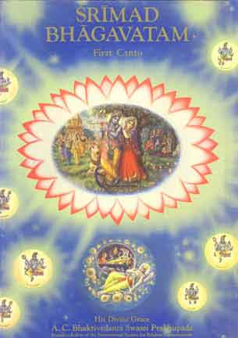
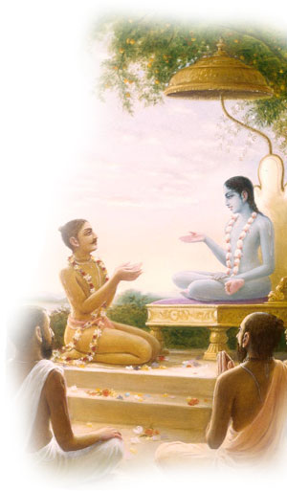
Srimad Bhagavtam 1.18.24-1.18.31 Maharaja Pariksit Cursed by a Brahmana Boy
Invocation prayers
Recap
SB 1.18.24-1.18.31
Session Summary
References

Slide 2
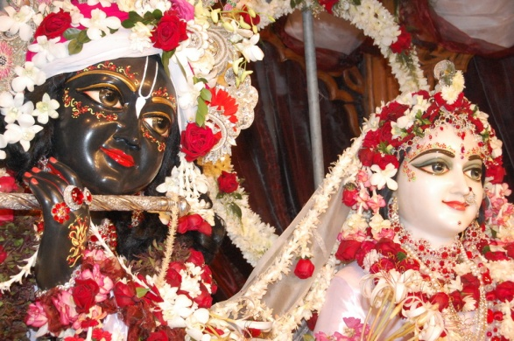
SB 1.2.4
narayanam namaskrtyam naram caiva narottamam devim sarasvatim vyasam tato jayam udirayet
Before reciting this Srimad-Bhagavatam, which is the very means of conquest, one should offer respectful obeisances unto the Personality of Godhead, Narayana, unto Nara-Narayana Rsi, the supermost human being, unto mother Sarasvati, the goddess of learning, and unto Srila Vyasadeva, the author.

Slide 3
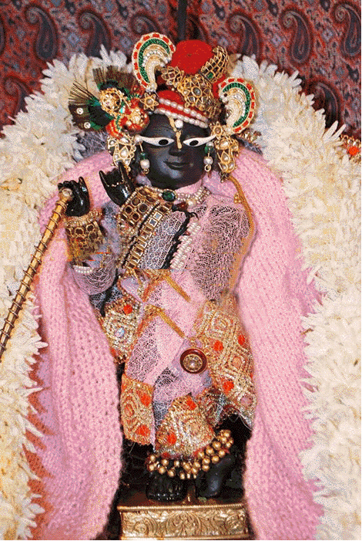
SB 1.2.18
nasta-prayesy abhadresu nityaḿ bhagavata-sevaya bhagavaty uttama-sloke bhaktir bhavati naisthiki
By regular attendance in classes on the Bhagavatam and by rendering of service to the pure devotee, all that is troublesome to the heart is almost completely destroyed, and loving service unto the Personality of Godhead, who is praised with transcendental songs, is established as an irrevocable fact.

Slide 4
Recap (1.18)
Austerity, cleanliness, mercy and truthfulness, the basic principles of religion, prepare the ground for the reception of advancement in spiritual knowledge, and Maharaja Pariksit made this favorable condition possible.
Parakshit Maharaj was a great king and the way he cursed Kali was an example of his wonderful administration.
A self-surrendered devotee of the Lord is called narayana-parayana. Such a person is never afraid of any place or person, not even of death. For him nothing is as important as the Supreme Lord, and thus he gives equal importance to heaven and hell. But in all conditions and in all circumstances, remembrance of Narayana is essential.
Those who are constantly engaged in remembering the lotus feet of the Lord, do not run the risk of having misconceptions even at the last moment of their lives.
Srimad-Bhagavatam is mainly full of the narrations of the activities of the Supreme Unlimited, and therefore it is the science of bhakti-yoga, or the devotional service of the Lord.

Slide 5
Recap (1.18)
Suta Gosvami did not take his birth in a brahmana family. He was born in a family of mixed caste, or an uncultured low family. But because of higher association, like Sri Sukadeva Gosvami and the great rsis of Naimisaranya the disqualification of inferior birth was washed off.
Offenseless chanting of the holy name of the Lord is transcendental, and, therefore, such chanting can at once purify one from the effects of all kinds of previous sins.
Self-controlled persons who are attached to the Supreme Lord Sri Krsna can all of a sudden give up the world of material attachment, including the gross body and subtle mind, and go away to attain the highest perfection of the renounced order of life, by which nonviolence and renunciation are consequential. Only the self-controlled can gradually be attached to the Supreme Personality of Godhead. Self-controlled means not indulging in sense enjoyment more than is necessary
The Supreme Absolute Truth is unlimited. No living being can know about the unlimited by his limited capacity. The Lord is impersonal, personal and localized.

Slide 6
[SB 1.18.24-25] ekada dhanur udyamya vicaran mrgayam vane mrgan anugatah srantah ksudhitas trsito bhrsam jalasayam acaksanah pravivesa tam asramam dadarsa munim asinam santam milita-locanam
Once upon a time Maharaja Pariksit, while engaged in hunting in the forest with bow and arrows, became extremely fatigued, hungry and thirsty while following the stags. While searching for a reservoir of water, he entered the hermitage of the well-known Samika Rsi and saw the sage sitting silently with closed eyes.

Slide 7
Key points
Maharaja Pariksit was a pure devotee of the Lord, and there was no reason for him to become extremely fatigued, hungry and thirsty because a devotee of the Lord never becomes perturbed by such bodily demands. But by the desire of the Lord, even such a devotee can become apparently fatigued and thirsty just to create a situation favorable for his renunciation of worldly activities. One has to give up all attachment for worldly relations before one is able to go back to Godhead, and thus when a devotee is too much absorbed in worldly affairs, the Lord creates a situation to cause indifference. The Supreme Lord never forgets His pure devotee, even though he may be engaged in so called worldly affairs. Sometimes He creates an awkward situation, and the devotee becomes obliged to renounce all worldly affairs. The devotee can understand by the signal of the Lord, but others take it to be unfavorable and frustrating.
Maharaja Pariksit was to become the medium for the revelation of Srimad-Bhagavatam by Lord Sri Krishnaa, as his grandfather Arjuna was the medium for the Bhagavad-gita. Had Arjuna not been taken up with an illusion of family affection by the will of the Lord, the Bhagavad-gita would not have been spoken by the Lord Himself for the good of all concerned. Similarly, had Maharaja Pariksit not been fatigued, hungry and thirsty at this time, Srimad-Bhagavatam would not have been spoken by Srila Sukadeva Goswami, the prime authority of Srimad-Bhagavatam.

Slide 8
[SB 1.18.26] pratiruddhendriya-pranamano- buddhim uparatam sthana-trayat param praptam brahma-bhutam avikriyam
The muni's sense organs, breath, mind and intelligence were all restrained from material activities, and he was situated in a trance apart from the three [wakefulness, dream and unconsciousness], having achieved a transcendental position qualitatively equal with the Supreme Absolute.

Slide 9
Key points
The transcendental position is attained by three processes, namely the process of jnana, or theoretical knowledge of transcendence, the process of yoga, or factual realization of trance by manipulation of the physiological and psychological functions of the body, and the most approved process of bhakti-yoga, or the engagement of senses in the devotional service of the Lord.
Our material mind and body develop from the living entity, the soul, and being influenced by the three qualities of matter, we forget our real identity. The jnana process theoretically speculates about the reality of the soul. But bhakti-yoga factually engages the spirit soul in activities.

Slide 10
Gradual development of perception from matter to a living entity.
Perception of matter
Subtler State of Senses
Subtler Mind
Breathing Activities
Intelligence
The living soul is realized by the mechanical activities of the yoga system, or practice of meditation restraining the senses, regulating the breathing system and applying intelligence
Transcendental position.
Stops all material activities of the body.

Slide 11
[SB 1.18.27] viprakirna-jatacchannam rauravenajinena ca visusyat-talur udakam tatha-bhutam ayacata
The sage, in meditation, was covered by the skin of a stag, and long, compressed hair was scattered all over him. The King, whose palate was dry from thirst, asked him for water.

Slide 12
[SB 1.18.28] alabdha-trna-bhumy-adir asampraptarghya-sunrtah avajnatam ivatmanam manyamanas cukopa ha
The King, not received by any formal welcome by means of being offered a seat, place, water and sweet addresses, considered himself neglected, and so thinking he became angry.

Slide 13
Key points
A great devotee and king asked for water from a sage absorbed in trance was certainly providential. Otherwise there was no chance of such a unique happening. Maharaja Pariksit was thus placed in an awkward position so that gradually Srimad-Bhagavatam could be revealed.
The law of reception in the codes of the Vedic principles states that even if an enemy is received at home, he must be received with all respects.
E.g. Lord Krishna accompanying Arjuna and Bhima at the home of Jarasandha in Magadha
When Maharaja Pariksit entered the door of Samika Rsi, he did not expect a royal reception

Slide 14
Key points
As a matter of fact, the King was right to get angry with the rsi when he needed a glass of water very badly. To become angry in such a grave situation was not unnatural for the King, but because the King himself was not less than a great saint, his becoming angry and taking action were astonishing. So it must be accepted that it was so ordained by the supreme will of the Lord.
The King was a great devotee of the Lord, and the saint was also as good as the King. But by the will of the Lord, the circumstances were so created that they became ways to the King's becoming unattached to family connection and governmental activities and thus becoming a completely surrendered soul unto the lotus feet of Lord Krsna.

Slide 15
Punch line
The merciful Lord sometimes creates such awkward positions for his pure devotees in order to drag them towards Himself from the mire of material existence. But outwardly the situations appear to be frustrating to the devotees. The devotees of the Lord are always under the protection of the Lord, and in any condition, frustration or success, the Lord is the supreme guide for the devotees. The pure devotees, therefore, accept all conditions of frustration as blessings from the Lord.

Slide 16
[SB 1.18.29] abhuta-purvah sahasa ksut-trdbhyam arditatmanah brahmanam praty abhud brahman matsaro manyur eva ca
O brahmanas, the King's anger and envy, directed toward the brahmana sage, were unprecedented, being that circumstances had made him hungry and thirsty.

Slide 17
[SB 1.18.30] sa tu brahma-rser amse gatasum uragam rusa vinirgacchan dhanus-kotya nidhaya puram agatah
While leaving, the King, being so insulted, picked up a lifeless snake with his bow and angrily placed it on the shoulder of the sage. Then he returned to his palace.

Slide 18
Key points
For a king like Maharaja Pariksit to become angry and envious, especially at a sage and brahmana, was undoubtedly unprecedented. The King knew well that brahmanas, sages, children, women and old men are always beyond the jurisdiction of punishment.
The King was right to punish his subject for coldly receiving him or neglecting him, but because the culprit was a sage and a brahmana, it was unprecedented.
As the Lord is never envious of anyone, so also the Lord's devotee is never envious of anyone. The only justification for Maharaja Pariksit's behavior is that it was ordained by the Lord.
The King thus treated the sage tit for tat, although he was never accustomed to such silly actions. By the will of the Lord, the King, while going away, found a dead snake in front of him, and he thought that the sage, who had coldly received him, thus might be coldly rewarded by being offered a garland of a dead snake.

Slide 19
[SB 1.18.31] esa kim nibhrtasesakarano militeksanah mrsa-samadhir ahosvit kim nu syat ksatra-bandhubhih
Upon returning, he began to contemplate and argue within himself whether the sage had actually been in meditation, with senses concentrated and eyes closed, or whether he had just been feigning trance just to avoid receiving a lower ksatriya.

Slide 20
Key points
The King, being a devotee of the Lord, did not approve of his own action, and thus he began to wonder whether the sage was really in a trance or was just pretending in order to avoid receiving the King, who was a ksatriya and therefore lower in rank.
Repentance comes in the mind of a good soul as soon as he commits something wrong.
Srila Visvanatha Cakravarti Thakura and Srila Jiva Gosvami do not believe that the King's action was due to his past misdeeds.
The arrangement was so made by the Lord just to call the King back home, back to Godhead.

Slide 21
Key points
Srila Visvanatha Cakravarti, the plan was made by the will of the Lord, and by the will of the Lord the situation of frustration was created. The plan was that for his so-called misdeed the King could be cursed by an inexperienced brahmana boy infected by the influence of Kali, and thus the King would leave his hearth and home for good. His connections with Srila Sukadeva Gosvami would enable the presentation of the great Srimad-Bhagavatam, which is considered to be the book incarnation of the Lord.
This specific pastime of the Lord has a special significance because anyone who properly learns about this particular pastime of the Lord will certainly be dissuaded from mundane sex desire and be placed on the path of sublime devotional service to the Lord.

Slide 22
Key points
The pure devotee's mundane frustration is meant to elevate the devotee to a higher transcendental position.
By placing Arjuna and the Pandavas in frustration due to the intrigue of their cousin-brothers, tthe Battle of Kuruksetra was created by the Lord. This was to incarnate the sound representative of the Lord, Bhagavad-gita.
So by placing King Pariksit in an awkward position, the incarnation of Srimad-Bhagavatam, the book representative of the Lord, was created by the will of the Lord.
Being distressed by hunger and thirst was only a show, because the King endured much, even in the womb of his mother. He was never disturbed by the glaring heat of the brahmastra released by Asvatthama.
The King's distressed condition was certainly unprecedented. The devotees like Maharaja Pariksit are powerful enough to forbear such distresses, by the will of the Lord, and they are never disturbed. The situation, in this case, was therefore all planned by the Lord.

Slide 23
Session Summary
Maharaja Pariksit was a pure devotee of the Lord, and there was no reason for him to become extremely fatigued, hungry and thirsty because a devotee of the Lord never becomes perturbed by such bodily demands
One has to give up all attachment for worldly relations before one is able to go back to Godhead, and thus when a devotee is too much absorbed in worldly affairs, the Lord creates a situation to cause indifference. The Supreme Lord never forgets His pure devotee, even though he may be engaged in so called worldly affairs. Sometimes He creates an awkward situation, and the devotee becomes obliged to renounce all worldly affairs. The devotee can understand by the signal of the Lord, but others take it to be unfavorable and frustrating.
Maharaja Pariksit was to become the medium for the revelation of Srimad-Bhagavatam by Lord Sri Krishnaa, as his grandfather Arjuna was the medium for the Bhagavad-gita.

Slide 24
Session Summary
As a matter of fact, the King was right to get angry with the rsi when he needed a glass of water very badly. To become angry in such a grave situation was not unnatural for the King, but because the King himself was not less than a great saint, his becoming angry and taking action were astonishing
Our material mind and body develop from the living entity, the soul, and being influenced by the three qualities of matter, we forget our real identity. The jnana process theoretically speculates about the reality of the soul. But bhakti-yoga factually engages the spirit soul in activities.
As the Lord is never envious of anyone, so also the Lord's devotee is never envious of anyone. The only justification for Maharaja Pariksit's behavior is that it was ordained by the Lord.
Repentance comes in the mind of a good soul as soon as he commits something wrong.
Srila Visvanatha Cakravarti Thakura and Srila Jiva Gosvami do not believe that the King's action was due to his past misdeeds.
The arrangement was so made by the Lord just to call the King back home, back to Godhead.

Slide 25
Punch line
The devotees of the Lord are always under the protection of the Lord, and in any condition, frustration or success, the Lord is the supreme guide for the devotees.

Slide 26
Srimad Bhagavtam Ki Jai Srila Prabhupada ki Jai
References
Srimad Bhagavatam – His divine grace A.C.Bhaktivedanta Swami

