Slide 1
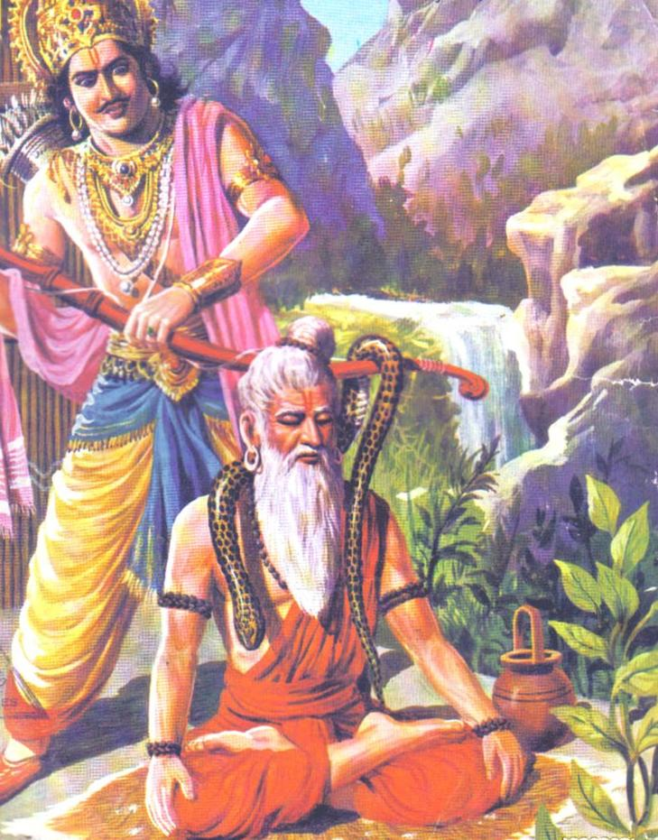
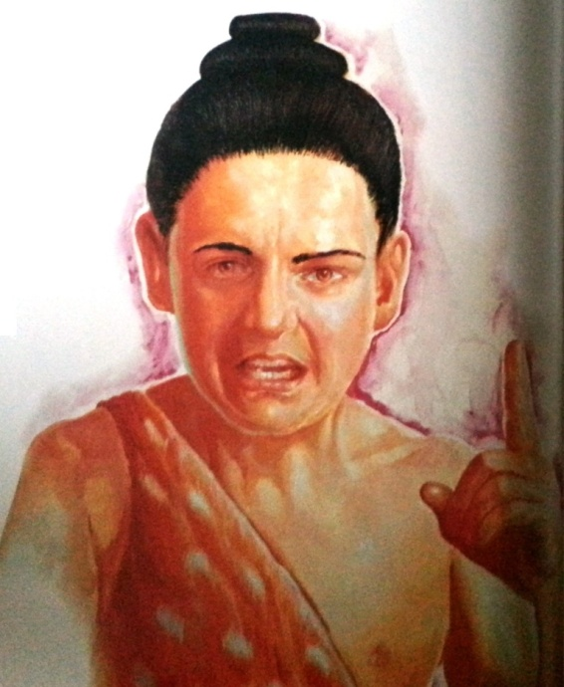
SB Canto 1
18.18-23
Maharaja Parikshit cursed by a Brahmana Boy
By Sudevi dasi

Slide 2
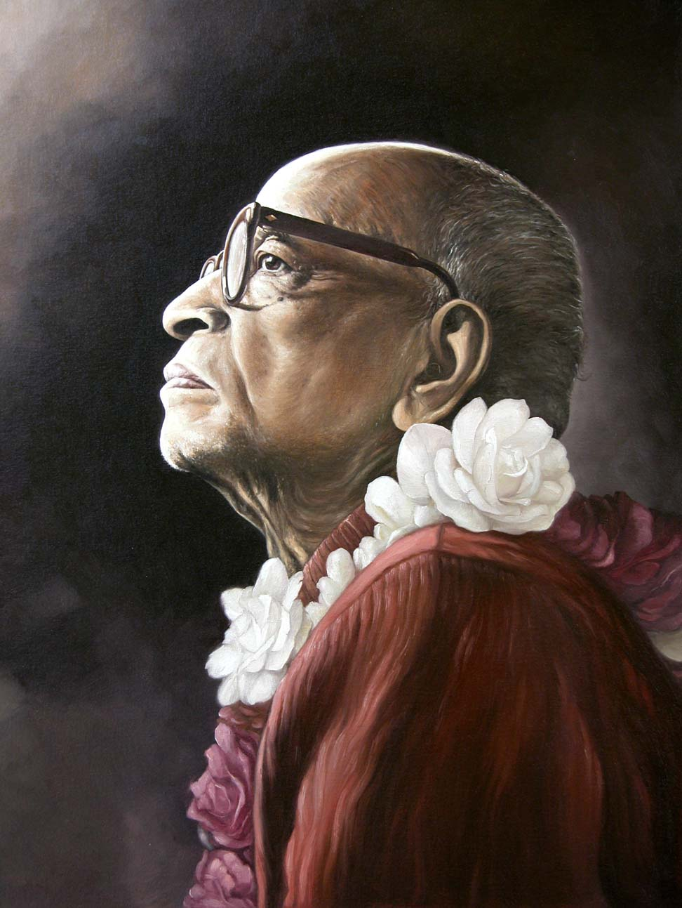
Based on the Teachings of His Divine Grace A.C. Bhaktivedanta Swami Prabhupada

Slide 3
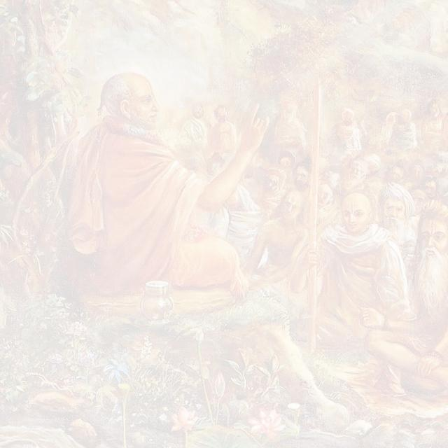
SB 1.2.4 narayanam namaskrtya naram caiva narottamam devim sarasvatim vyasam tato jayam udirayet
Before reciting this Srimad-Bhagavatam, which is the very means of conquest, one should offer respectful obeisances unto the Personality of Godhead, Narayana, unto Nara-Narayana Rsi, the supermost human being, unto mother Sarasvati, the goddess of learning, and unto Srila Vyasadeva, the author.

Slide 4
SB 1.2.18 nasta-prayesv abhadresu nityam bhagavata-sevaya bhagavaty uttama-sloke bhaktir bhavati naisthiki
By regular attendance in classes on the Bhagavatam and by rendering of service to the pure devotee, all that is troublesome to the heart is almost completely destroyed, and loving service unto the Personality of Godhead, who is praised with transcendental songs, is established as an irrevocable fact.

Slide 5
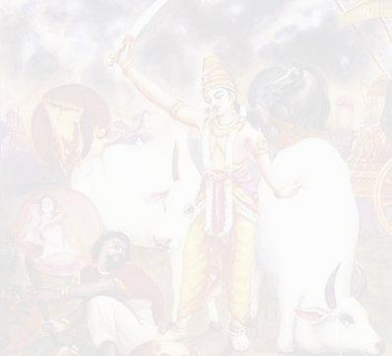
Chapter 18 : Maharaj Parikshit cursed by a Brahmana boy
Suta Goswami begins describing Maharaj Parikshit’s life which contains wonderful dealings with Krishna.
Suta Goswami tells how the King dealt with the appearance of Kali within His kingdom.
The sages glorify Suta Goswami and the importance of hearing about Krsna from great devotees.
They then request Him to describe the pastimes of the Lord, especially the topics upon which Maharaj Parikshit fixed His mind and thus attained Krsna's Lotus Feet.
Suta Goswami explains how purification happens by hearing about Krsna & then begins explaining Krsna's exalted qualities
1
2
3
4
5
6
7
8
9
10
11
12
13
14
15
16
17
18
19
20
21
22
23
Suta Goswami begins narrating how Maharaj Parikshit insulted the sage Shamika Rishi by placing a dead snake around the meditating sage's neck.
After Shamika Rishi is insulted, His son, Shringi, curses Maharaj Parikshit to die in seven days.
Shamika Rishi laments when He hears what His son has done.
Shamika Rishi prays to the Supreme Lord to forgive His son's foolishness.
24
25
26
27
28
29
30
31
38
39
40
41
42
43
44
45
46
32
33
34
35
36
37
47
48
49
50

Slide 6
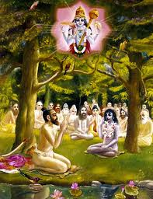
SB. 1.18.18 – Power of Association with Pure Devotee
süta uväca
aho vayaà janma-bhåto 'dya häsma
våddhänuvåttyäpi viloma-jätäù
dauñkulyam ädhià vidhunoti çéghraà
mahattamänäm abhidhäna-yogaù
Çré Süta Gosvämé said: O God, although we are born in a mixed caste, we are still promoted in birthright simply by serving and following the great who are advanced in knowledge. Even by conversing with such great souls, one can without delay cleanse oneself of all disqualifications resulting from lower births.
Purport :
Family linage of Suta Goswami – so called disqualifications
One can become pure devotee by association. Eg. Lord Chaitanya
He clearly stated that any man, whatever he may be, whether a brähmaëa or çüdra by birth, or a householder or mendicant in the order of society, if he is conversant with the science of Kåñëa, he can be accepted as an äcärya or guru, a spiritual master.

Slide 7
SB. 1.18.18 – Power of Association with Pure Devotee
Purport :
Suta Goswami’s double association and completely free from disqualification of lower birth.
Lord Çré Caitanya revived the original Vedic system, and He elevated Öhäkura Haridäsa to the position of nämäcärya, or the authority in preaching the glories of the holy name of the Lord, although His Holiness Çréla Haridäsa Öhäkura was pleased to appear in a family of Mohammedans.
Such is the power of pure devotees of the Lord. The Ganges water is accepted as pure, and one can become purified after taking a bath in the waters of the Ganges. But as far as the great devotees of the Lord are concerned, they can purify a degraded soul even by being seen by the lowborn, and what to speak of association. Lord Çré Caitanya Mahäprabhu wanted to purify the whole atmosphere of the polluted world by sending qualified preachers all over the world, and it remains with the Indians to take up this task scientifically and thus do the best kind of humanitarian work.
Being situated in his original Kåñëa conscious position, a pure devotee does not identify with the body. Such a devotee should not be seen from a materialistic point of view. Indeed, one should overlook a devotee's having a body born in a low family, a body with a bad complexion, a deformed body, or a diseased or infirm body. According to ordinary vision, such imperfections may seem prominent in the body of a pure devotee, but despite such seeming defects, the body of a pure devotee cannot be polluted. It is exactly like the waters of the Ganges, which sometimes during the rainy season are full of bubbles, foam and mud. The Ganges waters do not become polluted. Those who are advanced in spiritual understanding will bathe in the Ganges without considering the condition of the water.
NOI 6
dåñöaiù svabhäva-janitair vapuñaç ca doñair
na präkåtatvam iha bhakta janasya paçyet
gaìgämbhasäà na khalu budbuda-phena-paìkair
brahma-dravatvam apagacchati néra-dharmaiù

Slide 8
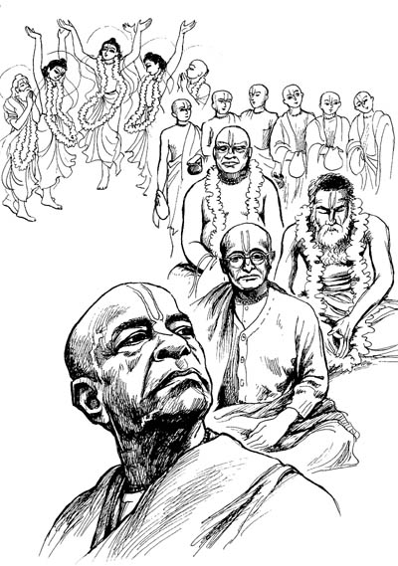
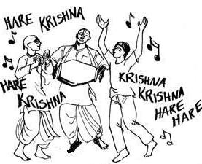
SB. 1.18.19 – Glories of the Holyname
kutaù punar gåëato näma tasya
mahattamaikänta-paräyaëasya
yo 'nanta-çaktir bhagavän ananto
mahad-guëatväd yam anantam ähuù
And what to speak of those who are under the direction of the great devotees, chanting the holy name of the Unlimited, who has unlimited potency? The Personality of Godhead, unlimited in potency and transcendental by attributes, is called the ananta [Unlimited].
Purport :
Glories of the Holyname

Slide 9
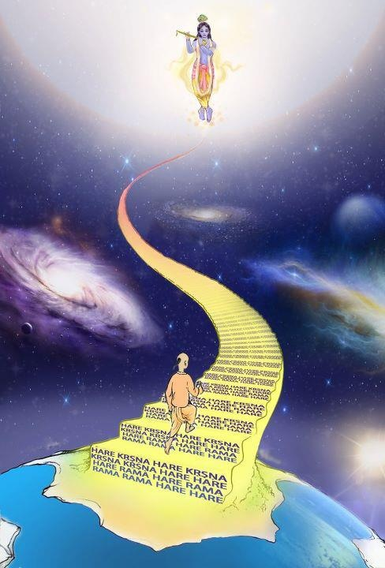
SB. 1.18.19 – Glories of the Holyname
Purport :
The dvija-bandhu, or the less intelligent, uncultured men born of higher castes, put forward many arguments against the lower-caste men becoming brähmaëas in this life. They argue that birth in a family of çüdras or less than çüdras is made possible by one's previous sinful acts and that one therefore has to complete the terms of disadvantages due to lower birth. And to answer these false logicians, Çrémad-Bhägavatam asserts that one who chants the holy name of the Lord under the direction of a pure devotee can at once get free from the disadvantages due to a lower-caste birth. A pure devotee of the Lord does not commit any offense while chanting the holy name of the Lord. There are ten different offenses in the chanting of the holy name of the Lord. To chant the holy name under the direction of a pure devotee is offenseless chanting. Offenseless chanting of the holy name of the Lord is transcendental, and, therefore, such chanting can at once purify one from the effects of all kinds of previous sins. This offenseless chanting indicates that one has fully understood the transcendental nature of the holy name and has thus surrendered unto the Lord. Transcendentally the holy name of the Lord and the Lord Himself are identical, being absolute. The holy name of the Lord is as powerful as the Lord.

Slide 10
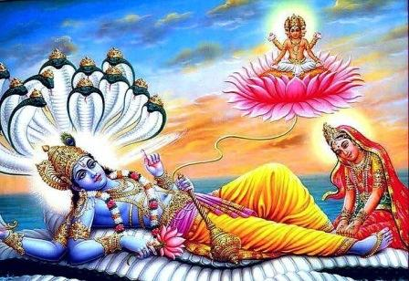
SB. 1.18.20 – Glories of the Supreme Lord
etävatälaà nanu sücitena
guëair asämyänatiçäyanasya
hitvetarän prärthayato vibhütir
yasyäìghri-reëuà juñate 'nabhépsoù
It is now ascertained that He [the Personality of Godhead] is unlimited and there is none equal to Him. Consequently no one can speak of Him adequately. Great demigods cannot obtain the favor of the goddess of fortune even by prayers, but this very goddess renders service unto the Lord, although He is unwilling to have such service.
Purport :
Glories of the Supreme Lord.

Slide 11
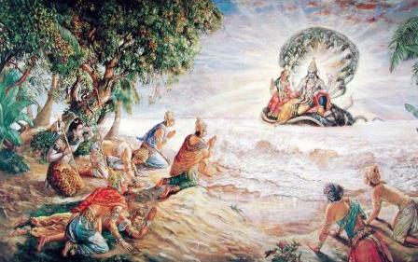
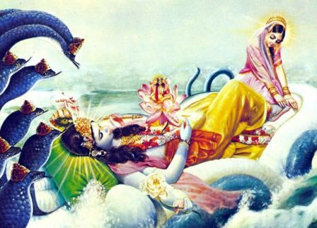
SB. 1.18.20 – Glories of the Supreme Lord
Purport :
The Personality of Godhead, or the Parameçvara Parabrahman, according to the çrutis, has nothing to do. He has no equal. Nor does anyone excel Him. He has unlimited potencies, and His every action is carried out systematically in His natural and perfect ways. Thus the Supreme Personality of Godhead is full in Himself, and He has nothing to accept from anyone else, including the great demigods like Brahmä. Others ask for the favor of the goddess of fortune, and despite such prayers she declines to award such favors. But still she renders service unto the Supreme Personality of Godhead, although He has nothing to accept from her.

Slide 12
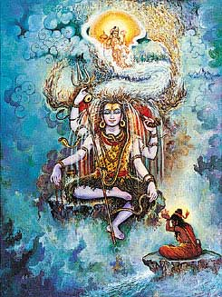
SB. 1.18.21 – Glories of the Supreme Lord
athäpi yat-päda-nakhävasåñöaà
jagad viriïcopahåtärhaëämbhaù
seçaà punäty anyatamo mukundät
ko näma loke bhagavat-padärthaù
Who can be worthy of the name of the Supreme Lord but the Personality of Godhead Çré Kåñëa? Brahmäjé collected the water emanating from the nails of His feet in order to award it to Lord Çiva as a worshipful welcome. This very water [the Ganges] is purifying the whole universe, including Lord Çiva.
Purport :
The conception of many gods in the Vedic literatures by the ignorant is completely wrong. The Lord is one without a second, but He expands Himself in many ways, and this is confirmed in the Vedas. Such expansions of the Lord are limitless, but some of them are the living entities.

Slide 13
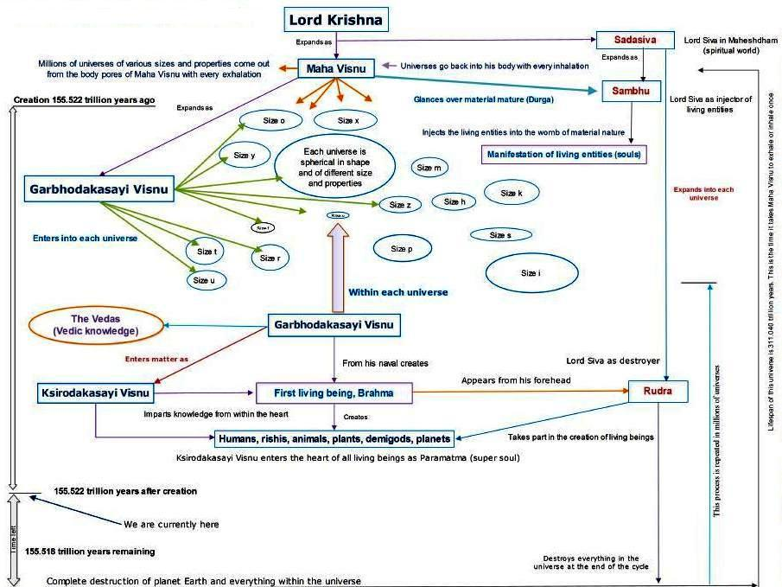

Slide 14
All of the four original sampradäyas are still scrupulously engaged in the transcendental service of the Lord up to date, and they all declare that Lord Kåñëa, Mukunda, is the Supreme Personality of Godhead, and no other personality is equal to Him or greater than Him.

Slide 15
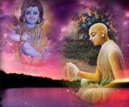
SB. 1.18.22 – Qualities of Self-Controlled Person
yatränuraktäù sahasaiva dhérä
vyapohya dehädiñu saìgam üòham
vrajanti tat pärama-haàsyam antyaà
yasminn ahiàsopaçamaù sva-dharmaù
Self-controlled persons who are attached to the Supreme Lord Çré Kåñëa can all of a sudden give up the world of material attachment, including the gross body and subtle mind, and go away to attain the highest perfection of the renounced order of life, by which nonviolence and renunciation are consequential.
Purport :
Qualities of Self-Controlled Person

Slide 16
SB. 1.18.22 – Qualities of Self-Controlled Person
Self Controlled Person
Not Engaged in Sense enjoyment more than necessary
Includes dry speculation
Leads to path of path of darkness
One not self controlled
Means
Attained by
Not attained by
Not achieved by artificially stopping senses from Material enjoyment
Engaging senses in the services of Krsna.
(BG 2.61)
Bhakti Yoga
Those attached to Bhakti Yoga can give up homely or bodily attachment for service of Lord
Results
What is Highest Perfection?
Highest Perfection
Parmahamsa stage
Real Renunciation
Perfect dependence on the mercy of the Lord and not on the Material Nature
Qualities of Parmahamsa
SB 5.18.12
Prideless
Freedom from Vanity
Non-Violence
Tolerance
Simplicity
Worship
Devotion
Sincerity
Respectability
Free from Envy

Slide 17
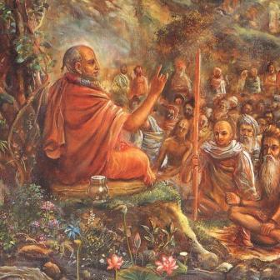
SB. 1.18.23 – Humility of Suta Goswami
ahaà hi påñöo 'ryamaëo bhavadbhir
äcakña ätmävagamo 'tra yävän
nabhaù patanty ätma-samaà patattriëas
tathä samaà viñëu-gatià vipaçcitaù
O åñis, who are as powerfully pure as the sun, I shall try to describe to you the transcendental pastimes of Viñëu as far as my knowledge is concerned. As the birds fly in the sky as far as their capacity allows, so do the learned devotees describe the Lord as far as their realization allows.

Slide 18
SB. 1.18.23 – Humility of Suta Goswami
Purport :
The Supreme Absolute Truth is unlimited. No living being can know about the unlimited by his limited capacity. The Lord is impersonal, personal and localized. By His impersonal feature He is all-pervading Brahman, by His localized feature He is present in everyone's heart as the Supreme Soul, and by His ultimate personal feature He is the object of transcendental loving service by His fortunate associates the pure devotees. The pastimes of the Lord in different features can only be estimated partly by the great learned devotees. So Çréla Süta Gosvämé has rightly taken this position in describing the pastimes of the Lord as far as he has realized. Factually only the Lord Himself can describe Himself, and His learned devotee also can describe Him as far as the Lord gives him the power of description.

Slide 19
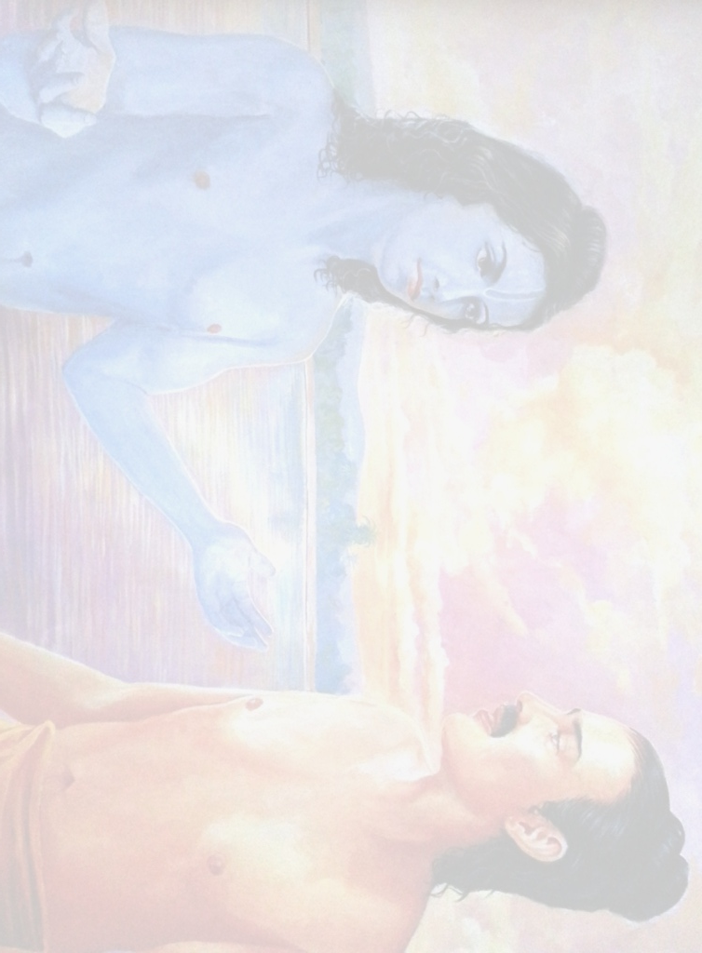
Chapter 18 : Maharaj Parikshit cursed by a Brahmana boy
Suta Goswami begins describing Maharaj Parikshit’s life which contains wonderful dealings with Krishna.
Suta Goswami tells how the King dealt with the appearance of Kali within His kingdom.
The sages glorify Suta Goswami and the importance of hearing about Krsna from great devotees.
They then request Him to describe the pastimes of the Lord, especially the topics upon which Maharaj Parikshit fixed His mind and thus attained Krsna's Lotus Feet.
Suta Goswami explains how purification happens by hearing about Krsna & then begins explaining Krsna's exalted qualities
1
2
3
4
5
6
7
8
9
10
11
12
13
14
15
16
17
18
19
20
21
22
23
Suta Goswami begins narrating how Maharaj Parikshit insulted the sage Shamika Rishi by placing a dead snake around the meditating sage's neck.
After Shamika Rishi is insulted, His son, Shringi, curses Maharaj Parikshit to die in seven days.
Shamika Rishi laments when He hears what His son has done.
Shamika Rishi prays to the Supreme Lord to forgive His son's foolishness.
24
25
26
27
28
29
30
31
38
39
40
41
42
43
44
45
46
32
33
34
35
36
37
47
48
49
50

Slide 20
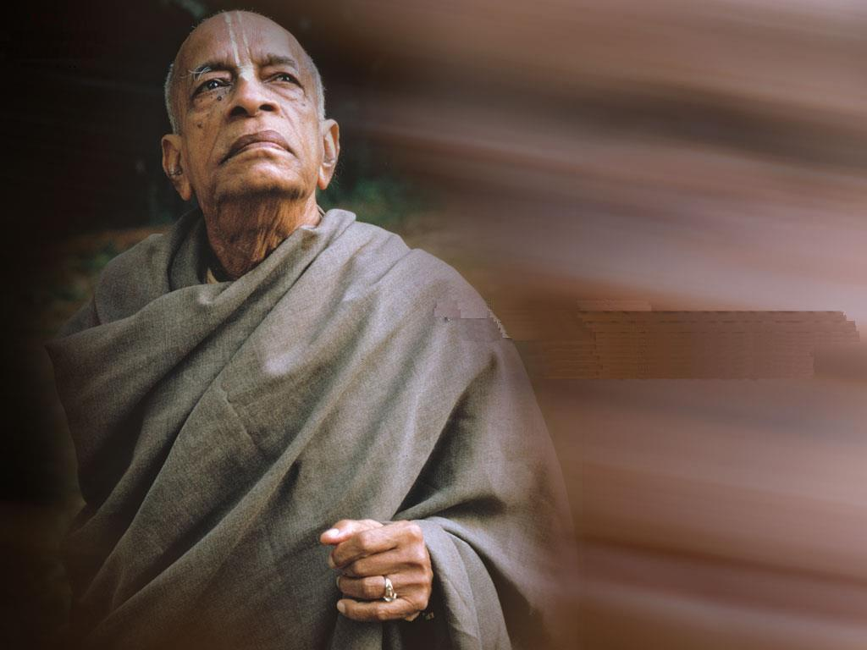
Srila Prabhupada ki jaya!!!
References
SB Classes given by Srila Prabhupada Unveiling the Lotus Feet
Bhakti Vaibhava Classes given by HG Bhurijana Prabhu
www.rompadaswami.com classes on Canto 1 Chapter 18.18-23

