Slide 1
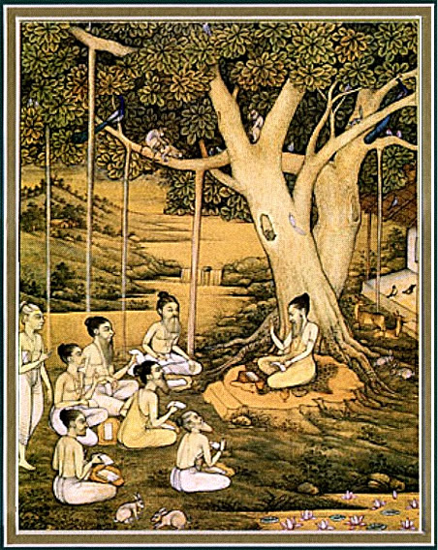
Srimad bhagavataM 1.18.10 – 17
EAGERNESS TO
HEAR

Slide 2
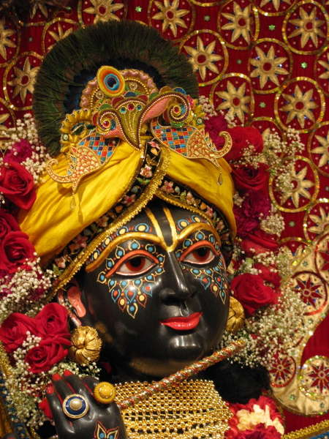
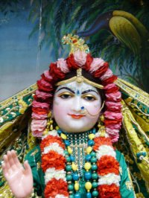
SB 1.2.4 narayanam namaskrtyam naram caiva narottamam devim sarasvatim vyasam tato jayam udirayet
Translation: Before reciting this Srimad Bhagavatam, which is the
very means of conquest, one should offer respectful obeisances
unto the Personality of Godhead, Narayana, unto Nara-Narayana
Rsi, the supermost human being, unto mother Sarasvati, the
goddess of learning, and unto Srila Vyasadeva, the author.

Slide 3
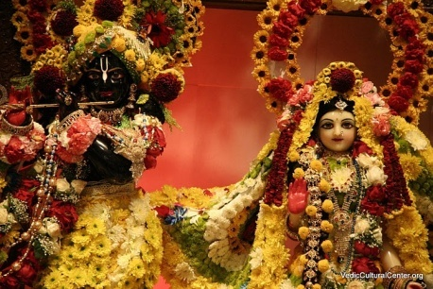
nasta-prayesy abhadresu nityaḿ bhagavata-sevaya bhagavaty uttama-sloke bhaktir bhavati naisthiki
SB 1.2.18
Translation: By regular attendance in classes on the
Bhagavatam and by rendering of service to the pure devotee,
all that is troublesome to the heart is almost completely
destroyed, and loving service unto the Personality of
Godhead, who is praised with transcendental songs, is
established as an irrevocable fact.

Slide 4
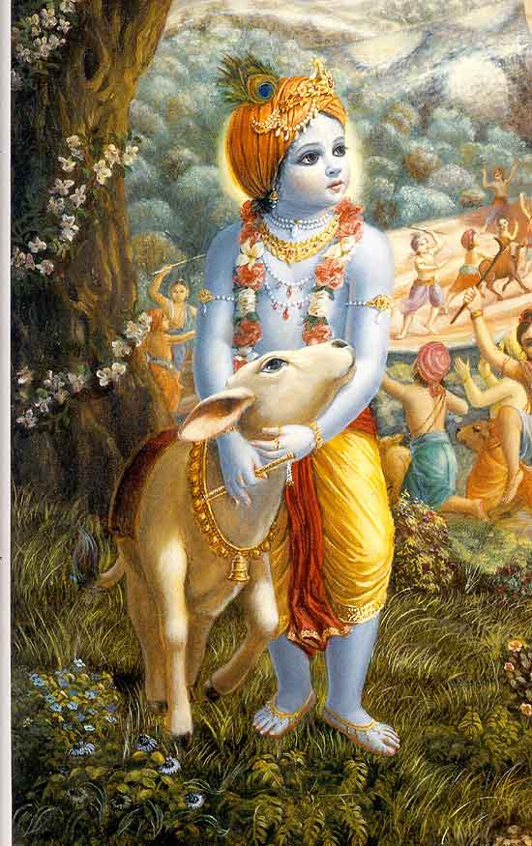
SB 1.18.10 – 17
Eagerness to Hear about the Lord

Slide 5
Section outline
10 - 11 Glories of Hearing about the Lord
Sages fully satisfied by hearing
Glories of associating with Pure devotees
14 - 17 Sages express eagerness to hear more

Slide 6
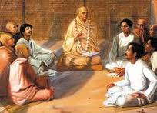
SB 1.18.10
yā yāḥ kathā bhagavataḥ
kathanīyoru-karmaṇaḥ
guṇa-karmāśrayāḥ pumbhiḥ
saḿsevyās tā bubhūṣubhiḥ
Those who are desirous of achieving complete perfection in life must submissively hear all topics that are connected with the transcendental activities and qualities of the Personality of Godhead, who acts wonderfully.

Slide 7
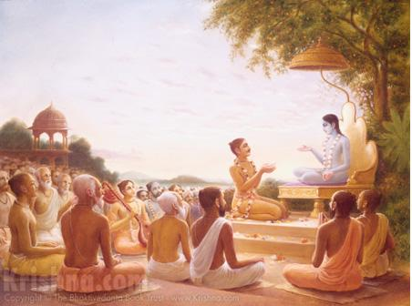
1.18.10 Glories of Hearing about the Lord
Pushes one towards eternal life (BG 4.9)
Remedy for counteracting birth, death etc.
Gives Transcendental bliss.
Goal of Human life
“Systematic hearing means knowing Him gradually in truth and fact, and this knowing Him in truth and fact means attaining eternal life, as stated in the Bhagavad-gītā. Such transcendental, glorified activities of Lord Śrī Kṛṣṇa are the prescribed remedy for counteracting the process of birth, death, old age and disease. The culmination of such a perfectional stage of life is the goal of human life and the attainment of transcendental bliss.”
Notes:
History
- Brahmana mystic
- Incarnaton of Lord Siva
- Kumari kunti pleases Durvasa
- Could travel in Space – 1 year – ambrish maharaja
Visit the pandavas
- Duryodhana’s plot
- Draupadi’s calling for Krsna

Slide 8
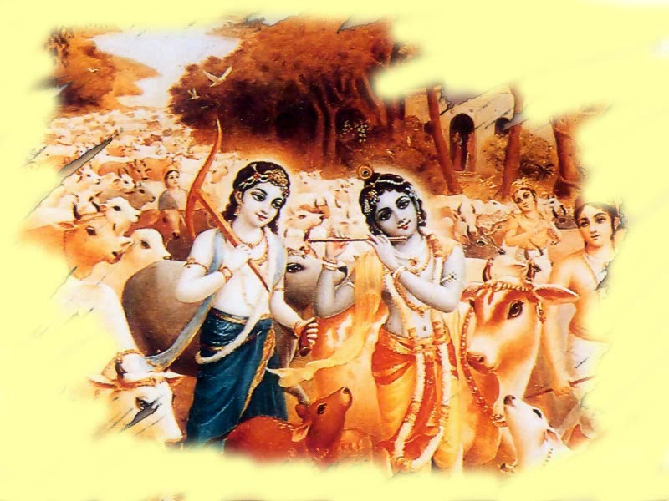
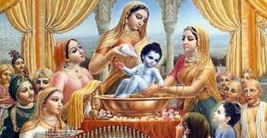
SB 1.18.11
ṛṣaya ūcuḥ
sūta jīva samāḥ saumya
śāśvatīr viśadaḿ yaśaḥ
yas tvaḿ śaḿsasi kṛṣṇasya
martyānām amṛtaḿ hi naḥ
The good sages said: O grave Sūta Gosvāmī! May you live many years and have eternal fame, for you are speaking very nicely about the activities of Lord Kṛṣṇa, the Personality of Godhead. This is just like nectar for mortal beings like us.

Slide 9
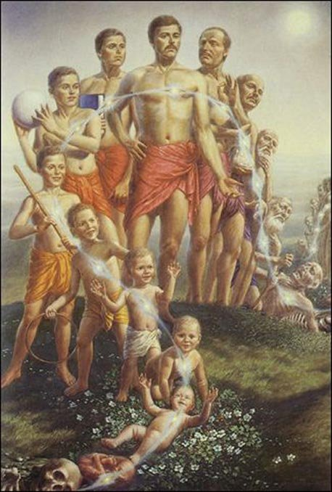
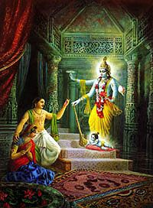
1.18.11 All Transcendental Lord
Activities are all Transcendental (BG 4.9)
- Does not act / take birth like us
- His body is not material / changeable like us.
One who understands has no re-birth
- Admitted into Spiritual realm
- Engages in Transcendental loving service
“Therefore, the more we hear about the transcendental activities of the Lord, as they are stated in the Bhagavad-gītā and Śrīmad-Bhāgavatam, the more we can know about His transcendental nature and thus make definite progress on the path back to Godhead.”
Notes:
History
- Brahmana mystic
- Incarnaton of Lord Siva
- Kumari kunti pleases Durvasa
- Could travel in Space – 1 year – ambrish maharaja
Visit the pandavas
- Duryodhana’s plot
- Draupadi’s calling for Krsna

Slide 10
SB 1.18.12
karmaṇy asminn anāśvāse
dhūma-dhūmrātmanāḿ bhavān
āpāyayati govinda-
pāda-padmāsavaḿ madhu
We have just begun the performance of this fruitive activity, a sacrificial fire, without certainty of its result due to the many imperfections in our action. Our bodies have become black from the smoke, but we are factually pleased by the nectar of the lotus feet of the Personality of Godhead, Govinda, which you are distributing.

Slide 11
1.18.12 Satisfaction by Hearing
Flaws in the sacrifice
- Acute scarcity of expert Brahmanas
- Result is uncertain. Ex: Agricultural enterprises
- Harer Nama eva kevalam
Sages fully satisfied
- like being nourished by eating food
“In the Brahma-vaivarta Purāṇa, Viṣṇu tells Śiva that in the age of Kali, men full of anxieties of various kinds can vainly labor in fruitive activity and philosophical speculations, but when they are engaged in devotional service, the result is sure and certain, and there is no loss of energy. In other words, nothing performed for spiritual realization or for material benefit can be successful without the devotional service to the Lord.”
Notes:
History
- Brahmana mystic
- Incarnaton of Lord Siva
- Kumari kunti pleases Durvasa
- Could travel in Space – 1 year – ambrish maharaja
Visit the pandavas
- Duryodhana’s plot
- Draupadi’s calling for Krsna

Slide 12
SB 1.18.13
tulayāma lavenāpi
na svargaḿ nāpunar-bhavam
bhagavat-sańgi-sańgasya
martyānāḿ kim utāśiṣaḥ
The value of a moment's association with the devotee of the Lord cannot even be compared to the attainment of heavenly planets or liberation from matter, and what to speak of worldly benedictions in the form of material prosperity, which are for those who are meant for death.

Slide 13
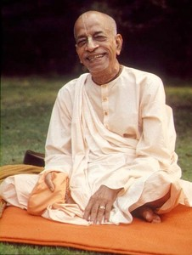
1.18.13 Characteristics of Pure devotees
Heavenly pleasure like phantasmagoria
Already liberated from all material conceptions
Liberated even when in the material world
Engaged in the loving service of the Lord
Analogy: Government servant
Nothing to do with material benedictions
Two types of association
- Yosit-sangi
- Bhagavata-sangi
Notes:
History
- Brahmana mystic
- Incarnaton of Lord Siva
- Kumari kunti pleases Durvasa
- Could travel in Space – 1 year – ambrish maharaja
Visit the pandavas
- Duryodhana’s plot
- Draupadi’s calling for Krsna

Slide 14
1.18.13 Characteristics of Pure devotees
“When there are some similar points, it is possible to compare one thing to another. One cannot compare the association of a pure devotee to anything material…Devotional service is eternal; it has no end, because it is spiritual. Therefore, since the assets of a pure devotee are completely different from material assets, there is no comparison between the two. Sūta Gosvāmī was a pure devotee of the Lord, and therefore his association with the ṛṣis in Naimiṣāraṇya is unique.”
Notes:
History
- Brahmana mystic
- Incarnaton of Lord Siva
- Kumari kunti pleases Durvasa
- Could travel in Space – 1 year – ambrish maharaja
Visit the pandavas
- Duryodhana’s plot
- Draupadi’s calling for Krsna

Slide 15
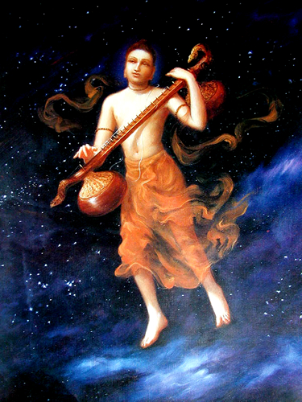
SB 1.18.14
ko nāma tṛpyed rasavit kathāyāḿ
mahattamaikānta-parāyaṇasya
nāntaḿ guṇānām aguṇasya jagmur
yogeśvarā ye bhava-pādma-mukhyāḥ
The Personality of Godhead, Lord Kṛṣṇa [Govinda], is the exclusive shelter for all great living beings, and His transcendental attributes cannot even be measured by such masters of mystic powers as Lord Śiva and Lord Brahmā. Can anyone who is expert in relishing nectar [rasa] ever be fully satiated by hearing topics about Him?

Slide 16
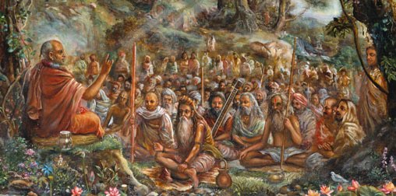
1.18.14 Sages become eager to Hear more
Demigods are not Supremely powerful
- Lord Siva drank ocean of poison
- Brahma can create many demigods
- Lord’s attributes cannot be measured by demigods
Why demigods are attracted to topics of Krsna?
- Lord is reservoir of all enjoyment
- Everyone is seeking for pleasure
- Transcendental loving service gives unlimited pleasure
- Lord is unlimited and who relish never feel satisfied
Notes:
History
- Brahmana mystic
- Incarnaton of Lord Siva
- Kumari kunti pleases Durvasa
- Could travel in Space – 1 year – ambrish maharaja
Visit the pandavas
- Duryodhana’s plot
- Draupadi’s calling for Krsna

Slide 17
1.18.14 Sages become eager to Hear more
“There is no end to such transcendental discourses. In mundane affairs there is the law of satiation, but in transcendence there is no such satiation. Sūta Gosvāmī desired to continue the topics of Lord Kṛṣṇa before the sages of Naimiṣāraṇya, and the sages also expressed their readiness to hear from him continuously. Since the Lord is transcendence and His attributes are transcendental, such discourses increase the receptive mood of the purified audience.”
Notes:
History
- Brahmana mystic
- Incarnaton of Lord Siva
- Kumari kunti pleases Durvasa
- Could travel in Space – 1 year – ambrish maharaja
Visit the pandavas
- Duryodhana’s plot
- Draupadi’s calling for Krsna

Slide 18
SB 1.18.15
tan no bhavān vai bhagavat-pradhāno
mahattamaikānta-parāyaṇasya
harer udāraḿ caritaḿ viśuddhaḿ
śuśrūṣatāḿ no vitanotu vidvan
O Sūta Gosvāmī, you are a learned and pure devotee of the Lord because the Personality of Godhead is your chief object of service. Therefore please describe to us the pastimes of the Lord, which are above all material conception, for we are anxious to receive such messages.

Slide 19
1.18.15 How to hear spiritual topics
Proper way
- Speaker’s only object of worship – Sri Krsna
- Audience anxious to hear about Him
Result:
- Congenial to continue discourses
- Transcendental / No material motive
- Unlimited transcendental pleasure for both
Improper way
- Professional speaker (family maintenance)
- Materially absorbed audience (dharma, artha, kama, moksha)
Result:
- No purification
- After discourse both engage in material activities
Notes:
History
- Brahmana mystic
- Incarnaton of Lord Siva
- Kumari kunti pleases Durvasa
- Could travel in Space – 1 year – ambrish maharaja
Visit the pandavas
- Duryodhana’s plot
- Draupadi’s calling for Krsna

Slide 20
1.18.15 How to hear spiritual topics
“The discourses between the saints of Naimiṣāraṇya and Śrī Sūta Gosvāmī are on the transcendental level. There is no motive for material gain. In such discourses, unlimited transcendental pleasure is relished both by the audience and by the speaker, and therefore they can continue the topics for many thousands of years.”
Notes:
History
- Brahmana mystic
- Incarnaton of Lord Siva
- Kumari kunti pleases Durvasa
- Could travel in Space – 1 year – ambrish maharaja
Visit the pandavas
- Duryodhana’s plot
- Draupadi’s calling for Krsna

Slide 21
SB 1.18.16
sa vai mahā-bhāgavataḥ parīkṣid
yenāpavargākhyam adabhra-buddhiḥ
jñānena vaiyāsaki-śabditena
bheje khagendra-dhvaja-pāda-mūlam
O Sūta Gosvāmī, please describe those topics of the Lord by which Mahārāja Parīkṣit, whose intelligence was fixed on liberation, attained the lotus feet of the Lord, who is the shelter of Garuḍa, the king of birds. Those topics were vibrated by the son of Vyāsa [Śrīla Śukadeva].

Slide 22
1.18.16 Perfect stage of liberation
Two types of transcendentalists
- impersonalists
- devotees
Three types of devotees
- Prakrta (3rd class)
- Madhyama (2nd class)
- Maha-bhagavata (1st class)
Devotee is higher than impersonalist
Destination of Maharaja Parikshit
- Attained loving service of the Lord
- Apavarga (perfect stage of liberation)
Notes:
History
- Brahmana mystic
- Incarnaton of Lord Siva
- Kumari kunti pleases Durvasa
- Could travel in Space – 1 year – ambrish maharaja
Visit the pandavas
- Duryodhana’s plot
- Draupadi’s calling for Krsna

Slide 23
1.18.16 Perfect stage of liberation
“Simple knowledge of liberation is material knowledge. Actual freedom from material bondage is called liberation, but attainment of the transcendental service of the Lord is called the perfect stage of liberation. Such a stage is attained by knowledge and renunciation, as we have already explained (Bhāg. 1.2.12), and perfect knowledge, as delivered by Śrīla Śukadeva Gosvāmī, results in the attainment of the transcendental service of the Lord.”
Notes:
History
- Brahmana mystic
- Incarnaton of Lord Siva
- Kumari kunti pleases Durvasa
- Could travel in Space – 1 year – ambrish maharaja
Visit the pandavas
- Duryodhana’s plot
- Draupadi’s calling for Krsna

Slide 24
SB 1.18.17
tan naḥ paraḿ puṇyam asaḿvṛtārtham
ākhyānam atyadbhuta-yoga-niṣṭham
ākhyāhy anantācaritopapannaḿ
pārīkṣitaḿ bhāgavatābhirāmam
Thus please narrate to us the narrations of the Unlimited, for they are purifying and supreme. They were spoken to Mahārāja Parīkṣit, and they are very dear to the pure devotees, being full of bhakti-yoga.

Slide 25
1.18.17 SB very dear to pure devotees
“What was spoken to Mahārāja Parīkṣit and what is very dear to the pure devotees is Śrīmad-Bhāgavatam. Śrīmad-Bhāgavatam is mainly full of the narrations of the activities of the Supreme Unlimited, and therefore it is the science of bhakti-yoga, or the devotional service of the Lord. Thus it is para, or supreme, because although it is enriched with all knowledge and religion, it is specifically enriched with the devotional service of the Lord.”
Notes:
History
- Brahmana mystic
- Incarnaton of Lord Siva
- Kumari kunti pleases Durvasa
- Could travel in Space – 1 year – ambrish maharaja
Visit the pandavas
- Duryodhana’s plot
- Draupadi’s calling for Krsna

Slide 26
Practical Application
Develop eagerness to Hear about the Lord
Take advantage of devotee association
Make Lord our exclusive shelter
Make Srimad Bhagavatam our dear most

Slide 27
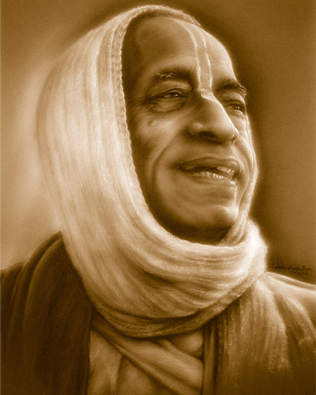
References
HH Romapada maharaja’s lectures on this section.
Srila Prabhupada’s purports.
All glories to Srila Prabhupada!

