Slide 1
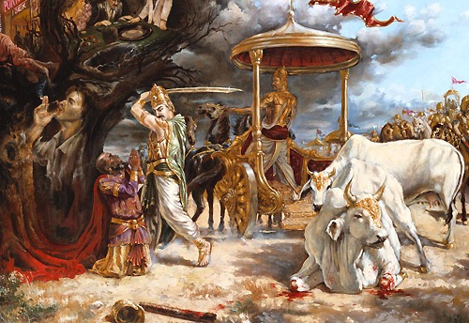
Punishment and Reward of Kali

Slide 2
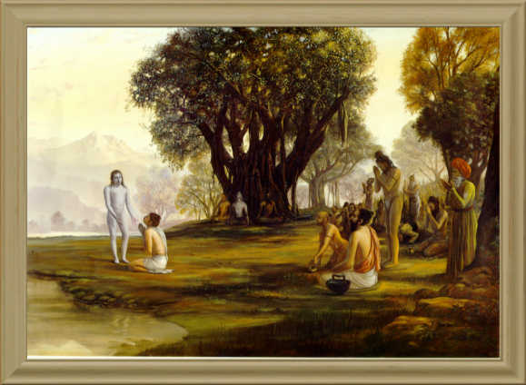
Srimad Bhagavatam
1.17.17 – 1.17.28
By Anuradha Sakhi Devi Dasi

Slide 3
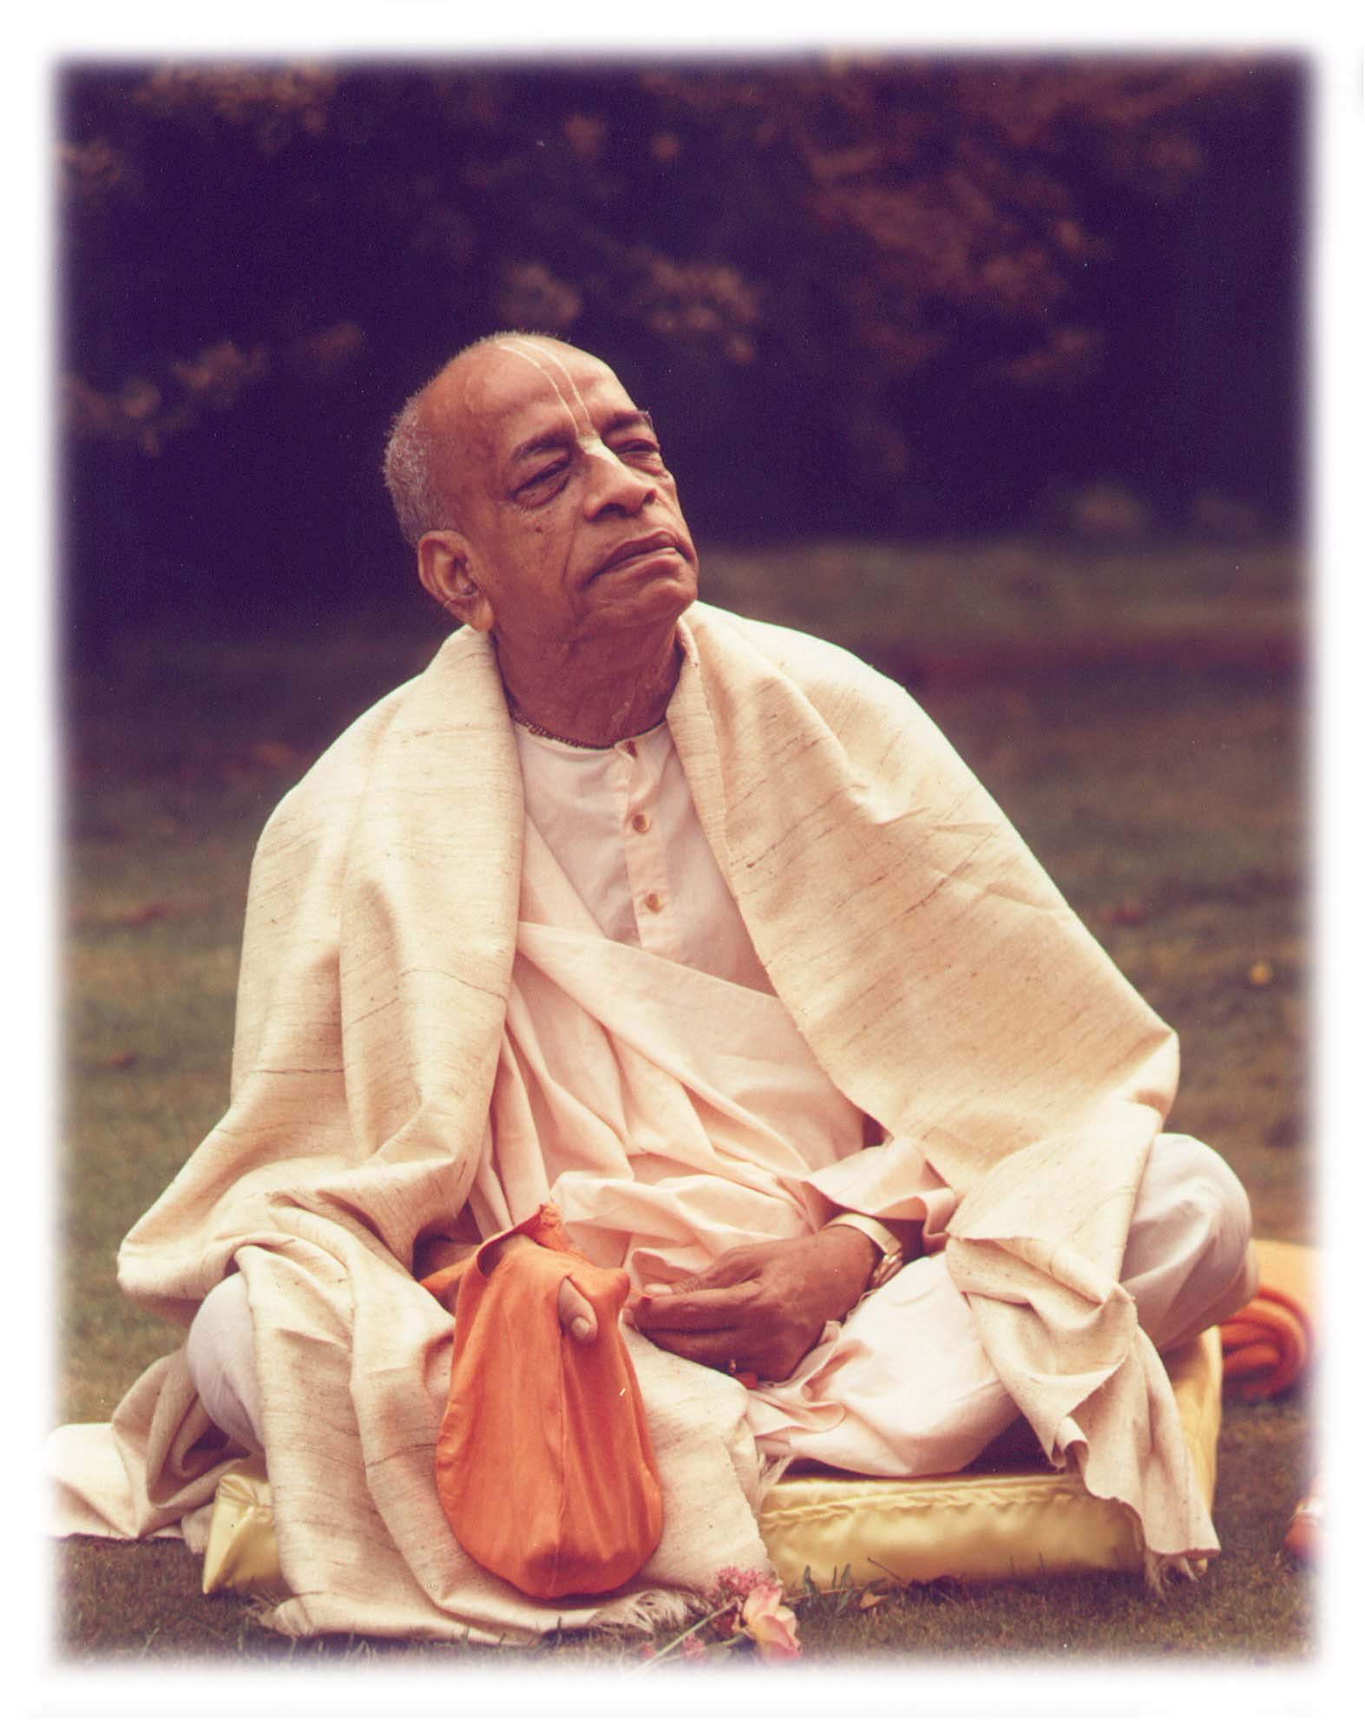
Based on the teachings of His Divine Grace A.C. Bhaktivedanta Swami Prabhupada
~ Founder Acharya ~
International Society For Krishna Consciousness

Slide 4
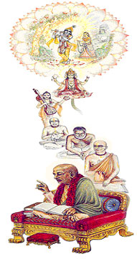
Seeking the Blessings of Guru, Gauranga & All the Assembled Vaishnavas

Slide 5
Śrīmad Bhāgavatam 1.2.4
nārāyaṇaḿ namaskṛtya
naraḿ caiva narottamam
devīḿ sarasvatīḿ vyāsaḿ
tato jayam udīrayet
TRANSLATION
Before reciting this Śrīmad-Bhāgavatam, which is the very means of conquest, one should offer respectful obeisances unto the Personality of Godhead, Nārāyaṇa, unto Nara-nārāyaṇa Ṛṣi, the supermost human being, unto mother Sarasvatī, the goddess of learning, and unto Śrīla Vyāsadeva, the author.

Slide 6
Śrīmad Bhāgavatam 1.2.18
naṣṭa-prāyeṣv abhadreṣu
nityaḿ bhāgavata-sevayā
bhagavaty uttama-śloke
bhaktir bhavati naiṣṭhikī

Slide 7
Section Theme – Arrival of Kali
1.17.17
The personality of religion speaks highly of Pandavas.
1.17.18-20
Six philosophies.
1.17.21
The Emperor Parīkṣit is satisfied and responds to The personality of religion
1.17.22-27
the Emperor Parīkṣit recognizes the bull is non other than The personality of religion , explains four pillars of religion and the degradation due to Kali Yuga
1.17.28
The Emperor Parīkṣit prepares to kill Kali personified

Slide 8
Śrīmad Bhāgavatam 1.17.17
dharma uvāca
etad vaḥ pāṇḍaveyānāḿ
yuktam ārtābhayaḿ vacaḥ
yeṣāḿ guṇa-gaṇaiḥ kṛṣṇo
dautyādau bhagavān kṛtaḥ
TRANSLATION
The personality of religion said: These words just spoken by you befit a person of Pāṇḍava dynasty. Captivated by the devotional qualities of the Pāṇḍavas, even LordKṛṣṇa, the Personality of Godhead, performed duties as a messenger.

Slide 9
Śrīmad Bhāgavatam 1.17.17
The assurances and challenges made by Mahārāja Parīkṣit are never exaggerations of his real power. The Mahārāja said that even the denizens of heaven could not escape his stringent government if they were violators of religious principles. He was not falsely proud, for a devotee of the Lord is equally as powerful as the Lord or sometimes more powerful by His grace, and any promise made by a devotee, though it may be ordinarily very difficult to fulfill, is properly executed by the grace of the Lord.
Unalloyed devotional service by Pandavas and lord’s reciprocation
Lord protected Mahārāja Parīkṣit in his mother’s womb
Notes:
The assurances and challenges made by Mahārāja Parīkṣit are never exaggerations of his real power. The Mahārāja said that even the denizens of heaven could not escape his stringent government if they were violators of religious principles. He was not falsely proud, for a devotee of the Lord is equally as powerful as the Lord or sometimes more powerful by His grace, and any promise made by a devotee, though it may be ordinarily very difficult to fulfill, is properly executed by the grace of the Lord. The Pāṇḍavas, by their unalloyed devotional service and full surrender unto the Lord, made it possible for the Lord to become a chariot driver or sometimes their letter messenger. Such duties executed by the Lord for His devotee are always very pleasing to the Lord because the Lord wants to render service to His unalloyed devotee, whose life has no other engagement than to serve the Lord with full love and devotion. Mahārāja Parīkṣit, grandson of Arjuna, the celebrated friendly servitor of the Lord, was a pure devotee of the Lord like his grandfather, and therefore the Lord was always with him, even from the time when he was helplessly lying in the womb of his mother and was attacked by the blazing brahmāstra weapon ofAśvatthāmā. A devotee is always under the protection of the Lord, and therefore the assurance of protection by Mahārāja Parīkṣit could never be without meaning. The personality of religion accepted this fact and thus thanked the King for his being true to his exalted position.

Slide 10
Śrīmad Bhāgavatam 1.17.18
na vayaḿ kleśa-bījāni
yataḥ syuḥ puruṣarṣabha
puruṣaḿ taḿ vijānīmo
vākya-bheda-vimohitāḥ
TRANSLATION
O greatest among human beings, it is very difficult to ascertain the particular miscreant who has caused our sufferings, because we are bewildered by all the different opinions of theoretical philosophers.

Slide 11
Śrīmad Bhāgavatam 1.17.18
Six philosophers about cause of suffering and effect on different living beings
Kaṇāda, the author of Vaiśeṣika philosophy;
Gautama, the author of logic;
Patañjali, the author of mystic yoga;
Kapila, the author of Sāńkhya philosophy;
Jaimini, the author of Karma-mīmāḿsā; and
Vyāsadeva, the author of Vedānta-darśana.
Notes:
The assurances and challenges made by Mahārāja Parīkṣit are never exaggerations of his real power. The Mahārāja said that even the denizens of heaven could not escape his stringent government if they were violators of religious principles. He was not falsely proud, for a devotee of the Lord is equally as powerful as the Lord or sometimes more powerful by His grace, and any promise made by a devotee, though it may be ordinarily very difficult to fulfill, is properly executed by the grace of the Lord. The Pāṇḍavas, by their unalloyed devotional service and full surrender unto the Lord, made it possible for the Lord to become a chariot driver or sometimes their letter messenger. Such duties executed by the Lord for His devotee are always very pleasing to the Lord because the Lord wants to render service to His unalloyed devotee, whose life has no other engagement than to serve the Lord with full love and devotion. Mahārāja Parīkṣit, grandson of Arjuna, the celebrated friendly servitor of the Lord, was a pure devotee of the Lord like his grandfather, and therefore the Lord was always with him, even from the time when he was helplessly lying in the womb of his mother and was attacked by the blazing brahmāstra weapon ofAśvatthāmā. A devotee is always under the protection of the Lord, and therefore the assurance of protection by Mahārāja Parīkṣit could never be without meaning. The personality of religion accepted this fact and thus thanked the King for his being true to his exalted position.

Slide 12
Śrīmad Bhāgavatam 1.17.18
Although the bull, or the personality of religion, and the cow, the personality of the earth, knew perfectly well that the personality of Kali was the direct cause of their sufferings, still, as devotees of the Lord, they knew well also that without the sanction of the Lord no one could inflict trouble upon them. According to the Padma Purāṇa, our present trouble is due to the fructifying of seedling sins, but even those seedling sins also gradually fade away by execution of pure devotional service. Thus even if the devotees see the mischief-mongers, they do not accuse them for the sufferings inflicted. They take it for granted that the mischief-monger is made to act by some indirect cause, and therefore they tolerate the sufferings, thinking them to be God-given in small doses, for otherwise the sufferings should have been greater.
Mahārāja Parīkṣit wanted to get a statement of accusation against the direct mischief-monger, but they declined to give it on the abovementioned grounds.
Notes:
The assurances and challenges made by Mahārāja Parīkṣit are never exaggerations of his real power. The Mahārāja said that even the denizens of heaven could not escape his stringent government if they were violators of religious principles. He was not falsely proud, for a devotee of the Lord is equally as powerful as the Lord or sometimes more powerful by His grace, and any promise made by a devotee, though it may be ordinarily very difficult to fulfill, is properly executed by the grace of the Lord. The Pāṇḍavas, by their unalloyed devotional service and full surrender unto the Lord, made it possible for the Lord to become a chariot driver or sometimes their letter messenger. Such duties executed by the Lord for His devotee are always very pleasing to the Lord because the Lord wants to render service to His unalloyed devotee, whose life has no other engagement than to serve the Lord with full love and devotion. Mahārāja Parīkṣit, grandson of Arjuna, the celebrated friendly servitor of the Lord, was a pure devotee of the Lord like his grandfather, and therefore the Lord was always with him, even from the time when he was helplessly lying in the womb of his mother and was attacked by the blazing brahmāstra weapon ofAśvatthāmā. A devotee is always under the protection of the Lord, and therefore the assurance of protection by Mahārāja Parīkṣit could never be without meaning. The personality of religion accepted this fact and thus thanked the King for his being true to his exalted position.

Slide 13
Śrīmad Bhāgavatam 1.17.19
kecid vikalpa-vasanā
āhur ātmānam ātmanaḥ
daivam anye 'pare karma
svabhāvam apare prabhum
TRANSLATION
Some of the philosophers, who deny all sorts of duality, declare that one's own self is responsible for his personal happiness and distress. Others say that superhuman powers are responsible, while yet others say that activity is responsible, and the gross materialists maintain that nature is the ultimate cause.

Slide 14
Śrīmad Bhāgavatam 1.17.19
Kaṇāda, the author of Vaiśeṣika philosophy :- Atomic combination is the cause
Gautama, the author of logic; Atomic combination is the cause
Patañjali, the author of mystic yoga;
Kapila, the author of Sāńkhya philosophy;- material nature is the cause
Jaimini, the author of Karma-mīmāḿsā; - Living entity is the cause
Vyāsadeva, the author of Vedānta-darśana – Lord Krishna is the cause
impersonalists like Aṣṭāvakra discover that the spiritual effulgence of Brahman is the cause of all causes. But in the Bhagavad-gītā the Lord Himself declares that He is the source of impersonal Brahman, and therefore He, the Personality of Godhead, is the ultimate cause of all causes. It is also confirmed in the Brahma-saḿhitā that Lord Kṛṣṇa is the ultimate cause of all causes.
Notes:
The assurances and challenges made by Mahārāja Parīkṣit are never exaggerations of his real power. The Mahārāja said that even the denizens of heaven could not escape his stringent government if they were violators of religious principles. He was not falsely proud, for a devotee of the Lord is equally as powerful as the Lord or sometimes more powerful by His grace, and any promise made by a devotee, though it may be ordinarily very difficult to fulfill, is properly executed by the grace of the Lord. The Pāṇḍavas, by their unalloyed devotional service and full surrender unto the Lord, made it possible for the Lord to become a chariot driver or sometimes their letter messenger. Such duties executed by the Lord for His devotee are always very pleasing to the Lord because the Lord wants to render service to His unalloyed devotee, whose life has no other engagement than to serve the Lord with full love and devotion. Mahārāja Parīkṣit, grandson of Arjuna, the celebrated friendly servitor of the Lord, was a pure devotee of the Lord like his grandfather, and therefore the Lord was always with him, even from the time when he was helplessly lying in the womb of his mother and was attacked by the blazing brahmāstra weapon ofAśvatthāmā. A devotee is always under the protection of the Lord, and therefore the assurance of protection by Mahārāja Parīkṣit could never be without meaning. The personality of religion accepted this fact and thus thanked the King for his being true to his exalted position.

Slide 15
Śrīmad Bhāgavatam 1.17.20
apratarkyād anirdeśyād
iti keṣv api niścayaḥ
atrānurūpaḿ rājarṣe
vimṛśa sva-manīṣayā
TRANSLATION
There are also some thinkers who believe that no one can ascertain the cause of distress by argumentation, nor know it by imagination, nor express it by words. O sage amongst kings, judge for yourself by thinking over all this with your own intelligence.

Slide 16
Śrīmad Bhāgavatam 1.17.20
The Vaiṣṇavites, the devotees of the Lord, do believe, as above explained, that nothing can take place without the sanction of the Supreme Lord.
He is the knower of all past, present and future, and nothing can be concealed from Him. The devotees know this truth, and therefore they discharge their duties sincerely, without being overly anxious for rewards.
The conclusion is, therefore, that the sufferings of the representative of religion and the representative of the earth, as present before Mahārāja Parīkṣit, were planned to prove that Mahārāja Parīkṣit was the ideal executive head because he knew well how to give protection to the cows (the earth) and the brāhmaṇas (religious principles), the two pillars of spiritual advancement.
Notes:
The assurances and challenges made by Mahārāja Parīkṣit are never exaggerations of his real power. The Mahārāja said that even the denizens of heaven could not escape his stringent government if they were violators of religious principles. He was not falsely proud, for a devotee of the Lord is equally as powerful as the Lord or sometimes more powerful by His grace, and any promise made by a devotee, though it may be ordinarily very difficult to fulfill, is properly executed by the grace of the Lord. The Pāṇḍavas, by their unalloyed devotional service and full surrender unto the Lord, made it possible for the Lord to become a chariot driver or sometimes their letter messenger. Such duties executed by the Lord for His devotee are always very pleasing to the Lord because the Lord wants to render service to His unalloyed devotee, whose life has no other engagement than to serve the Lord with full love and devotion. Mahārāja Parīkṣit, grandson of Arjuna, the celebrated friendly servitor of the Lord, was a pure devotee of the Lord like his grandfather, and therefore the Lord was always with him, even from the time when he was helplessly lying in the womb of his mother and was attacked by the blazing brahmāstra weapon ofAśvatthāmā. A devotee is always under the protection of the Lord, and therefore the assurance of protection by Mahārāja Parīkṣit could never be without meaning. The personality of religion accepted this fact and thus thanked the King for his being true to his exalted position.

Slide 17
Śrīmad Bhāgavatam 1.17.21
sūta uvāca
evaḿ dharme pravadati
sa samrāḍ dvija-sattamāḥ
samāhitena manasā
vikhedaḥ paryacaṣṭa tam
TRANSLATION
Sūta Gosvāmī said: O best among the brāhmaṇas, the Emperor Parīkṣit, thus hearing the personality of religion speak, was fully satisfied, and without mistake or regret he gave his reply..

Slide 18
Key points
King was satisfied as he could understand that bull was not ordinary one.
2 Equal level of sagacity so replied to the point.
Notes:
The assurances and challenges made by Mahārāja Parīkṣit are never exaggerations of his real power. The Mahārāja said that even the denizens of heaven could not escape his stringent government if they were violators of religious principles. He was not falsely proud, for a devotee of the Lord is equally as powerful as the Lord or sometimes more powerful by His grace, and any promise made by a devotee, though it may be ordinarily very difficult to fulfill, is properly executed by the grace of the Lord. The Pāṇḍavas, by their unalloyed devotional service and full surrender unto the Lord, made it possible for the Lord to become a chariot driver or sometimes their letter messenger. Such duties executed by the Lord for His devotee are always very pleasing to the Lord because the Lord wants to render service to His unalloyed devotee, whose life has no other engagement than to serve the Lord with full love and devotion. Mahārāja Parīkṣit, grandson of Arjuna, the celebrated friendly servitor of the Lord, was a pure devotee of the Lord like his grandfather, and therefore the Lord was always with him, even from the time when he was helplessly lying in the womb of his mother and was attacked by the blazing brahmāstra weapon ofAśvatthāmā. A devotee is always under the protection of the Lord, and therefore the assurance of protection by Mahārāja Parīkṣit could never be without meaning. The personality of religion accepted this fact and thus thanked the King for his being true to his exalted position.

Slide 19
Śrīmad Bhāgavatam 1.17.22
rājovāca
dharmaḿ bravīṣi dharma-jña
dharmo 'si vṛṣa-rūpa-dhṛk
yad adharma-kṛtaḥ sthānaḿ
sūcakasyāpi tad bhavet
TRANSLATION
The King said: O you, who are in the form of a bull! You know the truth of religion, and you are speaking according to the principle that the destination intended for the perpetrator of irreligious acts is also intended for one who identifies the perpetrator. You are no other than the personality of religion..

Slide 20
Śrīmad Bhāgavatam 1.17.22
A devotee's conclusion is that no one is directly responsible for being a benefactor or mischief-monger without the sanction of the Lord; therefore he does not consider anyone to be directly responsible for such action. But in both the cases he takes it for granted that either benefit or loss is God-sent, and thus it is His grace.
Jesus Christ was seemingly put into such great difficulty, being crucified by the ignorant, but he was never angry at the mischief-mongers. That is the way of accepting a thing, either favorable or unfavorable.
By God's grace, the devotee tolerates all reverses. Mahārāja Parīkṣit observed this, and therefore he could understand that the bull was no other than the personality of religion himself. In other words, a devotee has no suffering at all because so-called suffering is also God's grace for a devotee who sees God in everything. The cow and bull never placed any complaint before the King for being tortured by the personality of Kali, although everyone lodges such complaints before the state authorities.
The extraordinary behavior of the bull made the King conclude that the bull was certainly the personality of religion, for no one else could understand the finer intricacies of the codes of religion.
Notes:
The assurances and challenges made by Mahārāja Parīkṣit are never exaggerations of his real power. The Mahārāja said that even the denizens of heaven could not escape his stringent government if they were violators of religious principles. He was not falsely proud, for a devotee of the Lord is equally as powerful as the Lord or sometimes more powerful by His grace, and any promise made by a devotee, though it may be ordinarily very difficult to fulfill, is properly executed by the grace of the Lord. The Pāṇḍavas, by their unalloyed devotional service and full surrender unto the Lord, made it possible for the Lord to become a chariot driver or sometimes their letter messenger. Such duties executed by the Lord for His devotee are always very pleasing to the Lord because the Lord wants to render service to His unalloyed devotee, whose life has no other engagement than to serve the Lord with full love and devotion. Mahārāja Parīkṣit, grandson of Arjuna, the celebrated friendly servitor of the Lord, was a pure devotee of the Lord like his grandfather, and therefore the Lord was always with him, even from the time when he was helplessly lying in the womb of his mother and was attacked by the blazing brahmāstra weapon ofAśvatthāmā. A devotee is always under the protection of the Lord, and therefore the assurance of protection by Mahārāja Parīkṣit could never be without meaning. The personality of religion accepted this fact and thus thanked the King for his being true to his exalted position.

Slide 21
Śrīmad Bhāgavatam 1.17.23
athavā deva-māyāyā
nūnaḿ gatir agocarā
cetaso vacasaś cāpi
bhūtānām iti niścayaḥ
TRANSLATION
Thus it is concluded that the Lord's energies are inconceivable. No one can estimate them by mental speculation or by word jugglery.

Slide 22
Śrīmad Bhāgavatam 1.17.23
A question may be raised as to why a devotee should refrain from identifying an actor, although he knows definitely that the Lord is the ultimate doer of everything. Knowing the ultimate doer, one should not pose himself as ignorant of the actual performer. To answer this doubt, the reply is that the Lord is also not directly responsible, for everything is done by His deputed māyā-śakti, or material energy. The material energy is always provoking doubts about the supreme authority of the Lord. The personality of religion knew perfectly well that nothing can take place without the sanction of the Supreme Lord, and still he was put into doubts by the deluding energy, and thus he refrained from mentioning the supreme cause. This doubtfulness was due to the contamination of both Kali and the material energy. The whole atmosphere of the age of Kali is magnified by the deluding energy, and the proportion of measurement is inexplicable..

Slide 23
Śrīmad Bhāgavatam 1.17.24
tapaḥ śaucaḿ dayā satyam
iti pādāḥ kṛte kṛtāḥ
adharmāḿśais trayo bhagnāḥ
smaya-sańga-madais tava
TRANSLATION
In the age of Satya [truthfulness] your four legs were established by the four principles of austerity, cleanliness, mercy and truthfulness. But it appears that three of your legs are broken due to rampant irreligion in the form of pride, lust for women, and intoxication.

Slide 24
Śrīmad Bhāgavatam 1.17.24
The Lord Himself also warns that the deluding power of material energy is too powerful to overcome, but one who completely surrenders unto the Lord can easily do so. But to surrender unto the lotus feet of the Lord is also not very easy. Such surrender is possible by persons of austerity, cleanliness, mercy and truthfulness. These four principles of advanced civilization were remarkable features in the age of Satya. In that age, every human being was practically a qualified brāhmaṇa of the highest order, and in the social orders of life they were all paramahaḿsas, or the topmost in the renounced order. By cultural standing, the human beings were not at all subjected to the deluding energy. Such strong men of character were competent enough to get away from the clutches of māyā. But gradually, as the basic principles of brahminical culture, namely austerity, cleanliness, mercy and truthfulness, became curtailed by proportionate development of pride, attachment for women and intoxication, the path of salvation or the path of transcendental bliss retreated far, far away from human society.
Man cannot check all these evils simply by statutory acts and police vigilance, but he can cure the disease of the mind by the proper medicine, namely advocating the principles of brahminical culture or the principles of austerity, cleanliness, mercy and truthfulness.
We must always remember that false pride, or too high an estimation of one's own values of life, undue attachment to women or association with them, and intoxication will divert human civilization from the path of peace, however much the people clamor for peace in the world. The preaching of the Bhāgavatam principles will automatically render all men austere, clean both inside and outside, merciful to the suffering, and truthful in daily behavior.
That is the way of correcting the flaws of human society, which are very prominently exhibited at the present moment..

Slide 25
Śrīmad Bhāgavatam 1.17.25
idānīḿ dharma pādas te
satyaḿ nirvartayed yataḥ
taḿ jighṛkṣaty adharmo 'yam
anṛtenaidhitaḥ kaliḥ
TRANSLATION
You are now standing on one leg only, which is your truthfulness, and you are somehow or other hobbling along. But quarrel personified [Kali], flourishing by deceit, is also trying to destroy that leg.

Slide 26
Śrīmad Bhāgavatam 1.17.25
This peace of mind was complete in the Satya age because of the existence of the above-mentioned attributes of the human beings. Gradually these attributes have diminished in the Tretā-yuga to three fourths, in the Dvāpara to half, and in this age of Kali to one fourth, which is also gradually diminishing on account of prevailing untruthfulness.
By pride, either artificial or real, the resultant action of austerity is spoiled; by too much affection for female association, cleanliness is spoiled; by too much addiction to intoxication, mercy is spoiled; and by too much lying propaganda, truthfulness is spoiled. The revival of bhāgavata-dharma can save human civilization from falling prey to evils of all description.
Truthfulness is the only leg remaining and partialy operating hence we need to move that leg mean cultivate truthfulness. That is very important. At the same time cultivate austerity , cleanliness, and mercy

Slide 27
Śrīmad Bhāgavatam 1.17.25
idānīḿ dharma pādas te
satyaḿ nirvartayed yataḥ
taḿ jighṛkṣaty adharmo 'yam
anṛtenaidhitaḥ kaliḥ
TRANSLATION
You are now standing on one leg only, which is your truthfulness, and you are somehow or other hobbling along. But quarrel personified [Kali], flourishing by deceit, is also trying to destroy that leg.

Slide 28
Śrīmad Bhāgavatam 1.17.25
This peace of mind was complete in the Satya age because of the existence of the above-mentioned attributes of the human beings. Gradually these attributes have diminished in the Tretā-yuga to three fourths, in the Dvāpara to half, and in this age of Kali to one fourth, which is also gradually diminishing on account of prevailing untruthfulness.
By pride, either artificial or real, the resultant action of austerity is spoiled; by too much affection for female association, cleanliness is spoiled; by too much addiction to intoxication, mercy is spoiled; and by too much lying propaganda, truthfulness is spoiled. The revival of bhāgavata-dharma can save human civilization from falling prey to evils of all description.

Slide 29
Śrīmad Bhāgavatam 1.17.26
iyaḿ ca bhūmir bhagavatā
nyāsitoru-bharā satī
śrīmadbhis tat-pada-nyāsaiḥ
sarvataḥ kṛta-kautukā
TRANSLATION
The burden of the earth was certainly diminished by the Personality of Godhead and by others as well. When He was present as an incarnation, all good was performed because of His auspicious footprints.

Slide 30
Śrīmad Bhāgavatam 1.17.27
śocaty aśru-kalā sādhvī
durbhagevojjhitā satī
abrahmaṇyā nṛpa-vyājāḥ
śūdrā bhokṣyanti mām iti
TRANSLATION
Now she, the chaste one, being unfortunately forsaken by the Personality of Godhead, laments her future with tears in her eyes, for now she is being ruled and enjoyed by lower-class men who pose as rulers.

Slide 31
Śrīmad Bhāgavatam 1.17.27
The kṣatriya, or the man who is qualified to protect the sufferers, is meant to rule the state. Untrained lower-class men, or men without ambition to protect the sufferers, cannot be placed on the seat of an administrator. Unfortunately, in the age of Kali the lower-class men, without training, occupy the post of a ruler by strength of popular votes, and instead of protecting the sufferers, such men create a situation quite intolerable for everyone. Such rulers illegally gratify themselves at the cost of all comforts of the citizens, and thus the chaste mother earth cries to see the pitiable condition of her sons, both men and animals. That is the future of the world in the age of Kali, when irreligiosity prevails most prominently. And in the absence of a suitable king to curb irreligious tendencies, educating the people systematically in the teaching of Śrīmad-Bhāgavatam will clear up the hazy atmosphere of corruption, bribery, blackmail, etc.

Slide 32
Śrīmad Bhāgavatam 1.17.28
iti dharmaḿ mahīḿ caiva
sāntvayitvā mahā-rathaḥ
niśātam ādade khaḍgaḿ
kalaye 'dharma-hetave
TRANSLATION
Mahārāja Parīkṣit, who could fight one thousand enemies single-handedly, thus pacified the personality of religion and the earth. Then he took up his sharp sword to kill the personality of Kali, who is the cause of all irreligion..

Slide 33
Śrīmad Bhāgavatam 1.17.28
This age of Kali will certainly be full of all activities of Kali, but this does not mean that the leaders of society, the executive heads, the learned and intelligent men, or above all the devotees of the Lord should sit down tightly and become callous to the reactions of the age of Kali. In the rainy season certainly there will be profuse rainfalls, but that does not mean that men should not take means to protect themselves from the rains. It is the duty of the executive heads of state and others to take all necessary actions against the activities of Kali or the persons influenced by the age of Kali; and Mahārāja Parīkṣit is the ideal executive head of the state, for at once he was ready to kill the personality of Kali with his sharp sword.

Slide 34
References
http://www.romapadaswami.com
www.iskcondesiretree.net

Slide 35
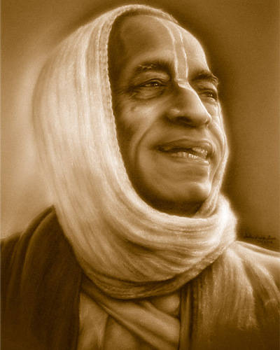
All glories to Srila Prabhupada!

