Slide 1
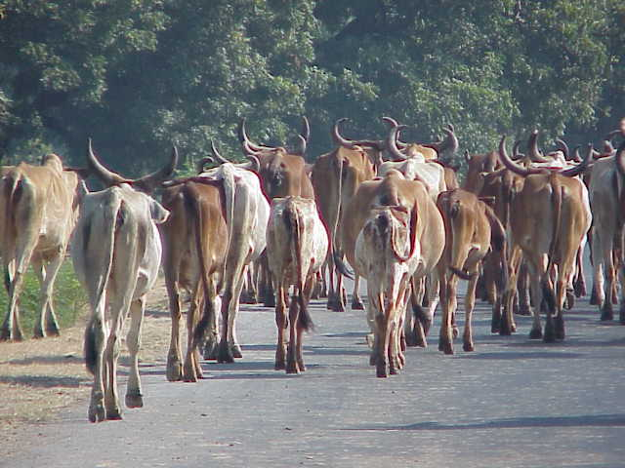
Srimad Bhagavatham 1.17.9 - 16

Slide 2
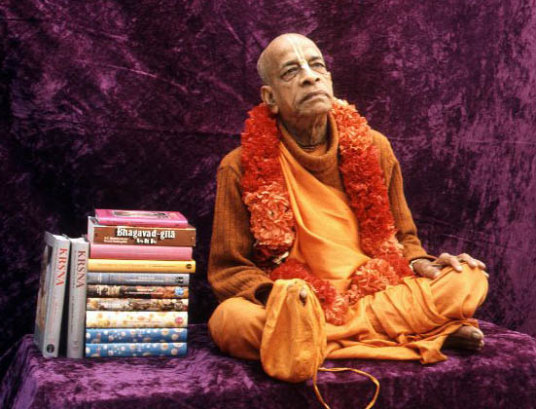

Slide 3
Śrīmad Bhāgavatam 1.17.9
mā saurabheyātra śuco
vyetu te vṛṣalād bhayam
mā rodīr amba bhadraḿ te
khalānāḿ mayi śāstari
O son of Surabhi, you need lament no longer now. There is no need to fear this low-class śūdra. And, O mother cow, as long as I am living as the ruler and subduer of all envious men, there is no cause for you to cry. Everything will be good for you.

Slide 4
Śrīmad Bhāgavatam 1.17.9
Protection of bulls and cows and all other animals can be possible only when there is a state ruled by an executive head like Mahārāja Parīkṣit. Mahārāja Parīkṣit addresses the cow as mother, for he is a cultured, twice-born, kṣatriya king. Surabhi is the name of the cows which exist in the spiritual planets and are especially reared by Lord Śrī Kṛṣṇa Himself. As men are made after the form and features of the Supreme Lord, so also the cows are made after the form and features of the surabhi cows in the spiritual kingdom. In the material world the human society gives all protection to the human being, but there is no law to protect the descendants of Surabhi, who can give all protection to men by supplying the miracle food, milk.

Slide 5
Śrīmad Bhāgavatam 1.17.9
But Mahārāja Parīkṣit and the Pāṇḍavas were fully conscious of the importance of the cow and bull, and they were prepared to punish the cow-killer with all chastisement, including death. There has sometimes been agitation for the protection of the cow, but for want of pious executive heads and suitable laws, the cow and the bull are not given protection. The human society should recognize the importance of the cow and the bull and thus give all protection to these important animals, following in the footsteps of Mahārāja Parīkṣit. For protecting the cows and brahminical culture, the Lord, who is very kind to the cow and the brāhmaṇas (go-brāhmaṇa-hitāya), will be pleased with us and will bestow upon us real peace.

Slide 6
Śrīmad Bhāgavatam 1.17.10-11
yasya rāṣṭre prajāḥ sarvās
trasyante sādhvy asādhubhiḥ
tasya mattasya naśyanti
kīrtir āyur bhago gatiḥ
eṣa rājñāḿ paro dharmo
hy ārtānām ārti-nigrahaḥ
ata enaḿ vadhiṣyāmi
bhūta-druham asattamam

Slide 7
Śrīmad Bhāgavatam 1.17.10-11
O chaste one, the king's good name, duration of life and good rebirth vanish when all kinds of living beings are terrified by miscreants in his kingdom. It is certainly the prime duty of the king to subdue first the sufferings of those who suffer. Therefore I must kill this most wretched man because he is violent against other living beings.

Slide 8
Śrīmad Bhāgavatam 1.17.10-11
When there is some disturbance caused by wild animals in a village or town, the police or others take action to kill them. Similarly, it is the duty of the government to kill at once all bad social elements such as thieves, dacoits and murderers. The same punishment is also due to animal-killers because the animals of the state are also the prajā. Prajā means one who has taken birth in the state, and this includes both men and animals.

Slide 9
Śrīmad Bhāgavatam 1.17.10-11
Any living being who takes birth in a state has the primary right to live under the protection of the king. The jungle animals are also subject to the king, and they also have a right to live. So what to speak of domestic animals like the cows and bulls.
Any living being, if he terrifies other living beings, is a most wretched subject, and the king should at once kill such a disturbing element. As the wild animal is killed when it creates disturbances, similarly any man who unnecessarily kills or terrifies the jungle animals or other animals must be punished at once.

Slide 10
Śrīmad Bhāgavatam 1.17.10-11
By the law of the Supreme Lord, all living beings, in whatever shape they may be, are the sons of the Lord, and no one has any right to kill another animal, unless it is so ordered by the codes of natural law. The tiger can kill a lower animal for his subsistence, but a man cannot kill an animal for his subsistence. That is the law of God, who has created the law that a living being subsists by eating another living being. Thus the vegetarians are also living by eating other living beings. Therefore, the law is that one should live only by eating specific living beings, as ordained by the law of God. The Īśopaniṣad directs that one should live by the direction of the Lord and not at one's sweet will. A man can subsist on varieties of grains, fruits and milk ordained by God, and there is no need of animal food, save and except in particular cases.

Slide 11
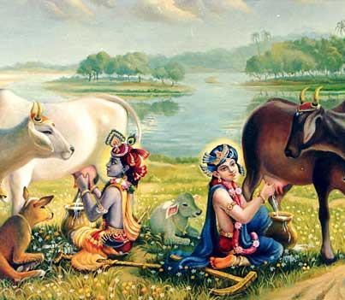

Slide 12
Śrīmad Bhāgavatam 1.17.10-11
The illusioned king or executive head, even though sometimes advertised as a great philosopher and learned scholar, will allow slaughterhouses in the state without knowing that torturing poor animals clears the way to hell for such foolish kings or executive heads. The executive head must always be alert to the safety of the prajās, both man and animal, and inquire whether a particular living being is harassed at any place by another living being. The harassing living being must at once be caught and put to death, as shown by Mahārāja Parīkṣit.

Slide 13
Śrīmad Bhāgavatam 1.17.10-11
The people's government, or government by the people, should not allow killing of innocent animals by the sweet will of foolish government men. They must know the codes of God, as mentioned in the revealed scriptures. Mahārāja Parīkṣit quotes here that according to the codes of God the irresponsible king or state executive jeopardizes his good name, duration of life, power and strength and ultimately his progressive march towards a better life and salvation after death. Such foolish men do not even believe in the existence of a next life.

Slide 14
Śrīmad Bhāgavatam 1.17.10-11
Mahārāja Parīkṣit was pious according to the scriptural codes, whereas the modern politician goes by his personal belief and sentiments. Any great man of the material world is, after all, a conditioned soul. He is bound by his hands and feet by the ropes of material nature, and still the foolish conditioned soul thinks of himself as free to act by his whimsical sentiments. The conclusion is that people in the time of Mahārāja Parīkṣit were happy, and the animals were given proper protection because the executive head was not whimsical or ignorant of God's law. Foolish, faithless creatures try to avoid the existence of the Lord and proclaim themselves secular at the cost of valuable human life.

Slide 15
Śrīmad Bhāgavatam 1.17.10-11
The human life is especially meant for knowing the science of God, but foolish creatures, especially in this age of Kali, instead of knowing God scientifically, make propaganda against religious belief as well as the existence of God, even though they are always bound by the laws of God by the symptoms of birth, death, old age and disease.

Slide 16
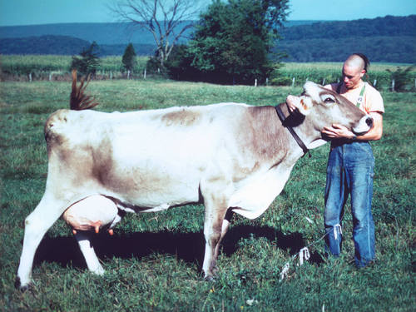

Slide 17
Some facts
India is the only country in world that provides in its Constitution for mercy and care of the animals.
According to its laws, only those animals can be slain, which are older than 16 years of age, and are useless. However, now meat of young healthy buffalos between 4 months and one year is allowed for exports.
Meat of one cow/buffalo is worth Rs. 20,000. However, the same animal may produce, in its 18 years of life span, goods (milk, butter, and manure) worth Rs. 300,000. Thus, the country has to suffer a loss of Rs. 280,000 for each animal slaughtered.
Britain has not opened any new slaughterhouse since 1980, whereas the Indian government is opening new slaughterhouses and modernizing the older ones
Alkabir alone holds permits to export 15,000 tonnes of meat a year. The other permit-holders are even bigger: Frigorico Alanali (Aurangabad) has permits for 24,000 tonnes, Hind Industries (Aligadh) has permits for 25,000 tonnes, and Alana Sons (Delhi, Andhra and Maharashtra) have permits for 45,000 tonnes. These are just legal numbers. Illegal business is even bigger. Alkabir, even though originally licensed only for export, now sells meat in India too.

Slide 18
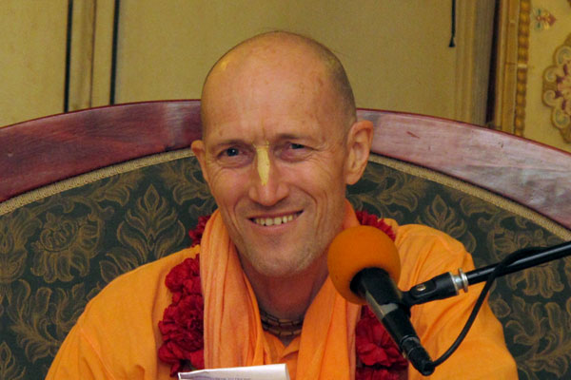
“They don’t know that the Katrina came from killing the cows that is in canned food they are distributing as relief”
HH Bhakti Vikasa Swami

Slide 19
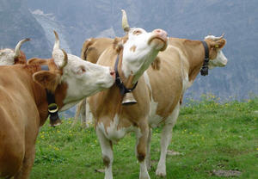

Slide 20
Shyamasundara (das) ACBSP
Cows were the basis of Indian agriculture and agriculture in India cannot be executed without the help of cow.
2) To break the Backbone of Indian agriculture cows had to be eliminated.
The first slaughterhouse in India was started in 1760, with a capacity to kill 30,000 (Thirty thousand only) per day, at least one crore cows were eliminated in an years time.
He estimated that the number of cows in Bengal outnumbered the number of men. Similar was the situation in the rest of India.
As a part of the Master plan to destabilize the India, cow slaughter was initiated.
Once the cows were slaughtered, then there was no manure and there is no insecticide like cow urine.
In 1929 Nehru in a public meeting stated that if he were to become the prime minister of India, the first thing he would do is to stop all the slaughterhouses.
The tragedy of the situation is since 1947 the number has increased from350 to 36,000(thirty six thousand) slaughter houses.

Slide 21
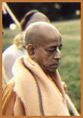
Srila Prabhupada Quotes Rascal presidents, rascal voters
Nowadays, unqualified men have taken the presidential post. And although they may pose themselves as very religious, they are simply rascals. Why? Because under their noses thousands of cows are being killed, while they collect a good salary. Any leader who is at all religious should resign his post in protest if cow slaughter goes on under his rule. Since people do not know that these administrators are rascals, they are suffering. And the people are also rascals because they are voting for these bigger rascals.
Quoted in “Beyond Illusion and Doubt” and “The Journey of Self-Discovery”

Slide 22
Protector Of Cows And Brahmanas" Los Angeles, May 5, 1973
This demonic world is the greatest enemy of cows. Just see how they are maintaining hundreds and thousands of slaughterhouse. Hundreds and thousands of slaughterhouse. Innocent animals, giving you milk, the most important foodstuff. Even after death, it is giving you its skin for your shoes, and you are so rascal that you are killing. And you want to be happy in this world. You see? How sinful they are! They have no consideration that this animal... Why cow protection is so much advocated? Because it is very, very important. Therefore... There is no such injunction that "You don't eat the flesh of the tiger." You can eat. Because those who are meat eaters, those who are meat eaters, they have been recommended to eat the flesh of goats or other lower animals -- sometimes dogs also, they eat, or the hogs -- you can eat.

Slide 23
Protector Of Cows And Brahmanas" Los Angeles, May 5, 1973
But never the flesh of cows. So, innocent animal, the most important animal, giving service even after death... While living, giving service, so important service, giving you milk, even after death she is giving service by supplying the skin, the hoof, the horn. You utilize in so many ways. But still, the present human society is so ungrateful and rascal that they are killing cows. So Krsna comes to punish them, these rascals. Therefore it is said that go-dvija-surarti-hara. Krsna comes to... Therefore we worship Krsna, namo brahmanya-devaya go-brahmana-hitaya ca. Brahmana.

Slide 24
Cow Killing--Rascal Government" Hawaii, January 18, 1974
Cow is giving you milk, just to give her protection, that "You take my blood, turn into milk. Please do not kill me." So why these things are happening? Because there is rascal government. Kalina upasrstan. Rascal government. So one should lament that this, "We are under this rascal government, under the rascal guru, rascal father. But who are meant for giving protection, they are all rascals. This is our position." This is called Kali-yuga. This is Kali-yuga.

Slide 25
Śrīmad Bhāgavatam 1.17.12
ko 'vṛścat tava pādāḿs trīn
saurabheya catuṣ-pada
mā bhūvaḿs tvādṛśā rāṣṭre
rājñāḿ kṛṣṇānuvartinām
He [Mahārāja Parīkṣit] repeatedly addressed and questioned the bull thus: O son of Surabhi, who has cut off your three legs? In the state of the kings who are obedient to the laws of the Supreme Personality of Godhead, Kṛṣṇa, there is no one as unhappy as you.

Slide 26
Śrīmad Bhāgavatam 1.17.12
The kings or the executive heads of all states must know the codes of Lord Kṛṣṇa (generally Bhagavad-gītā and Śrīmad-Bhāgavatam) and must act accordingly in order to fulfill the mission of human life, which is to make an end to all miseries of material conditions. One who knows the codes of Lord Kṛṣṇa can achieve this end without any difficulty. In the Bhagavad-gītā, in a synopsis, we can understand the codes of Godhead, and in the Śrīmad-Bhāgavatam the same codes are explained further.

Slide 27
Śrīmad Bhāgavatam 1.17.12
In a state where the codes of Kṛṣṇa are followed, no one is unhappy. Where such codes are not followed, the first sign is that three legs of the representative of religion are cut off, and thereby all miseries follow. When Kṛṣṇa was personally present, the codes of Kṛṣṇa were being followed without question, but in His absence such codes are presented in the pages of Śrīmad-Bhāgavatam for the guidance of the blind persons who happen to be at the helm of all affairs.

Slide 28
Śrīmad Bhāgavatam 1.17.13
ākhyāhi vṛṣa bhadraḿ vaḥ
sādhūnām akṛtāgasām
ātma-vairūpya-kartāraḿ
pārthānāḿ kīrti-dūṣaṇam
O bull, you are offenseless and thoroughly honest; therefore I wish all good to you. Please tell me of the perpetrator of these mutilations, which blackmail the reputation of the sons of Pṛthā.

Slide 29
Śrīmad Bhāgavatam 1.17.13
The reputation of the reign of Mahārāja Rāmacandra and that of the kings who followed in the footsteps of Mahārāja Rāmacandra, like the Pāṇḍavas and their descendants, are never to be forgotten because in their kingdom offenseless and honest living beings were never in trouble. The bull and the cow are the symbols of the most offenseless living beings because even the stool and urine of these animals are utilized to benefit human society.

Slide 30
Śrīmad Bhāgavatam 1.17.13
The descendants of the sons of Pṛthā, like Mahārāja Parīkṣit, were afraid of losing their reputations, but in the modern days the leaders are not even afraid of killing such offenseless animals. Herein lies the difference between the reign of those pious kings and the modern states ruled by irresponsible executive heads without knowledge of the codes of God.

Slide 31
Śrīmad Bhāgavatam 1.17.14
jane 'nāgasy aghaḿ yuñjan
sarvato 'sya ca mad-bhayam
sādhūnāḿ bhadram eva syād
asādhu-damane kṛte
Whoever causes offenseless living beings to suffer must fear me anywhere and everywhere in the world. By curbing dishonest miscreants, one automatically benefits the offenseless

Slide 32
Śrīmad Bhāgavatam 1.17.14
Dishonest miscreants flourish because of cowardly and impotent executive heads of state. But when the executive heads are strong enough to curb all sorts of dishonest miscreants, in any part of the state, certainly they cannot flourish. When the miscreants are punished in an exemplary manner, automatically all good fortune follows. As said before, it is the prime duty of the king or the executive head to give protection in all respects to the peaceful, offenseless citizens of the state.

Slide 33
Śrīmad Bhāgavatam 1.17.14
The devotees of the Lord are by nature peaceful and offenseless, and therefore it is the prime duty of the state to arrange to convert everyone to become a devotee of the Lord. Thus automatically there will be peaceful, offenseless citizens. Then the only duty of the king will be to curb the dishonest miscreants. That will bring about peace and harmony all over human society.

Slide 34
Śrīmad Bhāgavatam 1.17.15
anāgaḥsv iha bhūteṣu
ya āgas-kṛn nirańkuśaḥ
āhartāsmi bhujaḿ sākṣād
amartyasyāpi sāńgadam
An upstart living being who commits offenses by torturing those who are offenseless shall be directly uprooted by me, even though he be a denizen of heaven with armor and decorations.

Slide 35
Śrīmad Bhāgavatam 1.17.15
The denizens of the heavenly kingdom are called amara, or deathless, due to their possessing a long span of life, far greater than that of the human beings. For a human being, who has only a maximum one-hundred-year duration of life, a span of life spreading over millions of years is certainly considered to be deathless. For example, from the Bhagavad-gītā we learn that on the Brahmaloka planet the duration of one day is calculated to be 4,300,000 x 1,000 solar years. Similarly, in other heavenly planets one day is calculated to be six months of this planet, and the inhabitants get a life of ten million of their years.

Slide 36
Śrīmad Bhāgavatam 1.17.15
Therefore, in all higher planets, since the span of life is far greater than that of the human being, the denizens are called deathless by imagination, although actually no one within the material universe is deathless.
Mahārāja Parīkṣit challenges even such denizens of heaven if they torture the offenseless. This means that the state executive head must be as strong as Mahārāja Parīkṣit so that he may be determined to punish the strongest offenders. It should be the principle of a state executive head that the offender of the codes of God is always punished.

Slide 37
Śrīmad Bhāgavatam 1.17.16
rājño hi paramo dharmaḥ
sva-dharma-sthānupālanam
śāsato 'nyān yathā-śāstram
anāpady utpathān iha
The supreme duty of the ruling king is to give all protection to law-abiding persons and to chastise those who stray from the ordinances of the scriptures in ordinary times, when there is no emergency.

Slide 38
Śrīmad Bhāgavatam 1.17.16
In the scriptures there is mention of āpad-dharma, or occupational duty at times of extraordinary happenings. It is said that sometimes the great sage Viśvāmitra had to live on the flesh of dogs in some extraordinary dangerous position. In cases of emergency, one may be allowed to live on the flesh of animals of all description, but that does not mean that there should be regular slaughterhouses to feed the animal-eaters and that this system should he encouraged by the state. No one should try to live on flesh in ordinary times simply for the sake of the palate. If anyone does so, the king or the executive head should punish him for gross enjoyment.

Slide 39
Śrīmad Bhāgavatam 1.17.16
There are regular scriptural injunctions for different persons engaged in different occupational duties, and one who follows them is called svadharma-stha, or faithful in one's prescribed duties. In the Bhagavad-gītā (18.48) it is advised that one should not give up his occupational prescribed duties, even if they are not always flawless. Such sva-dharma might be violated in cases of emergency, if one is forced by circumstances, but they cannot be violated in ordinary times.

Slide 40
Śrīmad Bhāgavatam 1.17.16
The state executive head is to see that such sva-dharma is not changed by the follower, whatever it may be, and he should give all protection to the follower of sva-dharma. The violator is subject to punishment in terms of the śāstra, and the duty of the king is to see that everyone strictly follows his occupational duty, as prescribed in the scripture.

Slide 41
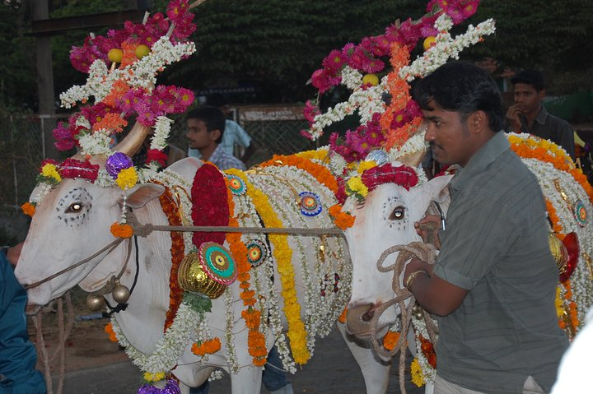

Slide 42
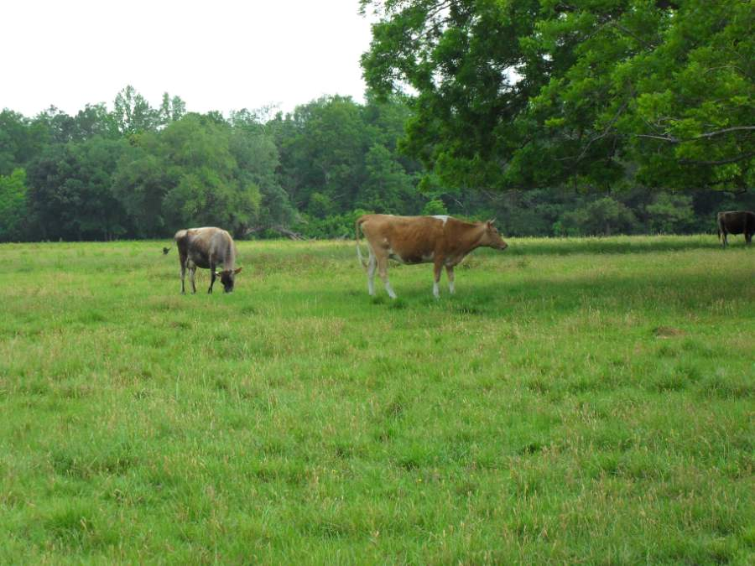
Eco Village New Talavana
The vision for the eco-village is to serve as a cooperative organic farming village and educational center. It will be a community where devotees can take part in a holistic experience of daily sadhana; cooperative, meaningful and organized service; shared meals; healthy devotee relationships and open communication all in an ecologically intelligent, peaceful and highly sustainable village setting. This will be a place for mature devotees to come and take part in this revolutionary spiritual communal effort and strive towards Srila Prabhupada's ideal.

Slide 43
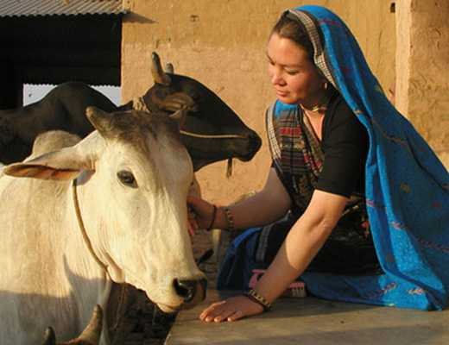
Hare Krishna Valley, Australia

