Slide 1
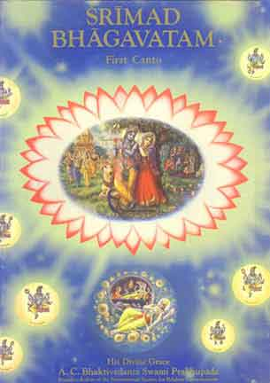
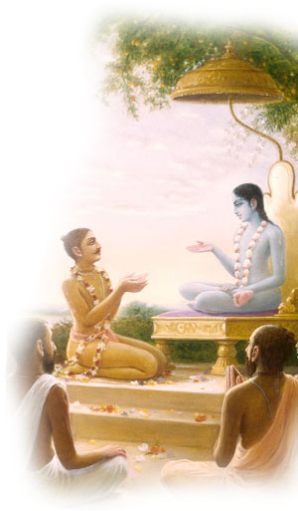
Srimad Bhagavtam 1.16.17-1.16.24 How Pariksit Received the Age of Kali
Invocation prayers
Recap
SB 1.16.17-1.16.24
Session Summary
Smile
References

Slide 2
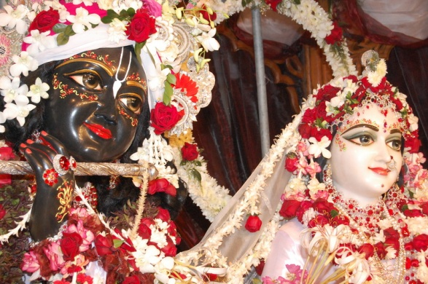
SB 1.2.4
narayanam namaskrtyam naram caiva narottamam devim sarasvatim vyasam tato jayam udirayet
Before reciting this Srimad-Bhagavatam, which is the very means of conquest, one should offer respectful obeisances unto the Personality of Godhead, Narayana, unto Nara-Narayana Rsi, the supermost human being, unto mother Sarasvati, the goddess of learning, and unto Srila Vyasadeva, the author.

Slide 3
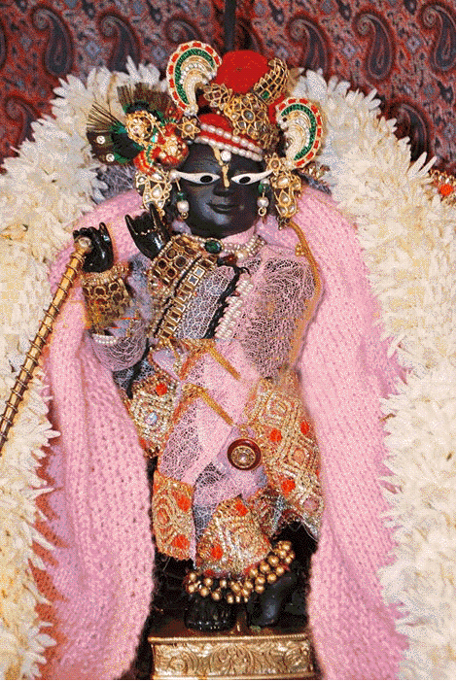
SB 1.2.18
nasta-prayesy abhadresu nityaḿ bhagavata-sevaya bhagavaty uttama-sloke bhaktir bhavati naisthiki
By regular attendance in classes on the Bhagavatam and by rendering of service to the pure devotee, all that is troublesome to the heart is almost completely destroyed, and loving service unto the Personality of Godhead, who is praised with transcendental songs, is established as an irrevocable fact.

Slide 4
Recap (1.16)
Glories of Maharaj Paraksit is in the previous verses. The verses talk about how he was a great king, with great bearing, great linage, great nature , great surrendered soul and mainly a great devotee. His birth was glorious, his life was glorious, his activities were glorious and even his death was glorious.
Krsna and His unalloyed devotees cannot be separated, and therefore glorifying the devotee means glorifying the Lord and vice versa.
Lord Krsna is everything to the unalloyed devotees
The Lord was for the pandavas the Supreme Lord, the spiritual master, the worshipable Deity, the guide, the chariot driver, the friend, the servant, the messenger and everything they could conceive of.
And thus the Lord also reciprocated the feelings of the Pandavas.
Simply by appreciating the dealings of the Lord with His pure devotees, one can attain salvation.
The Lord's dealings with His devotees appear to be ordinary human dealings, but one who knows them in truth becomes at once eligible to go back home, back to Godhead.

Slide 5
[SB 1.16.17] tasyaivam vartamanasya purvesam vrttim anvaham natidure kilascaryam yad asit tan nibodha me
Now you may hear from me of what happened while Maharaja Pariksit was passing his days hearing of the good occupations of his forefathers and being absorbed in thought of them..

Slide 6
Srila Prabhupada Uvaca
Purvesam vrttim anvaham, tasya vartamanasya. He was situated always on the platform where his forefathers remained. This is called aristocratic
Because a monarch is rajarsi. He should be rajarsi, a saintly person. Without being saintly person, how he can become representative of God? A king is supposed to be representative of God. So unless he has got godly character, saintly character, great devotee, how he can become the head of a state? Just like the demigods in the heavenly planets...
So Pariksit Maharaja special qualification... Sva-purvesam mahatmanam. Mahatma means devotee. Mahatma does not mean a politician. Ananya-manasah, without any deviation, twenty-four hours, he is engaged in Krsna's service. That is mahatma. So Maharaja Pariksit's situation is described. Here it is said, tasyaivam vartamanasya. How he kept himself always, na purvesam. Purvesam, the very word again, as it was used previously in the thirteenth and fifteenth verse. Sva-purvesam mahatmanam. He was so responsible that always thinking, "Whether I am deviating from the path of my grandfathers, Yudhisthira, Arjuna?" That was his... In this way he was always thinking. That was his first business. Because his grandfathers were devotees, rajarsi. Rajarsi Yudhisthira.
Srimad-Bhagavatam Los Angeles, January 12, 1974

Slide 7
[SB 1.16.18] dharmah padaikena caran vicchayam upalabhya gam prcchati smasru-vadanam vivatsam iva mataram
The personality of religious principles, Dharma, was wandering about in the form of a bull. And he met the personality of earth in the form of a cow who appeared to grieve like a mother who had lost her child. She had tears in her eyes, and the beauty of her body was lost. Thus Dharma questioned the earth as follows.

Slide 8
[SB 1.16.19] dharma uvaca kaccid bhadre 'namayam atmanas te vicchayasi mlayatesan mukhena alaksaye bhavatim antaradhim dure bandhum socasi kancanamba
Dharma [in the form of a bull] asked: Madam, are you not hale and hearty? Why are you covered with the shadow of grief? It appears by your face that you have become black. Are you suffering from some internal disease, or are you thinking of some relative who is away in a distant place?

Slide 9
Key points
The bull is the emblem of the moral principle, and the cow is the representative of the earth. When the bull and the cow are in a joyful mood, it is to be understood that the people of the world are also in a joyful mood. The reason is that the bull helps production of grains in the agricultural field, and the cow delivers milk, the miracle of aggregate food values.
But at the present moment in this age of Kali both the bull and the cow are now being slaughtered and eaten up as foodstuff by a class of men who do not know the brahminical culture.
Brahminical culture is the topmost perfection of all cultural affairs.
By advancement of such culture, the morale of society is properly maintained, and so peace and prosperity are also attained without extraneous effort.
The people of the world in this age of Kali are always full of anxieties. Everyone is diseased with some kind of ailment.
There are sufferings from internal diseases, separation from those near and dear, and anxieties for maintaining the status quo.

Slide 10
Key points
This age of Kali is very degraded age. In the beginning, there is Satya-yuga; and then, Treta-yuga; next, Dvapara-yuga; and this is the Kali-yuga. The aggregate of all these four yugas is called yuga: sahasra-yuga-paryantam ahar yad brahmano viduh [Bg. 8.17]. The duration of Satya-yuga is 1,800,000's of years; and Treta-yuga, roughly 1,200,000's of years; and Dvapara-yuga, 800,000's of years; and this Kali-yuga, 432,000's of years. In this Kali-yuga we have passed only five thousand years. Out of 432,000's of years we have passed only five thousand. Since the Battle of Kuruksetra, which took place five thousand years ago, the Kali-yuga has begun.
There are 7 mothers. Real mother, from whose womb we have come to this world, real mother, atma-mata. Then guroh patni, wife of the teacher or spiritual master, Brahmani, the wife of a brahmana. The wife of the king, or the queen. Dhenu, the cow. Cow is also mother. And dhatri means nurse. Nurse is also mother. Tatha prthvi, and the earth, the earth is also our mother.. So this... So many mothers we have got, out of which, cow is also mother. Therefore she's addressed as amba. Amba means mother.

Slide 11
Srila Prabhpada Uvaca
So many symptoms are described, but at the end the remedy is suggested because sastra means it will guide you for the ultimate goal of life, for the perfection of life. So if the world condition is so bad, then how people will be saved? That is also suggested in the sastra: kaler dosa-nidhe rajann asti hy eko mahan gunah. Pariksit Maharaja was advised by Sukadeva Gosvami, "My dear King, I've described so many faults. It is like the ocean of faults. But there is one boon also. That is special prerogative, special advantage of this age." Kaler dosa-nidhe rajann asti hy eko mahan gunah. Kalau, kalau means "In this age of Kali, it is full of faulty things. But there is one boon." What is that? Kirtanad eva krsnasya mukta-sangah param vrajet. Kirtanad eva krsnasya: Simply by chanting the holy name of Krsna -- Hare Krsna, Hare Krsna, Krsna Krsna, Hare Hare/ Hare Rama, Hare Rama, Rama Rama, Hare Hare -- simply by chanting the holy name...," kirtanad eva krsnasya, krsnasya, so, mukta-sangah, "he becomes free from all these contaminations, by one thing, simply chanting Hare Krsna." Kirtanad eva krsnasya mukta-sangah. There are so many contaminations, so many faults of this age, but simply by chanting Hare Krsna maha-mantra, one becomes kirtanad eva krsnasya mukta-sangah, he becomes free from the contaminated association.

Slide 12
Punch line
Just like if there is some epidemic, disease, and if you take vaccine, it is supposed that you are free from the contamination. So this vaccine of chanting Hare Krsna maha-mantra will keep you fit without any any contamination of this age of Kali. Krsna consciousness movement means that we are preaching this cult.
harer nama harer nama harer namaiva kevalam kalau nasty eva nasty eva nasty eva gatir anyatha [Adi 17.21]
Without this, there is no other way of saving you from the contamination of Kali.

Slide 13
[SB 1.16.20] padair nyunam socasi maika-padam atmanam va vrsalair bhoksyamanam aho suradin hrta-yajna-bhagan praja uta svin maghavaty avarsati
I have lost my three legs and am now standing on one only. Are you lamenting for my state of existence? Or are you in great anxiety because henceforward the unlawful meat-eaters will exploit you? Or are you in a sorry plight because the demigods are now bereft of their share of sacrificial offerings because no sacrifices are being performed at present? Or are you grieving for living beings because of their sufferings due to famine and drought?

Slide 14
Key points
With the progress of the age of Kali, four things particularly, namely the duration of life, mercy, the power of recollection, and moral or religious principles will gradually diminish
Since Dharma, or the principles of religion, would be lost in the proportion of three out of four, the symbolic bull was standing on one leg only. When three fourths of the population of the whole world become irreligious, the situation is converted into hell for the animals.
One can acquire the respective qualifications by one's own efforts, and thus the son of a Vaisnava can become a mleccha, or the son of a candala can become more than a brahmana, all in terms of their association and intimate relation with the Supreme Lord.

Slide 15
Key points
This material world is a sort of prison house, as we have several times mentioned. The demigods are the servants of the Lord who see to the proper upkeep of the prison house. These demigods want to see that the rebel living beings, who want to survive faithlessly, are gradually turned towards the supreme power of the Lord. Therefore, the system of offering sacrifice is recommended in the scriptures.
The people of this age will not perform any sacrifice. The living beings are created by the creator Brahma, and just to maintain the created living being progressively towards the path back to Godhead, the system of performing sacrifice is also created by him.

Slide 16
Srila Prabhpada Uvaca
The materialistic men want to work hard and enjoy fruitive results for sense enjoyment. Thus they are committing many types of sins at every step of life. Those, however, who are consciously engaged in the devotional service of the Lord are transcendental to all varieties of sin and virtue. Their activities are free from the contamination of the three modes of material nature. For the devotees there is no need for performance of prescribed sacrifices because the very life of the devotee is a symbol of sacrifice. But persons who are engaged in fruitive activities for sense enjoyment must perform the prescribed sacrifices because that is the only means to get free from the reaction of all sins committed by fruitive workers. Sacrifice is the means for counteracting such accumulated sins. The demigods are pleased when such sacrifices are performed, just as prison officers are satisfied when the prisoners are turned into obedient subjects. Lord Caitanya, however, has recommended only one yajna, or sacrifice, called the sankirtana-yajna, the chanting of Hare Krsna, in which everyone can take part. Thus both devotees and fruitive workers can derive equal benefit from the performances of sankirtana-yajna.

Slide 17
[SB 1.16.21] araksyamanah striya urvi balan socasy atho purusadair ivartan vacam devim brahma-kule kukarmany abrahmanye raja-kule kulagryan
Are you feeling compunction for the unhappy women and children who are left forlorn by unscrupulous persons? Or are you unhappy because the goddess of learning is being handled by brahmanas addicted to acts against the principles of religion? Or are you sorry to see that the brahmanas have taken shelter of administrative families that do not respect brahminical culture?

Slide 18
Key points
In the age of Kali, the women and the children, along with brahmanas and cows, will be grossly neglected and left unprotected.
In this age illicit connection with women will render many women and children uncared for.
Circumstantially, the women will try to become independent of the protection of men, and marriage will be performed as a matter of formal agreement between man and woman.
The brahmanas are traditionally intelligent men, and thus they will be able to pick up modern education to the topmost rank, but as far as moral and religious principles are concerned, they shall be the most fallen.
The brahmanas are specifically restricted from accepting such service. But in this age they will not only accept service, but they will do so even if it is of the meanest quality. These are some of the symptoms of the Kali age which are harmful to the general welfare of human society.

Slide 19
[SB 1.16.22] kim ksatra-bandhun kalinopasrstan rastrani va tair avaropitani itas tato vasana-pana-vasahsnana- vyavayonmukha-jiva-lokam
The so-called administrators are now bewildered by the influence of this age of Kali, and thus they have put all state affairs into disorder. Are you now lamenting this disorder? Now the general populace does not follow the rules and regulations for eating, sleeping, drinking, mating, etc., and they are inclined to perform such anywhere and everywhere. Are you unhappy because of this?

Slide 20
Key points
There are some necessities of life on a par with those of the lower animals, and they are eating, sleeping, fearing and mating. These bodily demands are for both the human beings and the animals. But the human being has to fulfill such desires not like animals, but like a human being.
For the human being there are some rules and regulations, even for fulfilling common demands. The human society avoids such rules and regulations when it is bewildered by the influence of the age of Kali.

Slide 21
[SB 1.16.23] yadvamba te bhuri-bharavatara krtavatarasya harer dharitri antarhitasya smarati visrsta karmani nirvana-vilambitani
O mother earth, the Supreme Personality of Godhead, Hari, incarnated Himself as Lord Sri Krsna just to unload your heavy burden. All His activities here are transcendental, and they cement the path of liberation. You are now bereft of His presence. You are probably now thinking of those activities and feeling sorry in their absence.

Slide 22
Key points
The activities of the Lord include liberation, but they are more relish able than the pleasure derived from nirvana, or liberation.
Srila Jiva Gosvami and Visvanatha Cakravarti Thakura, the word used here is nirvana-vilambitani, that which minimizes the value of liberation.
To attain nirvana, liberation, one has to undergo a severe type of tapasya, austerity, but the Lord is so merciful that He incarnates to diminish the burden of the earth.
Simply by remembering such activities, one can defy the pleasure derived from nirvana and reach the transcendental abode of the Lord to associate with Him, eternally engaged in His blissful loving service.

Slide 23
[SB 1.16.24] idam mamacaksva tavadhi-mulam vasundhare yena vikarsitasi kalena va te balinam baliyasa surarcitam kim hrtam amba saubhagam
Mother, you are the reservoir of all riches. Please inform me of the root cause of your tribulations by which you have been reduced to such a weak state. I think that the powerful influence of time, which conquers the most powerful, might have forcibly taken away all your fortune, which was adored even by the demigods.

Slide 24
Key points
By the grace of the Lord, each and every planet is created fully equipped. So not only is this earth fully equipped with all the riches for the maintenance of its inhabitants, but also when the Lord descends on the earth the whole earth becomes so enriched with all kinds of opulences that even the denizens of heaven worship it with all affection.
He can do and undo a thing by His sweet will. Therefore no one should consider himself to be self-sufficient or independent of the Lord.

Slide 25
Session Summary
Praksit Maharaj was situated on the platform of his forefathers.
Only a saintly person can become representative of god.
Bulls is the emblem of moral principle and cow is the representative of earth. But in this age they are both tortured and so there is no joyful mood.
Age of Kali has on advantage is that is we can achieve liberation thru chanting of the holy names. It is that easy.
With progress of Kali, life expectancy, mercy, memory and moral/religious principles will diminish
People will also not offer sacrifices which have to performed by people seeking fruitive activities to please the demigods.
In the age of Kali, women, children, cows and brahamans will be neglected and left unprotected.

Slide 26
Session Summary
Eating, sleeping, mating, defending will be enjoyed by humans without any regulations just like animals.
But activities of the Lord are more relish able than liberation
Simply by remembering him, one can defy liberation and join the Lord in his eternal abode without going thru austerities.
Every planet is fully equipped by the Lord.
He can do and undo anything just by his sweet will.

Slide 27
Punch line
Therefore we should not consider ourselves to be independent or self sufficient from the Lord.

Slide 28
Srila Prabhpada Uvaca
Dharma means not a religious sentiment. Dharma means occupational duty.
So you can liquidate the debts simply... It is practically impossible. Therefore, if you take shelter of Mukunda, saranam saranyam, the worthy of taking shelter... If you take shelter of anyone else, he cannot give you protection. Krsna says, aham tvam sarva-papebhyo moksayisyami. If you cannot liquidate your debts, you become sinful. But if you surrender to Krsna, Krsna says, sarva-dharman parityajya mam ekam saranam vraja aham tvam sarva-papebhyo moksayisyami ma sucah [Bg. 18.66]

Slide 29
Srila Prabhpada Uvaca
So be careful that this material world is itself dangerous. Especially in this age of Kali, it is dangerous. It is stated in the sastra, padam padam yad vipadam, every step there is danger. This is the position. Maya is so strong that you should always expect simply danger. But if you become Krsna conscious, you can overcome these dangers... Padam padam yad vipadam na tesam. It is not... This dangerous position is not for them. Who? Samasrita ye pada-pallava-plavam, one who has taken shelter of the lotus feet. It is a great ocean, just like the Pacific Ocean. It is just like a great ocean, big ocean of ignorance. As in the ocean, if you go, even on a boat, it is always dangerous, similarly, we are in the ocean of material civilization. There is always danger. But if you take shelter of the lotus feet of Krsna, param padam, then you overcome the danger and you go back to home, back to Godhead.

Slide 30
Srila Prabhpada Uvaca
Any woman except his own wife is mother. Any woman. It doesn't matter whether she is elderly or young. No. That is the way. Still in India, any woman by unknown person, he can address any woman "Mother." The first relationship is mother. Now they have introduced "Sister," "Bahinaji." No, that is not Vedic etiquette. No bahinaji. Bahinaji means sister. Mother. Everyone should be addressed. We should learn this. Except one's one wife, all women should be addressed as "Mother." This is civilization. Then there will be no corrupt relation. If you, from the very beginning, you establish your relationship with other women as mother, then there is no question of other relationship.
These children, they are dancing, they are offering obeisances, they are offering a flower. They do not know what they are doing, but it will not go in vain. This is Krsna consciousness. These things are becoming assets, one after another. Just like if you keep money in the bank, daily you save, it is increasing your bank balance, similarly, these children, although they do not know what is this class, what is Prabhupada speaking, why we are offering... They are imitating. They are imitating, offering obeisances. We used to do so. Every children, every child does so. So if the mother is a devotee, the child automatically becomes a devotee, without any effort.

Slide 31
Smile

Slide 32
Srimad Bhagavtam Ki Jai Srila Prabhupada ki Jai
References
Srimad Bhagavatam – His divine grace A.C.Bhaktivedanta Swami
www.Prabhupadavani.org (all lecture dates recorded in the quotes)

