Slide 1
Srimad Bhagavatam
1.16.10 – 1.16.16
Mahārāja Parīkṣit Tours his kingdom

Slide 2
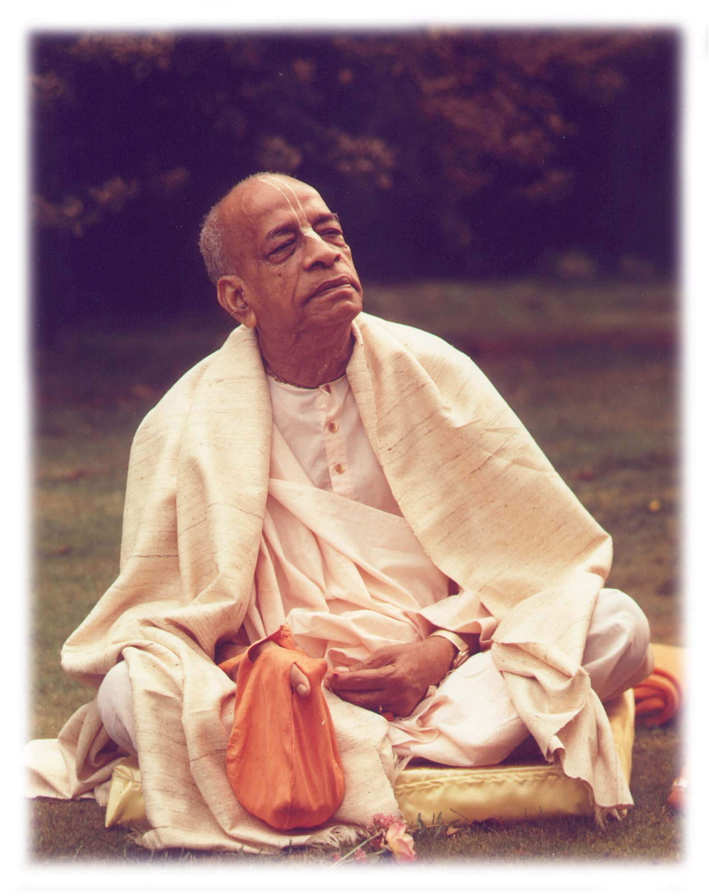
Based on the teachings of His Divine Grace A.C. Bhaktivedanta Swami Prabhupada
Founder Acharya
International Society for Krishna Consciousness

Slide 3
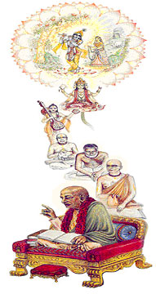
Seeking the Blessings of Guru, Gauranga & All the Assembled Vaishnavas

Slide 4
Mahārāja Parīkṣit Tours his kingdom
1.16.10 - 12: Mahārāja Parīkṣit travels
1.16.13 - 15: Glories of Pāṇḍavas
1.16.16: Causeless Mercy of the Lord

Slide 5
Śrīmad Bhāgavatam 1.16.10
sūta uvāca
yadā parīkṣit kuru-jāńgale 'vasat
kaliḿ praviṣṭaḿ nija-cakravartite
niśamya vārtām anatipriyāḿ tataḥ
śarāsanaḿ saḿyuga-śauṇḍir ādade
Translation
Sūta Gosvāmī said: While Mahārāja Parīkṣit was residing in the capital of the Kuru empire, the symptoms of the age of Kali began to infiltrate within the jurisdiction of his state. When he learned about this, he did not think the matter very palatable. This did, however, give him a chance to fight. He took up his bow and arrows and prepared himself for military activities

Slide 6
SB 1.16.10 Pariksit's Answer To Kali Important Points from Purport
Maharaja Pariksit – Perfect King
Kali Yuga – Age of Quarrel
Root Causes - Intoxication, Meat Eating, Illicit Sex, Gambling
By pride, either artificial or real, the resultant action of austerity is spoiled; by too much affection for female association, cleanliness is spoiled; by too much addiction to intoxication, mercy is spoiled; and by too much lying propaganda, truthfulness is spoiled.
Kali’s infiltration into the kingdom of Maharaja Pariksit
Maharaja Pariksit’s attitude
Not Happy – immediately wanted to root them out
Happy – Ksatriya spirit
Arguments by lazy peope – why to fight the symptoms of Kali?
Pre-destined – no need to fight
Counter Argument
Rainy season is pre-destined – still it is our duty to be prepared
Simlarly it is the duty of the King to protect the innocent citizens.

Slide 7
Śrīmad Bhāgavatam 1.16.11
svalańkṛtaḿ śyāma-turańga-yojitaḿ
rathaḿ mṛgendra-dhvajam āśritaḥ purāt
vṛto rathāśva-dvipapatti-yuktayā
sva-senayā digvijayāya nirgataḥ
Translation
Mahārāja Parīkṣit sat on a chariot drawn by black horses. His flag was marked with the sign of a lion. Being so decorated and surrounded by charioteers, cavalry, elephants and infantry soldiers, he left the capital to conquer in all directions.

Slide 8
SB 1.16.11 Subduing The Demons Important Points from Purport
Mahārāja Parīkṣit is distinguished from his grandfather Arjuna, for black horses pulled his chariot instead of white horses. He marked his flag with the mark of a lion, and his grandfather marked his with the mark of Hanumānjī.
A royal procession like that of Mahārāja Parīkṣit surrounded by well-decorated chariots, cavalry, elephants, infantry and band not only is pleasing to the eyes, but also is a sign of a civilization that is aesthetic even on the fighting front.
Application
For devotees fighting means preaching against the influence of Kali under the guidance of Spiritual Master
Prabhupada Uvaca
Similarly, for a preacher also, that is digvijaya. Go from country and country, from village to village, town to town, and make digvijaya: "Here is our philosophy. There is God. We can prove there is God. Who are you, you deny God? Come on." That is digvijaya.
Notes:
This lion is not to be considered an ordinary lion. This lion is Mrgendra or Narahari, Nrsimhadeva.
So Vaisnava does not mean he cannot do anything else except chanting. That is very experienced life, experienced Vaisnava. He can concentrate chanting. Just like Haridasa Thakura. Haridasa Thakura was chanting. But Sri Caitanya Mahaprabhu Himself, Nityananda Prabhu, they were preaching.

Slide 9
Śrīmad Bhāgavatam 1.16.12
bhadrāśvaḿ ketumālaḿ ca
bhārataḿ cottarān kurūn
kimpuruṣādīni varṣāṇi
vijitya jagṛhe balim
Translation
Mahārāja Parīkṣit then conquered all parts of the earthly planet — Bhadrāśva, Ketumāla, Bhārata, the northern Kuru, Kimpuruṣa, etc. — and exacted tributes from their respective rulers.

Slide 10
SB 1.16.12 Rogues And Rascals Cause War Important Points from Purport
This earth planet is divided into seven dvīpas by seven oceans, and the central dvīpa, called Jambūdvīpa, is divided into nine varṣas, or parts, by eight huge mountains.
Bhadrāśva: It is a tract of land near Meru Parvata, and it extends from Gandha-mādana Parvata to the saltwater ocean.
Ketumāla: It is said that in Ketumāla varṣa, women are the most beautiful. This part of the world is situated on the western side of the Meru Parvata, and inhabitants of this province used to live up to ten thousand years. Human beings living in this part of the globe are of golden color, and the women resemble the angels of heaven. The inhabitants are free from all kinds of diseases and grief.
In the center of Jambūdvīpa is Ilāvṛta-varṣa, and south of Ilāvṛta-varṣa is Hari-varṣa.
It is mentioned here that the women in both these varṣas are beautiful, and some of them are equal to the Apsarās, or heavenly women.

Slide 11
SB 1.16.12 Rogues And Rascals Cause War Important Points from Purport
Uttarakuru: Northernmost portion of Jambūdvīpa. It is surrounded by the saltwater ocean from three sides and divided by Śṛńgavān Mountain from the Hiraṇmaya-varṣa.
Kimpuruṣa-varṣa: North of the great Himalaya Mountain, which is eighty thousand miles in length and height and which covers sixteen thousand miles in width. The Kimpuruṣas are descendants of a daughter of Dakṣa. This part of the world is called Kimpuruṣa-varṣa, or sometimes the Himalayan provinces (Himavatī). It is said that Śukadeva Gosvāmī was born in these Himalayan provinces and that he came to Bhārata-varṣa after crossing the Himalayan countries.
In other words, Mahārāja Parīkṣit conquered all the world. He conquered all the continents adjoining all the seas and oceans in all directions, namely the eastern, western, northern and southern parts of the world.

Slide 12
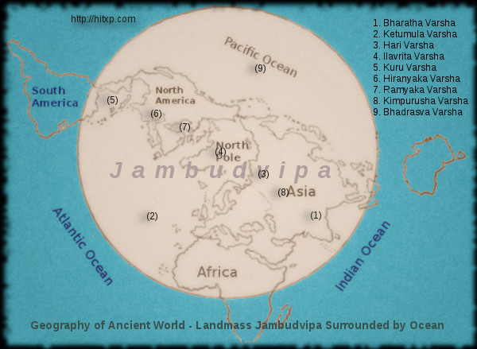

Slide 13
SB 1.16.12 Rogues And Rascals Cause War Srila Prabhupada Uvaca
The aim was... All the fights in Mahabharata or in Ramayana, it was meant for chastising the godless, godless. Just like Ramacandra. Ramacandra, Lord Ramacandra, chastised Ravana. So he went to Lanka -- they call Ceylon -- and crossed the sea by making bridge. But what was the idea? The idea was that "This rascal demon is a godless person; so therefore he must be punished." He was punished not alone. Anyone who joined with him, everyone was punished. But Lord Ramacandra did not occupy the land for His kingdom. He installed his brother Vibhisana, who was a devotee in the place of Ravana. Just like Krsna. Krsna was taking part in the Battlefield of Kuruksetra and inducing Arjuna that "You fight." Arjuna was not willing to fight, but He was inducing to fight.
So what is the purpose? Because the other party represented thieves, rogues, and demons. So Krsna wants therefore that somebody must be king who is His representative, devotee. That is the whole plan.

Slide 14
Śrīmad Bhāgavatam 1.16.13-15
tatra tatropaśṛṇvānaḥ
sva-pūrveṣāḿ mahātmanām
pragīyamāṇaḿ ca yaśaḥ
kṛṣṇa-māhātmya-sūcakam
ātmānaḿ ca paritrātam
aśvatthāmno 'stra-tejasaḥ
snehaḿ ca vṛṣṇi-pārthānāḿ
teṣāḿ bhaktiḿ ca keśave
tebhyaḥ parama-santuṣṭaḥ
prīty-ujjṛmbhita-locanaḥ
mahā-dhanāni vāsāḿsi
dadau hārān mahā-manāḥ

Slide 15
Śrīmad Bhāgavatam 1.16.13-15
Translation
Wherever the King visited, he continuously heard the glories of his great forefathers, who were all devotees of the Lord, and also of the glorious acts of Lord Kṛṣṇa. He also heard how he himself had been protected by the Lord from the powerful heat of the weapon of Aśvatthāmā. People also mentioned the great affection between the descendants of Vṛṣṇi and Pṛthā due to the latter's great devotion to Lord Keśava. The King, being very pleased with the singers of such glories, opened his eyes in great satisfaction. Out of magnanimity he was pleased to award them very valuable necklaces and clothing.

Slide 16
SB 1.16.13-15 Mischievous And Magnanimous Important Points from Purport
Culture of Respect – Kings and His representatives received with Welcome Addresses.
Such welcome addresses were full of facts and figures, and those who presented such addresses were sufficiently rewarded, whereas in the present days the welcome addresses are presented not always with factual statements but to please the postholder, and often they are full of flattering lies. And rarely are those who present such welcome addresses rewarded by the poor receiver.
The subject matter of those welcome addresses was Kṛṣṇa. Kṛṣṇa means Kṛṣṇa and His eternal devotees, as the king means the king and his confidential associates.

Slide 17
SB 1.16.13-15 Mischievous And Magnanimous Important Points from Purport
Kṛṣṇa and His unalloyed devotees cannot be separated, and therefore glorifying the devotee means glorifying the Lord and vice versa.
Pariksit Maharaja’s eagerness to hear about his great grandfather’s was them being the devotees of the Lord.
The Lord is present for the devotee by His acts and glories, and therefore Mahārāja Parīkṣit felt the presence of the Lord when He was glorified by His acts, especially when he was saved by the Lord in the womb of his mother.The devotees of the Lord are never in danger, but in the material world which is full of dangers at every step, the devotees are apparently placed into dangerous positions, and when they are saved by the Lord, the Lord is glorified.

Slide 18
Śrīmad Bhāgavatam 1.16.16
sārathya-pāraṣada-sevana-sakhya-dautya-
vīrāsanānugamana-stavana-praṇāmān
snigdheṣu pāṇḍuṣu jagat-praṇatiḿ ca viṣṇor
bhaktiḿ karoti nṛ-patiś caraṇāravinde
Translation
Mahārāja Parīkṣit heard that out of His causeless mercy Lord Kṛṣṇa [Viṣṇu], who is universally obeyed, rendered all kinds of service to the malleable sons of Pāṇḍu by accepting posts ranging from chariot driver to president to messenger, friend, night watchman, etc., according to the will of the Pāṇḍavas, obeying them like a servant and offering obeisances like one younger in years. When he heard this, Mahārāja Parīkṣit became overwhelmed with devotion to the lotus feet of the Lord.

Slide 19
SB 1.16.16: Everyone Of Us Loves Krishna Important Points from Purport
Lord Kṛṣṇa is everything to the unalloyed devotees like the Pāṇḍavas. The Lord was for them the Supreme Lord, the spiritual master, the worshipable Deity, the guide, the chariot driver, the friend, the servant, the messenger and everything they could conceive of.
And thus the Lord also reciprocated the feelings of the Pāṇḍavas. Mahārāja Parīkṣit, as a pure devotee of the Lord, could appreciate the Lord's transcendental reciprocation of the feelings of His devotees, and thus he himself also was overwhelmed with the dealings of the Lord.
Simply by appreciating the dealings of the Lord with His pure devotees, one can attain salvation. The Lord's dealings with His devotees appear to be ordinary human dealings, but one who knows them in truth becomes at once eligible to go back home, back to Godhead.
The Pāṇḍavas were so malleable to the will of the Lord that they could sacrifice any amount of energy for the service of the Lord, and by such unalloyed determination they could secure the Lord's mercy in any shape they desired.

Slide 20
References
Rompadaswami.com http://www.romapadaswami.com/node/4307
Prabhupadavani
http://prabhupadavani.org/main/Bhagavatam/266.html
http://prabhupadavani.org/main/Bhagavatam/267.html
http://prabhupadavani.org/main/Bhagavatam/268.html
http://prabhupadavani.org/main/Bhagavatam/269.html
http://prabhupadavani.org/main/Bhagavatam/270.html

