Slide 1
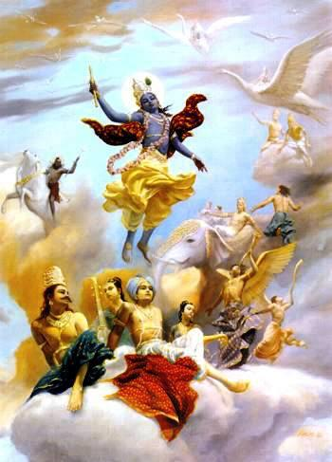
SB CANTO 1 CHAPTER 14 THE DISAPPEARANCE OF LORD KRSNA

Slide 2
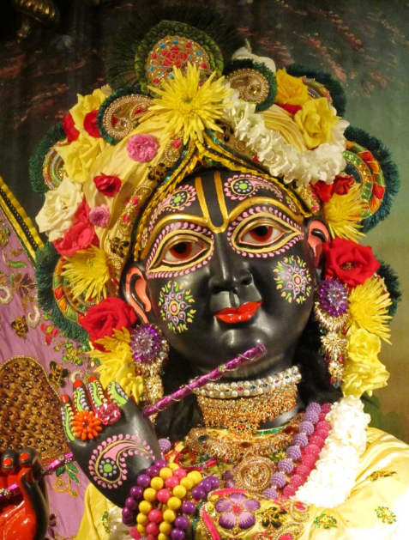
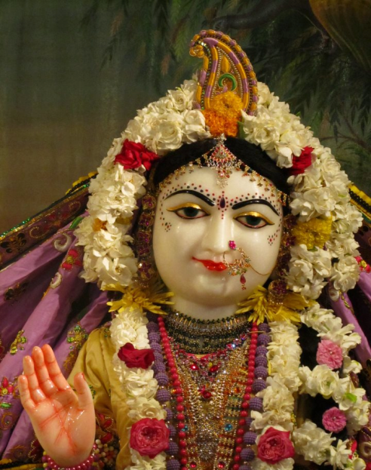
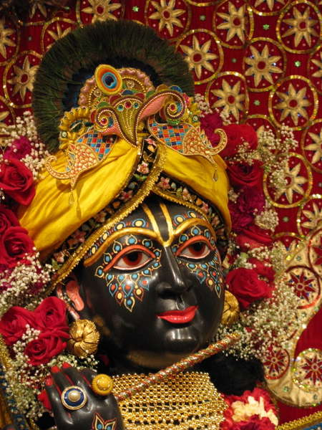
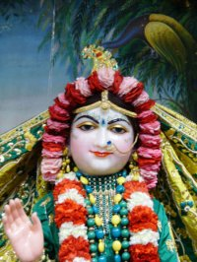
SB 1.2.4 narayanam namaskrtyam naram caiva narottamam devim sarasvatim vyasam tato jayam udirayet
Before reciting this Srimad-Bhagavatam, which is the very means of conquest, one should offer respectful obeisances unto the Personality of Godhead, Narayana, unto Nara-Narayana Rsi, the supermost human being, unto mother Sarasvati, the goddess of learning, and unto Srila Vyasadeva, the author.

Slide 3
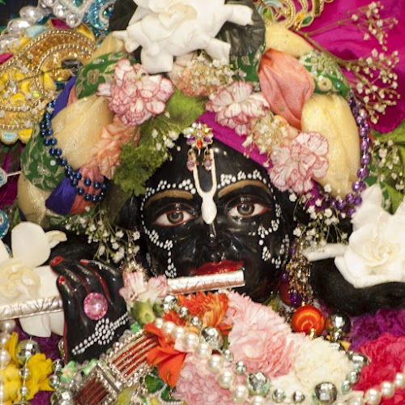
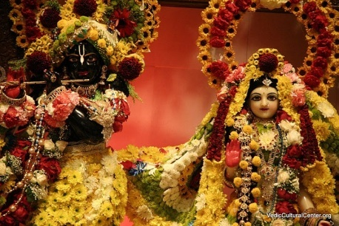
SB 1.2.18 nasta-prayesy abhadresu nityaḿ bhagavata-sevaya bhagavaty uttama-sloke bhaktir bhavati naisthiki
By regular attendance in classes on the Bhagavatam and by rendering of service to the pure devotee, all that is troublesome to the heart is almost completely destroyed, and loving service unto the Personality of Godhead, who is praised with transcendental songs, is established as an irrevocable fact.

Slide 4
Recap of Chapter 13
1.13.1-8 Vidura returns to Hastinapura after hearing about the science of self from Maitreya Muni
1.13.9-16 Yudhisthira Maharaja inquires from Vidura about his travelling (In 1.13.11- specifically inquires about Krsna and His associates in Dvaraka)
1.13.17-28 Vidura preaches strongly to Dhrtarastra
1.13.29-37 Dhrtarastra leaves home w/Gandhari and Vidura. Yudhisthira Maharaja inquires of their whereabouts from Sanjaya
1.13.38-48 Narada Muni instructs Yudhisthira Maharaja
1.13.49-60 Dhrtarastra practices astanga yoga and leaves his body (In 1.13.50- Narada Muni hints on Krsna’s departure from this earth)

Slide 5
Section Themes
1.14.1-9 The Lord’s presence and the Lord’s absence
1.14.10–21 The inauspicious omens observed by Yudhisthira Maharaja

Slide 6
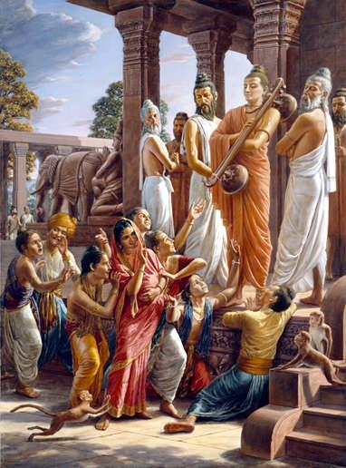
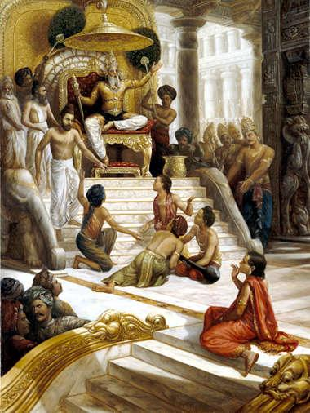
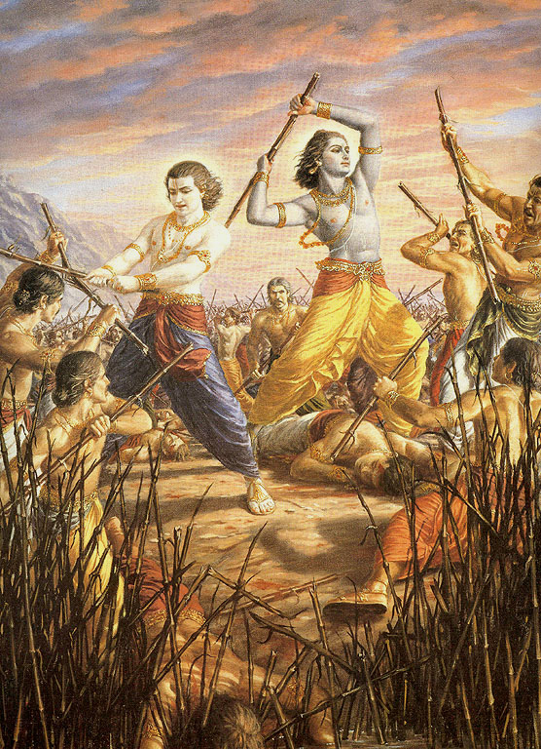
Destruction of Yadu Dynasty

Slide 7
1.14.1
sūta uvāca
samprasthite dvārakāyāḿ
jiṣṇau bandhu-didṛkṣayā
jñātuḿ ca puṇya-ślokasya
kṛṣṇasya ca viceṣṭitam
Śrī Sūta Gosvāmī said: Arjuna went to Dvārakā to see Lord Śrī Kṛṣṇa and other friends and also to learn from the Lord of His next activities.

Slide 8
Purport Points 1.14.1
Purpose of the Lord’s descend
---BG 4.7
The Lord’s mission was now complete
--Battle of Kuruksetra and establishment of Maharaja Yudhisthira as King
Purpose of Arjuna going to Dwarka
Notes:
Arjuna went to Dwarka implied in this is- Can I help you in the next phase

Slide 9
Practical Application 1.14.1
Pandavas never acted independently of the Lord/took complete shelter of the Lord
Krsna is known as Pranata Karuna- He who is merciful to the surrendered souls
eg. Owner of the cow
Always look for an opportunity to serve
Notes:
1. They were fully surrendered devotees- Krsna accepts this surrendered mood of His devotee.
Once we have surrendered to someone – stands the obligation to protect- Krsna fulfills this obligation perfectly –A devotee can 100% rely on this quality of Krsna.
COW- completely taken care of by the owner- eating, getting cleaned up, not well
2. Opportunity to serve- We have the option at every moment- to serve the Lord – any corner of the world we go – we always have an opportunity to serve
Know what to do- I have been around in ISKCON for 5, 10, 15 yrs- can act independent- no need to follow or inquire – is this activity good for me.

Slide 10
1.14.2
vyatītāḥ katicin māsās
tadā nāyāt tato 'rjunaḥ
dadarśa ghora-rūpāṇi
nimittāni kurūdvahaḥ
A few months passed, and Arjuna did not return. Mahārāja Yudhiṣṭhira then began to observe some inauspicious omens, which were fearful in themselves.

Slide 11
Purport Points 1.14.2
Sun is the source of all productivity and material energy
Krsna is ad infinitum
- Source of millions and billions of such suns
Krsna is compared to the sun
-Presence of sun- full flood of light
- Presence of Lord- all paraphernalia for peace, prosperity, religion and knowledge in full display
kṛṣṇa — sūrya-sama; māyā haya andhakāra
yāhāń kṛṣṇa, tāhāń nāhi māyāra adhikāra
"Kṛṣṇa is compared to sunshine, and māyā is compared to darkness. Wherever there is sunshine, there cannot be darkness. As soon as one takes to Kṛṣṇa consciousness, the darkness of illusion (the influence of the external energy) will immediately vanish. (Cc Madhya 22.31)
Notes:
1. B/c of sun we have all necessities of life.
1. As with light of the sun what darkness can stand ---In the presence of Krsna, what inauspiciousness can stand

Slide 12
Purport Points cont’d..(1.14.2)
Maharaja Yudhisthira observes some discrepancies in his kingdom
He suspected the departure of the Lord(ref : 1.13.50)
Notes:
Chapter 10- everything was so abundant
MY became anxious for Arjuna and also there was no news about Dwarka’s well being.

Slide 13
1.14.3
kālasya ca gatiḿ raudrāḿ
viparyastartu-dharmiṇaḥ
pāpīyasīḿ nṛṇāḿ vārtāḿ
krodha-lobhānṛtātmanām
He saw that the direction of eternal time had changed, and this was very fearful. There were disruptions in the seasonal regularities. The people in general had become very greedy, angry and deceitful. And he saw that they were adopting foul means of livelihood.

Slide 14
Purport Points 1.14.3
Result of civilization being disconnected from the SPG
- Seasonal changes
-Foul means of livelihood
-Greed, anger
Foul means– comes from deviation of one’s duty
Ignorance is the root cause of such anomalies- thinking this life is all in all
Notes:
We are accustomed to all these symptoms today- but they were naturally absent in MY’s kingdom and therefore he was very surprised to see symptoms like these coming up.
Godless man- carry no value and morals- becomes selfish and is geared to thinking only for one’s own sense gratification
Think this life is all in all--- is not aware of the actual goal of life eg of a person telling SP that he does not mind being a dog in his next life.

Slide 15
Our Disconnection from SPG
“We are meant to be connected with the Supreme just as our hand is meant to be connected to our body. We are part and parcel of the Supreme, just as the hand is part and parcel of the body. When the hand is severed from the body, it is valueless, but when it is joined to the body, it is invaluable. Similarly, in this material condition, we are disconnected from God. Actually, the word disconnected is not precise, because the connection is always there. God is always supplying all our necessities. Since nothing can exist without Krsna, we cannot be disconnected from Him. Rather, it is better to say that we have forgotten that we are connected to Krsna. Because of this forgetfulness, we have entered the criminal department of the universe. The government still takes care of its criminals, but they are legally disconnected from the civilian state. Our disconnection is a result of our engaging in so many nonsensical activities instead of utilizing our senses in the performance of our Krsna conscious duties.” (Path of Perfection- Moderation in Yoga-Pg 4)
Notes:
Eg of a son who says I have no connection with my father. How can he disconnect from the father. He may not act in that relationship- it is a dormant relationship but relationship is there. Similarly our relationship with Krsna is covered in the conditioned state under the spell of illusion.

Slide 16
AM I Connected with the Lord ?
I need to check my consciousness from time to time during the day.
Am I doing it for the pleasure of the Lord or His devotees or doing it because I like it.

Slide 17
How to Remove ignorance?
Srila Prabhupada’s purport 1.14.3
“Ignorance is the cause for all these anomalies in human society, and to remove this ignorance, especially in this age of degradation, the powerful sun is there to distribute light in the shape of Śrīmad-Bhāgavatam”.
Notes:
SP is giving the answer to the Question “ Where has religion taken shelter after the Lord’s departure- SB

Slide 19
1.14.4
jihma-prāyaḿ vyavahṛtaḿ
śāṭhya-miśraḿ ca sauhṛdam
pitṛ-mātṛ-suhṛd-bhrātṛ-
dam-patīnāḿ ca kalkanam
All ordinary transactions and dealings became polluted with cheating, even between friends. And in familial affairs, there was always misunderstanding between fathers, mothers and sons, between well-wishers, and between brothers. Even between husband and wife there was always strain and quarrel.

Slide 20
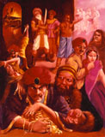

Slide 21
Purport Points 1.14.4
Four defects of the conditioned soul
- Cheating is the most prominent
Why?
- Unnatural desire to lord it over the material world
What is the result of such a desire?
-No satisfaction

Slide 22
Purport Points 1.14.4 Cont’d….
What is the solution?
- Only devotional service to the Lord
SB 1.2.6 sa vai puḿsāḿ paro dharmo
yato bhaktir adhokṣaje
ahaituky apratihatā
yayātmā suprasīdati
- It is a natural and it is the constitutional position of the soul
-Jivera svarupa haya –Krsnera nitya -dasa

Slide 23
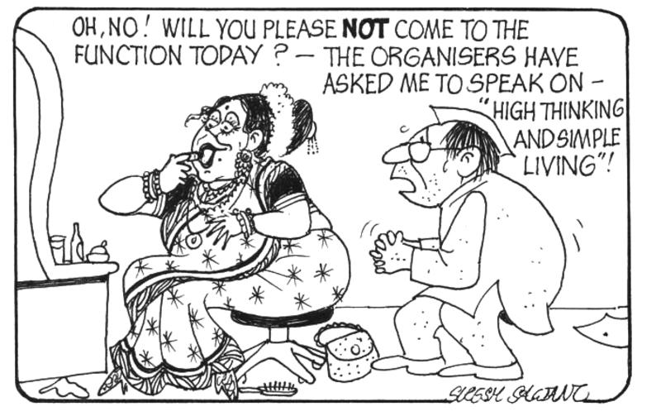
Practical Application-“Hypocrisy”
Hypocrisy:- Duplicity, pretending to have virtues, morals or principles, etc., that one does not actually have. It involves deception of others.

Slide 24
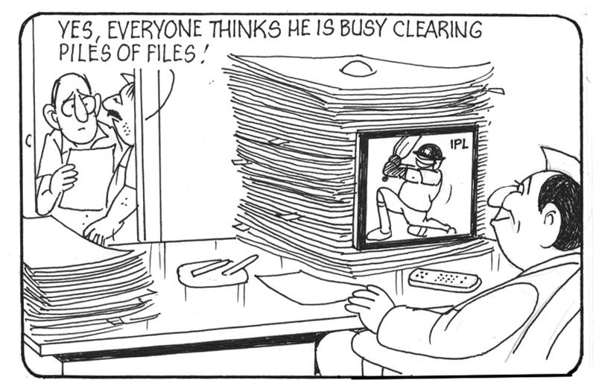

Slide 25
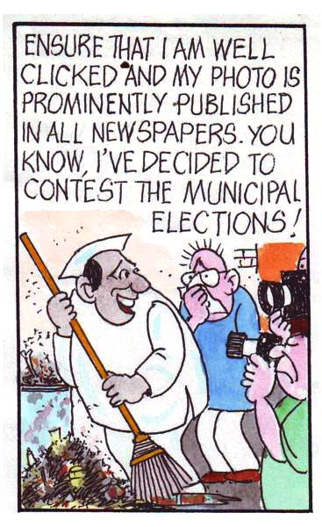

Slide 26
Practical Application-How to overcome hypocrisy
Stages of being honest/truthful:
Recognize that there are many ways I may not be honest
Recognize that I have many faults and undesirable qualities in my heart
Recognize that I can’t change on the strength of my own efforts alone – I need the help in the form of descending mercy!!
To sincerely and honestly accept the mercy available to me in the form of scriptures, devotee association, service and strive to live truthfully-Take trouble to change!!
Notes:
2. I am not as innocent as I think I am. The ability to recognize these truth to oneself and to others is itself the 1st stage of honesty. One should npt feel discouraged by this recognition but rather should feel enlightened to find and accept these truths.
3. If we try to do it on our on strength alone- means again we are cheating- thinking ourselves to be independent of the descending mercy(Krsna & His repres)
4. Be open to change ourselves= means be open to take instructions and apply them.

Slide 27
Practical Application Cont’d…
5. Associate with devotees who are truthful
6. Most important is to cultivate a deep sense of security in our relationship w/ Krsna and His representatives. This is the biggest support to bring about change of heart.
Notes:
5. By associating one will develop of those devotees by hearing from them and serving them.
6. Feeling deeply spiritually secure, we feel comfortable to let go of all pretense. When there is a strong and straightforward relationship with the SM or an advanced devotee, one becomes confident that they accept me completely and love me unconditionally for who I am. I am not being judged!!

Slide 28
1.14.5
nimittāny atyariṣṭāni
kāle tv anugate nṛṇām
lobhādy-adharma-prakṛtiḿ
dṛṣṭvovācānujaḿ nṛpaḥ
In course of time it came to pass that people in general became accustomed to greed, anger, pride, etc. Mahārāja Yudhiṣṭhira, observing all these omens, spoke to his younger brother.

Slide 29
1.14.6
yudhiṣṭhira uvāca
sampreṣito dvārakāyāḿ
jiṣṇur bandhu-didṛkṣay
jñātuḿ ca puṇya-ślokasya
kṛṣṇasya ca viceṣṭitam
Mahārāja Yudhiṣṭhira said to his younger brother Bhīmasena, I sent Arjuna to Dvārakā to meet his friends and to learn from the Personality of Godhead Kṛṣṇa of His program of work.
Notes:
This verse is being repeated here- 1.14.1- suta uvaca and now 1.14.6 Yudhisthira uvaca.
Arjuna having visited Dwarka before during his pilgrimage had made friends there and also he married Subhadra – so he had relatives as well.

Slide 30
1.14.7
gatāḥ saptādhunā māsā
bhīmasena tavānujaḥ
nāyāti kasya vā hetor
nāhaḿ vededam añjasā
Since he departed, seven months have passed, yet he has not returned. I do not know factually how things are going there.

Slide 31
1.14.8
api devarṣiṇādiṣṭaḥ
sa kālo 'yam upasthitaḥ
yadātmano 'ńgam ākrīḍaḿ
bhagavān utsisṛkṣati
Is He going to quit His earthly pastimes, as Devarṣi Nārada indicated? Has that time already arrived?

Slide 32
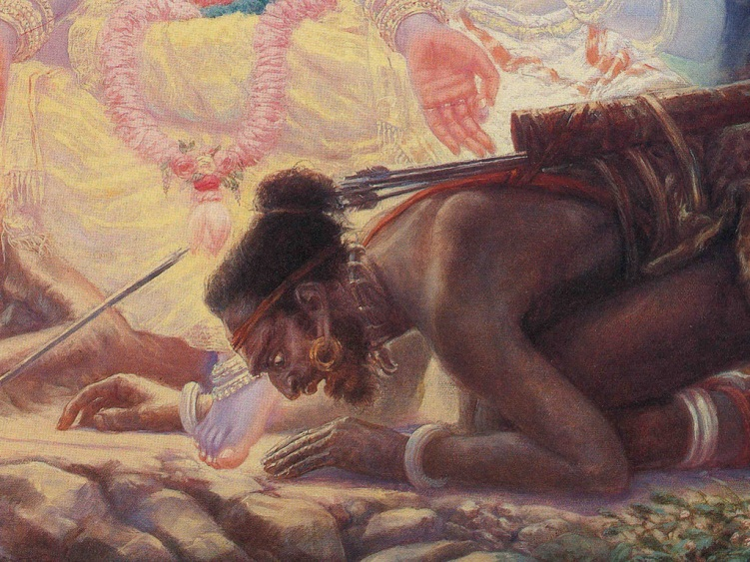
Purport Points 1.14.8
Understanding Krsna’s Disappearance Pastime-Mausala Lila

Slide 33
Krsna’s Disappearance 1.14.8
Krsna is transcendental- So are His appearance, disappearance and activities
- They are beyond the material realm- Need spiritual intelligence
How to understand them?
-BG 4.9
- Only thru love and devotion, when they are revealed to us --BG 10.10
“God dies”???
- Disappearance pastime is the most difficult to understand
- Striking Parallel between SPG’s activities and that of ordinary souls
e.g. Krsna marries, takes birth, is a son, husband, friend
- e.g. of a drama- hero dies- behind the curtain he is alive ready to do another drama.
Krsna’s pastimes can be compared to the sun
Notes:
Trans pastimes- theoretical understanding is not enough
God Dies- How is it that God dies. Just as Krsna is unborn takes birth.
Parallel- Humans tend to mistake Krsna’s pastimes as ordinary yet in each of His pastimes, they have always have elements which are so far beyond anything imaginable practically that a human being can do.
Sun- When the sun sets in one place means it has arisen in some other place. It may have been gone from our sight but it is still there in the sky. Siimilarly Krsna has withdrawn His pastimes from this world He is starting them in some other part of another universe- Krsns’s pastimes are eternal and are continuously taking place.

Slide 34
Krsna’s Disappearance Pastime Cont’d….
Krsna leaves behind His so-called material body(virat rupa) in this material world.
-Virat rupa is the material conception of His form.
When the Lord is transcendental, how can He have a material conception?
→It is the mistaken/illusory conception
Illusory conception- conceiving of His form in a wrong way and that is manifested in Virat rupa.
→ Leaving a body is just to bewilder the minds of the nondevotees
Therefore one needs spiritual guidance to understand Krsna and His pastimes
Notes:
Krsna does not have a body to quit- What body would He quit?
There is no inside and outsidefor Krsna like us- we have a body outside and the soul inside.
For Krsna – He is His body; He does not have a body to quit
This is an illusory pastime – Krsna created an illusory body out of His material energy while simultaneously remaining personally in His own sac-cid ananda body

Slide 35
1.14.9
yasmān naḥ sampado rājyaḿ
dārāḥ prāṇāḥ kulaḿ prajāḥ
āsan sapatna-vijayo
lokāś ca yad-anugrahāt
From Him only, all our kingly opulence, good wives, lives, progeny, control over our subjects, victory over our enemies, and future accommodations in higher planets have become possible. All this is due to His causeless mercy upon us.

Slide 36
1.14.10
paśyotpātān nara-vyāghra
divyān bhaumān sadaihikān
dāruṇān śaḿsato 'dūrā
bhayaḿ no buddhi-mohanam
Just see, O man with a tiger's strength, how many miseries due to celestial influences, earthly reactions and bodily pains — all very dangerous in themselves — are foreboding danger in the near future by deluding our intelligence.

Slide 37
1.14.11
ūrv-akṣi-bāhavo mahyaḿ
sphuranty ańga punaḥ punaḥ
vepathuś cāpi hṛdaye
ārād dāsyanti vipriyam
The left side of my body, my thighs, arms and eyes are all quivering again and again. I am having heart palpitations due to fear. All this indicates undesirable happenings.

Slide 38
Work Done Independent Of The Lord Versus Work Done While Depending Upon Him. (1.14.9-11)
Personal Endeavor | The Lord’s Benediction
Success not guaranteed Endeavor alone | Success guaranteed Endeavor +Mercy
One cannot counteract the threefold miseries by his own plans—meets with failures every time. -- BG 7.14 | Relief from the threefold miseries by His mercy.
Undesirable happenings in life cannot be checked by any number of plans. (Nature of this world- BG 8.15) Duhkhalyam asasvatam | The Lord sends His bona fide representatives for enlightenment, which save the devotees from all kinds of calamities. (samsara davanala lidha loka-tranaya karunya ghanaghanatvam) Have to beg for the mercy!!

Slide 39
1.14.9- Part of the Purport
“Despite the most advanced treatment of a suffering patient by the most up-to-date medical practitioner, there is death, and even in the most hopeless case, without medical treatment, a patient is cured astonishingly. Therefore the conclusion is that God's sanction is the immediate cause for all happenings, good or bad. Any successful man should feel grateful to the Lord for all he has achieved”.
Being Grateful -
-- understanding our insignificant position
-- By following the instructions received
Pastime of Nrsimhadev of Mayapur -
Notes:
Vaisesika Pr- One who is not grateful is a great fool
There was a fight in a village, and in the course of the fight one person was attacked with acid as a result of which his whole face was burnt and terribly disfigured. The sight of one of the eyes was completely lost and the other eye had only about 10% vision. The doctors said that the remaining eye, through which he had 10% vision, would also go blind very soon. They suggested taking the patient to Vellore (South India) for further treatment, to see if they could do something about it. At that time a devotee who was there, suggested that they should pray to Lord Nrsimhadev for the recovery of his eyes. As a result they prayed to Lord Nrsimhadev (at ISKCON Mayapur). The next day, much to the doctor's surprise, it was found that the patient could see everything very nicely.

Slide 40
1.14.12
śivaiṣodyantam ādityam
abhirauty analānanā
mām ańga sārameyo 'yam
abhirebhaty abhīruvat
Just see, O Bhīma, how the she jackal cries at the rising sun and vomits fire, and how the dog barks at me fearlessly.

Slide 41
1.14.13
śastāḥ kurvanti māḿ savyaḿ
dakṣiṇaḿ paśavo 'pare
vāhāḿś ca puruṣa-vyāghr
lakṣaye rudato mama
O Bhīmasena, tiger amongst men, now useful animals like cows are passing me on my left side, and lower animals like the asses are circumambulating me. My horses appear to weep upon seeing me.

Slide 43
1.14.14
mṛtyu-dūtaḥ kapoto 'yam
ulūkaḥ kampayan manaḥ
pratyulūkaś ca kuhvānair
viśvaḿ vai śūnyam icchataḥ
Just see! This pigeon is like a messenger of death. The shrieks of the owls and their rival crows make my heart tremble. It appears that they want to make a void of the whole universe

Slide 44
1.14.15
dhūmrā diśaḥ paridhayaḥ
kampate bhūḥ sahādribhiḥ
nirghātaś ca mahāḿs tāta
sākaḿ ca stanayitnubhiḥ
Just see how the smoke encircles the sky. It appears that the earth and mountains are throbbing. Just hear the cloudless thunder and see the bolts from the blue.

Slide 45
1.14.16
vāyur vāti khara-sparśo
rajasā visṛjaḿs tamaḥ
asṛg varṣanti jaladā
bībhatsam iva sarvataḥ
The wind blows violently, blasting dust everywhere and creating darkness. Clouds are raining everywhere with bloody disasters
Notes:
.

Slide 46
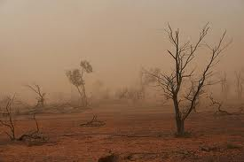
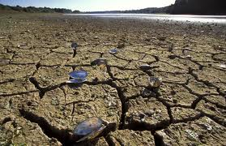
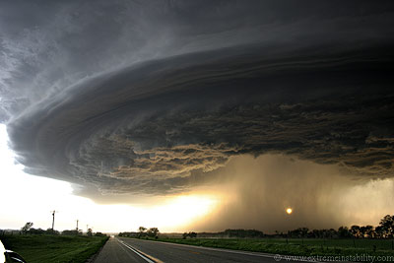
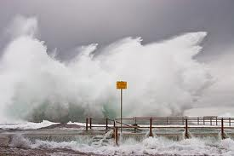

Slide 47
1.14.17
sūryaḿ hata-prabhaḿ paśya
graha-mardaḿ mitho divi
sasańkulair bhūta-gaṇair
jvalite iva rodasī
The rays of the sun are declining, and the stars appear to be fighting amongst themselves. Confused living entities appear to be ablaze and weeping.

Slide 48
1.14.18
nadyo nadāś ca kṣubhitāḥ
sarāḿsi ca manāḿsi ca
na jvalaty agnir ājyena
kālo 'yaḿ kiḿ vidhāsyati
Rivers, tributaries, ponds, reservoirs and the mind are all perturbed. Butter no longer ignites fire. What is this extraordinary time? What is going to happen?

Slide 49
1.14.19
na pibanti stanaḿ vatsā
na duhyanti ca mātaraḥ
rudanty aśru-mukhā gāvo
na hṛṣyanty ṛṣabhā vraje
The calves do not suck the teats of the cows, nor do the cows give milk. They are standing, crying, tears in their eyes, and the bulls take no pleasure in the pasturing grounds.

Slide 51
1.14.20
daivatāni rudantīva
svidyanti hy uccalanti ca
ime jana-padā grāmāḥ
purodyānākarāśramāḥ
bhraṣṭa-śriyo nirānandāḥ
kim aghaḿ darśayanti naḥ
The Deities seem to be crying in the temple, lamenting and perspiring. They seem about to leave. All the cities, villages, towns, gardens, mines and hermitages are now devoid of beauty and bereft of all happiness. I do not know what sort of calamities are now awaiting us.

Slide 52
1.14.21
manya etair mahotpātair
nūnaḿ bhagavataḥ padaiḥ
ananya-puruṣa-śrībhir
hīnā bhūr hata-saubhagā
I think that all these earthly disturbances indicate some greater loss to the good fortune of the world. The world was fortunate to have been marked with the footprints of the lotus feet of the Lord. These signs indicate that this will no longer be.

Slide 54
Summary of 1.14.1-21
Arjuna has gone to Dwarka – See and Inquire from the Lord (1)
Maharaja Yudhisthira(MY) began to observe some inauspicious omens- anxious about Arjuna and Dwarka’s well-being (2)
MY observed changes to seasonal regulations , greed, fraud, cheating, strained relations (3-7)
MY discloses his heart-his anxiety (8)
MY expresses his gratitude towards the Lord’s mercy(9)
Further symptoms of Kali –Yuga described(10-21)

Slide 55
References
HG Bhurijana prabhu’s lecture
www.romapadaswami.com
Sacinandana Swami’s class on 1.14.1

Slide 56
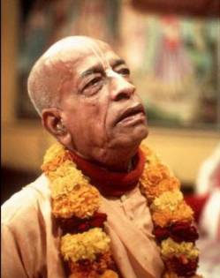
Srila Prabhupada ki jay!!!

