Slide 1
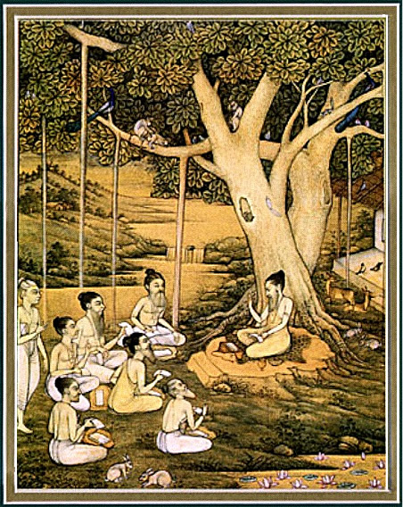
Srimad bhagavataM 1.13.29 – 37
SADHU SANGA

Slide 2
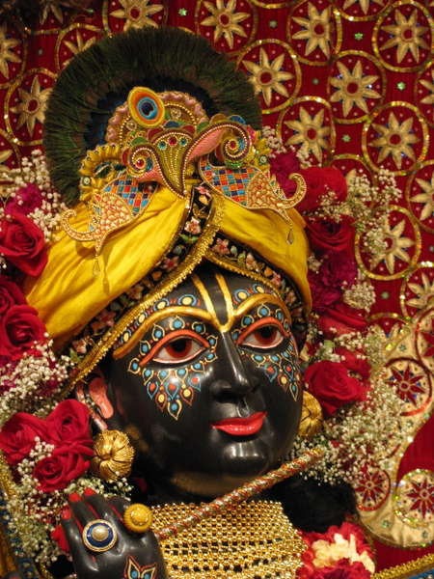
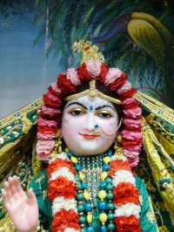
SB 1.2.4 narayanam namaskrtyam naram caiva narottamam devim sarasvatim vyasam tato jayam udirayet
Translation: Before reciting this Srimad Bhagavatam, which is the
very means of conquest, one should offer respectful obeisances
unto the Personality of Godhead, Narayana, unto Nara-Narayana
Rsi, the supermost human being, unto mother Sarasvati, the
goddess of learning, and unto Srila Vyasadeva, the author.

Slide 3
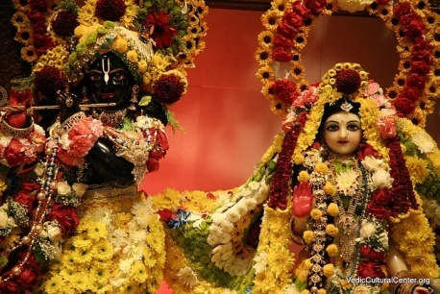
nasta-prayesy abhadresu nityaḿ bhagavata-sevaya bhagavaty uttama-sloke bhaktir bhavati naisthiki
SB 1.2.18
Translation: By regular attendance in classes on the
Bhagavatam and by rendering of service to the pure devotee,
all that is troublesome to the heart is almost completely
destroyed, and loving service unto the Personality of
Godhead, who is praised with transcendental songs, is
established as an irrevocable fact.

Slide 4
So far …
1.13.1 – 10 Welcoming Vidura home
1.13.11 – 17 Loving exchanges with Vidhura
1.13.18 – 28 Vidura instructs Dhrtarastra to
quit home
Notes:
1- 10: AND
Returns from Pilgrimage after hearing from Maitreya muni.
Kurus delighted to see.
Y remembers how he protected
Y inquires how he maintained his life
Y glorifies him as holy place personified
11 – 17: NGD
Y anxious to hear about Lord K and Yadus
V shared everything except annih of Yadus
Proper reception of V
History of V
Nature of time
18 – 28: RSD
Vidura instructs Dhrtarastra to quit home
Why ? Influence of time
Why ? Warning of old age
How ? Become a transcendentalist

Slide 5
SB 1.13.29 – 37
Sadhu Sanga
Notes:
-> Several themes but again emphasizing Sadhu sanga

Slide 6
Section Themes
29 – 30 Dhrtarastra and Gandhari leave home
31 – 32 Yudhisthira maharaja inquires from
Sanjaya
33 – 34 Yudhisthira maharaja feels responsible
35 – 37 Agitated Sanjaya replies
Notes:
D immediately becomes detached and ready to leave
G follows without being asked
Y comes to pay respects and finds them not there and asks sanjaya
Y takes personal responsibility
Sanjaya disturbed replies.

Slide 7
SB 1.13.29
evaà räjä vidureëänujena
prajïä-cakñur bodhita äjaméòhaù
chittvä sveñu sneha-päçän draòhimno
niçcakräma bhrätå-sandarçitädhvä
Thus Mahäräja Dhåtaräñöra, the scion of the family of
Ajaméòha, firmly convinced by introspective knowledge
[prajïä], broke at once the strong network of familial
affection by his resolute determination. Thus he
immediately left home to set out on the path of
liberation, as directed by his younger brother Vidura.

Slide 8
1.13.29 Importance of Sadhu Sanga
LCM - lava matra sadhu sanga
Srila Prabhupada’s inspiration
Vidura's association with Dhåtaräñöra
Why associate with Sadhus?
- To hear from them
- They cut illusory affection to this world
Material world is an illusion
- Dashing foam of the sea
- Cloud in the sky
“The scriptures enjoin, therefore, that one should associate with sädhus only, rejecting all other kinds of association, and by doing so one will have ample opportunity to hear the sädhus, who can cut to pieces the bonds of illusory affection in the material world.”
Notes:
’sädhu-sanga’, ‘sädhu-sanga’—sarva-sästre kaya
lava-mätra sädhu-sange sarva-siddhi haya
lava (one eleventh of a second)
Inspiration to write sb, businness magnate but not a devotee
D tried but failed from b to end. End greatest of all successes by forceful instructions
4. Cloud gives rains and vegetation, but everything will vanish except sky.
- Foolish attracted to temporary cloud
- Intelligent want eternal sky with variegatedness

Slide 9
1.13.29 Importance of Sadhu Sanga
Same devotees in the Spiritual World
Ye Yatha mam prapadyante
Purpose of ISKCON
Very rare and precious
“Let me engage myself in the service of the Gosvämés and associate with the devotees. I do not want anything." Janame janame mor ei abhiläñ. Bhaktivinoda Öhäkura said that kéöa-janma hau, jathä tuwä däs. This association. "Let me become a worm, not a devotee, even worm." Kéöa. Kéöa means worm, an insignificant ant, worm. Better to remain as an ant with the association of devotees than to become a Brahmä without any devotee's association. Brahmä-janme nähi mora äç. Bahir-mukha brahmä-janme, nähi mora äç, kéöa janma hau, jathä tuwä däs. This is Bhaktivinoda Öhäkura's hankering.”
Notes:
Narottama das thakur’s song, Bvt also.

Slide 10
SB 1.13.30
patià prayäntaà subalasya putré
pati-vratä cänujagäma sädhvé
himälayaà nyasta-daëòa-praharñaà
manasvinäm iva sat-samprahäraù
The gentle and chaste Gändhäré, who was the daughter
of King Subala of Kandahar [or Gändhära], followed her
husband, seeing that he was going to the Himalaya
Mountains, which are the delight of those who have
accepted the staff of the renounced order like fighters
who have accepted a good lashing from the enemy.
Notes:
Gandhari follows
Go to himalayas

Slide 11
1.13.30 Gandhari – Ideal wife
Chaste Gandhari follows
Examples of ideal wives
- Sitadevi
- Savithri
- Pishima
“Instructions for the renounced order of life were imparted to Dhåtaräñöra by Vidura, and Gändhäré was by the side of her husband. But he did not ask her to follow him because he was at that time fully determined, like a great warrior who faces all kinds of dangers in the battlefield. He was no longer attracted to so-called wife or relatives, and he decided to start alone, but as a chaste lady Gändhäré decided to follow her husband till the last moment.”
Notes:
Could have stayed home but followed husband
- D detached did not ask her to come
- She followed at her own risk
- D did not deny

Slide 12
1.13.30 Gandhari – Ideal wife
Why Himalayas?
- Ekadandi svamis - Mayavadi sannyasis
– Himalayas
– Dhiras
- Tridandi svamis – Vaisnava sannyasis
– Vrndavana or Puri
– Narottamas
Notes:
Advised to follow dhiras, narrottama is difficult for him

Slide 13
1.13.30 Ideal husband and wife
Women are like children
Women naturally follow
- Husband to provide protection and security
You be like Sita, but I cannot be like Rama
Charity begins at Home
‘Cover me’
“Husband and wife should love each other”
“Do everything together”
Notes:
Charity – make wife and children K.C, how can we make whole world K.c
To have favourable, devotee wife/husband is not a normal thing
Rasika mtj, more marital problems amongst devotees.

Slide 14
SB 1.13.31
ajäta-çatruù kåta-maitro hutägnir
viprän natvä tila-go-bhümi-rukmaiù
gåhaà praviñöo guru-vandanäya
na cäpaçyat pitarau saubaléà ca
Mahäräja Yudhiñöhira, whose enemy was never born,
performed his daily morning duties by praying, offering
fire sacrifice to the sun-god, and offering obeisances,
grains, cows, land and gold to the brähmaëas. He then
entered the palace to pay respects to the elderly.
However, he could not find his uncles or aunt, the
daughter of King Subala.
Notes:
1. Being a king he did all his duties – what about us?
2. Both uncles and aunt left in dead of night without informing anyone.

Slide 15
1.5.31 Yudhiñöhira – most pious king
Duties of householders
- Rise early
- Give charity to Brahmanas
- Offer respects to elderly members
Modern householders
- Rise late
- No cleanliness
- No purificatory practices
Consequences
- Children follow parents
- Whole generation glides down to hell
Remedy
- Association with Sadhus
- Release the effects of modern life
Notes:
Most pious – followed duties + assoc of sadhus
Rise late – check iphone

Slide 16
SB 1.13.32
tatra saïjayam äsénaà
papracchodvigna-mänasaù
gävalgaëe kva nas täto
våddho hénaç ca netrayoù
Mahäräja Yudhiñöhira, full of anxiety, turned to Saïjaya,
who was sitting there, and said: O Saïjaya, where is our
uncle, who is old and blind?
Notes:
Could not find them in palace
Asked s, secretary appointed by Vyasadeva – always stays with him.

Slide 17
SB 1.13.33
ambä ca hata-puträrtä
pitåvyaù kva gataù suhåt
api mayy akåta-prajïe
hata-bandhuù sa bhäryayä
äçaàsamänaù çamalaà
gaìgäyäà duùkhito 'patat

Slide 18
SB 1.13.33
Translation: Where is my well-wisher, uncle Vidura, and
mother Gändhäré, who is very afflicted due to all her
sons‘ demise? My uncle Dhåtaräñöra was also very
mortified due to the death of all his sons and grandsons.
Undoubtedly I am very ungrateful. Did he, therefore,
take my offenses very seriously and, along with his wife,
drown himself in the Ganges?
Notes:
1. Y’s character and example we all should follow

Slide 19
1.13.33 Yudhiñöhira feels responsible
Unavoidable misdeeds
Ungrateful
Application
- Find faults within
- Repent
“As a pious man, Mahäräja Yudhiñöhira took into account all his unavoidable misdeeds, and he never thought of the misdeeds of his uncle and company. Dhåtaräñöra had suffered the effects of his own misdeeds by the will of the Lord, but Mahäräja Yudhiñöhira was thinking only of his own unavoidable misdeeds. That is the nature of a good man and devotee of the Lord. A devotee never finds fault with others, but tries to find his own and thus rectify them as far as possible.”
Notes:
Arjuna and Y knew aftereffects of the war, hence declined to fight. But had to fight on Krsna’s order and face these.
Ungrateful - D gave royal facilities to live
Y killed D’s sons in return
3. Showing example how one should find faults within and seek good in others. 4. Gauranga pr: Judge others by their intentions and ourselves by our actions.

Slide 20
1.13.33 Overcoming fault finding
Fly or a Bee?
‘api cet su duracaro’ – BG 9.30
Spots on the moon
Root cause/Remedy
- Familiarity/Respect
- Material conceptions/Hear again and again
- False ego/Cultivate service attitude
- Speak faults/Glorify devotees

Slide 21
SB 1.13.34
pitary uparate päëòau
sarvän naù suhådaù çiçün
arakñatäà vyasanataù
pitåvyau kva gatäv itaù
When my father, Päëòu, fell down and we were all
small children, these two uncles gave us protection
from all kinds of calamities. They were always our
good well-wishers. Alas, where have they gone from
here?

Slide 22
SB 1.13.35
süta uväca
kåpayä sneha-vaiklavyät
süto viraha-karçitaù
ätmeçvaram acakñäëo
na pratyähätipéòitaù
Süta Gosvämé said: Because of compassion and
mental agitation, Saïjaya, not having seen his own
master, Dhåtaräñöra, was aggrieved and could not
properly reply to Mahäräja Yudhiñöhira.

Slide 23
1.13.35 Agitated Sanjaya replies
Sanjay’s interpretation
- Dhrtarastra left in frustration
- Unaware that Dhrtarastra’s inner vision is awakened.
“Unless one is convinced of a better life after renunciation of the present life, one cannot stick to the renounced order of life simply by artificial dress or staying out of the home.”
Notes:
Bg 3.6 – one whose mind dwells – mithyacari, false pretender
Bg 3.7 – engage senses in karma yoga sincerely.

Slide 24
SB 1.13.36
vimåjyäçrüëi päëibhyäà
viñöabhyätmänam ätmanä
ajäta-çatruà pratyüce
prabhoù pädäv anusmaran
First he slowly pacified his mind by intelligence, and
wiping away his tears and thinking of the feet of his
master, Dhåtaräñöra, he began to reply to Mahäräja
Yudhiñöhira.
Notes:
Result of chanting Lord’s glories as experienced by Sri Narada Muni.
We can also experience this – Srila Prabhupada gives we can qualify.
Goal is His intimate loving service

Slide 25
SB 1.13.37
saïjaya uväca
nähaà veda vyavasitaà
pitror vaù kula-nandana
gändhäryä vä mahä-bäho
muñito 'smi mahätmabhiù
Saïjaya said: My dear descendant of the Kuru dynasty, I
have no information of the determination of your two
uncles and Gändhäré. O King, I have been cheated by
those great souls.
Notes:
Feeling resentment - Your two uncles instead of my master

Slide 26
1.13.37 Transcendental Fraud
Great souls cheat others for a great cause
- Lord Krsna advised Yudhiñöhira maharaja to tell a lie
- Sanatana Goswami cheated prison guard
- Raghunatha das Goswami cheated his priest
- Srila Prabhupada cheated his family members
Why Sanjaya felt cheated?
- Was not informed of their departure
Is my cheating transcendental?
- Is it really to satisfy the Lord?
Notes:
1. Sanatana Gosvami bribing jail guard - http://vedabase.net/cc/madhya/20/en
2. Raghunath dasa Gosvami bribing brahmana - http://vedabase.net/cc/antya/6/153/en
3. Srila prabhupada leaving home taking sannyasa - ???
4. Their leaving is confidential sanjaya could not be informed
- Sanjaya is attached he would not let them go – he would discourage them.
5. Cheating consult Guru Sadhu and Shastra

Slide 27
1.13.37 Transcendental Fraud
“That great souls cheat others may be astonishing to know, but it is a fact that great souls cheat others for a great cause… To satisfy the Lord, anything is good, for it is in relation with the Absolute Truth. We also had the same opportunity to cheat the family members and leave home to engage in the service of Çrémad-Bhägavatam. Such cheating was necessary for a great cause, and there is no loss for any party in such transcendental fraud.”
Notes:
Their leaving is confidential sanjaya could not be informed
- Sanjaya is attached he would not let them go – he would discourage them.
2. Cheating consult Guru Sadhu and Shastra

Slide 28
Summary
Importance of Sadhu Sanga
Ideal husband and wife
Overcoming fault finding
Great souls cheat others for a great cause

Slide 29
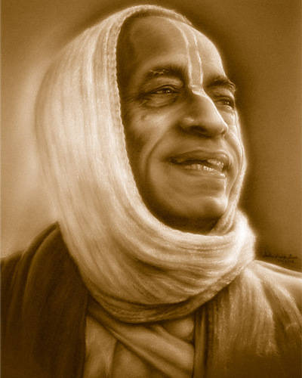
References
HH Romapada maharaja’s lectures on this section.
HG Bhurijana prabhu’s overview class on IskconDesireTree.
Srila Prabhupada’s purports.
All glories to Srila Prabhupada!

