Slide 1
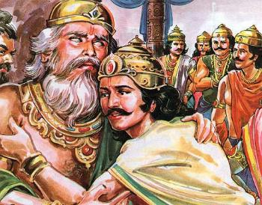
Srimad Bhagavatam
Canto 1 Chapter 13 - Dhritarastra Quits Home

Slide 2
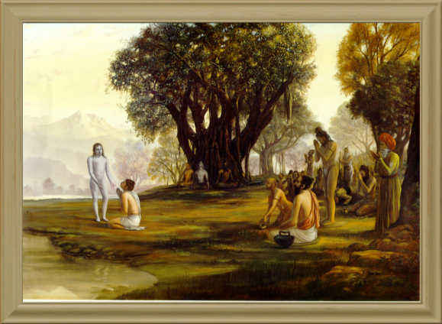
Srimad Bhagavatam
1.13.11 – 1.13.17
By Nritya Gauranga Das

Slide 3
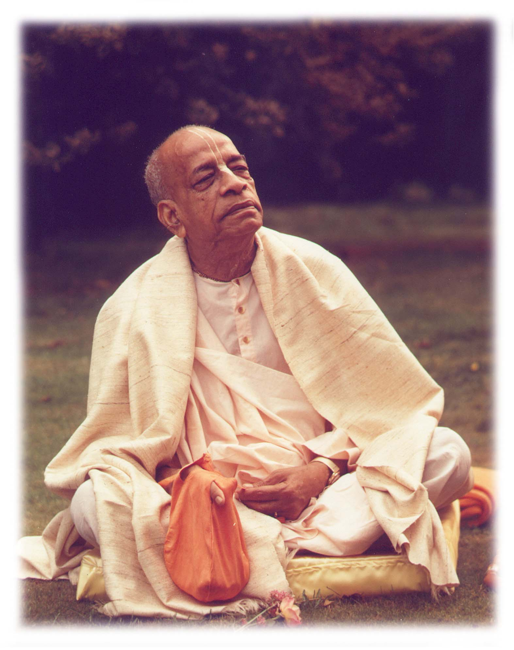
Based on the teachings of His Divine Grace A.C. Bhaktivedanta Swami Prabhupada
~ Founder Acharya ~
International Society For Krishna Consciousness

Slide 4
Seeking the Blessings of Guru, Gauranga & All the Assembled Vaishnavas

Slide 5
Śrīmad Bhāgavatam 1.2.4
nārāyaṇaḿ namaskṛtya
naraḿ caiva narottamam
devīḿ sarasvatīḿ vyāsaḿ
tato jayam udīrayet
TRANSLATION
Before reciting this Śrīmad-Bhāgavatam, which is the very means of conquest, one should offer respectful obeisances unto the Personality of Godhead, Nārāyaṇa, unto Nara-nārāyaṇa Ṛṣi, the supermost human being, unto mother Sarasvatī, the goddess of learning, and unto Śrīla Vyāsadeva, the author.

Slide 6
Śrīmad Bhāgavatam 1.2.18
naṣṭa-prāyeṣv abhadreṣu
nityaḿ bhāgavata-sevayā
bhagavaty uttama-śloke
bhaktir bhavati naiṣṭhikī
TRANSLATION
By regular attendance in classes on the Bhāgavatam and by rendering of service to the pure devotee, all that is troublesome to the heart is almost completely destroyed, and loving service unto the Personality of Godhead, who is praised with transcendental songs, is established as an irrevocable fact.

Slide 8
Section Theme - Sadhu
1.13.11
Mahārāja Yudhiṣṭhira anxious to hear about Lork Krishna and the descendants of Yadu from Mahatma Vidura.
1.13.12 – 1.13.13
Compassionate Vidura shared his experience, except for annihilation of the Yadu dynasty.
1.13.14
How Mahatma Vidhura was honored. Purpose of his vist. How he brought happiness to all.
1.13.15
History of Mahatma Vidura.
1.13.16
Mental Disposition & Prosperity of Mahārāja Yudhiṣṭhira.
1.13.17
The nature of Eternal Time.

Slide 9
Śrīmad Bhāgavatam 1.13.11
api naḥ suhṛdas tāta
bāndhavāḥ kṛṣṇa-devatāḥ
dṛṣṭāḥ śrutā vā yadavaḥ
sva-puryāḿ sukham āsate
TRANSLATION
My uncle, you must have visited Dvārakā. In that holy place are our friends and well-wishers, the descendants of Yadu, who are always rapt in the service of the Lord Śrī Kṛṣṇa. You might have seen them or heard about them. Are they all living happily in their abodes?

Slide 10
kṛṣṇa-devatāḥ - who are always rapt in the service of Lord Kṛṣṇa
Yādavas and the Pāṇḍavas, who were always rapt in the thought of the Lord Kṛṣṇa and His different transcendental activities
Vidura left home in order to devote himself completely to the service of the Lord.
Mahārāja Yudhiṣṭhira was engaged fully in the state affairs of the kingdom of the world.
However, Mahārāja Yudhiṣṭhira & Vidura were on the same level of devotion.
The real qualification of a pure devotee - Either at home or away from home - “Always Rapt in the thought of Kṛṣṇa - FAVORABLY”
Ex - Unfavorable Devoteees - Kaḿsa, Jarāsandha, Śiśupāla - Not on the same level as devotees.
Mahārāja Yudhiṣṭhira was therefore on the same level of devotion as Vidura, although engaged in the state affairs of the kingdom of the world.
Ex – Janaka Maharaj, Prahalad Maharaj, Bali Maharaj, Prahalad Maharaj, Druva Maharaj etc.,

Slide 11
Śrīmad Bhāgavatam 1.13.12
ity ukto dharma-rājena
sarvaḿ tat samavarṇayat
yathānubhūtaḿ kramaśo
vinā yadu-kula-kṣayam
TRANSLATION
Thus being questioned by Mahārāja Yudhiṣṭhira, Mahātmā Vidura gradually described everything he had personally experienced, except news of the annihilation of the Yadu dynasty.

Slide 12
Śrīmad Bhāgavatam 1.13.13
nanv apriyaḿ durviṣahaḿ
nṛṇāḿ svayam upasthitam
nāvedayat sakaruṇo
duḥkhitān draṣṭum akṣamaḥ
TRANSLATION
Compassionate Mahātmā Vidura could not stand to see the Pāṇḍavas distressed at any time. Therefore he did not disclose this unpalatable and unbearable incident because calamities come of their own accord..

Slide 13
Sakaruṇaḥ – Compassionate
Compassionate Mahātmā Vidura purposely refrained from disclosing this unpalatable and unbearable incident (The annihilation of the Yadu dynasty).
Why:
He could not stand, it was almost impossible to see the Pāṇḍavas distressed at any time.
According to Nīti-śāstra (civic laws): One should not speak an unpalatable truth to cause distress to others.
Distress comes upon us in its own way by the laws of nature, so one should not aggravate it by propaganda.

Slide 14
Qualities of a Sadhu :
Very sensitive to the feelings of others.
Always checks & carefully uses the words / deeds so as not to cause any pain to others in any circumstances.
Ex – Arjuna’s Compassion towards mother Kripi
It’s not about what / how I feel, it’s about how others feel or be affected with.
Code of life - Always considering the welfare of others
Everything they do is for the up-liftment of others. If not, dis-engage their senses, like a Tortoise.
(Q) Why did Uddava disclose immediately about Anhilation of Yadu Dynasty, when asked by Vidura?
What is right in one circumstance may not be right in other circumstance.

Slide 15
Śrīmad Bhāgavatam 1.13.14
kañcit kālam athāvātsīt
sat-kṛto devavat sukham
bhrātur jyeṣṭhasya śreyas-kṛt
sarveṣāḿ sukham āvahan
TRANSLATION
Thus Mahātmā Vidura, being treated just like a godly person by his kinsmen, remained there for a certain period just to rectify the mentality of his eldest brother and in this way bring happiness to all the others.

Slide 16
How was Vidura treated:
Mahārāja Yudhiṣṭhira received Vidura in the manner of reception offered to the demigods.
Saintly persons are representative of Lord.
They carry Lord within their heart.
They should be respected as good as Lord.
What makes denizens of heavenly planets visit earthy planet?
Spiritual culture of the people.
Ex: Sri Chitanya Mahaprabhu – Received by Brahmanas–South Inida tour.
Ex: Srila Prabhupad’s Father – Receiving saintly sanyasis at home.
Purpose of Vidura’s visit:
Not to enjoy material comforts at his paternal place
Reasons:
Already adopted the renounced order of life.
Fully self realized. Fully blissful within.
Rectify the mentality of Dhṛtarāṣṭra & to deliver him.

Slide 17
Condition of Dhṛtarāṣṭra:
Lost all his state and descendants in the fight.
Due to his sense of helplessness, he did not feel ashamed to accept the charity and hospitality of Mahārāja Yudhiṣṭhira.
Was still holding on the position of a King (Delusion of Supremacy).
Enjoying the royal treatment offered to him, unaware of other alternative.
Duty of a Sadhu - Vidura
Aware of deep rooted material attachment of his elder brother.
Self imposed duty to deliver his brother – Out of compassion.
Ex: House on Fire – Duty of a Fire marshal
Way to Spiritual Realization:
The message should be heard attentively.
If spoken by a realized soul, it will act on the dormant heart of the conditioned soul.
By continuously hearing, one can attain the perfect stage of self-realization.

Slide 18
Śrīmad Bhāgavatam 1.13.15
abibhrad aryamā daṇḍaḿ
yathāvad agha-kāriṣu
yāvad dadhāra śūdratvaḿ
śāpād varṣa-śataḿ yamaḥ
TRANSLATION
As long as Vidura played the part of a śūdra, being cursed by Maṇḍūka Muni, Aryamā officiated at the post of Yamarāja to punish those who committed sinful acts.

Slide 19
Vidhura was forbidden even to be a party of royal heritage
Reason : Born from the womb of a śūdra woman
How could he occupy the post of a preacher?
Reason 1:
Though born from the womb of a śūdra woman.
Vidhura renounced the world for spiritual enlightenment.
By the authority of Ṛṣi Maitreya, he was thoroughly educated in transcendental knowledge.
He was quite competent to occupy the post of an ācārya, or spiritual preceptor.
Śrī Caitanya Mahāprabhu, anyone who is conversant in the transcendental knowledge is eligible to become a spiritual master.
Cāṇakya Paṇḍita – Moral code – No harm in taking lessons from a person who may be by birth less than a śūdra.

Slide 20
Reason 2:
Actually Vidura was not a śūdra.
Cursed by Maṇḍūka Muni, he was playing the part of a so-called śūdra for one hundred years.
He was the incarnation of Yamarāja - One of the twelve mahājanas
Being a mahājana, it is his duty to preach the cult of devotion.
Always busy in plutonic kingdom punishing sinful persons.
Yamarāja is deputed by the Lord to do this thank less service.
Neither a śūdra nor a brāhmaṇa. He is transcendental to such divisions.
Lords incarnation as a hog - above all mundane creatures. Ex - Sun
Lord & authorized devotees - Play role of many lower creatures.
During Yamaraj’s absence his post was officiated by Aryamā.
Son of Kaśyapa and Aditi . One of twelve Aditya’s.
Conclusion - Vidura was never a śūdra, but was greater than the purest type of brāhmaṇa.
Prabhupada Lecture: - GBC Members of ISKCON – Compared to 12 Mahajans

Slide 22
Śrīmad Bhāgavatam 1.13.16
yudhiṣṭhiro labdha-rājyo
dṛṣṭvā pautraḿ kulan-dharam
bhrātṛbhir loka-pālābhair
mumude parayā śriyā
TRANSLATION
Having won his kingdom and observed the birth of one grandson competent to continue the noble tradition of his family, Mahārāja Yudhiṣṭhira reigned peacefully and enjoyed uncommon opulence in cooperation with his younger brothers, who were all expert administrators to the common people..

Slide 23
Both Mahārāja Yudhiṣṭhira and Arjuna were unhappy to fight, but did this as a matter of duty – Because it was planned by the supreme will of Lord Śrī Kṛṣṇa.
After the battle, Mahārāja Yudhiṣṭhira was unhappy over such mass killings. Practically there was none to continue the Kuru dynasty after them.
The only remaining hope was the child in the womb of his daughter-in-law, Uttarā, and he was also attacked by Aśvatthāmā, but by the grace of the Lord the child was saved.
When did Mahārāja Yudhiṣṭhira feel happy:
After the settlement of all disturbing conditions and reestablishment of the peaceful order of the state, and
After seeing the surviving child, Parīkṣit, well satisfied
Mahārāja Yudhiṣṭhira then felt some relief as a human being, although he had very little attraction for material happiness, which is always illusory and temporary

Slide 24
Śrīmad Bhāgavatam 1.13.17
evaḿ gṛheṣu saktānāḿ
pramattānāḿ tad-īhayā
atyakrāmad avijñātaḥ
kālaḥ parama-dustaraḥ
TRANSLATION
Insurmountable, eternal time imperceptibly overcomes those who are too much attached to family affairs and are always engrossed in their thought.

Slide 25
Foolish people, blind to the passing of eternal time, engross insanely in household activities and think as follow.
"I am now happy; I have everything in order; my bank balance is quite enough; I can now give my children enough estate; I am now successful; the poor beggar sanyāsīs depend on God, but they come to beg from me; therefore I am more than the Supreme God.
Eg: BG 16.13 – 15
TIME IS VALUABLE:
Life’s duration is measured. No one is able to enhance it even by a second against the scheduled time ordained by the supreme will.
Such valuable time, should be cautiously spent, cannot be purchased / replaced by any amount of wealth.
Every second must be used cautiously – To solve the real problems of life.
Real Problems of Life – Birth, Oldage, Disease & Death – Repeating in 8.4 million different species of life.
Cause of suffering – Material body
The living being is eternal - He is never born, nor does he ever die.

Slide 26
What is illusion and who are subjected to it?
To not know, that eternal time is passing away imperceptibly.
To not know, that eternal time is insurmountable.
To now know, their duration of life is diminishing every second.
Unaware of the above mentioned, foolish people become tomuch attached & engrossed in temporary family affairs.
Hence, they will not be being able to solve the Real big problems of life – Birth, diseace, oldage & death.
How can one get out of the illusion?
By awakening oneself into the devotional service of the Lord.
Yudhiṣṭhira Mahārāja and his brothers (Pāṇḍavas) are fully fixed in the service of the Lord Mukunda (The Lord, who can award salvation).
By knowing, that every living being is eternal.

Slide 27
By knowing, that one can be happy only in the eternal abode of God, from which no one returns to this region of repeated birth & death.
By knowing, that any material happiness which does not warrant an eternal life is nothing but illusion for the eternal living being.
This dispels the attraction for the illusory happiness of this material world.
One who understands the above mentioned is factually learned.
Learned persons - Sacrifice any amount of material happiness.
To achieve the desired goal, brahma-sukham, or absolute happiness.
Real transcendentalists are hungry for this happiness.
Hungry man - cannot be happy by all comforts of life , minus foodstuff.
Those who are hungry for eternal absolute happiness - cannot be satisfied by any amount of material happiness.
Therefore, the instruction described in this verse cannot be applied to Pandavas or their mother. It was meant for persons like Dhṛtarāṣṭra, for whom Vidura came especially to impart lessons.

Slide 28
Summary & Practical Application:
The real qualification of a pure devotee - Either at home or away from home - “Always Rapt in the thought of Kṛṣṇa - FAVORABLY” - kṛṣṇa-devatāḥ
Qualities of a Sadhu :
Very sensitive to the feelings of others.
Always checks & carefully uses the words / deeds so as not to cause any pain to others in any circumstances.
It’s not about what / how I feel, it’s about how others feel or be affected with.
Code of life - Always considering the welfare of others
Everything they do is for the up-liftment of others. If not, dis-engage their senses, like a Tortoise
Śrī Caitanya Mahāprabhu - anyone who is conversant in the transcendental knowledge, irrespective of being a brhaman, khastriya, vaishya or sudra is eligible to become a spiritual master.
Even if one commits the most abominable action, if he is engaged in devotional service he is to be considered saintly because he is properly situated in his determination. BG – 9.30

Slide 29
Nature of Eternal Time:
Eternal time is Insurmountable - No one can surpass it.
Eternal time imperceptibly (Unnoticebly) overcomes those who are too much attached to family affairs.
What is illusion and who are subjected to it?
To not know, that eternal time is insurmountable & imperceptibly passing away
To now know, that their duration of life is diminishing every second.
Unaware of the above mentioned, foolish people become too much attached and engrossed in temporary family affairs. Hence, they cannot solve the Real problem of life - Birth, disease, oldage & death.
How can one get out of the illusion?
By awakening oneself to the devotional service of the Lord unconditionally.
By knowing, that living being is eternal and can be happy only in the abode of God, from which no one returns to this region of repeated birth & death.
By knowing, that any material happiness which does not warrant an eternal life is but illusion for the eternal living being.
This dispels the attraction for the illusory happiness of this material world.
And those who are hungry for eternal absolute happiness - cannot be satisfied by any amount of material happiness.

Slide 30
References
http://www.prabhupadavani.org
http://www.romapadaswami.com

Slide 31
All glories to Srila Prabhupada!

