Slide 1
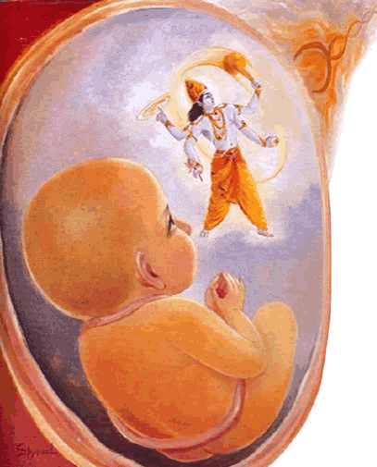
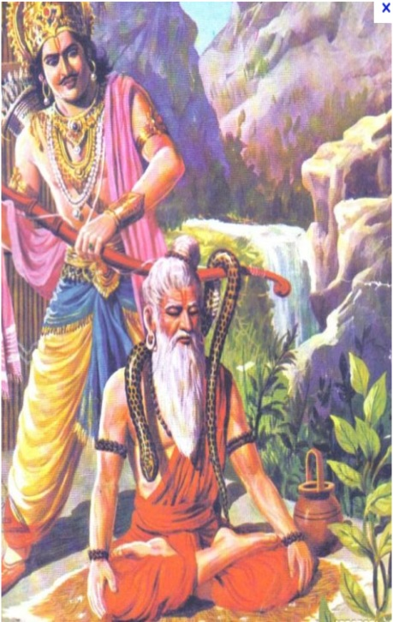
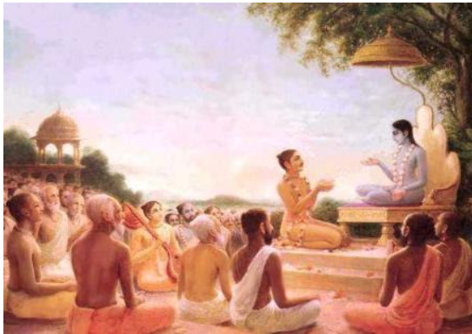
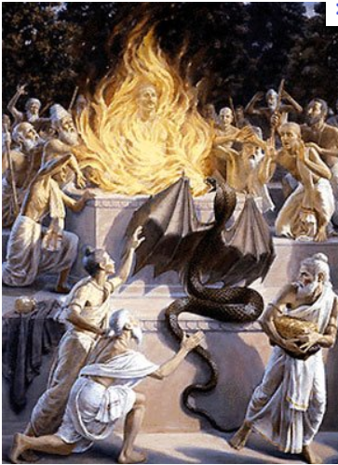
Srimad Bhagavatam Chapter 12 (Birth of Maharaj Parikshit) (1.12.30-1.12.36)

Slide 2
Review of Chapter 12 so far ….
1.12.1 – 1.12.3: Questions on Maharaj Parikshit’s birth by Saunaka Rishi – Eager to hear about Parikshit Maharaj.
1.12.4 – 1.12.18: Lord Krishna saves Maharaj Parishit in the womb of Uttara.
1.12.19 – 1.12.28: Jataka vipras glorify Maharaj Parikshit
King Iksvaku – In maintaining society
King Sibi - Charity
Arjuna – Bowman ship
King Rantidev – Magnanimity
Bali Maharaj – Patience
Prahlad Maharaj – staunch devotee
1.12.29: Jataka vipras being sumptuously
remunerated, return to their respective homes.

Slide 3
Contents 1.12.30 – 1.12.31: Parishit [Examiner] 1.12.32 – 1.12.35: King Yudhistir performs 3 horse sacrifices under the instruction of Lord Krishna 1.12.36: Lord Krishna leaves to the city of Dwarka.

Slide 4
1.12.30 sa eṣa loke vikhyātaḥ parīkṣid iti yat prabhuḥ pūrvaḿ dṛṣṭam anudhyāyan parīkṣeta nareṣv iha
So his son would become famous in the world as Parīkṣit [examiner] because he would come to examine all human beings in his search after that personality whom he saw before his birth. Thus he would come to constantly contemplate Him.

Slide 5
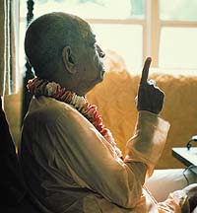
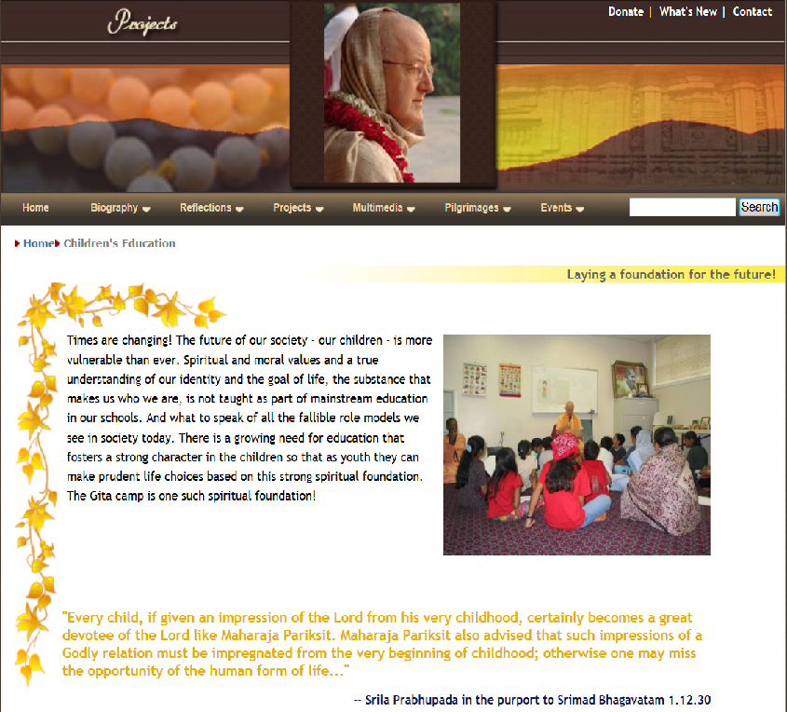
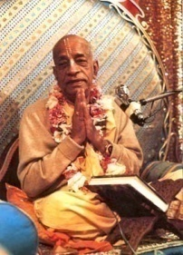
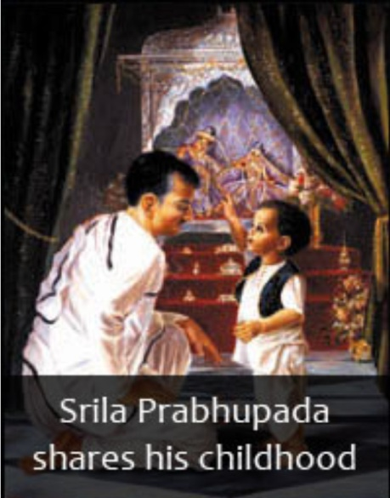
Srila Prabhupada’s Purport
Mahārāja Parīkṣit, fortunate as he was, got the impression of the Lord even in the womb of his mother, and thus his contemplation on the Lord was constantly with him. Once the impression of the transcendental form of the Lord is fixed in one's mind, one can never forget Him in any circumstance. Child Parīkṣit, after coming out of the womb, was in the habit of examining everyone to see whether he was the same personality whom he first saw in the womb. But no one could be equal to or more attractive than the Lord, and therefore he never accepted anyone. But the Lord was constantly with him by such examination, and thus Mahārāja Parīkṣit was always engaged in the devotional service of the Lord by remembrance.
Śrīla Jīva Gosvāmī remarks in this connection that every child, if given an impression of the Lord from his very childhood, certainly becomes a great devotee of the Lord like Mahārāja Parīkṣit. One may not be as fortunate as Mahārāja Parīkṣit to have the opportunity to see the Lord in the womb of his mother, but even if he is not so fortunate, he can be made so if the parents of the child desire him to be so. There is a practical example in my personal life in this connection.
Srila Prabhupad’s personal life:
My father was a pure devotee of the Lord, and when I was only four or five years old, my father gave me a couple of forms of Rādhā and Kṛṣṇa. In a playful manner, I used to worship these Deities along with my sister, and I used to imitate the performances of a neighboring temple of Rādhā-Govinda. By constantly visiting this neighboring temple and copying the ceremonies in connection with my own Deities of play, I developed a natural affinity for the Lord. My father used to observe all the ceremonies befitting my position. Later on, these activities were suspended due to my association in the schools and colleges, and I became completely out of practice. But in my youthful days, when I met my spiritual master, Śrī Śrīmad Bhaktisiddhānta Sarasvatī Gosvāmī Mahārāja, again I revived my old habit, and the same playful Deities became my worshipful Deities in proper regulation. This was followed up until I left the family connection, and I am pleased that my generous father gave the first impression which was developed later into regulative devotional service by His Divine Grace.
Mahārāja Prahlāda also advised that such impressions of a godly relation must be impregnated from the beginning of childhood, otherwise one may miss the opportunity of the human form of life, which is very valuable although it is temporary like others.

Slide 6
Always Remember Krishna!
Remembrance…
Take the impression of the Lord in the morning, and keep that impression throughout the day. In that way Krishna stays with us
Same with the holy name.
Service unto the Vaishnvas:
Mercy of Krishna through the Mercy of the Devotees
kṛṣṇa se tomāra, kṛṣṇa dīte pāro, tomāra śakati āche āmi to' kāńgāla, 'kṛṣṇa' 'kṛṣṇa' boli', dhāi tava pāche pāche
(Krsna is yours. You have the power to give Him to me. I am simply your servant running behind you shouting, "Krsna! Krsna!“)
Every child should be given an impression of the Lord:
Gaur Mohan De --- Mercy of father to his son by bringing many devotees to his home to bless
Mercy of Spiritual Master.
karuṇā nā hoile, kāndiyā kāndiyā, prāṇa nā rākhibo āra
(Your mercy is all that I am made of. If you are not merciful unto me, I can only weep, and I will not be able to maintain my life)
Advaita Acharya in Shantipur – Srila Prabhupada was so eager to receive the mercy. Service is the essence and we should carry the consciousness.

Slide 7
1.12.31 sa rāja-putro vavṛdhe āśu śukla ivoḍupaḥ āpūryamāṇaḥ pitṛbhiḥ kāṣṭhābhir iva so 'nvaham
As the moon, in its waxing fortnight, develops day after day, so the royal prince [Parīkṣit] very soon developed luxuriantly under the care and full facilities of his guardian grandfathers.

Slide 8
Chapter 16 continues Maharaj Parikshit’s pastimes. Chapter 16 begins with:
Sūta Gosvāmī said: O learned brāhmaṇas, Mahārāja Parīkṣit then began to rule over the world as a great devotee of the Lord under the instructions of the best of the twice-born brāhmaṇas. He ruled by those great qualities which were foretold by expert astrologers at the time of his birth.

Slide 9
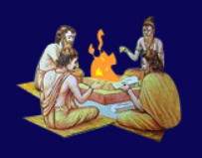
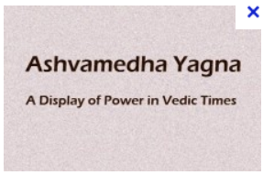
1.12.32 yakṣyamāṇo 'śvamedhena jñāti-droha-jihāsayā rājā labdha-dhano dadhyau nānyatra kara-daṇḍayoḥ
Just at this time, King Yudhiṣṭhira was considering performing a horse sacrifice to get freed from sins incurred from fighting with kinsmen. But he became anxious to get some wealth, for there were no surplus funds outside of fines and tax collection.

Slide 10
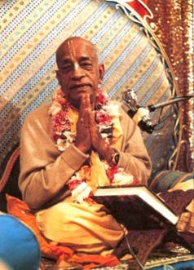
Purport
As the brāhmaṇas and vipras had a right to be subsidized by the state, the state executive head had the right to collect taxes and fines from the citizens. After the Battle of Kurukṣetra the state treasury was exhausted, and therefore there was no surplus fund except the fund from tax collection and fines. Such funds were sufficient only for the state budget, and having no excess fund, the King was anxious to get more wealth in some other way in order to perform the horse sacrifice. Mahārāja Yudhiṣṭhira wanted to perform this sacrifice under the instruction of Bhīṣmadeva.
--------------------------------------------------------------------------------------------------------
Nature of Maharaj Yudhistir is feeling the heaviness of what has just happened. Dharma Yudha. It had to be done. During Service also, it happens that some persons become hurt. Unfortunate but also sinful.
Rupa Goswami
“You can please some of the people some of the time but you cannot please all of the people all of the time.” One of the greatest encumbrances that impedes a devotees advancement is that we are too much concerned about what society will think of us. If you want to please the society, then you have to be just like the society. And in society everyone has a different opinion. If you become very very popular, that means you are going to be to that extent very unpopular amongst the other people. And they are going to destroy you and kill you. – HH Radhanath Swami Maharaj.
Jesus Christ: “Cannot Serve 2 masters”

Slide 11
1.12.33 tad abhipretam ālakṣya bhrātaro 'cyuta-coditāḥ dhanaḿ prahīṇam ājahrur udīcyāḿ diśi bhūriśah
Understanding the hearty wishes of the King, his brothers, as advised by the infallible Lord Kṛṣṇa, collected sufficient riches from the North [left by King Marutta].

Slide 12
Purport: King Marutta
Mahārāja Marutta: one of the great emperors of the world. He reigned over the world long before the reign of Mahārāja Yudhiṣṭhira. He was the son of Mahārāja Avikṣit and was a great devotee of the son of the sun-god, known as Yamarāja. His brother Samvarta was a rival priest of the great Bṛhaspati, the learned priest of the demigods. He conducted one sacrifice called Sańkāra-yajña by which the Lord was so satisfied that He was pleased to hand over to him the charge of a mountain peak of gold. This peak of gold is somewhere in the Himalaya Mountains, and modern adventurers may try to find it there. He was so powerful an emperor that at the day's end of sacrifice, the demigods from the other planets like Indra, Candra and Bṛhaspati used to visit his palace. And because he had the gold peak at his disposal, he had sufficient gold in his possession. The canopy of the sacrificial altar was completely made of gold. in his daily performances of the sacrificial ceremonies, some of the inhabitants of the Vāyuloka (airy planets) were invited to expedite the cooking work of the ceremony. And the assembly of the demigods in the ceremony was led by Viśvadeva.
By his constant pious work he was able to drive out all kinds of diseases from the jurisdiction of his kingdom. All the inhabitants of higher planets like Devaloka and Pitṛloka were pleased with him for his great sacrificial ceremonies. Every day he used to give in charity to the learned brāhmaṇas such things as beddings, seats, conveyances and sufficient quantities of gold. Because of munificent charities and performances of innumerable sacrifices, the King of heaven, Indradeva, was fully satisfied with him and always wished for his welfare. Due to his pious activities, he remained a young man throughout his life and reigned over the world for one thousand years, surrounded by his satisfied subjects, ministers, legitimate wife, sons and brothers. Even Lord Śrī Kṛṣṇa praised his spirit of pious activities. He handed over his only daughter to Maharṣi Ańgirā, and by his good blessings, he was elevated to the kingdom of heaven. First of all, he wanted to offer the priesthood of his sacrifices to learned Bṛhaspati, but the demigod refused to accept the post because of the King's being a human being, a man of this earth. He was very sorry for this, but on the advice of Nārada Muni he appointed Samvarta to the post, and he was successful in his mission.

Slide 13
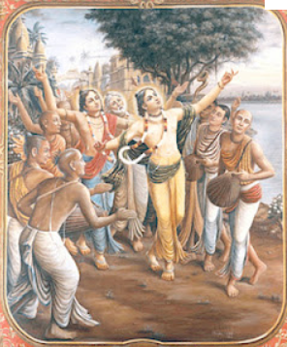
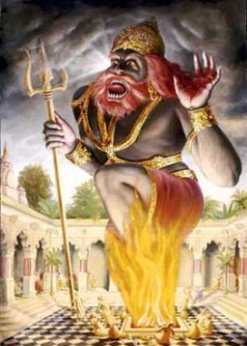
Purport
The success of a particular type of sacrifice completely depends on the priest in charge. In this age, all kinds of sacrifice are forbidden because there is no learned priest amongst the so-called brāhmaṇas, who go by the false notion of becoming sons of brāhmaṇas without brahminical qualifications.
Tvasta made one mistake while chanting vedic hyms during the yajna (6.9.11), indra-satro. – “the enemies of Indra” to “Indra, who is an enemy”
Asvamedha Yajna – On the contrary, animals offered for the yajña were rejuvenated to a new span of life by the transcendental power of chanting the Vedic hymns, which, if properly chanted, are different from what is understood by the common layman. The Veda-mantras are all practical, and the proof is rejuvenation of the sacrificed animal.
In this age of Kali, therefore, only one kind of sacrifice is recommended, sańkīrtana-yajña, as inaugurated by Lord Śrī Caitanya Mahāprabhu.
Never underestimate the power of congregational chanting of the holy names.
Prakashananda Saraswati

Slide 14
1.12.34 tena sambhṛta-sambhāro dharma-putro yudhiṣṭhiraḥ vājimedhais tribhir bhīto yajñaiḥ samayajad dharim
By those riches, the King could procure the ingredients for three horse sacrifices. Thus the pious King Yudhiṣṭhira, who was very fearful after the Battle of Kurukṣetra, pleased Lord Hari, the Personality of Godhead.

Slide 15
Purport (Being Satisfied)
Even Mahārāja Yudhiṣṭhira had to collect the necessary heaps of gold left by Mahārāja Marutta and the brāhmaṇas who were given gold in charity by King Marutta. The learned brāhmaṇas could not take away all the loads of gold given by Mahārāja Marutta, and therefore they left behind the major portion of the gift. And Mahārāja Marutta also did not again collect such heaps of gold given away in charity. Besides that, all the golden plates and utensils which were used in the sacrifice were also thrown in the dustbins, and all such heaps of gold remained unclaimed property for a long time, till Mahārāja Yudhiṣṭhira collected them for his own purposes.
Lord Śrī Kṛṣṇa advised the brothers of Mahārāja Yudhiṣṭhira to collect the unclaimed property because it belonged to the King. The more astonishing thing is that no subject of the state also collected such unclaimed gold for industrial enterprise or anything like that. This means that the state citizens were completely satisfied with all necessities of life and therefore not inclined to accept unnecessary productive enterprises for sense gratification. Mahārāja Yudhiṣṭhira also requisitioned the heaps of gold for performing sacrifices and for pleasing the Supreme Hari Personality of Godhead. Otherwise he had no desire to collect them for the state treasury.

Slide 16
Purport: (Fearful of Sins)
One should take lessons from the acts of Mahārāja Yudhiṣṭhira. He was afraid of sins committed on the battlefield, and therefore he wanted to satisfy the supreme authority. This indicates that unintentional sins are also committed in our daily occupational discharge of duties, and to counteract even such unintentional crimes, one must perform sacrifices as they are recommended in the revealed scriptures. The Lord says in Bhagavad-gītā (yajñārthāt karmaṇo 'nyatra loko 'yaḿ karma-bandhanaḥ [Bg. 3.9]) that one must perform sacrifices recommended in the scriptures in order to get rid of commitments of all unauthorized work, or even unintentional crimes which we are apt to commit. By doing so, one shall be freed from all kinds of sins.
And those who do not do so but work for self-interest or sense gratification have to undergo all tribulations accrued from committed sins. Therefore, the main purpose of performing sacrifices is to satisfy the Supreme Personality Hari. The process of performing sacrifices may be different in terms of different times, places and persons, but the aim of such sacrifices is one and the same at all times and in all circumstances, viz. , satisfaction of the Supreme Lord Hari. That is the way of pious life, and that is the way of peace and prosperity in the world at large. Mahārāja Yudhiṣṭhira did all these as the ideal pious king in the world.
If Mahārāja Yudhiṣṭhira is a sinner in his daily discharge of duties, in royal administration of state affairs, wherein killing of man and animals is a recognized art, then we can just imagine the amount of sins committed consciously or unconsciously by the untrained population of the Kali-yuga who have no way to perform sacrifice to please the Supreme Lord. The Bhāgavatam says, therefore, that the prime duty of the human being is to satisfy the Supreme Lord by the performance of one's occupational duty (Bhāg. 1.2.13).

Slide 17
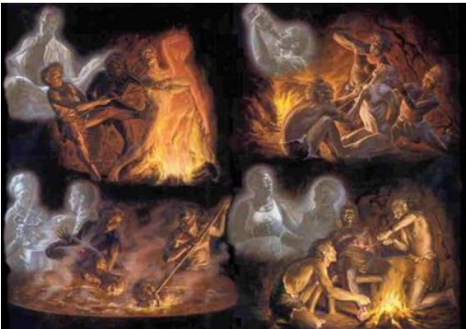
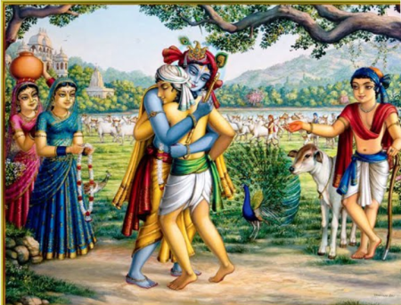
Fearful of Sins!
What to do about Sins:
Last Chapter of the 5th Canto describes the Hellish planets
Beginning of the 6th Canto, Maharaj Parikshit asks:
“O greatly fortunate and opulent Śukadeva Gosvāmī, now kindly tell me how human beings may be saved from having to enter hellish conditions in which they suffer terrible pains”.
For every sin, there is a side-by-side arrangement of prayaschita.
Let any man of any place or community, caste or creed be engaged in any sort of occupational duty, but he must agree to perform sacrifices as it is recommended in the scriptures for the particular place, time and person. In the Vedic literatures it is recommended that in Kali-yuga people engage in glorifying the Lord by chanting the holy name of Kṛṣṇa (kīrtanād eva kṛṣṇasya mukta-sańgaḥ paraḿ vrajet) without offense. By doing so one can be freed from all sins and thus can attain the highest perfection of life by returning home, back to Godhead.
Summary: Goal should be Satisfaction of Hari.
Skanda Purana – Mouse dancing.

Slide 18
1.12.35 āhūto bhagavān rājñā yājayitvā dvijair nṛpam uvāsa katicin māsān suhṛdāḿ priya-kāmyayā
Lord Śrī Kṛṣṇa, the Personality of Godhead, being invited to the sacrifices by Mahārāja Yudhiṣṭhira, saw to it that they were performed by qualified [twice-born] brāhmaṇas. After that, for the pleasure of the relatives, the Lord remained a few months.

Slide 19
Purport
Lord Śrī Kṛṣṇa was invited by Mahārāja Yudhiṣṭhira to look into the supervision of the performances of yajña, and the Lord, to abide by the orders of His elderly cousin, caused the performance of yajñas by learned twice-born brāhmaṇas.
Simply taking birth in the family of a brāhmaṇa does not make one qualified to perform yajñas. One must be twice-born by proper training and initiation from the bona fide ācārya.
Example: Shameek Rishi, Shringi
The once-born scions of brāhmaṇa families are equal with the once-born śūdras, and such brahma-bandhus, or unqualified once-born scions, must be rejected for any purpose of religious or Vedic function. Lord Śrī Kṛṣṇa was entrusted to look after this arrangement, and perfect as He is, He caused the yajñas to be performed by the bona fide twice-born brāhmaṇas for successful execution.

Slide 20
1.12.36
tato rājñābhyanujñātaḥ
kṛṣṇayā saha-bandhubhiḥ
yayau dvāravatīḿ brahman
sārjuno yadubhir vṛtaḥ
O Śaunaka, thereafter the Lord, having bade farewell to King Yudhiṣṭhira, Draupadī and other relatives, started for the city of Dvārakā, accompanied by Arjuna and other members of the Yadu dynasty.

Slide 21
References
http://www.romapadaswami.com
http://prabhupadavani.org
audio.Iskcondesiretree.info:
Bhurijana prabhu’s Srimad Bhagavatam Overview
Unveiling His Lotus feet – HG Bhurijana prabhu

