Slide 1
Srimad Bhagavatham 1.12.21 – 1.12.29
Qualities of Mahārāja Parīkṣit

Slide 2
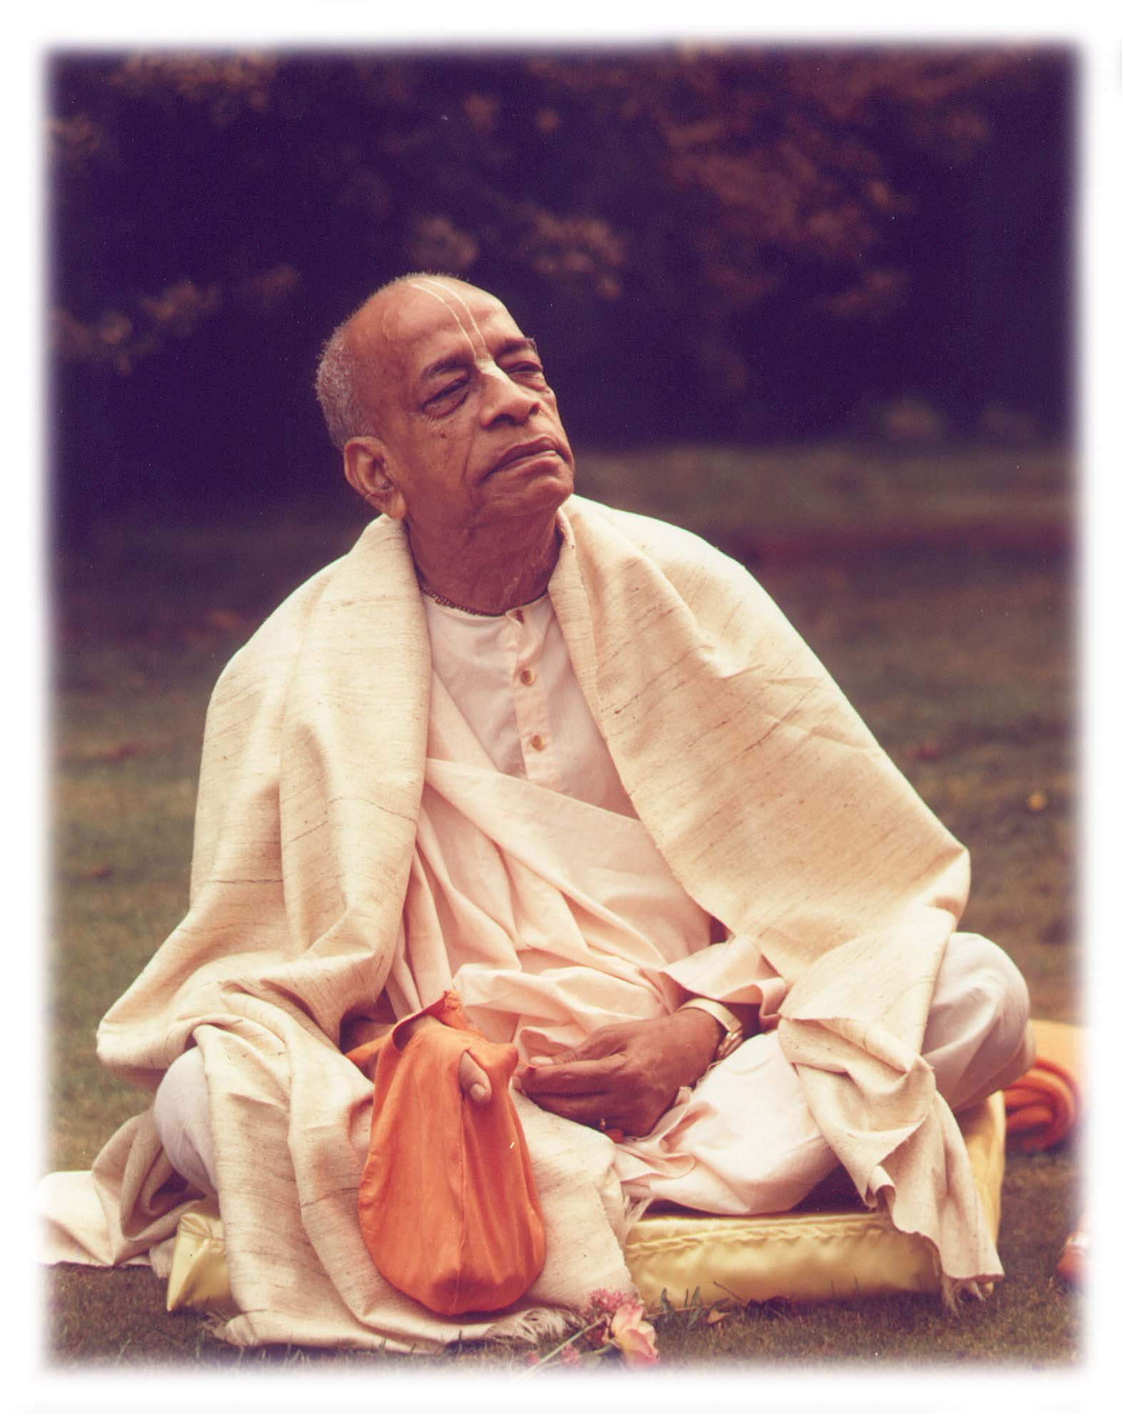
Based on the teachings of His Divine Grace A.C. Bhaktivedanta Swami Prabhupada
Founder Acharya of International Society for Krishna Consciousness

Slide 3
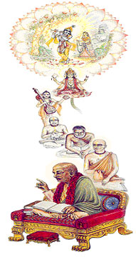
Seeking the Blessings of Guru, Gauranga & All the Vaishnavas

Slide 4
Prayers before reciting Srimad Bhagavatam
Om namah bhagavate vasudevaya
I offer my obeisances to the Supreme Personality of Godhead, Vasudeva.
narayanam namaskritya naram chaiva narottamam
devim sarasvatim vyasam tato jayam udirayet
Before reciting this Srimad-Bhagavatam, which is the very means of conquest, one should offer respectful obeisances unto the Personality of Godhead, Narayana, unto Nara-narayana Rishi, the supermost human being, unto Mother Sarasvati, the goddess of learning, and unto Srila Vyasadeva, the author. SB 1.2.4
Shrinvatam sva-kathah Kṛṣṇah punya-shravana-kirtanah
hridy antah stho hy abhadrani vidhunoti suhrit satam
Sri Krishna, the Personality of Godhead, who is the Paramatma in everyone's heart and the benefactor of the truthful devotee, cleanses desire for material enjoyment from the heart of the devotee who has developed the urge to hear His messages, which are in themselves virtuous when properly heard and chanted.
nashta-prayeshu abhadreshu nityam bhagavata-sevaya
bhagavaty uttama-shloke bhaktir bhavati naishthiki
By regular attendance in classes on the Bhagavatam and by rendering service to the pure devotee, all that is troublesome to the heart is almost completely destroyed, and loving service unto the Personality of Godhead, who is praised with transcendental songs, is established as an irrevocable fact.

Slide 5
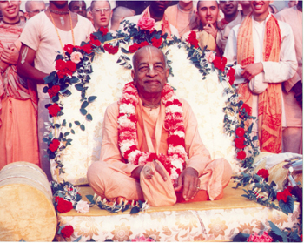
 | nama om vishnu-padaya krishna-preshthaya bhu-tale srimate bhaktivedanta swamin iti namine namaste saraswati deve gaura-vani-pracharine nirvishesha-shunyavadi pashchatya-desha-tarine

Slide 6
So far we have discussed …
Birth of Mahārāja Parikshit
Jatakarma Saḿskāra of Parikshit Mahārāja done by the Astrologers
In presence of the great sages, Kṛpācārya and Dhaumya
Of all the Qualities Mahārāja Yudhiṣṭhira was mainly interested in the below quality
Is he going to follow his predecessors (which means submission)
Basis of all good features of Character
Potential might be there, but it will be maximized only when there is submission

Slide 7
Qualities of Parīkṣit Mahārāja/Qualities that a Vaishnava should have
SB 1.12.19 – Quality of Truthfulness
SB1.12.20 – Quality of giving Protection to the Surrendered Souls
SB1.12.21 – Qualities of a Ksatriya/Leader
SB1.12.22 – Qualities that we should want to please Kṛṣṇa
SB1.12.23 – Quality of Equanimity, Munificence & giving Shelter to all
SB1.12.24 – Acquiring Godly Qualities
SB1.12.25 – Quality of Patience and Strong Devotion to the Lord
SB1.12.26 – Who is the Wisest of all
SB1.12.27 - Taking Complete Shelter of the Lord
SB1.12.28 –Quality of Fearlessness

Slide 8
Srimad Bhagavatham 1.12.21
dhanvinām agraṇīr eṣa
tulyaś cārjunayor dvayoḥ
hutāśa iva durdharṣaḥ
samudra iva dustaraḥ
Translation
Amongst great bowmen, this child will be as good as Arjuna. He will be as irresistible as fire and as unsurpassable as the ocean.

Slide 9
SB1.12.21 – Life of Pandava Arjuna Important Points from the Purport
Life of Pandava Arjuna
Great Devotee, Friend of Lord Kṛṣṇa
Because of Arjuna, Kṛṣṇa spoke the transcendental knowledge on the battlefield of Kurukṣetra
Son of Queen Kunti & Lord Indra
Four Wives – Draupadī, Subhadrā, Citrańgada and Ulūpī
Four Sons – Śrutakīrti, Abhimanyu, Babhruvāhana and Irāvān
Very Studious and topmost student of Droṇācārya
Story of Piercing the Target – Bowmanship Award from Droṇācārya
Saved Droṇācārya from the attack of a Crocodile – rewarded Arjuna with weapon Brahmaśira
Story of Mahārāja Drupada - Arjuna arrested Drupada and brought him in front of his Guru
Story of Draupadī's Swayamwara – At this time all the Pandavas were in incognito
Story of Ulūpī, Citrańgada & Subhadrā
Notes:
Notes to myself: First Talk about different Arjunas and then cover first two points in the slide
Just like there were different Bharat Maharaj, there are two Arjuna’s, both of whom were famous for their bowmanship.
Kartavirya Arjuna, King of Haihaya
Pandava Arjuna, who is the Grandfather of Pariksit Maharaj
Life of Pandava Arjuna is described in Great detail by Srila Prabhupada in this purport.
Arjuna is the plenary part of Lord of the Heaven, King Indra and was born in the month of Phalguna, hence he is also called as Phalguni.
Vasudeva, father of Kṛṣṇa and maternal uncle of Arjuna, sent his priest representative Kaśyapa to purify Arjuna by all the prescribed saḿskāras. His saḿskāra of being given a name was performed in the presence of the great ṛṣis
Notes to myself: Talk about Four Wives, Four Sons and how studious he was and then got to the next point
Piercing the Target Story – Examination of Kauravas and Pandavas → Target was Parrot’s Eye. Others were seeing everything other than the target. Only Arjuna was the one who could see only the target. Very focused.
Saving Droṇācārya from the Crocodile (illusion created by Droṇācārya) – Arjuna shoots an arrow such that the jaws of the Crocodile won’t close. Droṇācārya was just testing the prowess of his students so that he could find someone who could take the revenge on Maharaj Drupada
Story of Droṇācārya & Drupada – Both of them studied together and were very good friends. Drupada Promised that Droṇācārya will get a place in his kingdom when he will inherit the throne. But when he became the king, he forgot. Droṇācārya married Krpi, twin sister of Krpacarya. Son was Ashwathama. They were very poor and couldn’t afford milk, so once they gave Ashwathama rice flour mixed with water instead of milk. Other Brahmin boys made fun of Ashwathama. Droṇācārya remembered the promise and went to Drupada Maharaj. But Drupada humiliated Droṇācārya. Droṇācārya was very angry that a qualified king is breaking his word of promise (Main quality of a King). So he went to Krpacarya, he made the arragement to Droṇācārya to give military training to all the Pandavas and Kauravas. They were all playing and the ball fell inside a well. Droṇācārya took the ball by piercing the ball with an arrow and using a string to pull it out. Bhisma was then approached by Droṇācārya to teach the kids the art of military skills. After all the training he asked for Dakshin and his Dakshin was to bring Drupad captured. All the Kauravas went and they were all defeated. Then Arjuna went and captured Drupada and brought him before Droṇācārya. Droṇācārya gives him back half kingdom (as per their promise in childhood). Drupada was insulted and he wanted to take revenge. So he did a Yagna to get a son who could defeat Droṇācārya. Dristadyumna and Draupadi came out of the fire Yagna.
Competition set by Drupada for Draupadi’s Swayamvara – Target was the fish Eye
Reason of why Draupadi had to marry all the Pandavas – Draupadi in her previous life was a great worshipper of Lord Shiva. She was worshipping to have a qualified husband. Lord Shiva was very pleased and he personally came. Draupadi asked the boon five times to get a qualified husband.
Story of Ulupi – Once, to save the cowherd men, Arjuna entered into the personal quarters where Maharaja Yudistira and Draupadi were staying (since his bow and arrow were in that room). He defeated the dacoits, but when he came back, he repented that he broke the word of his mother and then went to pilgrimage for 1 year. When he was taking bath in Haridwar, Ulupi captured Arjuna and took him under water to a kingdom called Nagaloka. Ulupi expressed her desire to marry him. Arjuna married her and Iravan was born to them. Under similar circumstances he met Citrańgada and married her as well. Babhruvāhana was born to them. During the same time, we went to Dwaraka and there he met Subhadra under the influence of Krishna. Balaram wanted her to marry Duryodhana. But Krishna didn’t want his sister to marry Duryodhana. So he arranged Arjuna to marry Subhadra. To marry her he disguised himself as a Sage and entered into the Kingdom of Dwaraka. Abhimanyu was born to them.

Slide 10
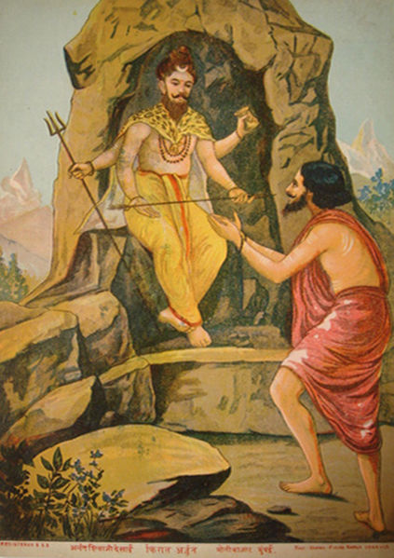
SB1.12.21 – Life of Pandava Arjuna contd… Important Points from the Purport
Life of Pandava Arjuna contd…
Story of Lord Shiva testing Arjuna
Curse of Urvashi to be a eunuch for one year
Saved Duryodhana from the Gandharvas
Music teacher of Uttarā (Abhimanyu married Uttarā)
Babhruvāhana defeated Arjuna in a war that took place in Manipur. Ulūpī got the Nagamani from the Nagaloka and brought Arjuna back to life
After Lord Kṛṣṇa dissappeared, Arjuna was taking all the wives of the Lord to Indraprastha, but he was defeated by Abhiras
Notes:
Arjuna defeated by Lord Shiva and Shiva presented him with Pasupathastra – Shiva wanted to test the strength of Arjuna
Arjuna received Dandastra from Yamaraja, paśāstra from Varuṇa, and antardhana-astra from Kuvera
He then went to Indraloka. In Indraloka he learnt musical science and military science as used in the Heavenly planet
there he was approached by Urvashi to marry him, but Arjuna addressed her as a mother of Kuru dynasty. She cursed him
Duryodhana gave a benediction to Arjuna – he used it in the battle of kurukshetra to get the five arrows
Later, he was a music teacher of Uttarā in the court of King Virata known by Name Bṛhannala. Here he was in cognito as a Eunuch. He fought on behalf of Uttara, son of King Virata to defeat the Kurus. Arjun took the role of a chariot driver of Uttara when Kurus attached the kingdom of King Virat. He defeated the whole Kuru army single handedly.

Slide 11
Srimad Bhagavatham 1.12.22
mṛgendra iva vikrānto
niṣevyo himavān iva
titikṣur vasudhevāsau
sahiṣṇuḥ pitarāv iva
Translation
This child will be as strong as a lion, and as worthy a shelter as the Himalaya Mountains. He will be forbearing like the earth, and as tolerant as his parents.

Slide 12
SB1.12.22 – Qualities that we should want to please Kṛṣṇa
This verse is mainly talking about the Qualities that we should want to please Kṛṣṇa
Serving Kṛṣṇa, the devotee becomes decorated by Qualities. Qualities please Kṛṣṇa, hence the devotee becomes more dear to Kṛṣṇa and he decorates them further with more qualities and so on…Devotee is serving, serving, serving….Kṛṣṇa is decorating, decorating, decorating…
Lamb at Home and Lion in the Chase (Soft and Strong at the same time)
Srila Prabhupada is expanding on this: Leader is one who gives protection to those who have surrendered
Eg: Arjuna protecting Mayadanava, Personality of Kali, Jagai and Madhai who had offended Lord Nithyananda
Suppose one is enemical towards Kṛṣṇa or Kṛṣṇa’s devotees – mṛgendra iva vikrānto – Quality of being capable of great prowess to establish the well being of those who have taken shelter
Notes:
Krishna is Bhakta Vatsala

Slide 13
SB1.12.22 – Qualities that we should want to please Kṛṣṇa contd…
Capable of giving shelter to anyone: Munificent (Like Himalayas)
Materialist
Minerals, Valuable things etc
Spiritualist
Caves to live in and do Tapasya, Medicines for Health, Water to drink etc
As practicing Devotees for us, Holy Name is the Shelter
Holy Name – which can give shelter to anyone (like a Touchstone)
Holy Name is Krishna and supplies everything for everyone
For Materialist the Holy name can supply Dharma, Artha, Kama and Moksha
For Impersonalist, the Holy name can supply liberation
For Pure Devotee, the Holy name can supply Love of God
Notes:
In Harinam Cintamani by Bhakti Vinod Thakur. When Caitanya Mahaprabhu is discussing with Haridas Thakur he says that the Holy Name is Krishna. As Krishna He supplies everything for everyone.
For Materialist the Holy name can supply Dharma, Artha, Kama and Moksha
For Impersonalist, the Holy name can supply liberation
For Pure Devotee, the Holy name can supply Love of God
Then he asks Haridas Thakur, how to come to the stage when one can chant like that?
"One who chants the holy name even once is considered a Vaisnava devotee, and the householders should be very attentive to respect such a person. But the devotee who constantly chants Krsna's name is even a better Vaisnava, for he is endowed with all good qualities and he needs to be served. The most advanced Vaisnava of all is he who inspires others who see him to immediately chant the Lord's name. When he chants the name even once, attraction to rendering eternal devotional service to the Supreme Lord is irrevocably established. Kindly tell Me how the nondevotees can be made to accept the chanting of the holy name of Krsna."

Slide 14
SB1.12.22 – Qualities that we should want to please Kṛṣṇa contd…
titikṣuḥ → Forbearance
Earth remains unmoved even when there are so many disturbances
Similarly we need to be unmoved – like inner strength
A Leader needs to have this Quality
sahiṣṇuḥ → Tolerance
More specifically about the mind
Tolerate Duality for a higher purpose
Notes:
Tolerance: All the Maharaja’s who travel all across the world to preach about Kṛṣṇa. Sometimes it is cold, sometimes it is Hot but they remain unaffected. Because they tolerate the duality for a Higher purpose, to give the Love of God to others.
Maharaj Parikshit possessed all these qualities – Munificent like Himalayas, Strong and Soft at the same time, Forbearing and Tolerant

Slide 15
Srimad Bhagavatham 1.12.23
pitāmaha-samaḥ sāmye
prasāde giriśopamaḥ
āśrayaḥ sarva-bhūtānāḿ
yathā devo ramāśrayaḥ
Translation
This child will be like his grandfather Yudhiṣṭhira or Brahmā in equanimity of mind. He will be munificent like the Lord of the Kailāsa Hill, Śiva. And he will be the resort of everyone, like the Supreme Personality of Godhead Nārāyaṇa, who is even the shelter of the goddess of fortune.

Slide 16
SB1.12.23 - Equanimity Important Points from the purport
Equanimity (samaḥ)
Quality of a Brahman – Being Equal Minded (not affected by Duality)
Happens when there is shelter – at the soul level we have taken shelter of Kṛṣṇa
Lord Shiva is describing the Quality of King Citraketu (SB 6.17.28)
nārāyaṇa-parāḥ sarve
na kutaścana bibhyati
svargāpavarga-narakeṣv
api tulyārtha-darśinaḥ
Devotees solely engaged in the devotional service of the Supreme Personality of Godhead, Nārāyaṇa, never fear any condition of life. For them the heavenly planets, liberation and the hellish planets are all the same, for such devotees are interested only in the service of the Lord.
Examples: Yudhiṣṭhira Maharaj, Lord Brahmā
Notes:
How does this happen? Happens when there is shelter
Quote by Lord Shiva:
Complete Surrender means to the Supreme Personality of Godhead - Ones life is the Supreme Lord – at that point Duality is insignificant. When one is attached to the Service of Kṛṣṇa they are really not interested in going to Heaven, not interested in Liberation or don’t mind going to Hell. They are only concerned about service to Kṛṣṇa. Caitanaya Mahaprabhu also mentions in the Sikshastakam – ashlishya va pada-ratam pinashtu mam;adarshanan marma-hatam karotu va;yatha tatha va vidadhatu lampato;mat-prana-nathas tu sa eva naparah I know no one but Kṛṣṇa as my Lord, and He shall remain so even if He handles me roughly by His embrace or makes me brokenhearted by not being present before me. He is completely free to do anything and everything, for He is always my worshipful Lord, unconditionally.
Pitamaha here can either be Yudhisthira Maharaj or Lord Brahma → Yudhisthira Maharaj was equanimous in all the situations (Duryodhana tried to Poison Bhima, but he still remained neutral), Example of Vaishampayana Lake (all the four brothers were killed) → He didn’t react, he patiently answered all the questions of Yaksha
Lord Brahma → Cursed by the Gopis → Eyes with Eyelids → Gopis didn’t want separation from Krnsa even for a fraction of a second
The Lesson is that even when we try to serve someone out of the way, we might be blamed. We should try to be Equanimous and tolerate patiently (tat tenu kampam…) It happens during our service, we will be criticized, but we should tolerate.

Slide 17
SB1.12.23 – Munificent & Shelter for All Important Points from the purport
Munificent (prasāde) – Merciful/Charitable
Eg: Lord Shiva awarding the benediction to Rāvaṇa, Vṛkāsura
Resort of Everyone
āśrayaḥ sarva-bhūtānāḿ - Shelter of all Living beings
Mahārāja Parīkṣit has taken the shelter of Lord Nārāyaṇa
Take shelter of Viṣṇu instead of directly seeking the protection of the goddess of fortune
Notes:
Munificent
Ravana was a great devotee of Lord Shiva. However he wanted to challenge Lord Rama. However Lord Shiva didn’t help him
Vrkasura – Got the benediction from Lord Shiva that when he touches the head of a person, that person will burn into ashes. He was so cunning that he wanted to try out the Benediction on Lord Shiva. However Lord Shiva was saved by Narayana / Lord Kṛṣṇa
Resort of Everyone
Mahārāja Parīkṣit is the shelter of all Living beings because he has taken the shelter of Lord Nārāyaṇa who is the Shelter of all Living beings. Since Maharaja Parikshit was fully surrendered to the Lord, he was able to provide protection and shelter to his praja.
Lakshmi Devi shouldn’t be worshipped alone, but should be worshipped along with Visnu because she is Chancal. She stays only where Lord Visnu is worshipped.

Slide 18
Srimad Bhagavatham 1.12.24
sarva-sad-guṇa-māhātmye
eṣa kṛṣṇam anuvrataḥ
rantideva ivodāro
yayātir iva dhārmikaḥ
Translation
This child will be almost as good as Lord Śrī Kṛṣṇa by following in His footsteps. In magnanimity he will become as great as King Rantideva. And in religion he will be like Mahārāja Yayāti.

Slide 19
SB1.12.24 - Important Points from the purport
sarva-sad-guṇa-māhātmye - Glorified by all godly attributes
How do we acquire Godly Qualities?
Association is the cause of acquiring qualities
To follow the instructions of the Lord is to associate with the Lord
Following His instruction because the Lord and His instruction and the Lord and His name, fame, attributes and paraphernalia are all identical with Him, being absolute knowledge
Achieve up-to 78% (50 of 64)of the godly qualities by the Lord's intimate association
Mahārāja Parīkṣit associated with the Lord even from the womb of his mother up to the last day of his valuable life, and thus he acquired all the essential good qualities of the Lord in all perfection.
Notes:
Children are just like Clay. Their Qualities can be easily molded and they learn all the Qualities from their parents. Hence Qualities of the Parents are very important

Slide 20
SB1.12.24 - Important Points from the purport
Udāraḥ – Magnanimity
King Rantideva
Top Most platform of Bhakti
Every Living Entity Engaged in the Service of the Lord
Very Charitable
dhārmikaḥ - Religiosity
King Yayāti
Performed over 1000 different sacrifices and was very charitable
Notes:
King Rantideva was on the top most platform of Bhakti. He saw every living entity engaged in the service of the Lord (except may be himself). Because of that he was very Charitable.
In the 9th Canto, there is a Story of the King: He fasted for 48 days from eating, drinking etc. 49th Morning, Royal feast with Ghee (specifically mentioned in SB). Just when he was about to break the fast, a Brahman came. King Rantidev offered the seat to the Brahman and told him to eat. After the Brahman ate, he left some remnants, so the King went to break the fast by taking the Maha Prasadam. But then again, a poor man came and he was hungry. King took equal proportion from the plate and gave it to the poor man. Then he sat down to break the fast. Then another poor man came with a number of dogs and he said that the dogs were hungry. The king gave everything that was left on his plate to the dogs. Only one thing was left, Water. But when he was about to take Water a Candala came and he said he was very thirsty. King gave Water to the Candala.
He always used to pray that he didn’t want anything from the Lord, but wanted to take some austerity so that he can relieve the general people from their sufferings.
King Yayāti: Although he was very irreligious during his youth, he became very religious later. Devayānī and Śarmiṣṭhā were friends. Once they had a quarrel and Śarmiṣṭhā pushed Devayānī into a well in a forest. Kind Yayati who was hunting in the forest saved her. Since Devayānī was naked and the king had seen her, She wanted him to marry her. However she, being the daughter of Śukrācārya, belonged to a Brahmin Family and as per sastras, a ksatriya couldn’t marry a Brahmana but the other way round was allowed. However Śukrācārya amended this law and he told them to marry each other. Although Śukrācārya forbid King Yayati from marrying Śarmiṣṭhā , who was Devayānī friend, Yayati married her. So Śukrācārya cursed him to become an old man and be impotent. But the King couldn’t accept it and begged Śukrācārya to withdraw the curse. Śukrācārya told that if any of his sons could give Yayati his youthfulness back, then he will be relieved of the Curse. Yayati ‘s youngest son Pūru gave his father his Youth. But after sometime, he understood that the material life was miserable and gave back the Youth to his son and made him the king.

Slide 21
Srimad Bhagavatham 1.12.25
dhṛtyā bali-samaḥ kṛṣṇe
prahrāda iva sad-grahaḥ
āhartaiṣo 'śvamedhānāḿ
vṛddhānāḿ paryupāsakaḥ
Translation
This child will be like Bali Mahārāja in patience, a staunch devotee of Lord Kṛṣṇa like Prahlāda Mahārāja, a performer of many Aśvamedha [horse] sacrifices and a follower of the old and experienced men.

Slide 22
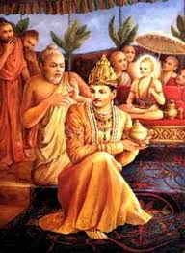
SB1.12.25 - Important Points from the purport
Dhṛtyā – Patience
Bali Mahārāja
One of the 12 Mahajans of Devotional Service to the Lord
Great authority in devotional service because he sacrificed everything to please the Lord and relinquished the connection of his so-called spiritual master who obstructed him on the path of risking everything for the service of the Lord
Why is this Quality important to us?
One should not be impatient in Kṛṣṇa consciousness.
Patience requires that one have:
Full Confidence in the Lord
One is free from the Urge of Fruitive Demands
One of the 6 qualities/principles that is mentioned in NOI by Śrīla Rūpa Gosvāmī that is favorable in the execution of Pure Devotional Service
Notes:
Bali Mahārāja:
Grandson of Prahlad Maharaj
Great authority in devotional service because he sacrificed everything to please the Lord and relinquished the connection of his so-called spiritual master who obstructed him on the path of risking everything for the service of the Lord
Patience: Patience is the quality that is attributed to Bali Maharaja.
Why is this important to Devotees?
It is also mentioned in the NOI (dhairyāt)
utsāhān niścayād dhairyāt
tat-tat-karma-pravartanāt
sańga-tyāgāt sato vṛtteḥ
ṣaḍbhir bhaktiḥ prasidhyati
In the purport Srila Prabhupada writes:
One should not be impatient in Kṛṣṇa consciousness. Indeed, this Kṛṣṇa consciousness movement was started single-handedly, and in the beginning there was no response, but because we continued to execute our devotional activities with patience, people gradually began to understand the importance of this movement, and now they are eagerly participating. One should not be impatient in discharging devotional service, but should take instructions from the spiritual master and execute them with patience, depending on the mercy of guru and Kṛṣṇa. The successful execution of Kṛṣṇa conscious activities requires both patience and confidence. A newly married girl naturally expects offspring from her husband, but she cannot expect to have them immediately after marriage. Of course, as soon as she is married she can attempt to get a child, but she must surrender to her husband, confident that her child will develop and be born in due time

Slide 23
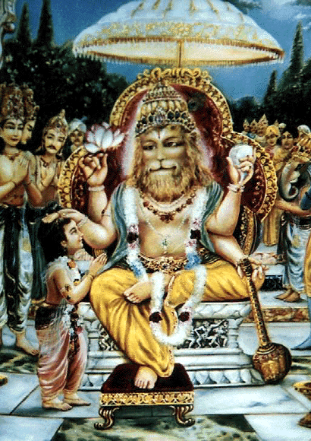
SB1.12.25 - Important Points from the purport
sat-grahaḥ - Staunch Devotee
Prahlāda Mahārāja
Prahlāda Mahārāja was an authority in the devotional service of the Lord because he had his father killed by Lord Nṛsiḿhadeva, setting the example that even a father should be removed from the path of devotional service if such a father happens to be an obstacle
Why is this Quality important to us?
Whatever obstacle may come in our life, the devotional service cannot be stopped.
Even in the most difficult circumstances, we should continue to do devotional service
Always there are so many obstacles while doing devotional service (Eg: Chanting), but still if we surrender to the Lord, He will help us overcome the obstacles

Slide 24
SB1.12.25 - Important Points from the purport
āhartaiṣo 'śvamedhānāḿ - performer of many Aśvamedha sacrifices
vṛddhānāḿ paryupāsakaḥ - follower of the old and experienced men
A qualified King or a Leader or a Devotee must be a follower of the predecessor Acharyas
Not Imitate them, Not Equal to them, but Follow them

Slide 25
Srimad Bhagavatham 1.12.26
rājarṣīṇāḿ janayitā
śāstā cotpatha-gāminām
nigrahītā kaler eṣa
bhuvo dharmasya kāraṇāt
Translation
This child will be the father of kings who will be like sages. For world peace and for the sake of religion, he will be the chastiser of the upstarts and the quarrelsome.

Slide 26
SB1.12.26 - Important Points from the purport
One of the Qualifications of a leader is that he should be wise like a sage
Because there will always be circumstances where in strength alone is not sufficient, but it requires wisdom
Wisest man in the world is a Devotee of the Lord
One of the duties of a leader is to create leaders
Wise Leaders should maintain peace and prosperity by subduing the upstarts and quarrelsome people who indulge in wine, illicit connection with women, gambling and meat-eating
Why is this Quality important to us?
Each of us need to be leaders in the society
Setting an Example so that others can look up to us
The State fathers/Leaders, therefore, must follow the principles of becoming wiser by devotion to the Lord, by chastising the breaker of discipline and by uprooting the symptoms of quarrel

Slide 27
Srimad Bhagavatham 1.12.27
takṣakād ātmano mṛtyuḿ
dvija-putropasarjitāt
prapatsyata upaśrutya
mukta-sańgaḥ padaḿ hareḥ
Translation
After hearing about his death, which will be caused by the bite of a snake-bird sent by a son of a brāhmaṇa, he will get himself freed from all material attachment and surrender unto the Personality of Godhead, taking shelter of Him.

Slide 28
SB1.12.27 - Important Points from the purport
mukta-sańgaḥ - Detachment of Material Affinity
prapatsyate hareḥ – Complete Shelter of the Lord
Material attachment and taking shelter of the lotus feet of the Lord go ill together. Material attachment means ignorance of transcendental happiness under the shelter of the Lord. Devotional service to the Lord, while existing in the material world, is a way to practice one's transcendental relation with the Lord, and when it is matured, one gets completely free from all material attachment and becomes competent to go back home, back to Godhead. Mahārāja Parīkṣit, being especially attached to the Lord from the beginning of his body in the womb of his mother, was continuously under the shelter of the Lord, and the so-called warning of his death within seven days from the date of the curse by the brāhmaṇa's son was a boon to him to enable him to prepare himself to go back home, back to Godhead. Since he was always protected by the Lord, he could have avoided the effect of such a curse by the grace of the Lord, but he did not take such undue advantage for nothing. Rather, he made the best use of a bad bargain. For seven days continuously he heard Śrīmad-Bhāgavatam from the right source, and thus he got shelter at the lotus feet of the Lord by that opportunity.
We should also strive to cultivate that Quality of taking Complete Shelter of the Lord. By God’s Grace and Guru’s Mercy we have been given that opportunity . We should take full advantage of it and continue doing devotional service till the last breath of life.
Notes:
Main points – Mahārāja Parīkṣit was not only protected in the womb of his mother, but he could see the Lord in a suitable size. He understood that he was being protected by the Lord. Although the beginning of his devotional service started in the womb, he didn’t think that he is now protected, so it is okay to stop the devotional service. Instead he continuously cultivated that mood under the shelter of the Lord and maintained it even at the time of death (by hearing SB for 7 days continuously without eating, drinking, sleeping etc).

Slide 29
Srimad Bhagavatham 1.12.28
jijñāsitātma-yāthārthyo
muner vyāsa-sutād asau
hitvedaḿ nṛpa gańgāyāḿ
yāsyaty addhākutobhayam
Translation
After inquiring about proper self-knowledge from the son of Vyāsadeva, who will be a great philosopher, he will renounce all material attachment and achieve a life of fearlessness.

Slide 30
SB1.12.28 - Important Points from the purport
akutaḥ-bhayam - life of fearlessness
Fearlessness comes because of the sense of Protection
Sense of Protection is not from our own strength
Hearing Śrīmad-Bhāgavatam one can get free from material attachment and enter into the kingdom of fearlessness
One should listen Śrīmad-Bhāgavatam from a Qualified Person
When we listen the Right Message from a Right Person in a Right Mood/Attitude, position of complete shelter of the Personality of Godhead is factually experienced
When one comes to the position of complete shelter, one is completely protected by the Lord
When one is protected, one develops the quality of Fearlessness
Dhruv Mahārāja was so fearless that when Death Personified approached him, he stepped on his head and ascended into the Vaikuntha Vimana
Notes:
Dhruv Mahārāja was so fearless that as he was walking to the Vaikuntha Vimana, Death Personified approached him, he stepped on his head and ascended into the Vaikuntha Vimana
Such is the Quality of a Great Devotee, feeling fully protected by the Personality of Godhead. So it is a Cultivation to come to that stage of being so spiritually connected and With that a natural detachment from the material things take place

Slide 31
Srimad Bhagavatham 1.12.29
iti rājña upādiśya
viprā jātaka-kovidāḥ
labdhāpacitayaḥ sarve
pratijagmuḥ svakān gṛhān
Translation
Thus those who were expert in astrological knowledge and in performance of the birth ceremony instructed King Yudhiṣṭhira about the future history of his child. Then, being sumptuously remunerated, they all returned to their respective homes.

Slide 32
SB1.12.29 - Important Points from the purport
The Vedas are the storehouse of knowledge, both material and spiritual. But such knowledge aims at perfection of self-realization. In other words, the Vedas are the guides for the civilized man in every respect. Since human life is the opportunity to get free from all material miseries, it is properly guided by the knowledge of the Vedas, in the matters of both material needs and spiritual salvation. The specific intelligent class of men who were devoted particularly to the knowledge of the Vedas were called the vipras, or the graduates of the Vedic knowledge. There are different branches of knowledge in the Vedas, of which astrology and pathology are two important branches necessary for the common man. So the intelligent men, generally known as the brāhmaṇas, took up all the different branches of Vedic knowledge to guide society. Even the department of military education (Dhanur-veda) was also taken up by such intelligent men, and the vipras were also teachers of this section of knowledge, as were Droṇācārya, Kṛpācārya, etc.
Notes:
This verse is spoken by Suta Goswami

Slide 33
SB1.12.29 - Important Points from the purport contd …
The word vipra mentioned herein is significant. There is a little difference between the vipras and the brāhmaṇas. The vipras are those who are expert in karma-kāṇḍa, or fruitive activities, guiding the society towards fulfilling the material necessities of life, whereas the brāhmaṇas are expert in spiritual knowledge of transcendence. This department of knowledge is called jñāna-kāṇḍa, and above this there is the upāsanā-kāṇḍa. The culmination of upāsanā-kāṇḍa is the devotional service of the Lord Viṣṇu, and when the brāhmaṇas achieve perfection, they are called Vaiṣṇavas. Viṣṇu worship is the highest of the modes of worship. Elevated brāhmaṇas are Vaiṣṇavas engaged in the transcendental loving service of the Lord, and thus Śrīmad-Bhāgavatam, which is the science of devotional service, is very dear to the Vaiṣṇavas. And as explained in the beginning of the Śrīmad-Bhāgavatam, it is the mature fruit of Vedic knowledge and is superior subject matter, above the three kāṇḍas, namely karma, jñāna and upāsanā.

Slide 34
SB1.12.29 - Important Points from the purport contd …
Amongst the karma-kāṇḍa experts, the jātaka expert vipras were good astrologers who could tell all the future history of a born child simply by the astral calculations of the time (lagna). Such expert jātaka-vipras were present during the birth of Mahārāja Parīkṣit, and his grandfather, Mahārāja Yudhiṣṭhira, awarded the vipras sufficiently with gold, land, villages, grains and other valuable necessaries of life, which also include cows. There is a need of such vipras in the social structure, and it is the duty of the state to maintain them comfortably, as designed in the Vedic procedure. Such expert vipras, being sufficiently paid by the state, could give free service to the people in general, and thus this department of Vedic knowledge could be available for all.
Notes:
In this paragraph, Prabhupada explains that Jatakarma experts are also needed and some section of society needs to do that. However they need to understand and respect that all of this is leading to Kṛṣṇa. If that is not there, then one will be misdirected, even though he might be an expert in it.

Slide 35
References
Srila Prabhupada’s purports on these verses
HH Romapada Swami Maharaj’s Lectures
Nectar of Instruction

