Slide 1
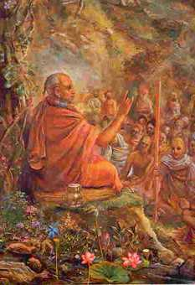
Srimad Bhagavatham 1.12.1 - 11
By Radhika Gopinath das

Slide 2
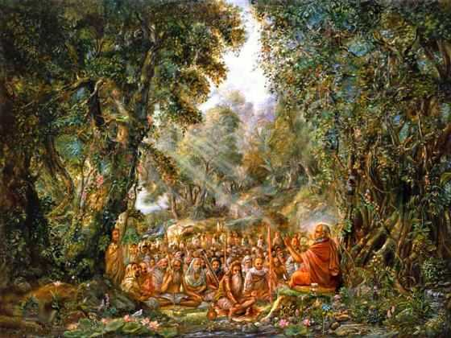
Suta Goswami narrating Srimad Bhagvatam.

Slide 3
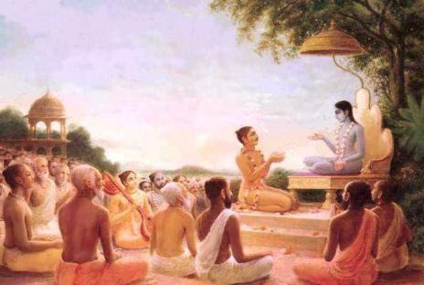

Slide 4
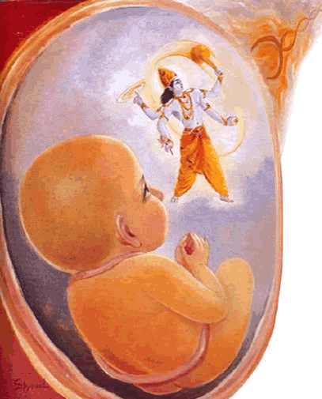
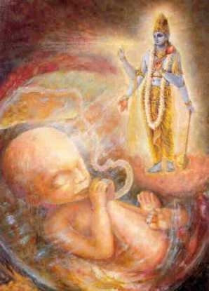

Slide 5
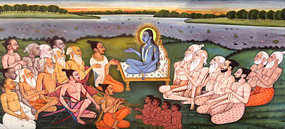

Slide 6
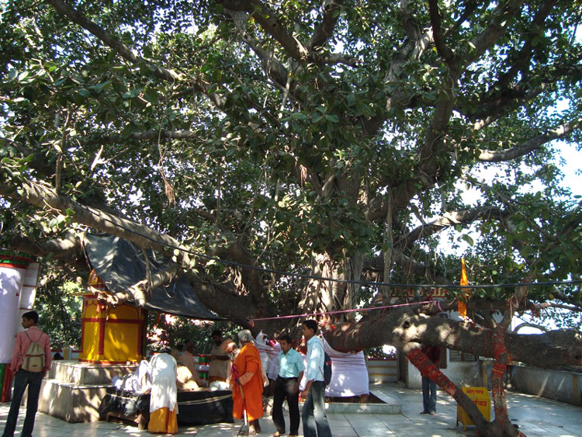
Suka Stala near Haridwar where sages met

Slide 7
śaunaka uvāca
aśvatthāmnopasṛṣṭena
brahma-śīrṣṇoru-tejasā
uttarāyā hato garbha
īśenājīvitaḥ punaḥ
TRANSLATION
The sage Śaunaka said: The womb of Uttarā, mother of Mahārāja Parīkṣit, was spoiled by the dreadful and invincible brahmāstra weapon released by Aśvatthāmā. But Mahārāja Parīkṣit was saved by the Supreme Lord.

Slide 8
The sages assembled in the forest of Naimiṣāraṇya inquired from Sūta Gosvāmī about the birth of Mahārāja Parīkṣit, but in the course of the narration other topics like the release of the brahmāstra by the son of Droṇa, his punishment by Arjuna, Queen Kuntīdevī's prayers, the Pāṇḍavas' visit to the place where Bhīṣmadeva was lying, his prayers and thereafter the Lord's departure for Dvārakā were discussed. His arrival at Dvārakā and residing with the sixteen thousand queens, etc., were narrated. The sages were absorbed in hearing such descriptions, but now they wanted to turn to the original topic, and thus the inquiry was made by Śaunaka Ṛṣi. So the subject of the release of the brahmāstra weapon by Aśvatthāmā is renewed.

Slide 9
tasya janma mahā-buddheḥ
karmāṇi ca mahātmanaḥ
nidhanaḿ ca yathaivāsīt
sa pretya gatavān yathā
TRANSLATION
How was the great emperor Parīkṣit, who was a highly intelligent and great devotee, born in that womb? How did his death take place, and what did he achieve after his death?

Slide 10
The king of Hastināpura (now Delhi) used to be the emperor of the world, at least till the time of the son of Emperor Parīkṣit. Mahārāja Parīkṣit was saved by the Lord in the womb of his mother, so he could certainly be saved from an untimely death due to the ill will of the son of a brāhmaṇa. Because the age of Kali began to act just after the assumption of power by Mahārāja Parīkṣit, the first sign of misgivings was exhibited in the cursing of such a greatly intelligent and devoted king as Mahārāja Parīkṣit. The king is the protector of the helpless citizens, and their welfare, peace and prosperity depend on him. Unfortunately, by the instigation of the fallen age of Kali, an unfortunate brāhmaṇa's son was employed to condemn the innocent Mahārāja Parīkṣit, and so the King had to prepare himself for death within seven days.

Slide 11
Mahārāja Parīkṣit is especially famous as one who is protected by Viṣṇu, and when he was unduly cursed by a brāhmaṇa's son, he could have invoked the mercy of the Lord to save him, but he did not want to because he was a pure devotee. A pure devotee never asks the Lord for any undue favor. Mahārāja Parīkṣit knew that the curse of the brāhmaṇa's son upon him was unjustified, as everyone else knew, but he did not want to counteract it because he knew also that the age of Kali had begun and that the first symptom of the age, namely degradation of the highly talented brāhmaṇa community, had also begun. He did not want to interfere with the current of the time, but he prepared himself to meet death very cheerfully and very properly. Being fortunate, he got at least seven days to prepare himself to meet death, and so he properly utilized the time in the association of Śukadeva Gosvāmī, the great saint and devotee of the Lord.

Slide 12
tad idaḿ śrotum icchāmo
gadituḿ yadi manyase
brūhi naḥ śraddadhānānāḿ
yasya jñānam adāc chukaḥ
TRANSLATION
We all respectfully want to hear about him [Mahārāja Parīkṣit] to whom Śukadeva Gosvāmī imparted transcendental knowledge. Please speak on this matter.

Slide 13
PURPORT
Śukadeva Gosvāmī imparted transcendental knowledge to Mahārāja Parīkṣit during the remaining seven days of his life, and Mahārāja Parīkṣit heard him properly, just like an ardent student. The effect of such a bona fide hearing and chanting of Śrīmad-Bhāgavatam was equally shared by both the hearer and the chanter. Both of them were benefited. Out of the nine different transcendental means of devotional service to the Lord prescribed in the Bhāgavatam, either all of them, or some of them or even one of them are equally beneficial if properly discharged. Mahārāja Parīkṣit and Śukadeva Gosvāmī were serious performers of the first two important items, namely the process of chanting and the process of hearing, and therefore both of them were successful in their laudable attempt. Transcendental realization is attained by such serious hearing and chanting and not otherwise. There is a type of spiritual master and disciple much advertised in this age of Kali.

Slide 14
It is said that the master injects spiritual force into the disciple by an electrical current generated by the master, and the disciple begins to feel the shock. He becomes unconscious, and the master weeps for his exhausting his store of so-called spiritual assets. Such bogus advertisement is going on in this age, and the poor common man is becoming the victim of such advertisement. We do not find such folk tales in the dealings of Śukadeva Gosvāmī and his great disciple Mahārāja Parīkṣit. The sage recited Śrīmad-Bhāgavatam in devotion, and the great King heard him properly. The King did not feel any shock of electrical current from the master, nor did he become unconscious while receiving knowledge from the master.

Slide 15
One should not, therefore, become a victim of these unauthorized advertisements made by some bogus representative of Vedic knowledge. The sages of Naimiṣāraṇya were very respectful in hearing about Mahārāja Parīkṣit because of his receiving knowledge from Śukadeva Gosvāmī by means of ardent hearing. Ardent hearing from the bona fide master is the only way to receive transcendental knowledge, and there is no need for medical performances or occult mysticism for miraculous effects. The process is simple, but only the sincere party can achieve the desired result.

Slide 16
sūta uvāca
apīpalad dharma-rājaḥ
pitṛvad rañjayan prajāḥ
niḥspṛhaḥ sarva-kāmebhyaḥ
kṛṣṇa-pādānusevayā
TRANSLATION
Śrī Sūta Gosvāmī said: Emperor Yudhiṣṭhira administered generously to everyone during his reign. He was exactly like his father. He had no personal ambition and was freed from all sorts of sense gratification because of his continuous service unto the lotus feet of the Lord Śrī Kṛṣṇa.

Slide 17
PURPORT
As mentioned in our introduction, "There is a need for the science of Kṛṣṇa in human society for all the suffering humanity of the world, and we simply request the leading personalities of all nations to take to the science of Kṛṣṇa for their own good, for the good of society, and for the good of all the people of the world." So it is confirmed herein by the example of Mahārāja Yudhiṣṭhira, the personality of goodness. In India the people hanker after Rāma-rājya because the Personality of Godhead was the ideal king and all other kings or emperors in India controlled the destiny of the world for the prosperity of every living being who took birth on the earth. Herein the word prajāḥ is significant. The etymological import of the word is "that which is born." On the earth there are many species of life, from the aquatics up to the perfect human beings, and all are known as prajās. Lord Brahmā, the creator of this particular universe, is known as the prajāpati because he is the grandfather of all who have taken birth. Thus prajā is used in a broader sense than it is now used.

Slide 18
PURPORT
The king represents all living beings, the aquatics, plants, trees, reptiles, birds, animals and man. Every one of them is a part and parcel of the Supreme Lord (Bg. 14.4), and the king, being the representative of the Supreme Lord, is duty-bound to give proper protection to every one of them. This is not the case with the presidents and dictators of this demoralized system of administration, where the lower animals are given no protection while the higher animals are given so-called protection. But this is a great science which can be learned only by one who knows the science of Kṛṣṇa. By knowing the science of Kṛṣṇa, one can become the most perfect man in the world, and unless one has knowledge in this science, all qualifications and doctorate diplomas acquired by academic education are spoiled and useless. Mahārāja Yudhiṣṭhira knew this science of Kṛṣṇa very well, for it is stated here that by continuous cultivation of this science, or by continuous devotional service to Lord Kṛṣṇa, he acquired the qualification of administering the state.

Slide 19
The father is sometimes seemingly cruel to the son, but that does not mean that the father has lost the qualification to be a father. A father is always a father because he always has the good of the son at heart. The father wants every one of his sons to become a better man than himself. Therefore, a king like Mahārāja Yudhiṣṭhira, who was the personality of goodness, wanted everyone under his administration, especially human beings who have better developed consciousness, to become devotees of Lord Kṛṣṇa so that everyone can become free from the trifles of material existence. His motto of administration was all good for the citizens, for as personified goodness he knew perfectly well what is actually good for them. He conducted the administration on that principle, and not on the rākṣasi, demonic, principle of sense gratification.

Slide 20
As an ideal king, he had no personal ambition, and there was no place for sense gratification because all his senses at all times were engaged in the loving service of the Supreme Lord, which includes the partial service to the living beings, who form the parts and parcels of the complete whole. Those who are busy rendering service to the parts and parcels, leaving aside the whole, only spoil time and energy, as one does when watering the leaves of a tree without watering the root. If water is poured on the root, the leaves are enlivened perfectly and automatically, but if water is poured on the leaves only, the whole energy is spoiled. Mahārāja Yudhiṣṭhira, therefore, was constantly engaged in the service of the Lord, and thus the parts and parcels of the Lord, the living beings under his careful administration, were perfectly attended with all comforts in this life and all progress in the next. That is the way of perfect management of state administration.

Slide 21
sampadaḥ kratavo lokā
mahiṣī bhrātaro mahī
jambūdvīpādhipatyaḿ ca
yaśaś ca tri-divaḿ gatam
TRANSLATION
News even reached the celestial planets about Mahārāja Yudhiṣṭhira's worldly possessions, the sacrifices by which he would attain a better destination, his queen, his stalwart brothers, his extensive land, his sovereignty over the planet earth, and his fame, etc.

Slide 22
Only a rich and great man's name and fame are known all over the world, and the name and fame of Mahārāja Yudhiṣṭhira reached the higher planets because of his good administration, worldly possessions, glorious wife Draupadī, the strength of his brothers Bhīma and Arjuna, and his solid sovereign power over the world, known as Jambūdvīpa. Here the word lokāḥ is significant. There are different lokas or higher planets scattered all over the sky, both material and spiritual. A person can reach them by dint of his work in the present life, as stated in Bhagavad-gītā (9.25). No forceful entrance is allowed there.

Slide 23
The tiny material scientists and engineers who have discovered vehicles to travel over a few thousand miles in outer space will not be allowed entrance. That is not the way to reach the better planets. One must qualify himself to enter into such happy planets by sacrifice and service. Those who are sinful in every step of life can expect only to be degraded into animal life to suffer more and more the pangs of material existence, and this is also stated in Bhagavad-gītā (16.19). Mahārāja Yudhiṣṭhira's good sacrifices and qualifications were so lofty and virtuous that even the residents of the higher celestial planets were already prepared to receive him as one of them.

Slide 24
kiḿ te kāmāḥ sura-spārhā
mukunda-manaso dvijāḥ
adhijahrur mudaḿ rājñaḥ
kṣudhitasya yathetare
TRANSLATION
O brāhmaṇas, the opulence of the King was so enchanting that the denizens of heaven aspired for it. But because he was absorbed in the service of the Lord, nothing could satisfy him except the Lord's service.

Slide 25
PURPORT
There are two things in the world which can satisfy living beings.
When one is materially engrossed, he is satisfied only by sense gratification,
when one is liberated from the conditions of the material modes, he is satisfied only by rendering loving service for the satisfaction of the Lord.
This means that the living being is constitutionally a servitor, and not one who is served. Being illusioned by the conditions of the external energy, one falsely thinks himself to be the served, but actually he is not served; he is servant of the senses like lust, desire, anger, avarice, pride, madness and intolerance. When one is in his proper senses by attainment of spiritual knowledge, he realizes that he is not the master of the material world, but is only a servant of the senses.

Slide 26
PURPORT
At that time he begs for the service of the Lord and thus becomes happy without being illusioned by so-called material happiness. Mahārāja Yudhiṣṭhira was one of the liberated souls, and therefore for him there was no pleasure in a vast kingdom, good wife, obedient brothers, happy subjects and prosperous world. These blessings automatically follow for a pure devotee, even though the devotee does not aspire for them. The example set herein is exactly suitable. It is said that one who is hungry is never satisfied by anything other than food.

Slide 27
The whole material world is full of hungry living beings. The hunger is not for good food, shelter or sense gratification. The hunger is for the spiritual atmosphere. Due to ignorance only they think that the world is dissatisfied because there is not sufficient food, shelter, defense and objects of sense gratification. This is called illusion. When the living being is hungry for spiritual satisfaction, he is misrepresented by material hunger. But the foolish leaders cannot see that even the people who are most sumptuously materially satisfied are still hungry. And what is their hunger and poverty?

Slide 28
This hunger is actually for spiritual food, spiritual shelter, spiritual defense and spiritual sense gratification. These can be obtained in the association of the Supreme Spirit, Lord Śrī Kṛṣṇa, and therefore one who has them cannot be attracted by the so-called food, shelter, defense and sense gratification of the material world, even if they are relished by the denizens of the heavenly planets. Therefore, in the Bhagavad-gītā (8.16) it is said by the Lord that even in the topmost planet of the universe, namely the Brahmaloka, where the duration of life is multiplied by millions of years by earth calculation, one cannot satisfy his hunger. Such hunger can be satisfied only when the living being is situated in immortality, which is attained in the spiritual sky, far, far above the Brahmaloka, in the association of Lord Mukunda, the Lord who awards His devotees the transcendental pleasure of liberation.

Slide 29
mātur garbha-gato vīraḥ
sa tadā bhṛgu-nandana
dadarśa puruṣaḿ kañcid
dahyamāno 'stra-tejasā
TRANSLATION
O son of Bhṛgu [Śaunaka], when the child Parīkṣit, the great fighter, was in the womb of his mother, Uttarā, and was suffering from the burning heat of the brahmāstra [thrown by Aśvatthāmā], he could observe the Supreme Lord coming to him.

Slide 30
Death generally involves remaining in trance for seven months. A living being, according to his own action, is allowed to enter into the womb of a mother by the vehicle of a father's semina, and thus he develops his desired body. This is the law of birth in specific bodies according to one's past actions. When he is awake from trance, he feels the inconvenience of being confined within the womb, and thus he wants to come out of it and sometimes fortunately prays to the Lord for such liberation. Mahārāja Parīkṣit, while in the womb of his mother, was struck by the brahmāstra released by Aśvatthāmā, and he was feeling the burning heat

Slide 31
But because he was a devotee of the Lord, the Lord at once appeared Himself within the womb by His all-powerful energy, and the child could see that someone else had come to save him. Even in that helpless condition, the child Parīkṣit endured the unbearable temperature due to his being a great fighter by nature. And for this reason the word vīraḥ has been used.

Slide 32
ańguṣṭha-mātram amalaḿ
sphurat-puraṭa-maulinam
apīvya-darśanaḿ śyāmaḿ
taḍid vāsasam acyutam
TRANSLATION
He [the Lord] was only thumb high, but He was all transcendental. He had a very beautiful, blackish, infallible body, and He wore a dress of lightning yellow and a helmet of blazing gold. Thus He was seen by the child.

Slide 33
śrīmad-dīrgha-catur-bāhuḿ
tapta-kāñcana-kuṇḍalam
kṣatajākṣaḿ gadā-pāṇim
ātmanaḥ sarvato diśam
paribhramantam ulkābhāḿ
bhrāmayantaḿ gadāḿ muhuḥ
TRANSLATION
The Lord was enriched with four hands, earrings of molten gold and eyes blood red with fury. As He loitered about, His club constantly encircled Him like a shooting star.

Slide 34
PURPORT
It is said in the Brahma-saḿhitā (Ch. 5) that the Supreme Lord Govinda, by His one plenary portion, enters into the halo of the universe and distributes himself as Paramātmā, or the Supersoul, not only within the heart of every living being, but also within every atom of the material elements. Thus the Lord is all-pervading by His inconceivable potency, and thus He entered the womb of Uttarā to save His beloved devotee Mahārāja Parīkṣit. In the Bhagavad-gita (9.31) the Lord assured everyone that His devotees are never to be vanquished.

Slide 35
PURPORT
No one can kill a devotee of the Lord because he is protected by the Lord, and no one can save a person whom the Lord desires to kill. The Lord is all-powerful, and therefore He can both save and kill as He likes. He became visible to His devotee Mahārāja Parikṣit even in that awkward position (in the womb of his mother) in a shape just suitable for his vision. The Lord can become bigger than thousands of universes and can become smaller than an atom at the same time. Merciful as He is, He becomes just suitable to the vision of the limited living being. He is unlimited. He is not limited by any measurement of our calculation.

Slide 36
He can become bigger than what we can think of, and He can become smaller than what we can conceive. But in all circumstances He is the same all-powerful Lord. There is no difference between the thumb like Viṣṇu in the womb of Uttarā and the full-fledged Nārāyaṇa in the Vaikuṇṭha-dhāma, the kingdom of Godhead.
He accepts the form of arca-vigraha (worshipable Deity) just to accept service from His different incapable devotees. By the mercy of the arca-vigraha, the form of the Lord in material elements, the devotees who are in the material world can easily approach the Lord, although He is not conceivable by the material senses.

Slide 37
The arca-vigraha is therefore an all-spiritual form of the Lord to be perceived by the material devotees; such an arca-vigraha of the Lord is never to be considered material. There is no difference between matter and spirit for the Lord, although there is a gulf of difference between the two in the case of the conditioned living being. For the Lord there is nothing but spiritual existence, and similarly there is nothing except spiritual existence for the pure devotee of the Lord in his intimate relation with the Lord.

Slide 38
astra-tejaḥ sva-gadayā
nīhāram iva gopatiḥ
vidhamantaḿ sannikarṣe
paryaikṣata ka ity asau
TRANSLATION
The Lord was thus engaged in vanquishing the radiation of the brahmāstra, just as the sun evaporates a drop of dew. He was observed by the child, who thought about who He was.

Slide 39
vidhūya tad ameyātmā
bhagavān dharma-gub vibhuḥ
miṣato daśamāsasya
tatraivāntardadhe hariḥ
TRANSLATION
While thus being observed by the child, the Supreme Lord Personality of Godhead, the Supersoul of everyone and the protector of the righteous, who stretches in all directions and who is unlimited by time and space, disappeared at once.

Slide 40
Child Parīkṣit was not observing a living being who is limited by time and space. There is a gulf of difference between the Lord and the individual living being. The Lord is mentioned herein as the supreme living being unlimited by time and space. Every living being is limited by time and space. Even though a living being is qualitatively one with the Lord, quantitatively there is a great difference between the Supreme Soul and the common individual soul. In the Bhagavad-gītā both the living beings and the Supreme Being are said to be all-pervading (yena sarvam idaḿ tatam), yet there is a difference between these two kinds of all-pervasiveness.

Slide 41
A common living being or soul can be all-pervading within his own limited body, but the supreme living being is all-pervading in all space and all time. A common living being cannot extend its influence over another common living being by its all-pervasiveness, but the Supreme Supersoul, the Personality of Godhead, is unlimitedly able to exert His influence over all places and all times and over all living beings. And because He is all-pervasive, unlimited by time and space, He can appear even within the womb of the mother of child Parīkṣit. He is mentioned herein as the protector of the righteous.

Slide 42
Anyone who is a surrendered soul unto the Supreme is righteous, and he is specifically protected by the Lord in all circumstances. The Lord is the indirect protector of the unrighteous also, for He rectifies their sins through His external potency. The Lord is mentioned herein as one who is dressed in the ten directions. This means dressed with garments on ten sides, up and down. He is present everywhere and can appear and disappear at His will from everywhere and anywhere. His disappearance from the sight of the child Parīkṣit does not mean that He appeared on the spot from any other place.

Slide 43
He was present there, and even after His disappearance He was there, although invisible to the eyes of the child.
This material covering of the effulgent firmament is also something like a womb of the mother nature, and we are all put into the womb by the Lord, the father of all living beings. He is present everywhere, even in this material womb of mother Durgā, and those who are deserving can see the Lord.

Slide 44
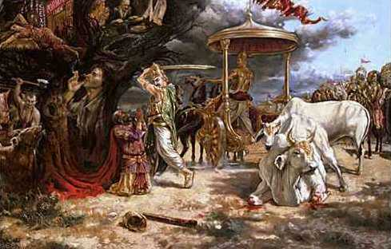

Slide 45
References
HDG A.C. Bhaktivedanta Prabhupada purports
His Grace Maha Visnu Prabhuji – Bhakti Vaibhava lecture

Slide 46
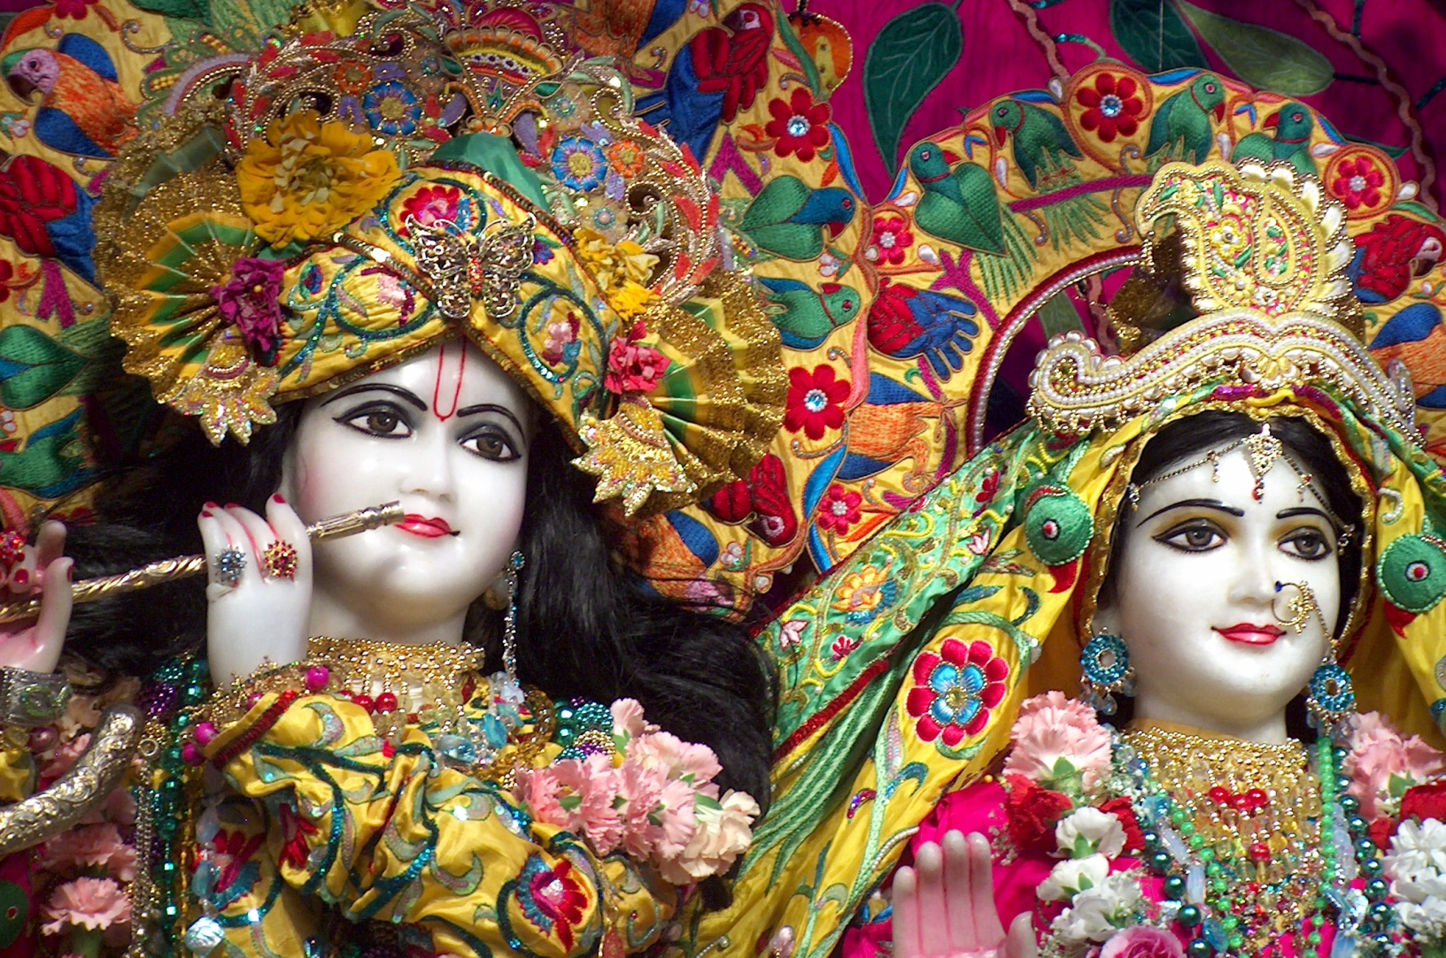
Hare Krishna

Slide 47
Prabhupada gave an example suppose we are in the middle of an ocean, being tossed by the waves, we know very well how deep the water could be in the middle of the ocean, it could be hundreds of meters or thousands of meters deep water, even just three meters water is enough to drown a human being. And we are in the middle of the ocean and the waves are tossing us, and let’s say even we are an expert swimmer still we will not be able to save ourselves, let alone saving others. So when a person in such a situation the only hope for him is, when there is an external help outside his own system. Otherwise however expert he may be, the ocean is too deep, the ocean is too vast, the waves are too powerful, the individual strength of a human being is very limited, he will not be able to cross over and reach the shore, it is simply not possible. This example is given in the Vedic literatures to explain our situation in the material world. As human beings, we may have sharp intelligence, but there is something known as the waves of tri-gunas that is acting on us, and these waves are very forceful, and the ocean of material existence which has these waves of rajo-guna, tamo-guna and sattva-guna, influence the mind, influence the intelligence, and influence the consciousness and one will not be able to figure out what is the reality? What is the real situation around us? Because these waves create a kind of an understanding for a person, that he will not be able to figure out, what is actually happening to him? Why he is here? What is the purpose? How he can come out of ignorance? And people can go on theorizing. That is why when philosophers come up with some different kinds of theories; we just see these are all people who are being lashed by the waves of material nature.
Notes:
Dhaumya family rishi of pandavas

Slide 48
And because a certain kind of a wave is affecting them, they have created a certain kind of a theory. And yet there is another person affected by another kind of a wave, and he creates another theory. So there will be different theories. But they will really miss out the real truth, and only way that they can understand reality, what is the real situation is they have to get help from outside of their system. They have to get help from outside of their body, mind, ego intelligence system, and that is called hearing Process. In hearing we shut away all our own misconceptions and say ‘now let me hear what the truth from an authorized source is’. So we need help from outside. Outside of our own system, and that is the process of receiving transcendental knowledge. We hear from outside of our system, this knowledge is actually coming from the spiritual world. It is being handed down by great spiritual masters, and that spiritual knowledge has to be served to us, and we must hear that, and that is the way of receiving the knowledge. It is not a mental concoction, it is not a creation of the mind, it is not a creation of someone’s intelligent brain, but it is hearing the spiritual knowledge coming from the spiritual platform. So that is why in the Bhagavatam and the Vedic tradition this hearing is so much emphasized, because that is our situation, we need help from outside of our system.
Notes:
Dhaumya family rishi of pandavas

Slide 49
In order to understand what we are, some great philosophers and thinkers in the world have come up with such great understanding, and some of their lives also demonstrate that, they were very concerned about others, compassion for others. But we see that from a transcendental point of view they are totally missing the real point. This is what happens when we don’t get knowledge from an external source, and we try to figure out our own solution. A man in the ocean he tries to figure out his own solution, how he can cross the ocean of ignorance and try to reach the shore of knowledge, he simply cannot, that is our position. This is a very important understanding and only one who has understood this will stop all speculation and prepare himself to receive knowledge from transcendental sources. So hearing is very important, here Srila Prabhupada has used several times an important word in Italics. Ardent hearing from the bona fide master is the only way to receive transcendental knowledge, and there is no need for medical performances or occult mysticism for the miraculous effects. So ardent hearing from the bona fide master is the process.
Ardent student means a student who is characterized by strong enthusiasm. Someone who is very enthusiastic to hear, to learn, to understand what the truth is, such a student is an ardent student. It is not some kind of a ritualistic, mechanical, uninterested kind of an activity, but it has to be an activity filled with enthusiasm.
Another aspect of ardent hearing is that there should be a burning fire in the heart, that I must know, I must understand. If that burning fire is not there, then there is no enthusiasm, there is no fire. We see this so much demonstrated in the life of Srila Prabhupada. At the age of sixty most people retire. Prabhupada was seventy plus and still he was full of enthusiasm to carry out the mission of his spiritual master. So that burning fire, wanting to serve the Lord, the mission of the Lord, I must understand this knowledge, that burning fire is very essential. Actually materialists have this burning fire. You see a lot of indications, lot of examples of materialists having this kind of a fire.
Notes:
Dhaumya family rishi of pandavas

Slide 50
Quotes on Parikshit Maharaj
1) Maharaja Parikshit was the Emperor of the world and all the seas and oceans, and he did not have to take the trouble to acquire such a kingdom by his own effort. He inherited it from his grandfathers Maharaja Yudhishthira and brothers. Besides that, he was doing well in the administration and was worthy of the good names of his forefathers. Consequently there was nothing undesirable in his opulence and administration. - Srimad-Bhagavatam 1.4.10 Purport
2) Maharaja Parikshit was a pious king. He conquered his enemies, and therefore the kingdom was full of prosperity. There was enough milk, grains and metals, and all the rivers and mountains were full of potency. - Srimad-Bhagavatam 1.4.11 Purport
3) The womb of Uttara, mother of Maharaja Parikshit, was spoiled by the dreadful and invincible brahmastra weapon released by Ashvatthama. But Maharaja Parikshit was saved by the Supreme Lord. - Srimad-Bhagavatam 1.12.1 Translation
4) Emperor Parikshit was a worthy king, and therefore all were happy during his reign. - Srimad-Bhagavatam 1.4.12 Purport
5) When Maharaja Parikshit was ruling the world as the King of Bharata-varsha, he chastised the personality of Kali. - Srimad-Bhagavatam 1.7.8 Purport
6) Maharaja Parikshit was not only a great kshatriya emperor, but also a great devotee of the Lord. - Srimad-Bhagavatam 1.12.12 Purport
7) The child Parikshit was saved by the all-powerful and all-pervasive Vishnu (Lord Krishna) for two reasons. The first reason is that the child in the womb of his mother was spotless due to his being a pure devotee of the Lord. The second reason is that the child was the only surviving male descendant of Puru, the pious forefather of the virtuous King Yudhishthira. - Srimad-Bhagavatam 1.12.16 Purport
8) The brahmastra, which was thrown by Ashvatthama at the child Parikshit, was certainly supernaturally powerful, and nothing of the material world could resist its force of penetration. But the all-powerful Lord, who is present everywhere, within and without, could counteract it by His all-powerful potency just to save a bona fide servant of the Lord and descendant of another devotee, Maharaja Yudhishthira, who was always obliged by the Lord by His causeless mercy. - Srimad-Bhagavatam 1.12.16 Purport
9) Only Vishnu and the devotees of Vishnu can give protection to all, and because Maharaja Parikshit was himself protected by Vishnu, it was quite possible for him to give complete protection to all who wanted to live under his rule. - Srimad-Bhagavatam 1.12.23 Purport
10) The total land on the earth bordered by the seas was under the subjugation of the King of Hastinapura. Maharaja Yudhishthira trained his grandson, Maharaja Parikshit, who was equally qualified, in state administration in terms of the king's obligation to the citizens. Thus Parikshit was enthroned on the seat of Maharaja Yudhishthira prior to his departure back to Godhead. - Srimad-Bhagavatam 1.15.38 Purport

