Slide 1
Lord Krsna’s entrance into Dvaraka
SB 1.11.11-22

Slide 2
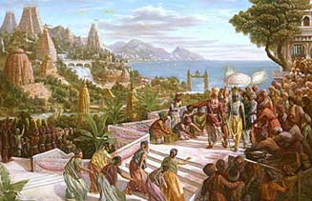
SB 1.11.11-12
Dvaraka city designed to develop finer qualities

Slide 3
1.11.11
madhu-bhoja-dasarharha
kukurandhaka-vrsnibhih
atma-tulya-balair guptam
nagair bhogavatim iva
“As Bhogavati, the capital of Nagaloka, is protected by the Nagas, so was Dvaraka protected by the descendants of Vrsnis – Bhoja, Madhu, Dasarha, Arha, Kukura, Andhaka – etc.- who were as strong as Lord Krsna.”

Slide 4
The city of Dvaraka was well protected by the descendants of Vrsni, who were as powerful as the Lord
The strength of was invested by the Lord to protect them
Analogy : Nagaloka protected by the Nagas

Slide 5
1.11.12
sarvatu-sarva-vibhava-
punya-vrksa-latasramaih
udyanopavanaramair
vrta-padmakara-sriyam
“The city of Dvarakapuri, was filled with opulences of all seasons. There were hermitages, orchards, flower gardens, parks and reservoirs of water breeding lotus flowers all over.”

Slide 6
Description of Dvaraka
The purpose of Vedic Culture was to provide an environment conducive to the development of the finer sentiments of human life, especially devotional service
All aspects of the Vedic society were nourishing to the elevation of the consciousness
Comparison with the modern day city
Because of Krsna’s presence in Dvaraka, everything was opulent

Slide 7
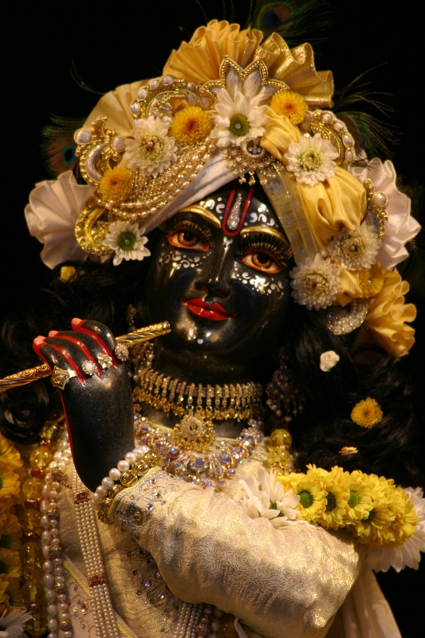
Krsna : Decorator of the qualities in His devotees
Good qualities come automatically while rendering devotional service
Krsna decorates His devotees with finer qualities as an act of His loving dealing
Propellant – Desire to please Krsna
Good qualities naturally create a good environment to practice Bhakti

Slide 8
1.11.13-15
Arrangements made to receive the Lord

Slide 9
1.11.13
gopura-dvara-margesu
krta-kautuka-toranam
citra-dhvaja-patakagrair
antah pratihatatapam
“The city gateway, the household doors and festooned arches along the roads were all nicely decorated with festive signs like plantain trees and mango leaves, all to welcome the Lord. Flags, garlands, and painted signs and slogans all combined to shade the sunshine.”

Slide 10
1.11.14
sammarjita-maha-marga-
rathyapanaka-catvaram
siktam gandha-jalair uptam
phala-puspaksatankuraih
“The highways, subways, lanes, markets and public meeting places were all thoroughly cleansed and then moistened with scented water. And to the welcome the Lord, fruits, flowers and unbroken seeds were strewn everywhere.”

Slide 11
1.11.15
dvari dvari grhanam ca
dadhy-aksata-phaleksubhih
alankrtam purna-kumbhair
balibhir dhupa-dipakaih
“In each and every door of the residential houses, auspicious things like curd, unbroken fruits, sugarcane and full waterpots with articles for worship, incense and candles were all displayed.”

Slide 12
Welcoming the Lord in our heart
Anarthas – blocking factor
Preparing our heart for Krsna to enter
- Chanting the Holy Names sincerely
- Krsna Katha
- Humility
- Gratitude – the currency of Bhakti
Heart is like wax
Chant with great intent – make your heart an inviting place for the Lord to appear

Slide 13
Mood of service – no question of separation
Parallel : Lord Ram’s return to Ayodhya
SB 9.10.35-38: When Lord Bharata understood that Lord Rāmacandra was returning to the capital, Ayodhyā, He immediately took upon His own head Lord Rāmacandra's wooden shoes and came out from His camp at Nandigrāma. Lord Bharata was accompanied by ministers, priests and other respectable citizens, by professional musicians vibrating pleasing musical sounds, and by learned brāhmaṇas loudly chanting Vedic hymns. Following in the procession were chariots drawn by beautiful horses with harnesses of golden rope. These chariots were decorated by flags with golden embroidery and by other flags of various sizes and patterns. There were soldiers bedecked with golden armor, servants bearing betel nut, and many well-known and beautiful prostitutes. Many servants followed on foot, bearing an umbrella, whisks, different grades of precious jewels, and other paraphernalia befitting a royal reception. Accompanied in this way, Lord Bharata, His heart softened in ecstasy and His eyes full of tears, approached Lord Rāmacandra and fell at His lotus feet with great ecstatic love.
More intense the sense of separation, more deeper the sense of union

Slide 14
1.11.16-17
The Real Thing to Hear About

Slide 15
1.11.16-17
nisamya prestham ayantam
vasudevo maha-manah
akruras cograsenas ca
ramas cadbhuta-vikramah
pradyumnas carudenas ca
sambo jambavati-sutah
praharsa-vegocchasita-
sayanasana-bhojanah
“On hearing that the most dear Krsna was approaching Dvarakadhama, magnanimous Vasudeva, Akrura, Ugrasena, Balarama (the superhumanly powerful), Pradyumna, Carudesna and Samba the son of Jambavati, all extremely happy, abandoned resting, sitting and dining.”

Slide 16
The only real thing is to hear about Krsna
Hearing brings about the transformation in consciousness
Parikshit Maharaj – perfection by hearing
Faithful hearing, recalling to memory and application – gradual detachment from illusory position and attachment to spiritual instructions

Slide 17
GREAT PERSONALITIES IN KRSNA LILA

Slide 18
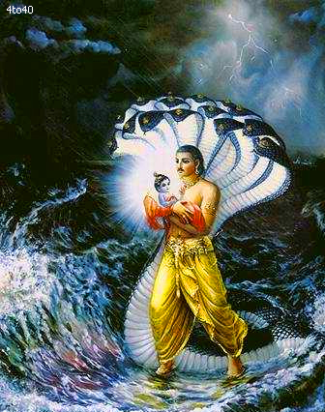
Vasudeva
Son of King Surasena, husband of Devaki and father of Lord Sri Krsna
Brother of Kunti and father of Subhadra
Appointed minister of Ugrasena and later on married Devaki
Took active part in the purificatory process of the Pandavas
Transferred Krsna to the house of Nanda Maharaj

Slide 19
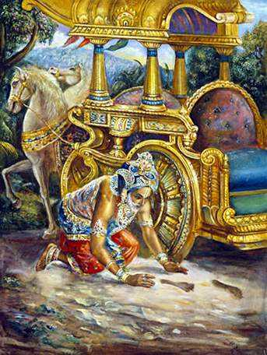
Akrura
Commander-in-chief of the Vrsni dynasty
Attained success in devotional service to the Lord by one single process of offering prayers
Supported Arjuna when Arjuna took Subhadra forcibly away by the will of Krsna
Present when Abhimanyu was married to Uttara

Slide 20
Ugrasena
Grandfather of Lord Krsna
Fought against Salva and repulsed the enemy
Heard from Narada Muni about the divinity of Lord Krsna
Ugrasena was entrusted with the iron lump produced from the womb of Samba

Slide 21
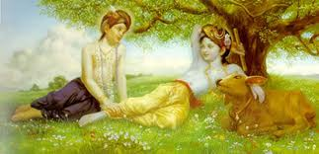
Baladeva
Divine son of Vasudeva and Rohini
Plenary manifestation of the Supreme Lord
As powerful as Lord Krsna, and can bestow spiritual power to the devotees (Baladeva)
No can know the Supreme Lord without being favored by Baladeva

Slide 22
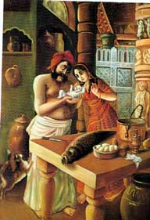
Pradyumna
Incarnation of Kama-deva
Son of Lord Krsna and Srimati Rukmini
Defeated Salva
One of the four plenary expansions of Lord Krsna
He inquired from his father about the glories of the brahmana

Slide 23
Carudesna
Another son of Lord Krsna and Srimati Rukmini
Present during the svayamvara ceremony of Draupadi
Great warrior like his father and brothers

Slide 24
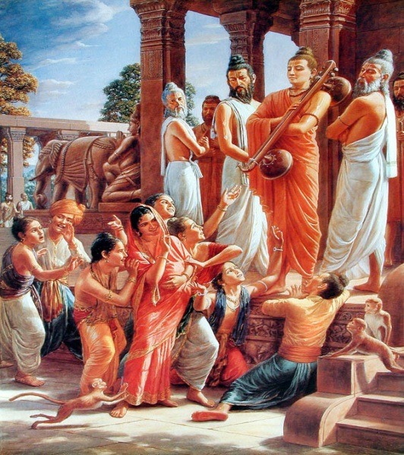
Samba
Son of Lord Krsna by His wife Jambavati
Learnt the military art of throwing arrows from Arjuna
Present during Asvamedha Yajna performed by Yudhistira
Delivered a large lump of iron which was the cause of destruction of Yadu dynasty

Slide 25
1.11.18-20
Welcoming the Lord

Slide 26
1.11.18
varanendram puraskrtya
brahmanaih sasumangalaih
sankha-turya-ninadena
brahma-ghosena cadrtah
pratyujjagmu rathair hrstah
pranayagata-sadhvasah
“They hastened towards the Lord on chariots with brahmanas bearing flowers. Before them were elephants, emblems of good fortune. Conch shells and bugles were sounded, and Vedic hymns were chanted. Thus they offered their respects, which were saturated with affection.”

Slide 27
The Vedic view of receiving a great personality creates an atmosphere of respect, which is saturated with affection and veneration for the person received.
Auspicious atmosphere of such a reception depends on the paraphernalia mentioned here
Main ingredient : Genuine affection, love and respect
Such a program of reception is full of sincerity, on the part of both the receiver and the received.

Slide 28
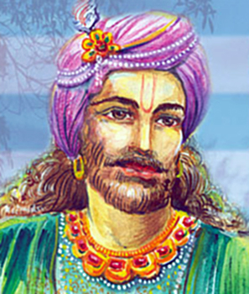
Proper Method of Receiving Sadhus
Reception of Vidura upon his return from Pilgrimage (Canto 1, Chapter 13)
One of the themes for the entire First Canto is the “Reception of a Sadhu”
Very important is the cultural point of receiving a guest properly

Slide 29
1.11.19
varamukhyas ca sataso
yanais tad-darsanotukah
lasat-kundala-nirbhata-
kapola-vadana-sriyah
“At the same time, many hundreds of well-known prostitutes began to proceed on various vehicles. They were all very eager to meet the Lord, and their beautiful faces were decorated with dazzling earrings, which enhanced the beauty of their foreheads.”

Slide 30
Anybody can engage in devotional service to the Lord
Bilvamangala Thakur and Cintamani
BG 9.32 – In the path of devotional service there are no impediments due to degraded birth and occupation
Only reformation that is necessary for the present day world is to make an organized effort to turn the citizens into devotees of the Lord.

Slide 31
Seeing Krsna face to face
If we do not learn to see Krsna face to face, all else we see is illusion
“Seeing the Lord” – only when mind has no distraction and 100% connected with the Lord
Seeing the Lord is “NOT” on the platform of the material senses
Krsna makes Himself visible in the devotee’s heart – act of His will and descending mercy
We “CAN” see the Lord with these eyes, if He bestows His karunya sakti upon us.

Slide 32
Brhad Bhagavatamrta – Sage Pippalayana’s instructions to Gopa Kumara
Attempting to see the Supreme with one’s material eyes is useless – Supreme Lord outside the scope of the activity of the senses
Direct vision of Lord Hari with one’s eyes takes place in the heart
What can bring us to the stage of seeing the Lord face-face? Primary qualification is firm faith in the intrinsic capacity of the chanting process
Lord is the embodiment of bliss – seeing Him brings the greatest joy.

Slide 33
One perceives the Lord by the process of hearing and chanting and receives joy through 3 agents – mind, ears and tongue
Devotional service better than the meditation process. Eg. Maitreya Muni, Prahlad

Slide 34
1.11.20
nata-nartaka-gandharvah
suta-magadha-vandinah
gayanti cottamsloka-
caritany adbhutani ca
“Expert dramatists, artists, dancers, singers, historians, genealogists and learned speakers all gave their respective contributions, being inspired by the superhuman pastimes of the Lord. Thus they proceeded on and on.”

Slide 35
1.11.21-22
Lord Krsna’s loving reciprocation

Slide 36
1.11.21
bhagavams tatra bandhunam
pauranam anuvartinam
yatha-vidhy upasangamya
sarvesam manam adadhe
“Lord Krsna, the Personality of Godhead, approached them and offered due honor and respect to each and every one of the friends, relatives, citizens, and all others who came to receive and welcome Him.”

Slide 37
Lord’s reciprocation is unique and personal
Brhad Bhagavatamrta – Narada Muni’s instructions to Gopa Kumar
Most amazing quality of Krsna – the “MAXIMUM” mercy which a devotee can accept is what Krsna gives him/her. Krishna never holds back His mercy from any person.
Why does Krsna not give the same most excellent kind of happiness to all His devotees?
Krsna gives what we desire.
BG 4.11 – Krsna reciprocates according to our surrender
Krsna satisfies everyone in terms of one’s development of spiritual consciousness, and a sample of such reciprocation is exhibited here with His different welcomers.

Slide 38
1.11.22
prahvabhivadanaslesa
kara-sparsa-smiteksanaih
asvasya casvapakebhyo
varais cabhimatair vibhuh
“The Almighty Lord greeted everyone present by bowing His head, exchanging greetings, embracing, shaking hands, looking and smiling, giving assurances and awarding benedictions, even to the lowest in rank.”

Slide 39
BG 3.21 – Lord is exemplary
Living entities are graded differently in terms of contamination of material modes of nature – but Lord is equally affectionate to all His parts and parcels

Slide 40
Summary
If we do not learn to see Krsna face to face, all else we see is illusion
The Lord’s loving exchanges are not mundane, but under the internal potencies
One who is not yet pure can achieve spiritual vision and see Krsna through chanting His name and taking shelter of Him as his only protector
Even today, the Lord can be seen by all in His arca form in temples. These forms will draw affection from every living being capable of giving affection, as the Lord drew affection from the residents of Dvaraka who saw Him everyday
We should understand that no soul can be satisfied unless he attains some position in the Lord’s service, and that the Lord appeared to attract the living entities into taking part in such relationships as the one’s He displayed in Dvaraka with His different relatives

Slide 41
References
www.romapadaswami.com
Lectures of HH Romapada Maharaj on these verses
Causeless mercy of the Vaishnavas

