Slide 1
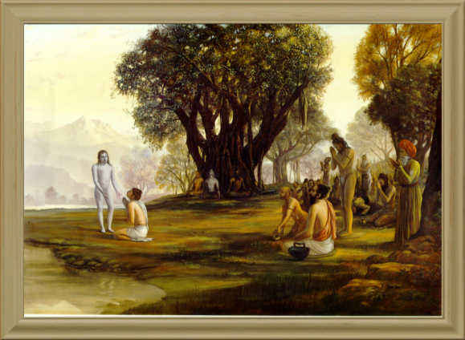
Srimad Bhagavatam
1.11.23 – 1.11.29
Devotees attraction to the Lord & The Lord’s reciprocation

Slide 2
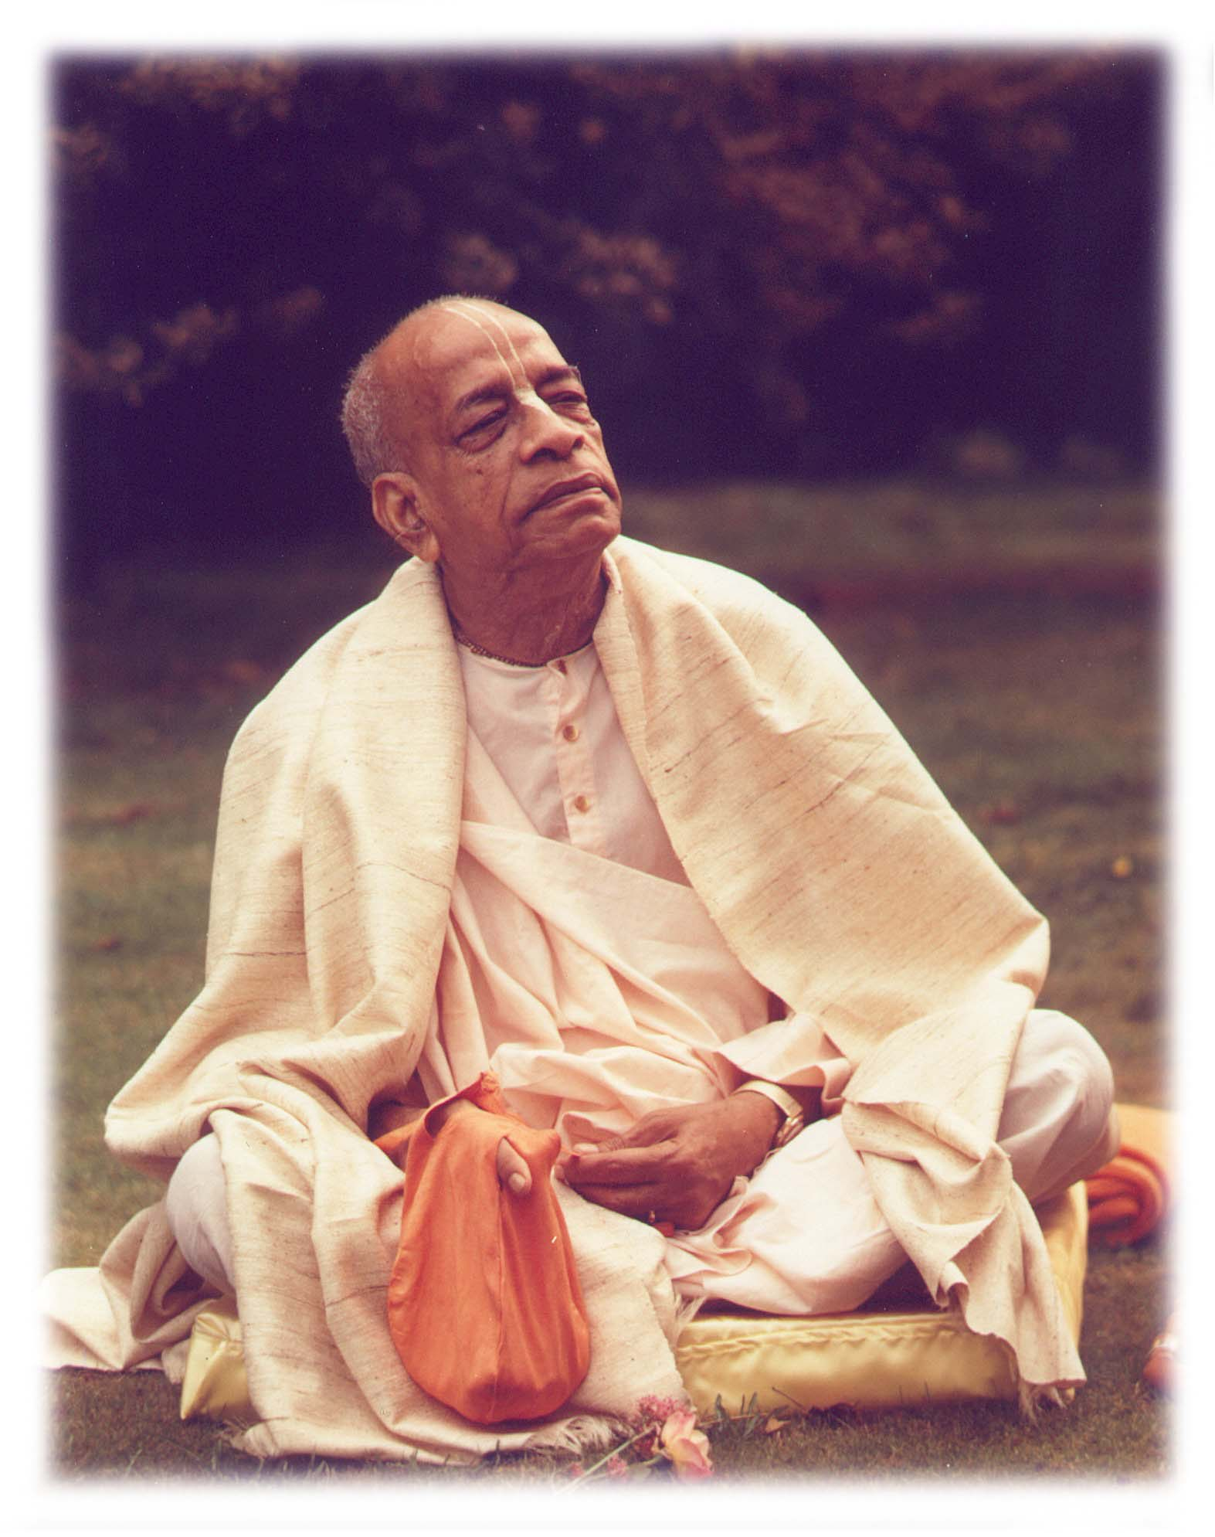
Based on the teachings of His Divine Grace A.C. Bhaktivedanta Swami Prabhupada
Founder Acharya
International Society for Krishna Consciousness

Slide 3
Seeking the Blessings of Guru, Gauranga & All the Assembled Vaishnavas

Slide 4
Lord Kṛṣṇa's Entrance into Dvārakā

Slide 5
Devotees attraction to the Lord & The Lord’s reciprocation
1.11.23- 25: Devotees attraction towards the Lord
1.11.26- 27: Reason for the attraction
1.11.28- 29: The Lord’s reciprocation

Slide 6
Śrīmad Bhāgavatam 1.11.23
svayaḿ ca gurubhir vipraiḥ
sadāraiḥ sthavirair api
āśīrbhir yujyamāno 'nyair
vandibhiś cāviśat puram
Translation
Then the Lord personally entered the city accompanied by elderly relatives and invalid brāhmaṇas with their wives, all offering benedictions and singing the glories of the Lord. Others also praised the glories of the Lord.

Slide 7
SB 1.11.23 Chanting the glories of the Lord Important Points from Purport
The brāhmaṇas in society were never attentive to banking money for future retired life. When they were old invalids, they used to approach the assembly of the kings, and simply by praising the glorious deeds performed by the kings, along with their wives, they would be provided with all necessities of life.
Such brāhmaṇas were not, so to speak, flatterers of the kings, but the kings were actually glorified by their actions, and they were sincerely still more encouraged in pious acts by such brāhmaṇas in a dignified way.
Lord Śrī Kṛṣṇa is worthy of all glories, and the praying brāhmaṇas and others were glorified themselves by chanting the glories of the Lord.

Slide 8
Śrīmad Bhāgavatam 1.11.24
rāja-mārgaḿ gate kṛṣṇe
dvārakāyāḥ kula-striyaḥ
harmyāṇy āruruhur vipra
tad-īkṣaṇa-mahotsavāḥ
Translation
When Lord Kṛṣṇa passed over the public roads, all the ladies from the respectable families of Dvārakā went up to the roofs of their palaces just to have a look at the Lord. They considered this to be the greatest festival.

Slide 9
SB 1.11.24 – Everyday is a festival Important Points from Purport
What is a great festival?
To Look at the Transcendental form of the Lord
Ladies of Dwaraka
Even now in India Ladies follow during Festivals in temples
How to have a great festival everyday?
By looking at the Diety form of the Lord in the temple
Importance of Arca-Vigraha
Non-different from the transcendental personal form of the Lord.
Expanded by His internal potency to facilitate DS in the material world.
Why does the Lord descend in the Arca-Vigraha form?
The material senses cannot perceive the spiritual nature of the Lord, hence the Lord accepts the arca-vigraha, which is apparently made of material elements like earth, wood and stone
Does this mean the Lord is materially contaminated?
No material contamination. Because the Lord is kaivalya (one alone), no matter in Him, He is one without a second. Hence the Almighty Lord can appear in any form without being contaminated by the material conception.
Hence Acharyas install the Dieties in the Temple to benefit common population
Srila Prabhupada & His disciples

Slide 10
SB 1.11.24 – Everyday is a festival Important Points from Purport contd…
Glorious Vedic Culture
Prosperity of Dvaraka
Ladies behavior
To maintain respectability ladies did not mix with the crowd on the street,
There was no artificial equality with the man.
Female respectability is preserved more elegantly by keeping the woman separate from the man.
The sexes should not mix unrestrictedly.
Lessons for us
Importance of conducting Festivals
Vaishnava Etiquette

Slide 11
Śrīmad Bhāgavatam 1.11.25
nityaḿ nirīkṣamāṇānāḿ
yad api dvārakaukasām
na vitṛpyanti hi dṛśaḥ
śriyo dhāmāńgam acyutam
TRANSLATION
The inhabitants of Dvārakā were regularly accustomed to look upon the reservoir of all beauty, the infallible Lord, yet they were never satiated.

Slide 12
SB 1.11.25 – Devotional Service is unlimited Important Points from Purport
Ladies of Dvaraka were very eager to look at the beautiful form of the Lord as if they were seeing for the First time.
Law of Satiation
Works in the material realm but not in Spiritual realm.
Significance of the word “Acyuta” – Infallible
The Lord is Acyuta as He is infallible whereas the living entities are fallible
The Lord is not under the modes of nature where as the living entities are
Why devotees are not satiated looking at the Lord’s form?
Lord is the reservoir of all beauties beyond our experience.
No one, therefore, is satiated by seeing the transcendental body of the Lord because there are always manifestations of newer and newer beauties.
The transcendental name, form, qualities, entourage, etc., are all spiritual manifestations,
there is no satiation in chanting the holy name of the Lord,
there is no satiation in discussing the qualities of the Lord,
and there is no limitation of the entourage of the Lord. He is the source of all and is limitless.

Slide 13
Śrīmad Bhāgavatam 1.11.26
śriyo nivāso yasyoraḥ
pāna-pātraḿ mukhaḿ dṛśām
bāhavo loka-pālānāḿ
sārańgāṇāḿ padāmbujam
Translation
The Lord's chest is the abode of the goddess of fortune. His moonlike face is the drinking vessel for eyes which hanker after all that is beautiful. His arms are the resting places for the administrative demigods. And His lotus feet are the refuge of pure devotees who never talk or sing of any subject except His Lordship.

Slide 14
SB 1.11.26 – How the Lord attracts important Points from Purport
Four types of attractions
Wealth – Chest
abode of Goddess of Fortune
Lord is being served by thousands of Goddesses of fortune
Lord is always served with all reverence by thousands and thousands of goddesses of fortune at the cintāmaṇi-dhāma,* the transcendental abode of the Lord where the trees are all desire trees and the buildings are made of touchstone. The Lord Govinda is engaged there in herding the surabhi cows as His natural occupation. These goddesses of fortune can be seen automatically if we are attracted by the bodily features of the Lord.
The impersonalists cannot observe such goddesses of fortune because of their dry speculative habit.

Slide 15
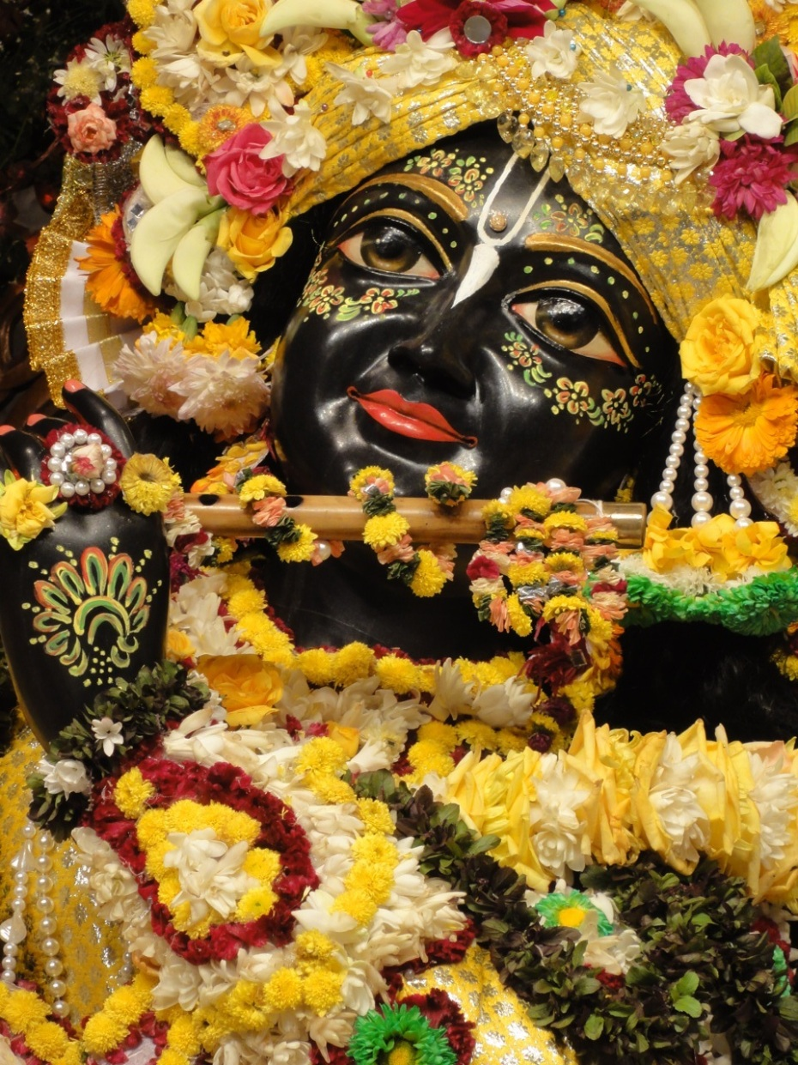
SB 1.11.26 – How the Lord attracts important Points from Purport
Beauty – Moonlike face
And those who are artists, overtaken by the beautiful creation, should better see to the beautiful face of the Lord for complete satisfaction.
The face of the Lord is the embodiment of beauty.
Beautiful nature is His smile,
Sweet songs of the birds are specimens of the whispering voice of the Lord.

Slide 16
SB 1.11.26 – How the Lord attracts important Points from Purport
Strength – Arms
There are administrative demigods in charge of departmental service of cosmic management, and there are tiny administrative gods in the state service.
They are always afraid of other competitors, but if they take shelter of the arms of the Lord, the Lord can protect them always from the attacks of enemies.
A faithful servant of the Lord engaged in the service of administration is the ideal executive head and can well protect the interest of the people in general. Other so-called administrators are symbols of anachronisms leading to the acute distress of the people who are governed by them.
The administrators can remain safely under the protection of the arms of the Lord.

Slide 17
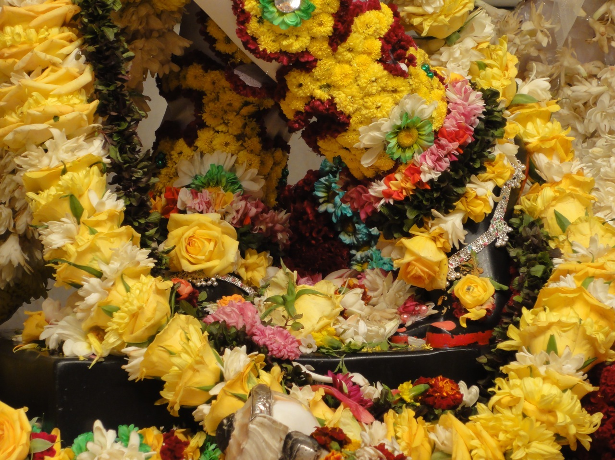
SB 1.11.26 – How the Lord attracts important Points from Purport
Shelter – Lotus Feet
The essence of everything is the Supreme Lord: He is called the sāram.
And those who sing and talk about Him are called the sārańgas, or the pure devotees.
The pure devotees are always hankering after the lotus feet of the Lord. The lotus has a kind of honey which is transcendentally relished by the devotees. They are like the bees who are always after the honey.
Śrīla Rūpa Gosvāmī, the great devotee ācārya of the Gauḍīya-Vaiṣṇava-sampradāya, has sung a song about this lotus honey, comparing himself to the bee:

Slide 18
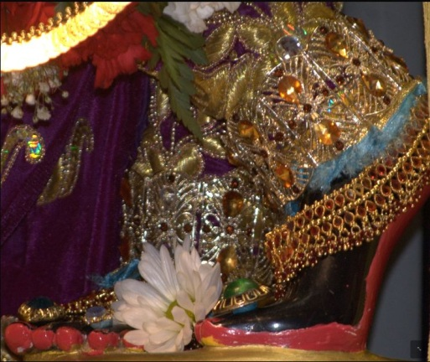
SB 1.11.26 – How the Lord attracts important Points from Purport
"O my Lord Kṛṣṇa, I beg to offer my prayers unto You. My mind is like the bee, and it is after some honey. Kindly, therefore, give my bee-mind a place at Your lotus feet, which are the resources for all transcendental honey. I know that even big demigods like Brahmā do not see the rays of the nails of Your lotus feet, even though they are engaged in deep meditation for years together. Still, O infallible one, my ambition is such, for You are very merciful to your surrendered devotees. O Mādhava, I know also that I have no genuine devotion for the service of Your lotus feet, but because Your Lordship is inconceivably powerful, You can do what is impossible to be done. Your lotus feet can deride even the nectar of the heavenly kingdom, and therefore I am very much attracted by them. O supreme eternal, please, therefore, let my mind be fixed at Your lotus feet so that eternally I may be able to relish the taste of Your transcendental service."
The devotees are satisfied with being placed at the lotus feet of the Lord
and have no ambition to see His all-beautiful face or
aspire for the protection of the strong arms of the Lord.
They are humble by nature, and the Lord is always leaning towards such humble devotees.

Slide 19
Śrīmad Bhāgavatam 1.11.27
sitātapatra-vyajanair upaskṛtaḥ
prasūna-varṣair abhivarṣitaḥ pathi
piśańga-vāsā vana-mālayā babhau
ghano yathārkoḍupa-cāpa-vaidyutaiḥ
Translation
As the Lord passed along the public road of Dvārakā, His head was protected from the sunshine by a white umbrella. White feathered fans moved in semicircles, and showers of flowers fell upon the road. His yellow garments and garlands of flowers made it appear as if a dark cloud were surrounded simultaneously by sun, moon, lightning and rainbows.

Slide 21
SB 1.11.27 – How the Lord attracts important Points from Purport
The sun, moon, rainbow and lightning do not appear in the sky simultaneously. When there is sun, the moonlight becomes insignificant, and if there are clouds and a rainbow, there is no manifestation of lightning. The Lord's bodily hue is just like a new monsoon cloud. He is compared herein to the cloud. The white umbrella over His head is compared to the sun. The movement of the bunch-hair fan of flukes is compared to the moon. The showers of flowers are compared to the stars. His yellow garments are compared to the rainbow.
So all these activities of the firmament, being impossible simultaneous factors, cannot be adjusted by comparison. The adjustment is possible only when we think of the inconceivable potency of the Lord.
The Lord is all-powerful, and in His presence anything impossible can be made possible by His inconceivable energy.
But the situation created at the time of His passing on the roads of Dvārakā was beautiful and could not be compared to anything besides the description of natural phenomena.

Slide 22
Śrīmad Bhāgavatam 1.11.28
praviṣṭas tu gṛhaḿ pitroḥ
pariṣvaktaḥ sva-mātṛbhiḥ
vavande śirasā sapta
devakī-pramukhā mudā
Translation
After entering the house of His father, He was embraced by the mothers present, and the Lord offered His obeisances unto them by placing His head at their feet. The mothers were headed by Devakī [His real mother].

Slide 23
SB 1.11.28 – Lords Reciprocation important Points from Purport
Vasudeva, the father of Lord Kṛṣṇa – lived in a separate residential quarters with his eighteen wives
Lord did not distinguish His real mother from His stepmothers, and He equally offered His obeisances unto all of them.
According to scriptures also, there are seven mothers: (1) the real mother, (2) the wife of the spiritual master, (3) the wife of a brāhmaṇa, (4) the wife of the king, (5) the cow, (6) the nurse, and (7) the earth.
All of them are mothers. Even by this injunction of the śāstras, the stepmother, who is the wife of the father, is also as good as the mother because the father is also one of the spiritual masters.
Lord Kṛṣṇa, the Lord of the universe, plays the part of an ideal son just to teach others how to treat their stepmothers.

Slide 24
Śrīmad Bhāgavatam 1.11.29
tāḥ putram ańkam āropya
sneha-snuta-payodharāḥ
harṣa-vihvalitātmānaḥ
siṣicur netrajair jalaiḥ
Translation
The mothers, after embracing their son, sat Him on their laps. Due to pure affection, milk sprang from their breasts. They were overwhelmed with delight, and the tears from their eyes wetted the Lord.
Purport
When Lord Kṛṣṇa was at Vṛndāvana even the cows would become moistened by affection towards Him, and He would draw milk from the nipples of every affectionate living being, so what to speak of the stepmothers who were already as good as His own mother.

Slide 25
SB 1.11.29 – Lords Reciprocation Cont… important Points from Purport
Vasudeva, the father of Lord Kṛṣṇa – lived in a separate residential quarters with his eighteen wives
Lord did not distinguish His real mother from His stepmothers, and He equally offered His obeisances unto all of them.
According to scriptures also, there are seven mothers: (1) the real mother, (2) the wife of the spiritual master, (3) the wife of a brāhmaṇa, (4) the wife of the king, (5) the cow, (6) the nurse, and (7) the earth.
All of them are mothers. Even by this injunction of the śāstras, the stepmother, who is the wife of the father, is also as good as the mother because the father is also one of the spiritual masters.
Lord Kṛṣṇa, the Lord of the universe, plays the part of an ideal son just to teach others how to treat their stepmothers.

Slide 26
References
Rompadaswami.com http://www.romapadaswami.com/taxonomy/term/1299?page=1
TKGTM http://tkgtm.com/listen/listen_1996_MP3.htm
ISKCON Desire Tree
http://audio.iskcondesiretree.info/index.php?q=s&sm=ff&s=SB+01-11-23&x=0&y=0
http://audio.iskcondesiretree.info/index.php?q=s&sm=ff&s=SB+01-11-24&x=0&y=0
http://audio.iskcondesiretree.info/index.php?q=s&sm=ff&s=SB+01-11-25&x=0&y=0
http://audio.iskcondesiretree.info/index.php?q=s&sm=ff&s=SB+01-11-26&x=0&y=0
http://audio.iskcondesiretree.info/index.php?q=s&sm=ff&s=SB+01-11-27&x=0&y=0
http://audio.iskcondesiretree.info/index.php?q=s&sm=ff&s=SB+01-11-28&x=0&y=0
http://audio.iskcondesiretree.info/index.php?q=s&sm=ff&s=SB+01-11-29&x=0&y=0

