Slide 1
The Prayers of the Ladies of Hastinapura, and Krishna Departs
Texts 1.10.27-36

Slide 2
Prayers before reciting SB
Om namah bhagavate vasudevaya
I offer my obeisances to the Supreme Personality of Godhead, Vasudeva.
narayanam namaskritya naram chaiva narottamam
devim sarasvatim vyasam tato jayam udirayet
Before reciting this Srimad-Bhagavatam, which is the very means of conquest, one should offer respectful obeisances unto the Personality of Godhead, Narayana, unto Nara-narayana Rishi, the supermost human being, unto Mother Sarasvati, the goddess of learning, and unto Srila Vyasadeva, the author. (Srimad-Bhagavatam 1.2.4)
Srnvatam sva-kathah krsnah punya-shravana-kirtanah
hridy antah stho hy abhadrani vidhunoti suhrit satam
Sri Krishna, the Personality of Godhead, who is the Paramatma in everyone's heart and the benefactor of the truthful devotee, cleanses desire for material enjoyment from the heart of the devotee who has developed the urge to hear His messages, which are in themselves virtuous when properly heard and chanted. (Srimad-Bhagavatam 1.2.17)
nashta-prayeshu abhadreshu nuyam bhagavata-sevaya
bhagavaty uttama-shloke bhaktir bhavati naishthiki
By regular attendance in classes on the Bhagavatam and by rendering service to the pure devotee, all that is troublesome to the heart is almost completely destroyed, and loving service unto the Personality of Godhead, who is praised with transcendental songs, is established as an irrevocable fact.

Slide 3
Chapter 10 so far
Lord Krsna stays with the Pandavas for a few months after Bhishma Deva’s departure and Maharaj Yudhishthira being coronated as the king
Thereafter He requests permission from the Pandavas to take their leave -the King gives Him permission.
The scene of the Lord’s departure is full of emotion all the royal ladies are feeling immense pain.
To get the last glimpse of the Lord they go to th top of the palace and offer Prayers

Slide 4
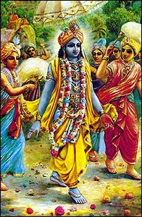
1.10.27
aho bata svar-yaśasas tiraskarī
kuśasthalī puṇya-yaśaskarī bhuvaḥ
paśyanti nityaḿ yad anugraheṣitaḿ
smitāvalokaḿ sva-patiḿ sma yat-prajāḥ
Undoubtedly it is wonderful that Dvārakā has defeated the glories of the heavenly
planets and has enhanced the celebrity of the earth. The inhabitants of Dvārakā are always seeing the soul of all living beings [Kṛṣṇa] in His loving feature. He glances at them and favors them with sweet smiles.

Slide 5
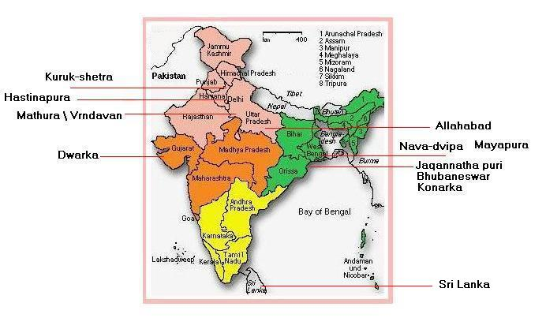
Summary of the purport
Usually the heavenly planets are celebrated places of enjoyment . People usually desire to go there.
However the earth has defeated their glories and become a celebrity because of the Lord’s pastimes in Vrindavan, Mathura and Dwarka all present on the earth.

Slide 6
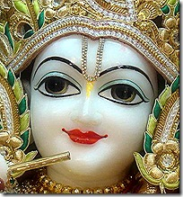
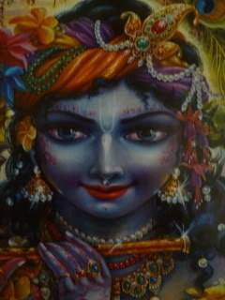
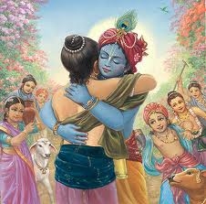
The Lord is the soul of all living beings, and He desires always to have all the living beings, in their svarūpa, in their constitutional position, to participate in transcendental life in His association. His attractive features and sweet smiles go deep into the heart of everyone, and once it is so done the living being is admitted into the kingdom of God, from which no one returns. This is confirmed in the Bhagavad-gītā.
…………..……. Because devotional service in these three places is magnified, those who go there to follow the principles in terms of instructions imparted in the revealed scriptures surely achieve the same result as obtained during the presence of Lord Śrī Kṛṣṇa. His abode and He Himself are identical, and a pure devotee under the guidance of another experienced devotee can obtain all the results, even at present.

Slide 7
Without the mercy of devotees there is no hope
Krishna’s glance and smiles can be experienced through mercy of His devotees.
Mercy is needed at every step of our devotional life
not just for initial connection in KC
Receiving mercy also means receiving guidance
Increase our meditation on how through the mercy of devotees little things have happened in our life
Chance to do a particular service
Guidance to do a particular service which is beyon our capacity
Their walking inspiration
Increase respect and gratitude → increased receptivity to receive from them
Deep relationships of sharing with devotees protect us from personal deviations in KC.
If we are unwilling to share our lives deeply with devotees we must search within as to what is blocking us?
Nava Yogendras to Maharaj Nimi :
SB 11.3.30: One should learn how to associate with the devotees of the Lord by gathering with them to chant the glories of the Lord. This process is most purifying. As devotees thus develop their loving friendship, they feel mutual happiness and satisfaction. And by thus encouraging one another they are able to give up material sense gratification, which is the cause of all suffering.

Slide 8
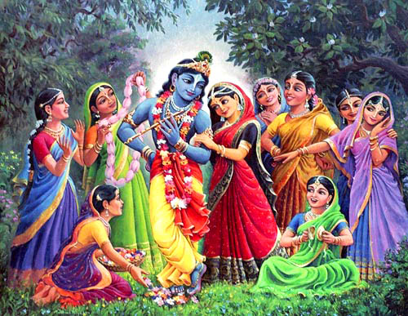
1.10.28
nūnaḿ vrata-snāna-hutādineśvaraḥ
samarcito hy asya gṛhīta-pāṇibhiḥ
pibanti yāḥ sakhy adharāmṛtaḿ muhur
vraja-striyaḥ sammumuhur yad-āśayāḥ
O friends, just think of His wives, whose
hands He has accepted. How they must
have undergone vows, baths, fire sacrifices and perfect worship of the Lord of the universe to constantly relish now the nectar from His lips [by kissing]. The damsels of Vrajabhūmi would often faint just by expecting such favors.
Notes:
Matajis thus extoll the fortune of other matajis the queens of Dwarka. Appreciation without envy – they understand their exalted position

Slide 9
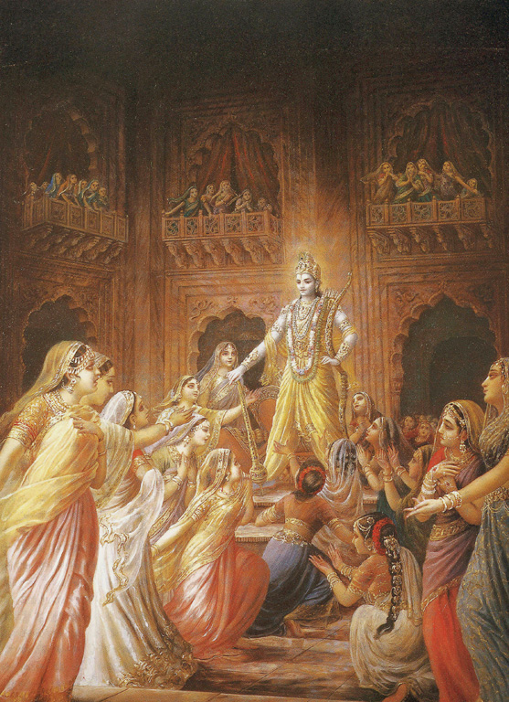
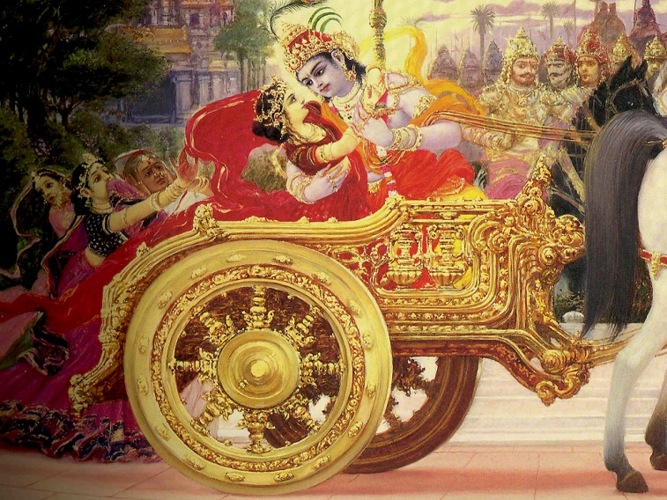
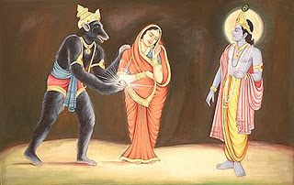
1.10.29
yā vīrya-śulkena hṛtāḥ svayaḿvare
pramathya caidya-pramukhān hi śuṣmiṇaḥ
pradyumna-sāmbāmba-sutādayo 'parā
yāś cāhṛtā bhauma-vadhe sahasraśaḥ
The children of these ladies are Pradyumna, Sāmba,
Amba, etc: Ladies like Rukmiṇī, Satyabhāmā and Jāmbavatī
were forcibly taken away by Him from their svayaḿvara ceremonies after He defeated many powerful kings, headed by Śiśupāla. And other ladies were also forcibly taken away by Him after He killed Bhaumāsura and thousands of his assistants. All of these ladies are glorious.
Notes:
Matajis thus extoll the fortune of other matajis the queens of Dwarka. Appreciation without envy – they understand their exalted position

Slide 10
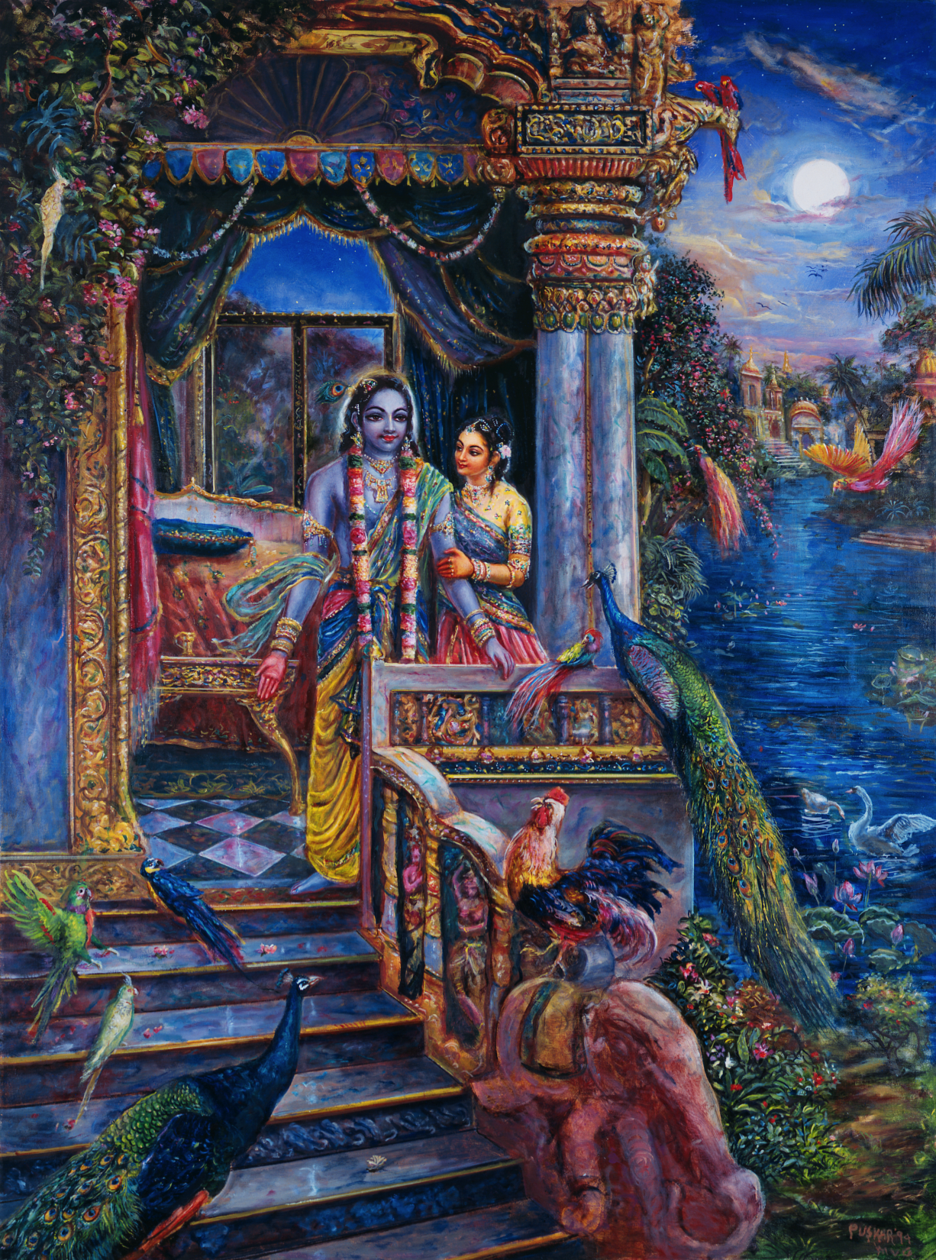
1.10.28,29,30
etāḥ paraḿ strītvam apāstapeśalaḿ
nirasta-śaucaḿ bata sādhu kurvate
yāsāḿ gṛhāt puṣkara-locanaḥ patir
na jātv apaity āhṛtibhir hṛdi spṛśan
All these women auspiciously glorified
their lives despite their being without
individuality and without purity.
Their husband, the lotus-eyed
Personality of Godhead never left them
alone at home. He always pleased
their hearts by making valuable
presentations.
Notes:
Matajis thus extoll the fortune of other matajis the queens of Dwarka. Appreciation without envy – they understand their exalted position

Slide 11
Important Points
The ladies of Hastinapura opened their prayers by detailing Krishna’s potency of creation, maintenance and annihilation.
WHY?
If one knows Krsna’s identity, he will not mistake Krsna’s intimate dealings in transcendental love for the lust experienced in the material realm
Thus we can appreciate these intimate loving exchanges between the Lord and His most qualified devotees, which so closely resemble the mundane reflection – the dealings between men and women of this world.
The ladies of Hastinapura praised the queens of Dwarka without any envy
They were happy for their lady friends from Dwarka
E.g flowers conscious of greatness of tulasi devi
HH Radhanath Maharaj: “It takes one, to know one”

Slide 12
Glorification of the Gopis
From Bhurijana Prabhu's lecture:
There is a mention of the Gopis and the mention of the queens - it looks like the Gopis are less fortunate than the Queens of Dwarka, but actually see what the verse is saying - the queens are so fortunate they are able to kiss Him so many times, that favor when the gopis even thought about that they would faint - what an incredible position of love they occupied. This is why Bhisma Dev glorified them just before he left- most exalted of Krishna's devotees. They would faint at the very thought of meeting Krishna at a lonely place

Slide 13
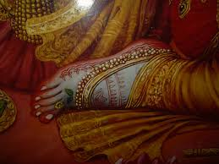
Greatness of the Queens of Dwarka
In 10th Canto Chapter 83 Draupadi meets Krishna’s queens in Dwarka and asks each of them about how they were married to the Lord. Each of the queens narrated their individual stories and glorified the Lord’s chivalry and how He reciprocated to their austerities and desires and at the end each said their prayer:
Sri Rukmini: ….. May I always be allowed to worship those feet of Lord Kṛṣṇa, the abode of Goddess Śrī.
SB 10.83.10: Śrī Jāmbavatī said: ………
I am simply the Lord's maidservant.
SB 10.83.11: Śrī Kālindī said: The Lord knew I was performing
severe austerities and penances with the hope of one day
touching His lotus feet. So He came to me in the company
of His friend and took my hand in marriage. Now I am engaged as a sweeper in His palace.
SB 10.83.12: Śrī Mitravindā said: …………May I be allowed to serve Him
by washing His feet, life after life.

Slide 14
Greatness of the Queens of Dwarka
SB 10.83.13-14: Śrī Satyā said: …………..Then He took me away with my maidservants
and a full army of four divisions, defeating all the kings who opposed Him along the road.
May I be granted the privilege of serving that Lord.
SB 10.83.15-16: Śrī Bhadrā said: ……………..My ultimate perfection is this: to always be allowed
to touch Lord Kṛṣṇa's lotus feet as I wander from life to life,
bound by my karma.
SB 10.83.39: Thus, by renouncing all material association
and practicing austere penances, we queens have all become
personal maidservants of the self-satisfied Supreme Lord.
SB 10.83.40: Rohiṇī-devi, speaking for the other queens, said: After killing Bhaumāsura and his followers, the Lord found us in the demon's prison and could understand that we were the daughters of the kings whom Bhauma had defeated during his conquest of the earth. The Lord set us free, and because we had been constantly meditating upon His lotus feet, the source of liberation from material entanglement, He agreed to marry us, though His every desire is already fulfilled.

Slide 15
Relationship with Krishna …….
The queens were firmly fixed in their relationship with Krishna and desired only more service to the Lotus feet of the Lord. The Lord being pleased with them reciprocated with their desires and thus they were able to serve the Lord’s lotus feet continuously
Who am I? – I am Krishna’s eternal servant
Who is Krishna? – Krishna is my eternal master
Prayer? – Krishna I am Yours, You are mine
I am yours – I am your eternal servant
You are mine – my relationship with You is mine

Slide 16
Develop our relationship with Krishna
In HH Mahavishnu Goswami’s words:
Sambandha – he is the Supreme Lord and I am His eternal servant
Abhideya – process to revive the relationship
Prayojana – experience that love through shelter
Thus he says:
Sambandha :
you are my only patih and you are the only gatih
Abhideya:
Therefore I have to focus my matih (Consciousness)
Prayojana
my matih will only be focused when there is ratih

Slide 17
Develop our relationship with Krishna
Therefore to invest our matih we have to develop ratih
Thus one pointed focus during sadhana stage is difficult because there is no love- we do things out of regulation.
What should we do to invest our matih and develop ratih ?
Shelter of the Lord’s Lotus Feet
Relationship with devotees
Chanting

Slide 18
Developing our relationship with Krishna

Slide 19
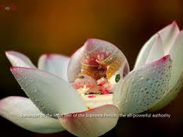
How to invest our matih?
The Lord’s Lotus Feet
Why are His feet called as Lotus Feet?
Krishna’s feet never leave the Lotus of Vraja Dhama
Lotus Petals are very soothing and soft similarly Krishna’s Feet are very beautiful, soothing and soft for the devotees
Meaning of taking shelter of the Lord’s Lotus feet
Physical Darshan
Humility
Want to serve Krishna , become a servant of Krishna and His devotees, take a humble position and follow instructions
Qualification to take darshan of the Lotus Feet:
Strong Attachment to hearing and chanting
Non- enviousness
What to do if there is envy?
Just hold on to the Holy Name(we will be cured like Kaliya)
How to meditate on the Lord’s Lotus feet?
Physically- step by step from feet to face
Following instructions of the Spiritual master
E.g Narayani Mataji says serving the toes of the Lotus Feet (4.22.39) means serving Srila Prabhupada

Slide 20
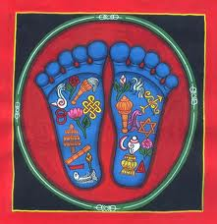
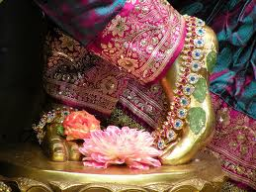
Nice verse about meditation on the Lord’s Lotus feet(11.3.40)
yarhy abja-nābha-caraṇaiṣaṇayoru-bhaktyā
ceto-malāni vidhamed guṇa-karma-jāni
tasmin viśuddha upalabhyata ātma-tattvaḿ
śākṣād yathāmala-dṛśoḥ savitṛ-prakāśaḥ
When one seriously engages in the devotional service of the Personality of Godhead, fixing the Lord's lotus feet within one's heart as the only goal of life, one can destroy the innumerable impure desires lodged within the heart as a result of one's previous fruitive work within the three modes of material nature. When the heart is thus purified one can directly perceive both the Supreme Lord and one's self as transcendental entities. Thus one becomes perfect in spiritual understanding through direct experience, just as one can directly experience the sunshine through normal, healthy vision.

Slide 21
How to invest our matih?
Relationship with Devotees:
Worship of Devotees is more dear to the Lord than worship of Himself
Krishna is a Person, Guru is a person
We cannot have a deep relationship with Guru and Krishna unless we can have deep relationship with devotees(Persons) around us
We cannot be personal with Guru and Krishna unless we are personal with the Devotees
We cannot have love for Krishna unless we have love for that which is Krishnas which means devotees.

Slide 22
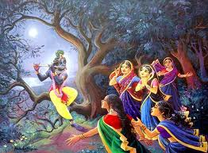
How to invest our matih?
Chanting:
tvayi me ’nanya-viṣayā matir madhu-pate ’sakṛt ratim udvahatād addhā gaṅgevaugham udanvati
O Lord of Madhu, as the Ganges forever flows to
the sea without hindrance, let my attraction be
constantly drawn unto You, without being divided
to anyone else.(1.8.42)
Attention during chanting should be
asakrt (continuous), no obstruction to develop ratih
E.g of Gopis in Sharad Purnima Pastime
Atleast during Japa time we must have the same
hankering and intensity as Kunti devi and as the Gopis – to keep Krishna’s pleasure as the top priority
If we cannot do it during rehearsals we cannot do it during the Final act
Just intellectually understanding our relationship with Krishna is not enough we have to aspire to be in that relationship constantly- at least during Japa time to begin with.
E.g of Radha Gopinath Pr- mind will go to where we feel sheltered
Sankirtana is like Rasa dance – each devotee is deeply meditating on Krishna and thinks Krishna is with them

Slide 23
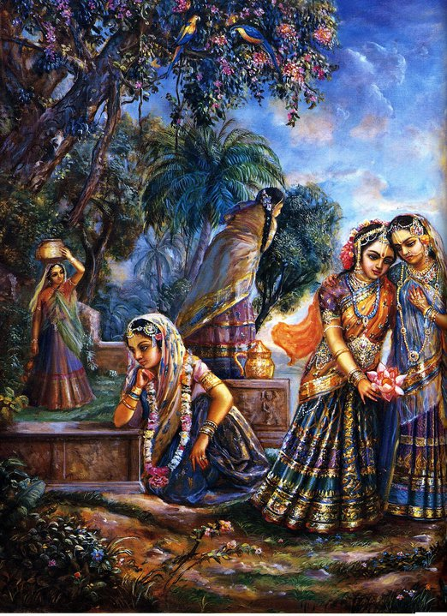
How to invest our matih?
Chanting:
Some visualizations for chanting:
Have same intensity that the Gopis have for Krishna
Filling gas before long journey,
umbilical cord only source of nourishment,
drowning person somebody throws a rope-
attentively holds the rope,
like fruity –
chanting is like the straw and you are sucking so that you can get the nectar-
If the straw is bent – then no nectar, similarly if mind goes somewhere we will not achieve the result
Calling on the cell phone- unlimited talk time with Krishna but if you have not charged your cellphone then when you need it the most then the phone will die on you.
If we chant with being conscious of our relationship with Krishna and for His pleasure then it will not remain a chore, it will become easy because it will become an act of love

Slide 24
1.10.31,32,33
evaḿvidhā gadantīnāḿ sa giraḥ pura-yoṣitām
Nirīkṣaṇenābhinandan sasmitena yayau hariḥ
While the ladies of the capital of Hastināpura were greeting Him and talking in this way, the Lord, smiling, accepted their good greetings, and casting the grace of His glance over them, He departed from the city.
ajāta-śatruḥ pṛtanāḿ gopīthāya madhu-dviṣaḥ
parebhyaḥ śańkitaḥ snehāt prāyuńkta catur-ańgiṇīm
Mahārāja Yudhiṣṭhira, although no one's enemy, engaged four divisions of defense [horse, elephant, chariot and army] to accompany Lord Kṛṣṇa, the enemy of the asuras [demons]. The Mahārāja did this because of the enemy, and also out of affection for the Lord.
atha dūrāgatān śauriḥ kauravān virahāturān
sannivartya dṛḍhaḿ snigdhān prāyāt sva-nagarīḿ priyaiḥ
Out of profound affection for Lord Kṛṣṇa, the Pāṇḍavas, who were of the Kuru dynasty, accompanied Him a considerable distance to see Him off. They were overwhelmed with the thought of future separation. The Lord, however, persuaded them to return home, and He proceeded towards Dvārakā with His dear companions.
When there is a relationship there will be feelings of separation also!

Slide 25
1.10.34-35
kuru-jāńgala-pāñcālān śūrasenān sayāmunān
brahmāvartaḿ kurukṣetraḿ matsyān sārasvatān atha
maru-dhanvam atikramya sauvīrābhīrayoḥ parān
ānartān bhārgavopāgāc chrāntavāho manāg vibhuḥ
O Śaunaka, the Lord then proceeded towards Kurujāńgala, Pāñcālā, Śūrasenā, the land on the bank of the River Yamunā, Brahmāvarta, Kurukṣetra, Matsyā, Sārasvatā, the province of the desert and the land of scanty water. After crossing these provinces He gradually reached the Sauvīra and Ābhīra provinces, then west of these, reached Dvārakā at last.
The direction given is sufficient to indicate that He traveled through Delhi, Punjab, Rajasthan, Madhya Pradesh, Saurastra and Gujarat and at last reached His home province at Dvārakā.
We do not gain any profit simply by researching the analogous provinces of those days up to now, but it appears that the desert of Rajasthan and the provinces of scanty water like Madhya Pradesh were present even five thousand years ago.

Slide 26
1.10.36
tatra tatra ha tatratyair hariḥ pratyudyatārhaṇaḥ
sāyaḿ bheje diśaḿ paścād gaviṣṭho gāḿ gatas tadā
On His journey through these provinces He was welcomed, worshiped and given various presentations. In the evening, in all places, the Lord suspended His journey to perform evening rites. This was regularly observed after sunset.

Slide 27
Summary of Today’s discussion
Greatness of the Planet Earth
Greatness of the Queens of Dwarka and Hastinapura
Gopis higher than Queens of Dwarka
Importance of developing relationship with Krishna
How to?
Shelter of Krishna’s Lotus Feet
Relationship with Devotees
Intense Chanting in awareness of our Sambandha
Krishna’s reciprocation
The route Krishna takes to reach Dwarka

Slide 28
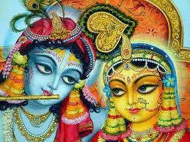
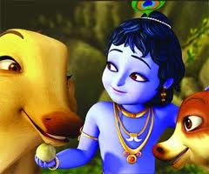
Ending with one verse from The Gopi’s song of separation
tava kathāmṛtaḿ tapta-jīvanaḿ
kavibhir īḍitaḿ kalmaṣāpaham
śravaṇa-mańgalaḿ śrīmad ātataḿ
bhuvi gṛṇanti ye bhūri-dā janāḥ
The nectar of Your words and the descriptions of Your activities are the life and soul of those suffering in this material world. These narrations, transmitted by learned sages, eradicate one's sinful reactions and bestow good fortune upon whoever hears them. These narrations are broadcast all over the world and are filled with spiritual power. Certainly those who spread the message of Godhead are most munificent.

Slide 29
Acknowledgements
Srila Prabhupada and the mercy of all the devotees
HG Bhurijana Prabhu’s book “Unveiling His Lotus feet”
HG Radha Gopinath Prabhu’s lecture:
11-10-16 SB-10-03-12 - Components of Prayers - Radha Gopinath Prabhu ISKCON Chowpatty
Link Location: http://audio.iskcondesiretree.info/05_-_ISKCON_Chowpatty/08_-_2011/10_-_Oct_2011/11-10-16_SB-10-03-12_-_Components_of_Prayers_-_Radha_Gopinath_Prabhu_ISKCON_Chowpatty.mp3
HG Vraja Vihari Prabhu’s lecture:
11-09-24 SB-10-02-30 - Praying unto lotus feet of lord and his Devotees - Vraj Vihari Prabhu ISKCON Chowpatty
Link Location: http://audio.iskcondesiretree.info/05_-_ISKCON_Chowpatty/08_-_2011/09_-_Sept_2011/11-09-24_SB-10-02-30_-_Praying_unto_lotus_feet_of_lord_and_his_Devotees_-_Vraj_Vihari_Prabhu_ISKCON_Chowpatty.mp3
HG Bhurijana Prabhu’s lecture on SB Canto 1 Chapter 10
http://vihe.org/audio_lectures.html

Slide 30
Thank You

