Slide 1
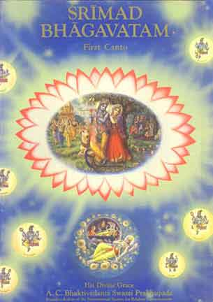
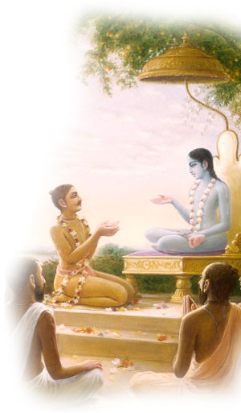
Srimad Bhagavtam 1.10.21-1.10.26
Invocation prayers
SB 1.10.21-1.10.26
Session Summary
References

Slide 2
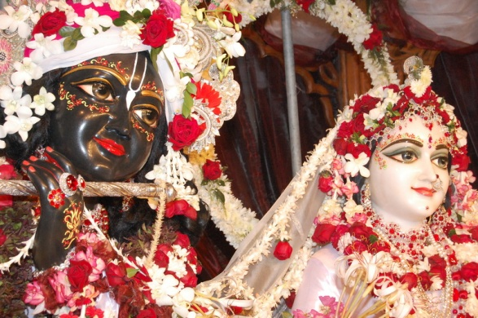
SB 1.2.4
narayanam namaskrtyam naram caiva narottamam devim sarasvatim vyasam tato jayam udirayet
Before reciting this Srimad-Bhagavatam, which is the very means of conquest, one should offer respectful obeisances unto the Personality of Godhead, Narayana, unto Nara-Narayana Rsi, the supermost human being, unto mother Sarasvati, the goddess of learning, and unto Srila Vyasadeva, the author.

Slide 3
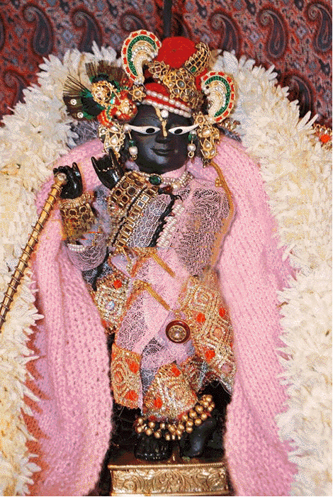
SB 1.2.18
nasta-prayesy abhadresu nityaḿ bhagavata-sevaya bhagavaty uttama-sloke bhaktir bhavati naisthiki
By regular attendance in classes on the Bhagavatam and by rendering of service to the pure devotee, all that is troublesome to the heart is almost completely destroyed, and loving service unto the Personality of Godhead, who is praised with transcendental songs, is established as an irrevocable fact.

Slide 4
[SB 1.10.21] sa vai kilayam purusah puratano ya eka asid avisesa atmani agre gunebhyo jagad-atmanisvare nimilitatman nisi supta-saktisu
They said: Here He is, the original Personality of Godhead as we definitely remember Him. He alone existed before the manifested creation of the modes of nature, and in Him only, because He is the Supreme Lord, all living beings merge, as if sleeping at night, their energy suspended.

Slide 5
Key points
There are two types of dissolution of the manifested cosmos. At the end of every 4,320,000,000 solar years, when Brahma, the lord of one particular universe, goes to sleep, there is one annihilation. And at the end of Lord Brahma's life, which takes place at the end of Brahma's one hundred years of age, in our calculation at the end of 8,640,000,000 x 30 x 12 x 100 solar years, there is complete annihilation of the entire universe, and in both the periods both the material energy called the mahat-tattva and the marginal energy called jiva-tattva merge in the person of the Supreme Lord. The living beings remain asleep within the body of the Lord until there is another creation of the material world, and that is the way of the creation, maintenance and annihilation of the material manifestation.

Slide 6
Key points
The merging of the living beings into the body of Maha-Visnu takes place automatically at the end of Brahma's one hundred years. But that does not mean that the individual living being loses his identity. The identity is there, and as soon as there is another creation by the supreme will of the Lord, all the sleeping, inactive living beings are again let loose to begin their activities in the continuation of past different spheres of life. It is called suptotthita naya, or awakening from sleep and again engaging in one's respective continuous duty. When a man is asleep at night, he forgets himself, what he is, what his duty is and everything of his waking state. But as soon as he awakens from slumber, he remembers all that he has to do and thus engages himself again in his prescribed activities.

Slide 7
Punch line
The living beings also remain merged
in the body of Maha-Visnu during the period of annihilation, but as soon
as there is another creation they arise to take up their unfinished work.
This is also confirmed in the Bhagavad-gita (8.18-20).

Slide 8
Punch line
This is also confirmed in the Bhagavad-gita (8.18-20).
The jivas (individual souls) remain compact in the body of Visnu and again and again are manifest at the arrival of Brahma's day. When Brahma's life is finally finished, they are all annihilated and remain unmanifest for millions and millions of years. When Brahma is born again in another millennium they are again manifest. In this way the jivas are captivated by the material world. However, those intelligent beings who take to Krsna consciousness and chant Hare Krsna, Hare Rama in devotional service transfer themselves, even in this life, to the spiritual planet of Krsna and become eternally blissful there, not being subject to such rebirths.

Slide 9
[SB 1.10.22] sa eva bhuyo nija-virya-coditam sva-jiva-mayam prakrtim sisrksatim anama-rupatmani rupa-namani vidhitsamano 'nusasara sastra-krt
The Personality of Godhead, again desiring to give names and forms to His parts and parcels, the living entities, placed them under the guidance of material nature. By His own potency, material nature is empowered to re-create.

Slide 10
Key points
The living entities are parts and parcels of the Lord. They are of two varieties,
nitya-mukta
nitya-baddha.
The nitya-muktas
Ther are eternally liberated souls, and they are eternally engaged in the reciprocation of transcendental loving service with the Lord in His eternal abode beyond the manifested mundane creations.

Slide 11
Key points
The nityabaddha,
They are eternally conditioned souls, are entrusted to His external energy, maya, for rectification of their rebellious attitude toward the Supreme Father. Nitya-baddhas are eternally forgetful of their relation with the Lord as parts and parcels. They are bewildered by the illusory energy as products of matter, and thus they are very busy in making plans in the material world for becoming happy

Slide 12
Key points
The spiritual spark living entities have no material names or forms. But in order to fulfill their desire to lord it over the material energy of material forms and names, they are given a chance for such false enjoyment, and at the same time they are given a chance to understand the real position through the revealed scriptures. The foolish and forgetful living being is always busy with false forms and false names.

Slide 13
Summary 1.10.22
Bhagavad-gita is the guiding principle for every human being, but by the spell of material energy they do not take care to carry out the programs of life in terms of the Bhagavad-gita.
Srimad-Bhagavatam is the post-graduate study of knowledge for one who has thoroughly understood the principles of the Bhagavad-gita. Unfortunately people have no taste for them, and therefore they are under the clutches of maya for repetition of birth and death.

Slide 14
[SB 1.10.23 ] sa va ayam yat padam atra surayo jitendriya nirjita-matarisvanah pasyanti bhakty-utkalitamalatmana nanv esa sattvam parimarstum arhati
Here is the same Supreme Personality of Godhead whose transcendental form is experienced by the great devotees who are completely cleansed of material consciousness by dint of rigid devotional service and full control of life and the senses. And that is the only way to purify existence.

Slide 15
Key points
The great devotees of the Lord who are able to clear the mind of all material dust by rigid devotional service can experience the Lord as He is.
Jitendriya means one who has full control over the senses.
The senses are active parts of the body, and their activities cannot be stopped.
The artificial means of the yogic processes to make the senses inactive has proved to be abject failure, even in the case of great yogis like Visvamitra Muni. Visvamitra Muni controlled the senses by yogic trance, but when he happened to meet Menaka (a heavenly society woman), he became a victim of sex, and the artificial way of controlling the senses failed.

Slide 16
Key points
The senses of a pure devotee are not at all artificially stopped from doing anything, but they are given different good engagements. When the senses are engaged in more attractive activities, there is no chance of their being attracted by any inferior engagements. In the Bhagavad-gita it is said that the senses can be controlled only by better engagements. Devotional service necessitates purifying the senses or engaging them in the activities of devotional service. Devotional service is not inaction. Anything done in the service of the Lord becomes at once purified of its material nature.

Slide 17
Key points
There is nothing beyond Vasudeva. The Vasudeva conception gradually develops in the heart of the learned after a prolonged acceleration of the receptive organs. But the process ends in the knowledge of accepting Vasudeva as all in all. In the case of devotional service, this very same method is accepted from the very beginning, and by the grace of the Lord all factual knowledge becomes revealed in the heart of a devotee due to dictation by the Lord from within. Therefore controlling the senses by devotional service is the only and easiest means.

Slide 18
Punch line
The Lord can be known in His real nature by dint of pure devotional service only.

Slide 19
[SB 1. 10.24 ] sa va ayam sakhy anugita-sat-katho vedesu guhyesu ca guhya-vadibhih ya eka iso jagad-atma-lilaya srjaty avaty atti na tatra sajjate
O dear friends, here is that very Personality of Godhead whose attractive and confidential pastimes are described in the confidential parts of Vedic literature by His great devotees. It is He only who creates, maintains and annihilates the material world and yet remains unaffected.

Slide 20
All the Vedic literatures are glorifying the greatness of Lord Sri Krsna.

Slide 21
Key points
The Vedas are expanded by many branches and subbranches by great devotees and empowered incarnations of the Lord like Vyasa, Narada, Sukadeva Gosvami, the Kumaras, Kapila, Prahlada, Janaka, Bali and Yamaraja
But in the Srimad-Bhagavatam especially, the confidential parts of His activities are described by the confidential devotee Sukadeva Gosvami.
Vedanta-sutras or Upanisads there is only a hint of the confidential parts of His pastimes.

Slide 22
[SB 1. 10.25] yada hy adharmena tamo-dhiyo nrpa jivanti tatraisa hi sattvatah kila dhatte bhagam satyam rtam dayam yaso bhavaya rupani dadhad yuge yuge
Whenever there are kings and administrators living like animals in the lowest modes of existence, the Lord in His transcendental form manifests His supreme power, the Truth Positive, shows special mercy to the faithful, performs wonderful activities and manifests various transcendental forms as is necessary in different periods and ages.

Slide 23
Key points
The basic philosophy of Isopanisad: everything is the
property of the Supreme Being.
No one should encroach upon the property of the Supreme Lord. One should accept only what is kindly awarded by Him.
The living beings are certainly His parts and parcels, or sons, and thus every one of them has a right to live at the mercy of the Lord to execute his prescribed work.
No one, therefore, can encroach upon the right of another individual man or animal without being so sanctioned by the Lord.

Slide 24
Key points
The king or the administrator is the representative of the Lord to look after the management of the Lord's will. Such kings have full responsibility and knowledge from authorities about the administration of the world.
But at times, due to the influence of the ignorance mode of material nature (tamo-guna), the lowest of the material modes, kings and administrators come into power without knowledge and responsibility, and such foolish administrators live like animals for the sake of their own personal interest.
The result is that the whole atmosphere becomes surcharged with anarchy and vicious elements.
And the devotees of the Lord or the faithful are persecuted by all means. All these symptoms indicate the time of an incarnation of the Lord to reestablish the principles of religion and to vanquish the mal-administrators. This is also confirmed in the Bhagavadgita.

Slide 25
Key points
The Lord then appears in His transcendental form without any tinge of
material qualities.
He descends just to keep the state of His creation in a normal condition. The normal condition is that the Lord has provided each and every planet with all the needs of the native living beings. They can happily live and execute their predestined occupations to attain salvation at the end, following the rules and regulations mentioned in the revealed scriptures.
The material world is created to satisfy the whims of the nitya-baddha, or everlasting conditioned souls, just as naughty boys are provided with playing cradles. Otherwise, there was no need of the material world.
When they become intoxicated with the power of material science to exploit the resources unlawfully without the sanction of the Lord, and that also only for sense gratification, there is necessity of the Lord's incarnation to chastise the rebellious and to protect the faithful.

Slide 26
Amazing Lord
When He descends, He exhibits superhuman acts just to prove His supreme right, and materialists like Ravana, Hiranyakasipu and Kamsa are sufficiently punished. He acts in a manner which no one can imitate. He is famous as the asamaurdhva, unparalleled. No one is equal to or greater than Him.

Slide 27
[SB 1. 10.26] aho alam slaghyatamam yadoh kulam aho alam punyatamam madhor vanam yad esa pumsam rsabhah sriyah patih sva-janmana cankramanena cancati
Oh, how supremely glorified is the dynasty of King Yadu, and how virtuous is the land of Mathura, where the supreme leader of all living beings, the husband of the goddess of fortune, has taken His birth and wandered in His childhood.

Slide 28
Key points
In the Bhagavad-gita the Personality of Godhead Sri Krsna has expressively given a description of His transcendental appearance, disappearance and activities.
The Lord appears in a particular family or place by His inconceivable potency.
He does not take His birth as a conditioned soul quits his body and accepts another body.
He exists at all times and at every place, but by His causeless mercy when He appears before us we take it for granted that He has taken His birth.

Slide 29
Key points
Anyone who can understand this truth, in terms of the statements of revealed scriptures, certainly becomes liberated just after quitting the present body.
Liberation is obtainable after many births and after great endeavor in patience and perseverance, in knowledge and renunciation.
But simply by knowing in truth about the Lord's transcendental births and activities, one can get liberation at once.
That is the verdict of the Bhagavad-gita.

Slide 30
Key points
But those who are in the darkness of ignorance conclude that the Lord's birth and activities in the material world are similar to those of the ordinary living being.
Such imperfect conclusions cannot give anyone liberation.
His birth, therefore, in the family of King Yadu as the son of King Vasudeva and His transfer into the family of Nanda Maharaja in the land of Mathura are all transcendental arrangements made by the internal potency of the Lord.

Slide 31
Key points
If simply by knowing the transcendental nature of the birth and activities of the Lord one can get liberation easily, we can just imagine what is in store for those who actually enjoyed the company of the Lord in person as a family member or as a neighbor.
All those who were fortunate enough to associate with the Lord, the husband of the goddess of fortune, certainly obtained something more than what is known as liberation.
Therefore, rightly, the dynasty and the land are both ever glorious by the grace of the Lord.

Slide 32
Hare Krishna Hare Krishna
Krishna Krishna
Hare Hare
Hare Rama Hare Rama
Rama Rama
Hare Hare
Chant and be happy.
Serve and associate with the devotees
Love and respect all (even your spouse)

Slide 33
Questions?
All questions and inquiries will be answered in due course of time by complete faith in the next set of speakers. Patience is a virtue and you can start to practice it now ☺

