Slide 1
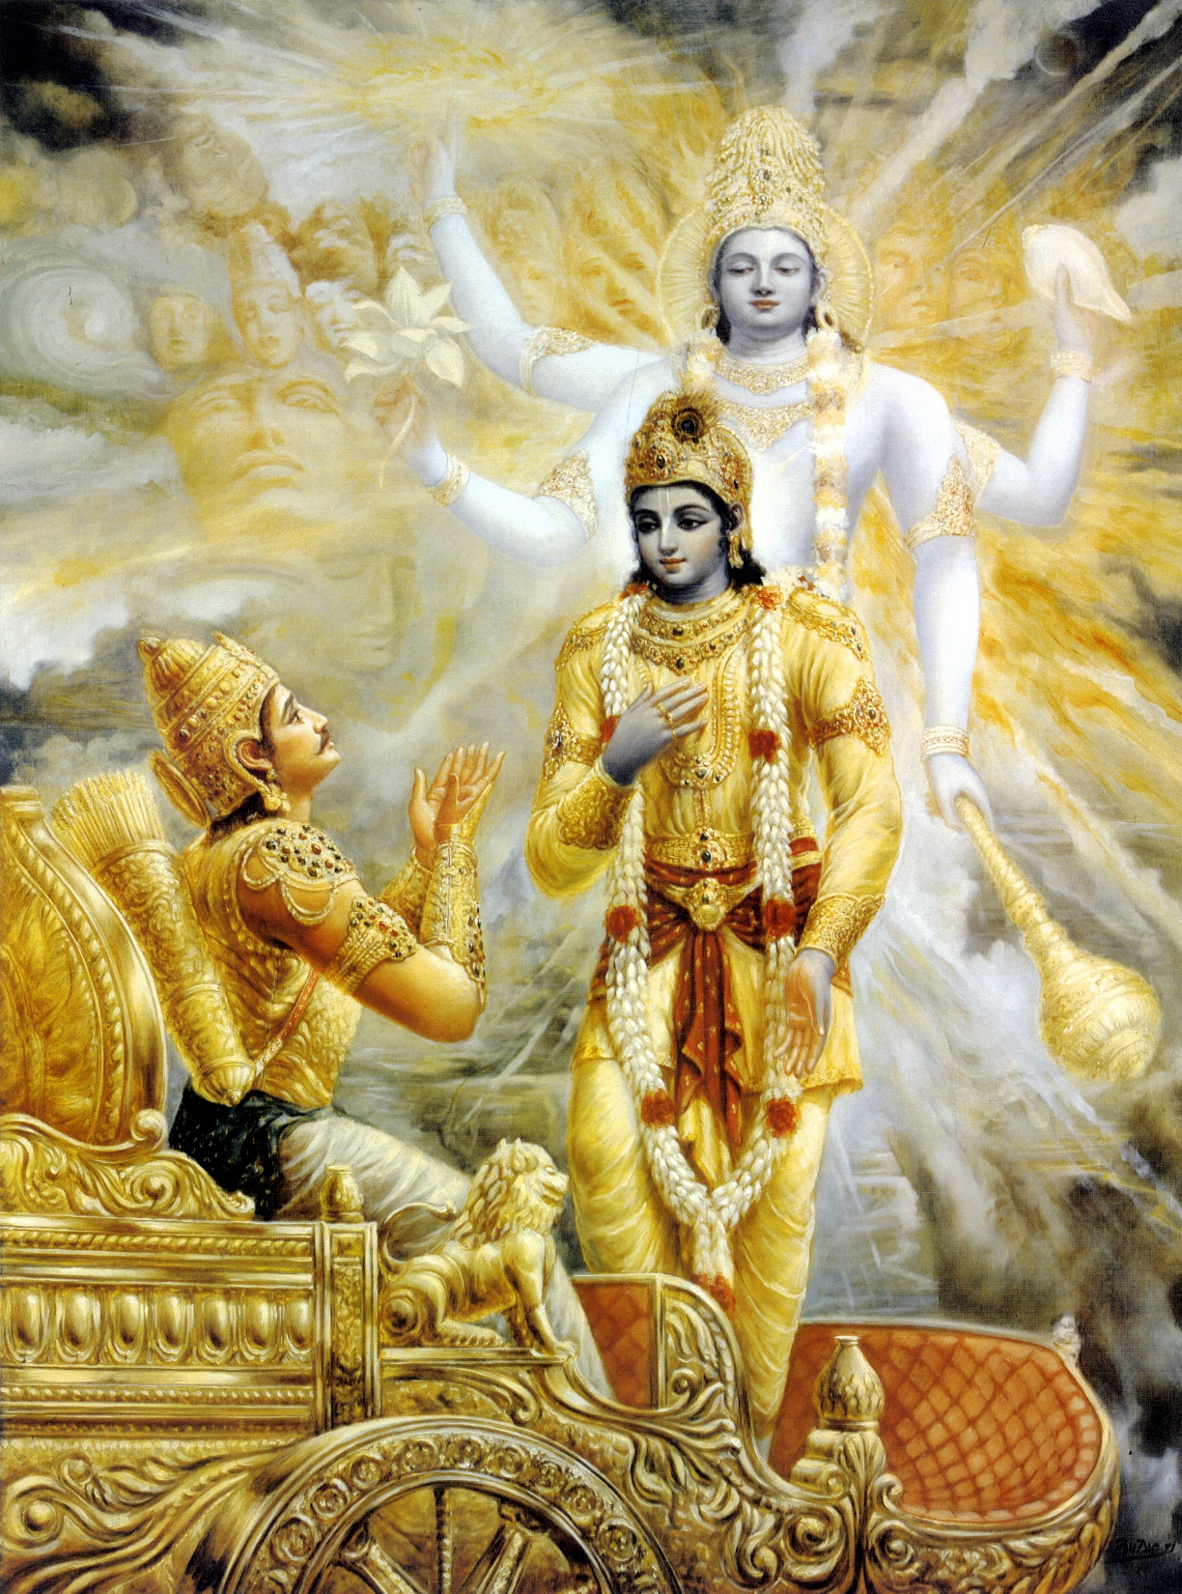
Bhagavad Gita As It Is Chapter 7 – Knowledge of the Absolute

Slide 2
Chapter In Brief
Connection with Chapter 6
About
Chapter 7

Slide 3
Sections
Verses | Description
7.1 to 7.3 | Knowing Krsna in full by hearing about him
7.4 to 7.12 | Knowing Krsna as the source of both the material and spiritual energies
7.13 to 7.14 | The three modes are controlled by Krsna – therefore surrender
7.15 to 7.19 | The impious lack knowledge and never surrender to Krsna; The pious develop knowledge and surrender
7.20 to 7.25 | Those without knowledge: Surrender to demigods Impersonalists
7.26 to 7.30 | Bewilderment and freedom by knowing Krsna

Slide 4
Section 1 - 7.1 to 7.3 Knowing Krsna by hearing about Him
Śravaṇam
Hear from Krsna or from His devotee in Krishna Consciousness (e.g., Rupmini Devi)
Take shelter of Krsna or His bonafide devotee
By doing Bhakti Yoga, we can know Him in full (full fledged form, Bhagavan realization) – not Paramatma or Brahman
Transcendental Knowledge
Matter, Sprit and the source of both;
Qualification – Devotee and non-envious(or a friend)
How – Hear from Krsna or from bonafide spiritual master in disciplic succession
Nothing remains to know

Slide 5
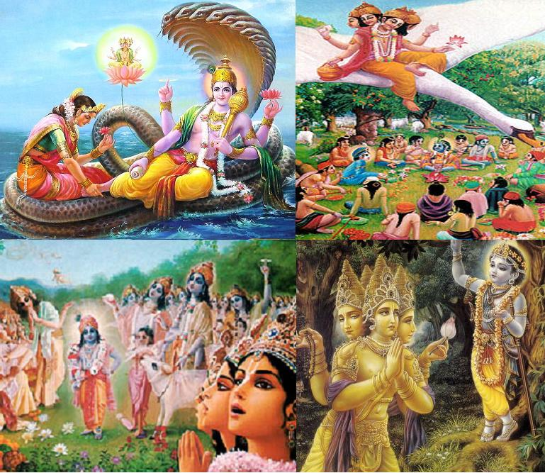
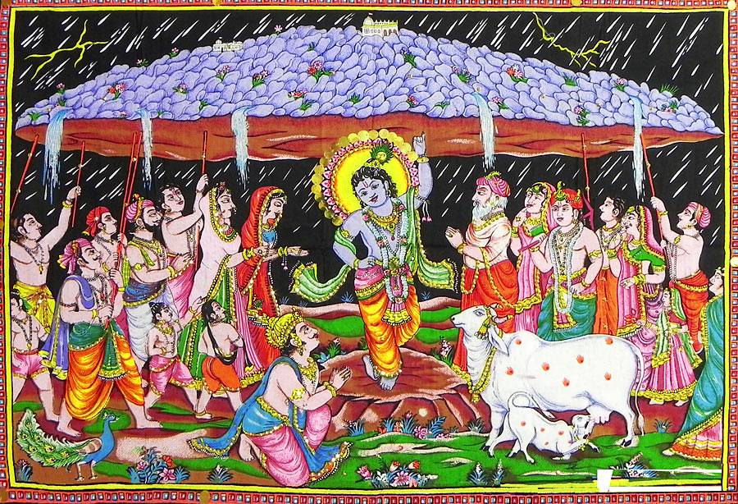
Section 1 - 7.1 to 7.3 Knowing Krsna by hearing about Him
Rarity
Rarely man achieves perfection, out of them only some understands Krsna
Cannot understand Krsna by blunt material senses
Only pure devotees can know something of the inconceivable transcendental qualities in Krsna.
Even great demigods are sometimes confused (Brahma-vimohan lila , Indira – Govardhan Hill, Siva – Mohini Murthy)

Slide 6
Extract from 7.1 purport:
To hear about Kṛṣṇa from Vedic literatures, or to hear from Him directly through the Bhagavad-gītā, is itself righteous activity. And for one who hears about Kṛṣṇa, Lord Kṛṣṇa, who is dwelling in everyone's heart, acts as a best-wishing friend and purifies the devotee who constantly engages in hearing of Him. In this way, a devotee naturally develops his dormant transcendental knowledge. As he hears more about Kṛṣṇa from the Bhāgavatam and from the devotees, he becomes fixed in the devotional service of the Lord…

Slide 7
Section 2 - 7.4 to 7.12 Krsna - source of material & spiritual energies
Material world summarized
Krsna separated energies (8 elements) -> Earth, Water, Fire, Air, Ether, Mind, Intelligence and False Ego
This world is constitutes of 24 elements
Living Entities | Material Nature
Superior energy | Inferior energy
Insignificant | Vast
Gets contaminated | Contaminates/Bewilders Living entities
Exploit material nature | Getting exploited
Notes:
8 elements - Earth, water, fire, air, ether, mind, intelligence and false ego
Total material world is divided into these 24 elements:
5 Gross elements - Earth, water, fire, air and ether
5 Sense objects – smell, taste, form, touch and sound (each higher gross element has all the prior sense objects)
3 - Mind, Intelligence and False Ego
10 – Senses 5 knowledge acquiring – Eyes, ears, nose, tongue and skin
5 working senses – mouth, legs, hands, anus and genitals
1 – Maha tatva
Yamuna Mataji – Prabhupada said “A devotee doesn’t waste anything”
Don’t think your children belong to you, they belong to Krsna and are under your care.

Slide 8
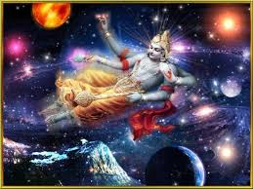
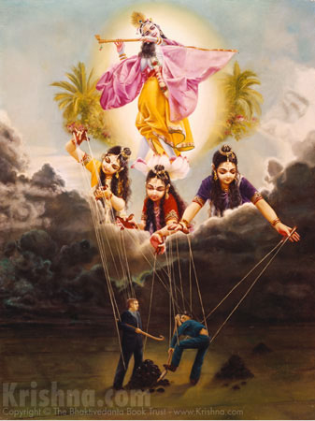
Section 2 - 7.4 to 7.12 Krsna - source of material & spiritual energies
Krsna is the origin
Everything that exists is product of matter and spirit
Krsna is creator, destroyer and maintainer of everything that exists.
Everything is Krsna energy, therefore we should
Remember and connect them back to Krsna/use them for/in His service
Not exploit it.
(e.g.: Prabhupada – tap leaking, Yamuna Devi Mataji & match sticks)
Krsna is the source of everything
Origin of Modes - not within modes and therefore He is Nirguna
(analogy: state laws & king not affected, Sun covered by clouds)
Krsna is the seed of all existences (8.4 million species)
Root of all intelligence
Note: Envy towards others indicate our enviousness towards Krsna.
Everything can be used in the service of Krsna (Strength, knowledge, etc.)

Slide 9
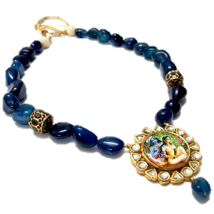
Section 2 - 7.4 to 7.12 Krsna - source of material & spiritual energies
No truth is beyond Him
Absolute Truth is the Supreme person
He is supporting everything (like string inside a necklace)
Krsna is the active element in material elements
Taste of Water
Light of Sun/Moon
Sound (OM) - in either
Ability in Man - What we are attracted in others is actually we are looking for Krsn
Original flavor of everything is Krsna
(E.g.: Srila Prabhupada & Indradyumna Maharaj – Charlie Chaplin show)

Slide 10
Extract from 7.5 purport:
While exploiting the gross and subtle inferior energy (matter), the superior energy (the living entity) forgets his real spiritual mind and intelligence. This forgetfulness is due to the influence of matter upon the living entity. But when the living entity becomes free from the influence of the illusory material energy, he attains the stage called mukti, or liberation. The false ego, under the influence of material illusion, thinks, "I am matter, and material acquisitions are mine."

Slide 11
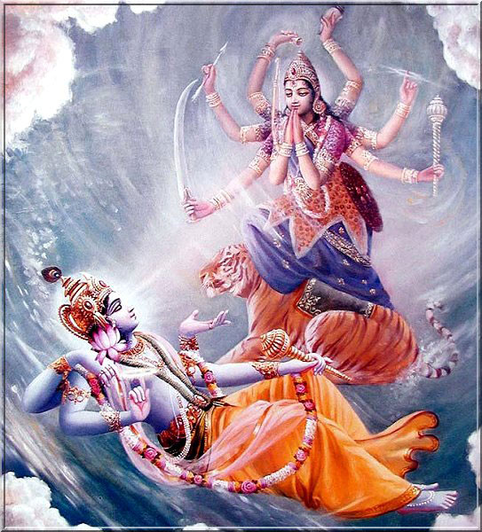
Section 3 - 7.13 to 7.14 Krsna - Controller of three modes
Material Energy
Divine energy
Three modes
Passion
Goodness
Ignorance
It holds us -> covers & bewilders
Powerful & Complicated – Difficult to overcome, but only those who surrender (Nine process of devotional services) to Him alone can easily cross beyond it.
It cannot be overcome by soul because of
It is powerful/vast though inferior in nature
It is ultimately conducted by Supreme Lord Himself
We are Nitya Bhadhas – but can conquer Krsna (though He is Achita) by love. Thus His Supreme will can be changed by Love to overcome Maya.
Krsna or His bonafide representative (Spiritual Master) can help us unbound / free from Maya (gunas also means ropes) – if we surrender and follow Their instructions
Even Brahma and Siva though greatly elevated, cannot release conditioned soul from the clutches of Maya. Only Krsna/Vishnu can do that.

Slide 12
Extract from 7.14 purport:
only Lord Kṛṣṇa, or His bona fide representative the spiritual master, can release the conditioned soul. Without such superior help, one cannot be freed from the bondage of material nature. Devotional service, or Kṛṣṇa consciousness, can help one gain such release.

Slide 13
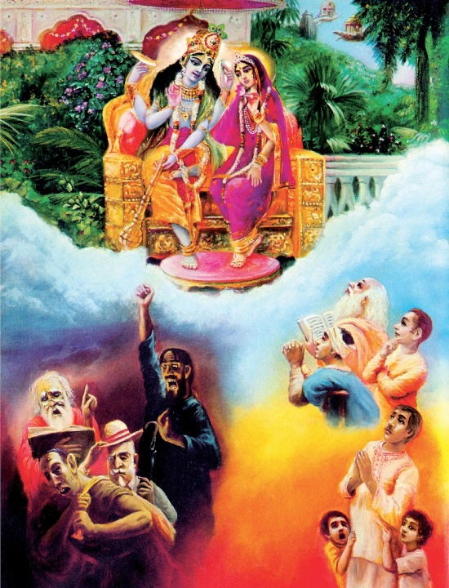
Section 4 - 7.15 to 7.19 Impious & Pious people
Duṣkṛtinas, or miscreants, are of four different patterns:
Mūḍhas – Grossly foolish -> Hardworking beasts of burden or engrossed in self enjoyment. (Ex: ass, swine)
Narādhama – Lowest among mankind -> Socially and politically developed but have no religious principles (eg., Jagai and Madhai)
Māyayāpahṛta-jñānāḥ – Knowledge is stolen by illusion -> Great philosphers, scientists, poets, etc. (eg., Indians running away from Krsna)
Āsuraḿ bhāvam āśritāḥ – Atheistic nature of demons -> Openly atheistic
Notes:
Mūḍhas - They want to enjoy the fruits of their labor by themselves and so do not want to part with them for the Supreme. They are busy working hard day and night for the benefit of their illusionary masters
Ass –This humble beast is made to work very hard by his master. The ass does not really know for whom he works so hard day and night. He remains satisfied by filling his stomach with a bundle of grass, sleeping for a while under fear of being beaten by his master, and satisfying his sex appetite at the risk of being repeatedly kicked by the opposite party. The ass sings poetry and philosophy sometimes, but this braying sound only disturbs others. This is the position of the foolish fruitive worker who does not know for whom he should work. He does not know that karma (action) is meant for yajña (sacrifice).
Swine - The swine who eat the night soil do not care to accept sweetmeats made of sugar and ghee. Similarly, the foolish worker will untiringly continue to hear of the sense-enjoyable tidings of the flickering mundane world, but will have very little time to hear about the eternal living force that moves the material world

Slide 14
Section 4 - 7.15 to 7.19 Impious & Pious people
Four kinds of people who surrender to Krsna
Artah – Distressed (e.g., Gajendra)
Arthathi - Desirer of Wealth (e.g., Druva)
Jijnasu – Inquisitive (e.g., Shaunaka Rushi)
Jñānī- Searching for knowledge/Absolute (e.g., Sukadeva, Four Bhrama Kumaras)
They are pious people -> not pure devotees, devotional service is tainted (Jñānī Mishra Bhakti, Karma Mishra Bhakti)
Association is the key – Srila Prabhupada books and devotees
Jñānī is the best
Wise and engages in pure devotional service. He is very dear to Krsna and Lord is dear to him
Full of knowledge of Absolute Truth and free from material desires
Protected in devotional service that material contamination cannot touch him
Mahatma – who ever comes to Krsna.

Slide 15
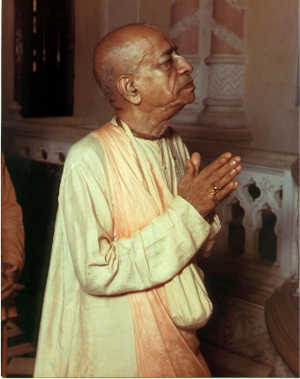
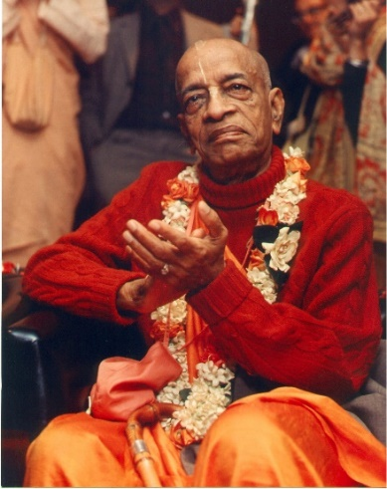
Section 4 - 7.15 to 7.19 Impious & Pious people
Pure devotees - cannot live a second without contacting or serving the Supreme Lord. Similarly, Supreme Lord is very fond of His devotee and cannot be separated from him.
Great souls are very rare
They understand that Lord as the cause of all causes
Knows that spiritual life is full of activities
Understand material world is perverted reflection of spiritual world
He thinks of everything in relation to Vāsudeva, or Śrī Kṛṣṇa
Surrenders in full knowledge
Sure to attain the Lord

Slide 16
Extract from 7.15 purport:
To pray to God when he is in difficulty is a natural instinct in every living being because he is eternally related with God.
Extract from 7.16 purport:
When these four kinds of persons come to the Supreme Lord for devotional service and are completely purified by the association of a pure devotee, they also become pure devotees. As far as the miscreants are concerned, for them devotional service is very difficult because their lives are selfish, irregular and without spiritual goals. But even some of them, by chance, when they come in contact with a pure devotee, also become pure devotees.

Slide 17
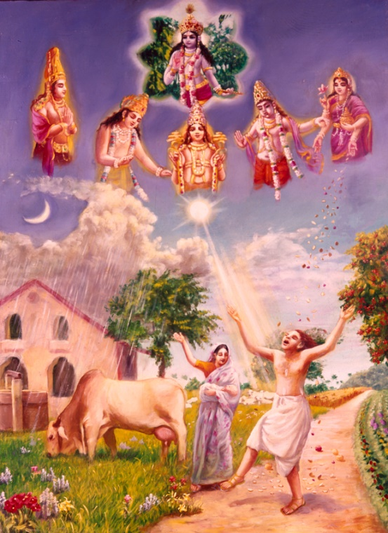
Section 5 – 7.20 to 7.25 People who surrender to demigods & Impersonalists
Demigod worshipers
They are less intelligent (alpa-medhasām) - Lack of knowledge
They are in lower modes (passion or ignorance)
Go to demigods planet
For quick results
Fear of giving up leading to distress
Worship of demigods
Wrong way
Considering them equal to Krsna
For material desires
Right way – Not to artificially lift someone up or bring someone down
They are administrators of Vishnu/Krsna
See them in connection with Supreme Lord – as how they are facilitating in material creation or serving Krsna
See them according to their qualification
Analogies
Cataka bird – does not take water for anywhere and only waits for clouds to pour water.
Bharat Maharaj – worshipped demigods as Vishnu’s agents
Gopis worshipped Kathyayani (Goddess Durga) to get Krsna as their husband.

Slide 18
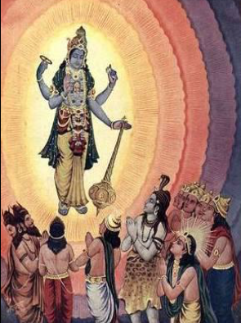
Section 5 – 7.20 to 7.25 People who surrender to demigods & Impersonalists
Supreme Lord
Facilitates individuals desire to worship demigods, to fulfill their desires.
Does not interfere with their independence.
Is present as Super soul within the heart of the demigod; He arranges through the demigod(s) to fulfill the desire of the living entity.
Both the demigods and the living entities are dependent on the Supreme will. They are not independent.
Demigods
cannot award benedictions without the permission of the Supreme Lord.
Fruits are limited and temporary
Material desires are impediments for those desiring to return to Godhead.
Impersonalists - People with no intelligence (abuddhayaḥ), think God as impersonal. They think Krsna has material body and his activities, form are māyā.
Krsna covers Impersonalists with His māyā potency, thus they don’t see or understand Him.

Slide 19
Extract from 7.22 purport:
For the living entity who desires to return to Godhead, material desires are impediments. A pure devotee of the Lord is therefore not awarded the material benefits desired by less intelligent living entities, who therefore prefer to worship demigods of the material world rather than engage in the devotional service of the Supreme Lord.
Extract from 7.24 purport:
One cannot understand the Supreme Personality of Godhead, Kṛṣṇa, or His form, quality or name simply by mental speculation or by discussing Vedic literature. One must understand Him by devotional service. When one is fully engaged in Kṛṣṇa consciousness, beginning by chanting the mahā-mantra — Hare Kṛṣṇa, Hare Kṛṣṇa, Kṛṣṇa Kṛṣṇa, Hare Hare/ Hare Rāma, Hare Rāma, Rāma Rāma, Hare Hare — then only can one understand the Supreme Personality of Godhead

Slide 20
Section 5 – 7.26 to 7.30 Bewilderment and freedom by knowing Krsna
Krsna
Spiritual body - does not change material bodies
Knows everything (past, present and future) - without interfering with our free will.
Maya is inferior to Krsna and is controlled by Krsna’s prowess. She cannot affect Him. (e.g., Sky covered by clouds blocks our vision to see Sun)
Even pure devotees based on our inclinations kind of know the future (eg. Woodcutter sitting on the branch and cutting the same branch, Mother knows kid’s and what they would choose)
Criteria who can understand Krsna –
Acted piously in previous life & in this life
There sinful actions have completely eradicated. Root cause for sin is ignorance
Bhakti can only give Bhakti – piety helps one situated favorably to receive the mercy of pure devotee.
One must render service to devotees and not be associated with materialistic people. (Best service is to listen from advance devotees)
Pure Devotees will be convinced that just by following KC, all the objectives and desires will be fulfilled

Slide 21
Section 5 – 7.26 to 7.30 Bewilderment and freedom by knowing Krsna
Krsna does not change bodies, he knows everything (past, present and future).
Even pure devotees based on our inclinations kind of know the future (eg. Woodcutter sitting on the branch and cutting the same branch, Mother knows kid’s and what they would choose)
Criteria who can understand Krsna –
Acted piously in previous life & in this life
There sinful actions have completely eradicated. Root cause for sin is ignorance
Pure Devotees will be convinced that just by following KC, all the objectives and desires will be fulfilled. One who understands completely about Krsna’s nature (Proprietor, Enjoyer, etc.) remembers Him at the time of death and goes back to Him.

Slide 22
Extract from 7.30 purport:
By gradual development of Kṛṣṇa consciousness in good association, the living entity can understand that due to forgetfulness of Kṛṣṇa he has become conditioned by the laws of material nature. He can also understand that this human form of life is an opportunity to regain Kṛṣṇa consciousness and that it should be fully utilized to attain the causeless mercy of the Supreme Lord.

Slide 23
Key Takeaways
Sravanam - Regularly listen to lectures, hear the mantra while chanting and read books
Utilize the opportunity of senior devotees, they are rare. We are lucky to have association of devotees (like HG Hari Vilas Pr.), listen to them submissively and serve them.
Seek shelter from bonafide Spiritual Master and make their instruction life and soul.
In reality – we are not really happy, we are always miserable/unhappy (little more or less). So don’t go behind material things which makes us entangled and take us away from Krsna.
In spite of attending classes and coming to temple for such long, if we are not trying to establish connection with Krsna, it implies we have no faith. We need to work on this.
Try to remember Krsna in all the material things we see. Praise the creator not the creation. For e.g., when drinking water, remember Krsna is the taste in water. This will help both quench the thirst and remember Krsna often.
Associate and please pure devotees -> this will rub their qualities on us and will help us progress. Avoid association with materialistic people. Give association but not take their association.
Make goals to – mould all our energies and all our efforts towards that. Have short term and long term devotional goals.

Slide 24
Key Takeaways
Avoid committing offenses – this will make us go backwards.
Make sincere efforts and do service - If you have done any sincere service – Krsna will take care of you
If our intelligence is
not pure – we go after material enjoyment -> Maya will catch us
Pure – we go after Krsna’s enjoyment -> Krsna will take care of us
If we are
Selfish –> Material energy would catch us –> we create Karma and are trapped
Selfless –> Krsna takes care of us

Slide 25
Key Takeaways
Demigods–
Respect them, they are elevated and empowered by Krsna.
Pray in proper context and with clear understanding. Seek help to go back to
Remember Krsna through service – improve it
Material and sense gratificatory desires do come – but we should resist and control them.
Krsna is Bhavagrahy, He sees our sincerity and not the result. So, have faith and practice devotional service sincerely.

Slide 26
Thank you!!!
Haribol
Haribol

